Slide 1
CS 162 Discussion Section Week 6 10/14 – 10/18

Slide 2
Today’s Section
Project discussion (5 min)
Survey (5 min)
Lecture Review (20 min)
Worksheet and Discussion (20 min)

Slide 3
Project 2
Initial Design due Thurs 10/17 at 11:59pm
submit proj2-initial-design
Questions?

Slide 4
No Quiz!
(if you’re here, you get a 5/5 on the quiz!)

Slide 5
Lecture Review

Slide 6
X86_64: Four-level page table!
9 bits
9 bits
9 bits
9 bits
12 bits
48-bit Virtual
Address:
Virtual
P1 index
Virtual
P2 index
Virtual
P3 index
Virtual
P4 index
Offset
PageTablePtr
8 bytes
4096-byte pages (12 bit offset) Page tables also 4k bytes (pageable)
Physical
Address:
(40-50 bits)
Physical Page #
12bit Offset

Slide 7
IPT address translation
Need an associative map from VM page to IPT address: Use a hash map.
Process 0 virtual address
Physical address
VMpage2 (52b) | Offset (12b)
0x3 | Offset (12b)
0x0000
pid 0 | VMpage0
pid 1
pid 0 | VMpage1
pid 0 | VMpage2
xx | free
pid 2
pid 1
pid 0 | VMpage3
0x0
VMpage0, proc0
0x1
0x1000
0x2
0x2000
0x3
0x3000
Hash VM page #
0x4
VMpage2, proc0
0x4000
0x5
VMpage1, proc0
0x5000
0x6
0x7
0x6000
Inverse Page Table
0x7000
VMpage3, proc0

Slide 8
Page Replacement Policies
Why do we care about Replacement Policy?
Replacement is an issue with any cache
Particularly important with pages
The cost of being wrong is high: must go to disk
Must keep important pages in memory, not toss them out
FIFO (First In, First Out)
Throw out oldest page. Be fair – let every page live in memory for same amount of time.
Bad, because throws out heavily used pages instead of infrequently used pages
MIN (Minimum):
Replace page that won’t be used for the longest time
Great, but can’t really know future…
Makes good comparison case, however
RANDOM:
Pick random page for every replacement
Typical solution for TLB’s. Simple hardware
Unpredictable

Slide 9
Implementing LRU & Second Chance
Perfect:
Timestamp page on each reference
Keep list of pages ordered by time of reference
Too expensive to implement in reality for many reasons
Second Chance Algorithm:
Approximate LRU
Replace an old page, not the oldest page
FIFO with “use” bit
Details
A “use” bit per physical page
set when page accessed
On page fault check page at head of queue
If use bit=1 → clear bit, and move page to tail (give the page second chance!)
If use bit=0 → replace page
Moving pages to tail still complex

Slide 10
Clock Algorithm
Clock Algorithm: more efficient implementation of second chance algorithm
Arrange physical pages in circle with single clock hand
Details:
On page fault:
Check use bit: 1→used recently; clear and leave it alone 0→selected candidate for replacement
Advance clock hand (not real time)
Will always find a page or loop forever?

Slide 11
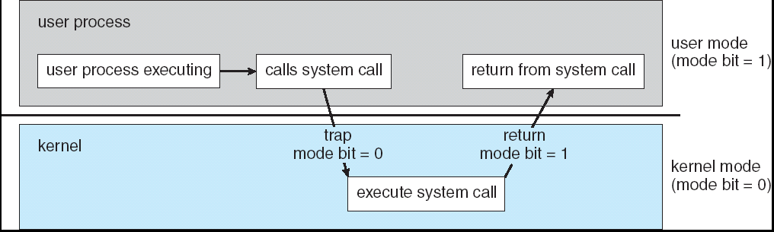
User→Kernel (System Call)
Can’t let inmate (user) get out of padded cell on own
Would defeat purpose of protection!
So, how does the user program get back into kernel?
System call: Voluntary procedure call into kernel
Hardware for controlled User→Kernel transition
Can any kernel routine be called?
No! Only specific ones
System call ID encoded into system call instruction
Index forces well-defined interface with kernel
I/O: open, close, read, write, lseek
Files: delete, mkdir, rmdir, chown
Process: fork, exit, join
Network: socket create, select

Slide 12
User→Kernel (Exceptions: Traps and Interrupts)
System call instr. causes a synchronous exception (or “trap”)
In fact, often called a software “trap” instruction
Other sources of Synchronous Exceptions:
Divide by zero, Illegal instruction, Bus error (bad address, e.g. unaligned access)
Segmentation Fault (address out of range)
Page Fault
Interrupts are Asynchronous Exceptions
Examples: timer, disk ready, network, etc….
Interrupts can be disabled, traps cannot!
SUMMARY – On system call, exception, or interrupt:
Hardware enters kernel mode with interrupts disabled
Saves PC, then jumps to appropriate handler in kernel
For some processors (x86), processor also saves registers, changes stack, etc.

Slide 13
How Does User Deal with Timing?
Blocking Interface: “Wait”
When request data (e.g., read() system call), put process to sleep until data is ready
When write data (e.g., write() system call), put process to sleep until device is ready for data
Non-blocking Interface: “Don’t Wait”
Returns quickly from read or write request with count of bytes successfully transferred to kernel
Read may return nothing, write may write nothing
Asynchronous Interface: “Tell Me Later”
When requesting data, take pointer to user’s buffer, return immediately; later kernel fills buffer and notifies user
When sending data, take pointer to user’s buffer, return immediately; later kernel takes data and notifies user

Slide 14
I/O Device Notifying the OS
The OS needs to know when:
The I/O device has completed an operation
The I/O operation has encountered an error
I/O Interrupt:
Device generates an interrupt whenever it needs service
Pro: handles unpredictable events well
Con: interrupts relatively high overhead
Polling:
OS periodically checks a device-specific status register
I/O device puts completion information in status register
Pro: low overhead
Con: may waste many cycles on polling if infrequent or unpredictable I/O operations
Actual devices combine both polling and interrupts
For instance – High-bandwidth network adapter:
Interrupt for first incoming packet
Poll for following packets until hardware queues are empty
Notes:
After the OS has issued a command to the I/O device either via a special I/O instruction or by writing to a location in the I/O address space, the OS needs to be notified when:
(a) The I/O device has completed the operation.
(b) Or when the I/O device has encountered an error.
This can be accomplished in two different ways: Polling and I/O interrupt.
+1 = 58 min. (Y:38)

Slide 15
Worksheet…

