Slide 1
Assignment 11 - Respondent Bias
Statenfreude

Slide 2
Research Question
What study strategies do university students think are effective and used frequently?
Verbal frequency and Likert scales were used to gauge which strategies used.
Many popular learning methods, highlighting & rereading are ineffective.
recall is a highly effective learning strategy but requires more effort
Make it Stick, $\text{Brown, Rudiger \& McDonald,2014}$

Slide 3
Acquiesence Bias
Subjects respond more positively if there is an indication of what is a positive response is included in the prompt.
We attempted to bias the question about recall.
The two questions representing passive learning methods were left as unbiased as possible.

Slide 4
Hypotheses
Passive, less effective methods will be more frequent $→$ Highlighting, rereading
Active, more effective method will be less frequent $→$ Recall
Highlighting may be less frequent because of digitization
After bias, recall will be more frequent

Slide 5
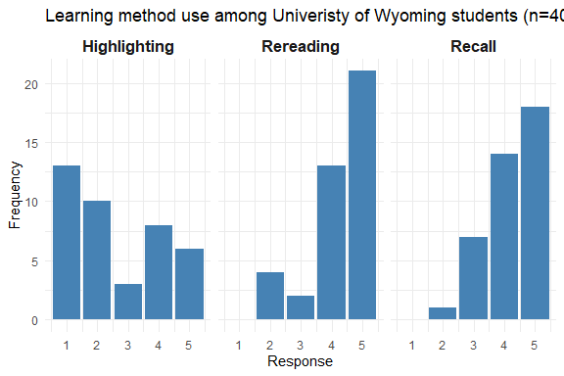
Results
All distributions skewed
Highlighter distribution skewed positive, others negative

Slide 6
Results (continued)
 | Min. | 1st Qu. | Median | Mean | 3rd Qu. | Max.
Highlighting | 1 | 1 | 2 | 2.600 | 4 | 5
Rereading | 2 | 4 | 5 | 4.275 | 5 | 5
Recall | 2 | 4 | 4 | 4.225 | 5 | 5
Large IQR for highlighting
Rereading most favoured learning method
Recall notably preferred to highlighting

Slide 7
Conclusion
Recall (med=4) and rereading (med=5) very similar
Suggests bias pushed recall results higher
Highlighting (med=2) lowest $→$ digitization
More difficult, active method performs better/the same after bias

Slide 8
Thank you!

