Slide 1

ENIAC Expansion to the Brazilian Market:
is Magist a reliable partner?
Magist potentials:
Centralized order management platform ✅
Strong market position in Brazil ✅
Full support for logistics & after-sales ✅
ENIAC
High-end
tech products
ENIAC concerns regarding magist:
Fit for high-end tech products ?
Delivery speed performance ?

Slide 2
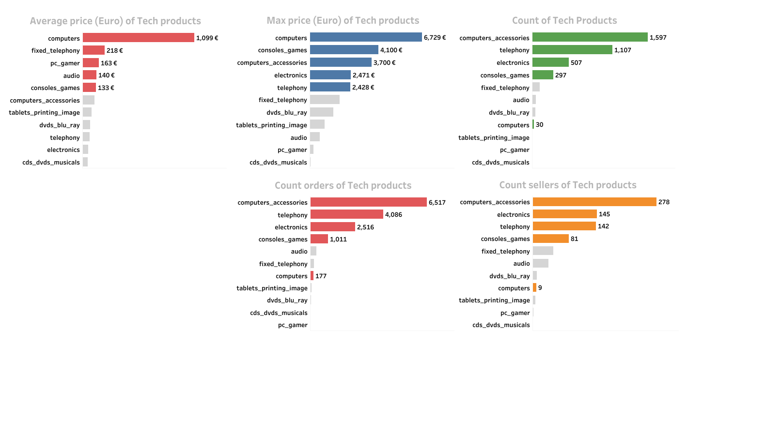
Magist's High-end Tech Products Overview
Premium tech
6.6%
Limited presence in high-end tech products categories
Sales
10.8%
Less focused on high-end tech products
Sellers
14.3%
Lack of specialized sellers in high-end tech product
On-time Delivery
93%
Strong delivery performance
13 days average delivery time

Slide 3
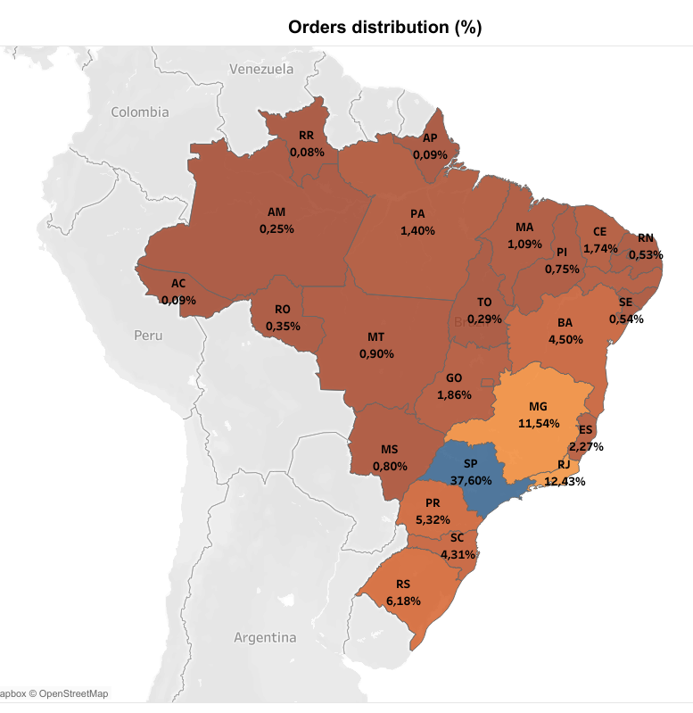
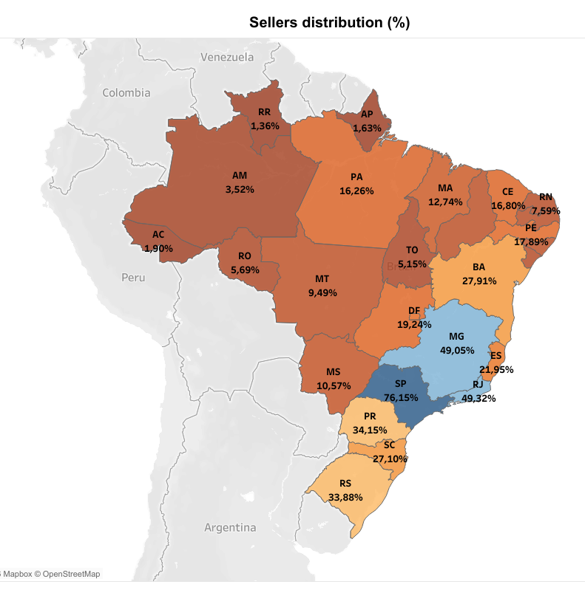
Geographic Distribution of Orders and Sellers
Brazil’s richest states (MG, SP, RJ) offer strong market potential

Slide 4
Strategic Recommendation:
Should ENIAC Partner with Magist?
Magist can be a reliable partner for Eniac considering:
Limited presence in high-end tech product markets
Reliable on-time delivery performance
Access to major tech customers and sellers
Key markets located in Brazil’s richest states (MG, SP, RJ)
Final recommendation:
Magist can accelerate Eniac’s entry into Brazilian Market but the partnership should be treated as a transitional strategy rather than a long-term operational solution.

Slide 5
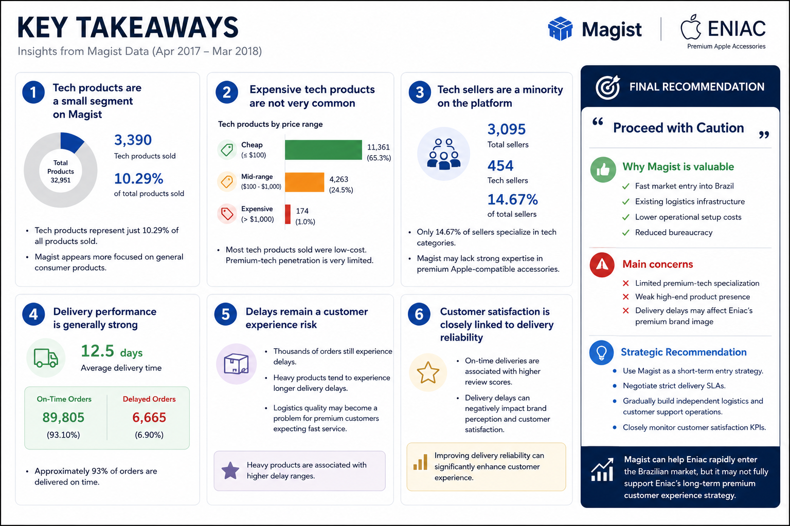

Slide 6
Thank You
ENIAC Expansion to Brazil | Magist Partner Assessment

