Slide 1
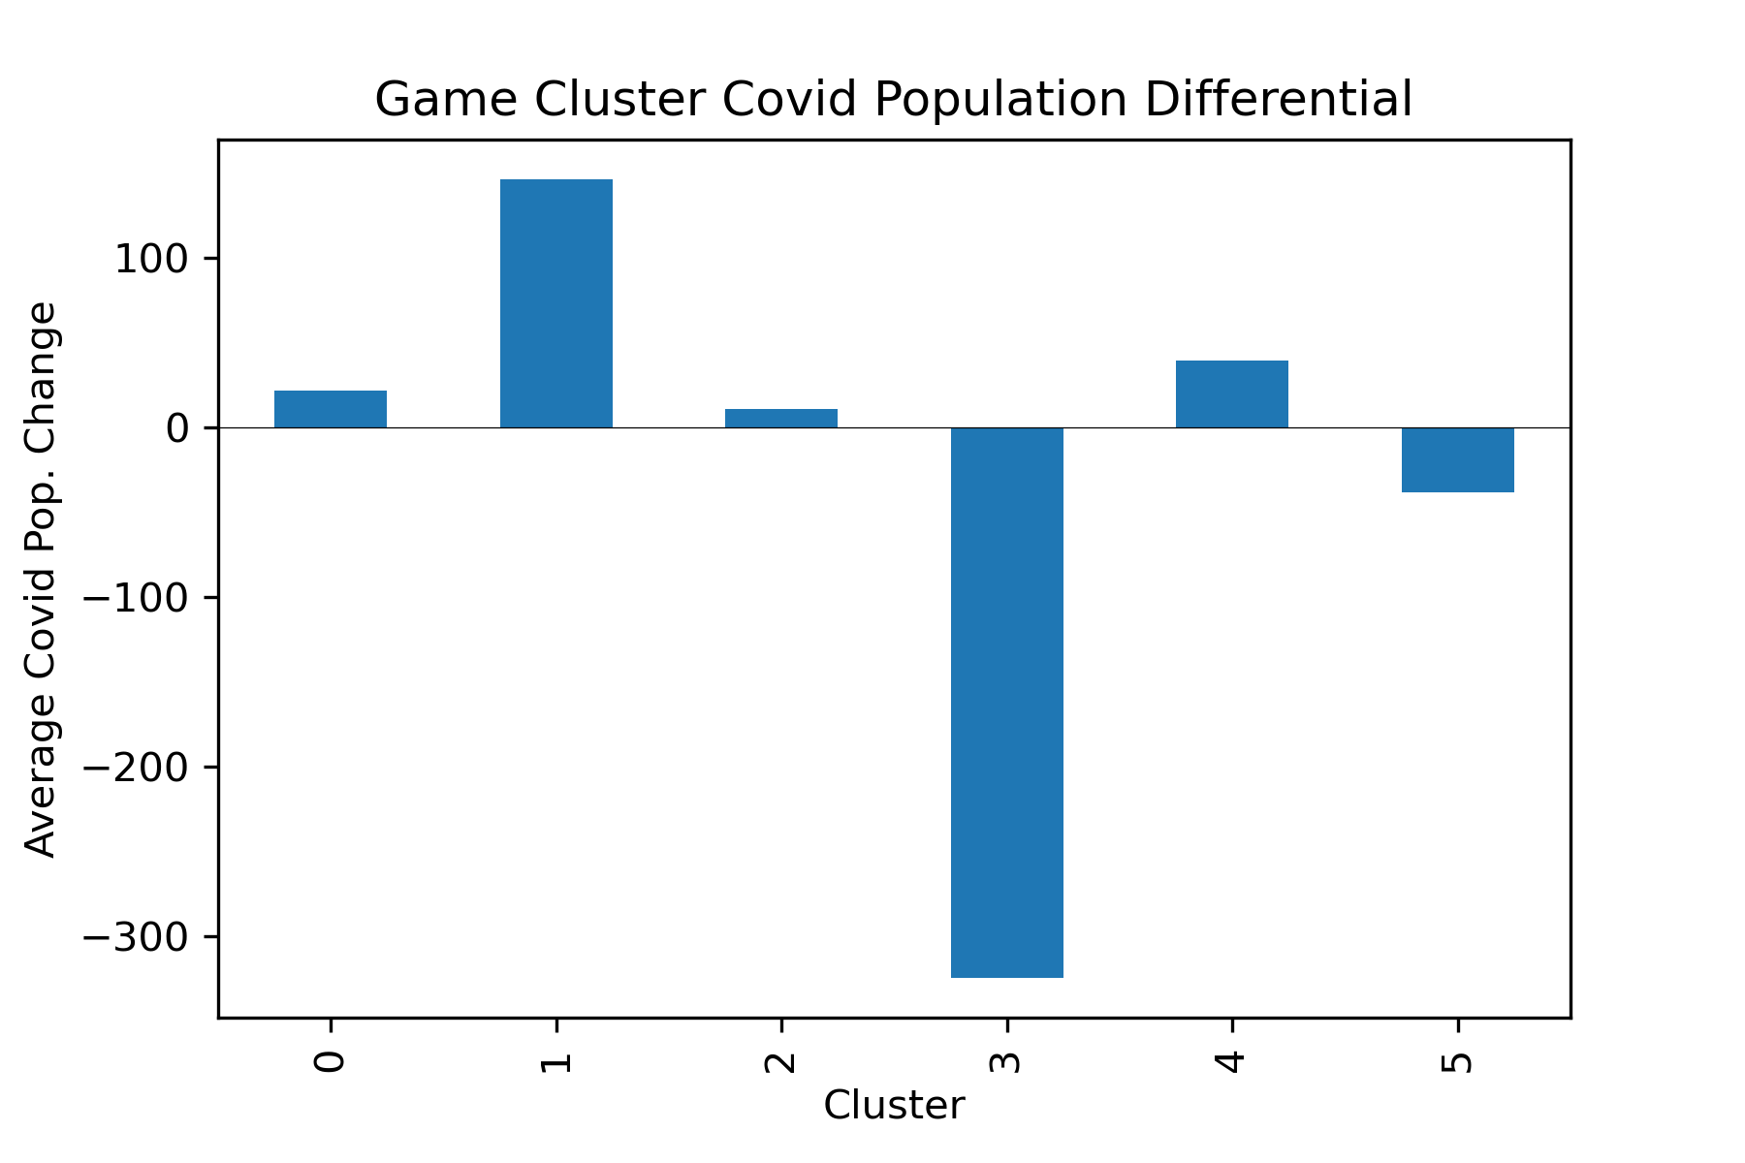
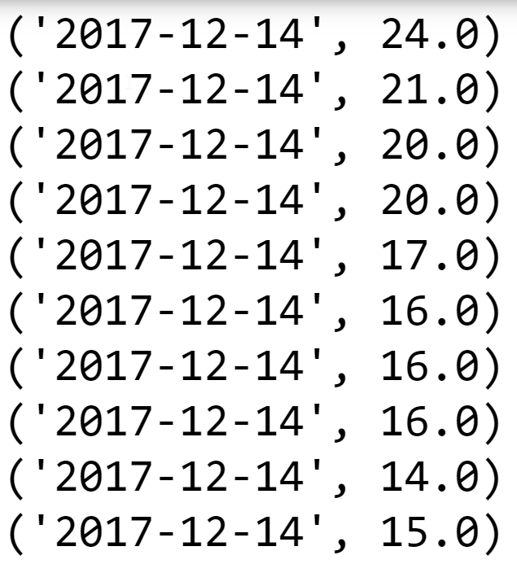

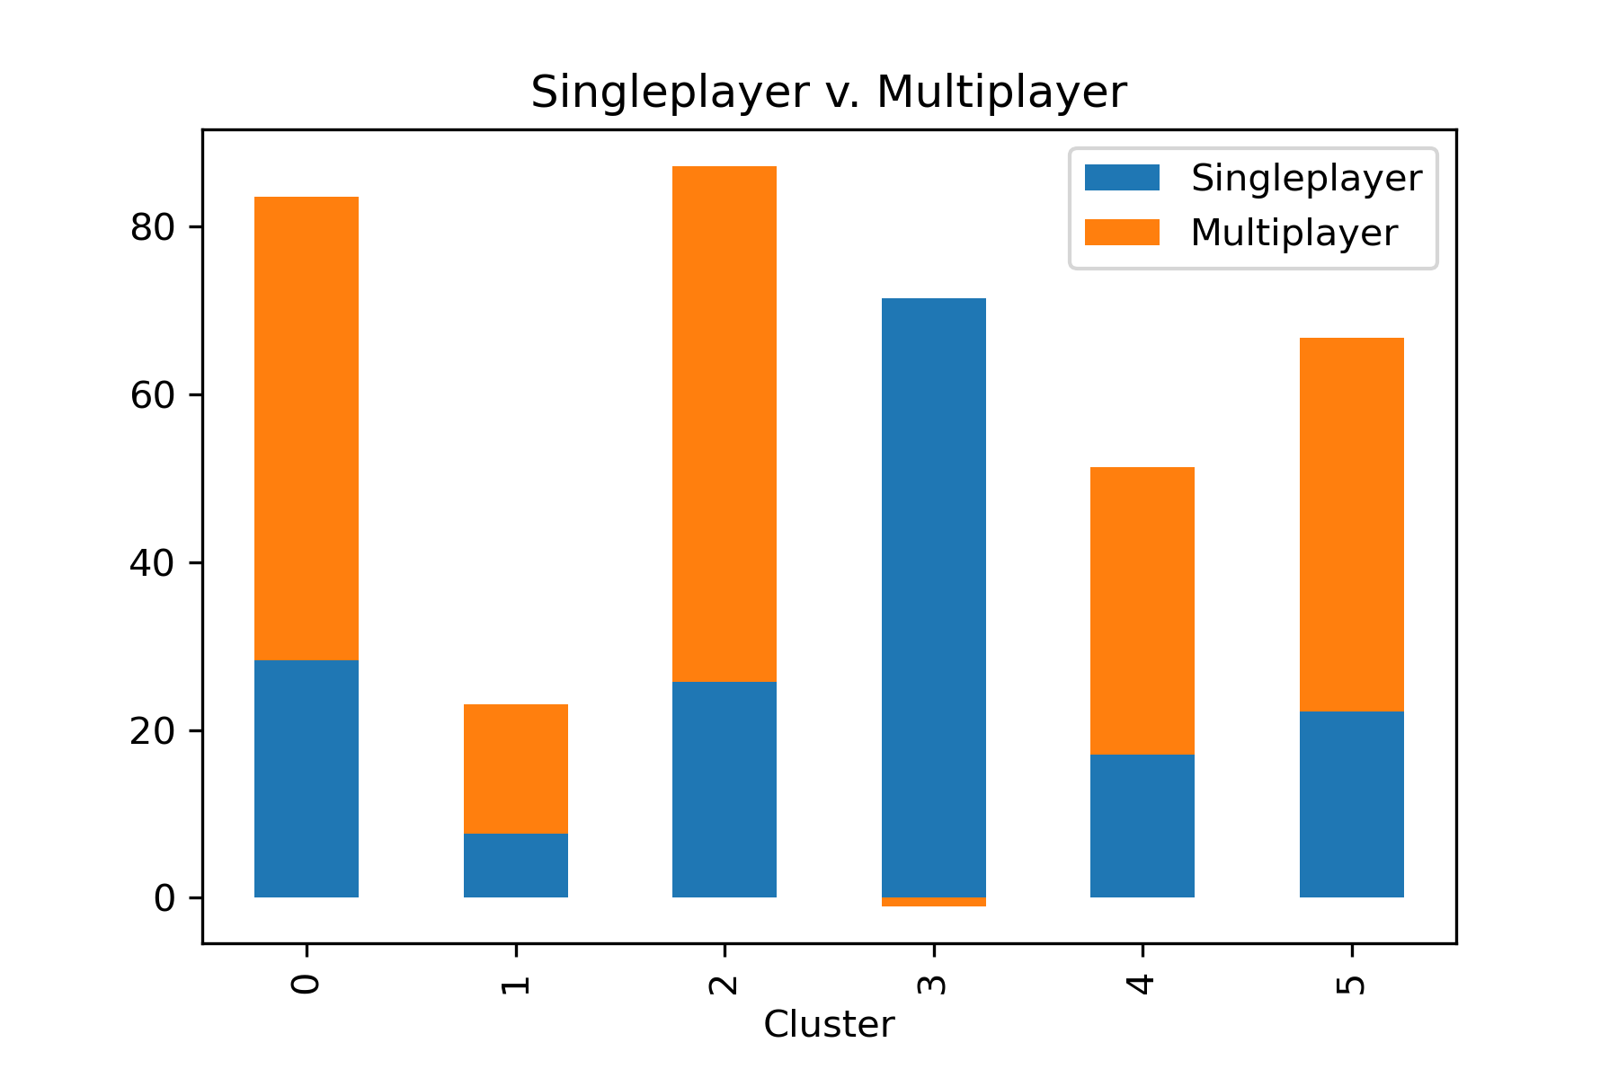
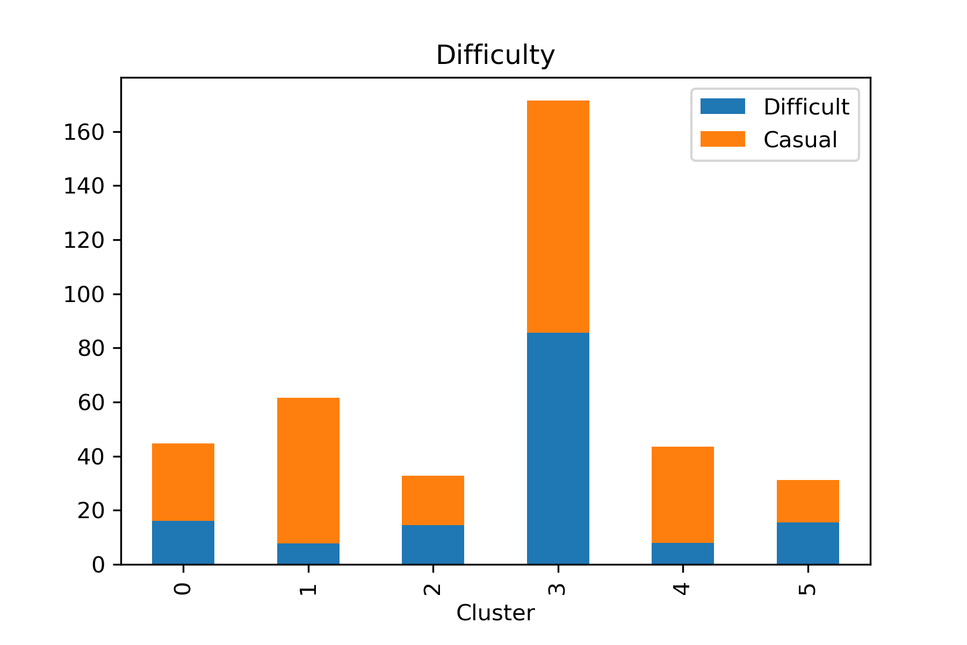
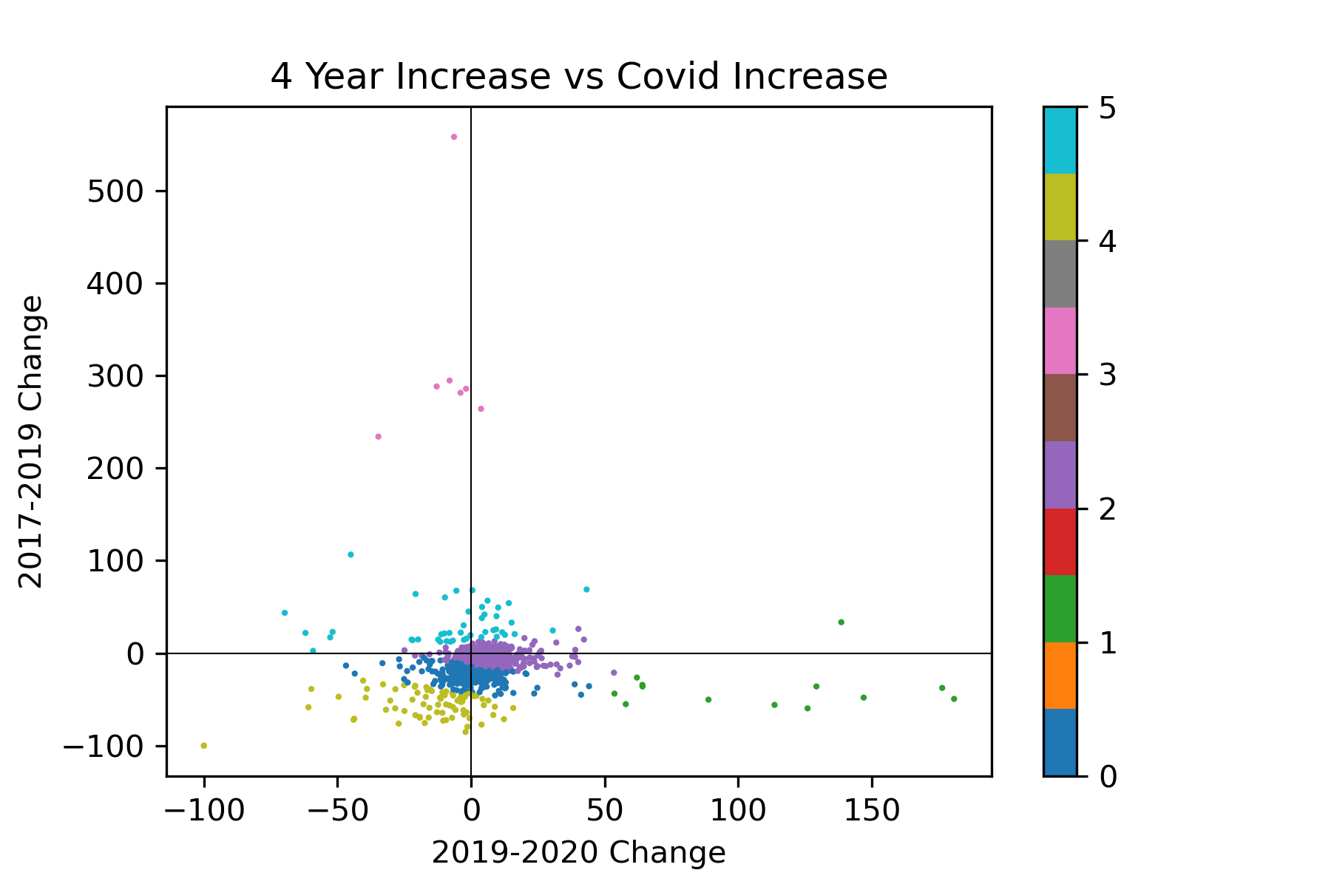
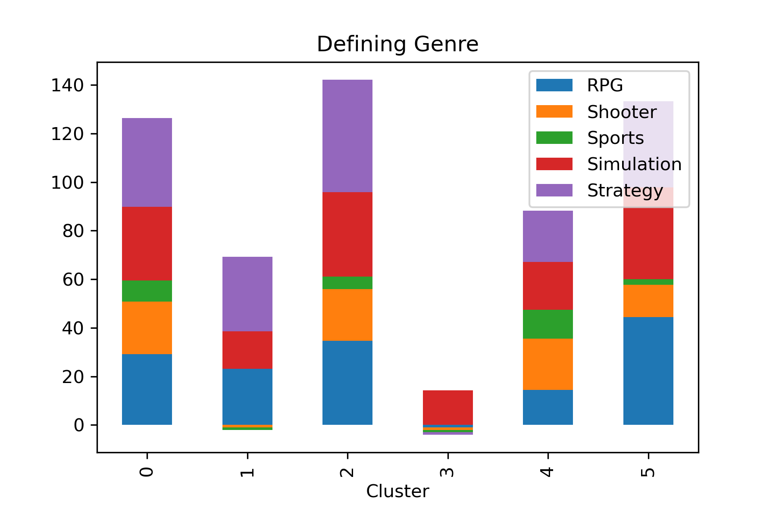
Analysis of the Effects of COVID-19 on Steam’s PC Gaming Population
Riley Barklow
University of Tennessee, Knoxville
COSC 426
Abstract
During the COVID-19 epidemic of 2020, global lockdowns began to affect numerous countries across the world. During this period, the world's largest PC gaming platform, Steam, continuously broke records for its user numbers. The purpose of this data analysis is to determine whether or not there are quantifiable trends in what types of games people chose to play during the 2020 COVID-19 lockdowns. To perform an analysis of what types of were games being played during this period, KMeans clustering was used to group the top 1000 most popular games by their player count data, tracked from 2017-2019. From the resulting clusters, the attributes of each game were analyzed, including whether or not the cluster gained or lost during COVID-19, the defining genre of the game, whether the game was singleplayer or multiplayer focused, and the difficulty of the game. While single and multiplayer games both gained users during COVID-19, multiplayer games overall grew more than singleplayer ones. There was not enough evidence to determine whether or not the games’ defining genre had any adverse effect on its population growth before or during COVID-19. Overwhelmingly, “casual” and more forgiving games experienced more player growth during COVID-19 than “difficult” games did; there was a strong correlation between difficult games gaining more players before COVID-19 than during it. For further research, I would like to develop a better system for tagging the games’ genres in a way that makes the results clearer. Due to how the datasets’ tagging of games was, where games could be tagged with multiple “conflicting” genres, getting a 100% binary distinction between certain attributes of the games was impossible.
Introduction
Since 2020, it has been noted by many that the COVID-19 lockdowns caused large user gains in multitudes of entertainment platforms.
Steam, the PC gaming platform, experienced large user gains during this time period, and continuously broke their peak concurrent user record as 2020 progressed.
It is easy to determine from available data that they gained players, but this study aims to answer the question of whether or there are definable trends in what specific types of games gained players;
Did the conditions and emotions caused COVID-19 and the lockdowns affect what games people chose to play?
Methods
The dataset being analyzed in this project contains the player count of the top 1000 games every 15 minutes for over four years.
The processing of this data was done using the python implementation of Apache Spark, PySpark;
Specifically, the mapReduce system was utilized to turn the hundreds of thousands of lines in each data entry into a smaller output
Figure 1: Spark’s mapReduce used to turn more than a hundred thousand entries into one
KMeans clustering was performed on the data using the average yearly growth of the game from the years 2017-2019 versus the growth from 2019 through 2020.
Figure 2: Visualization of the clusters using matplotlib
Different attributes of the games were analyzed on a cluster by cluster basis to determine whether there were any noticeable trends
Results
Figure 3: The differential between pre and post covid population growth by cluster
Figure 4: Percent of games tagged with Figure 5: Percent of games tagged with
single/multiplayer by cluster casual/difficult by cluster
Figure 6: Percent of games tagged with defining genres by cluster
Conclusion
Multiplayer games tended to have higher player growth during the period of COVID-19 lockdowns than singleplayer games
Casual games gained more users during the lockdowns than difficult games did
There appeared to be no significant correlation between a games’ defining genre and its popularity before and after lockdown

