Slide 1
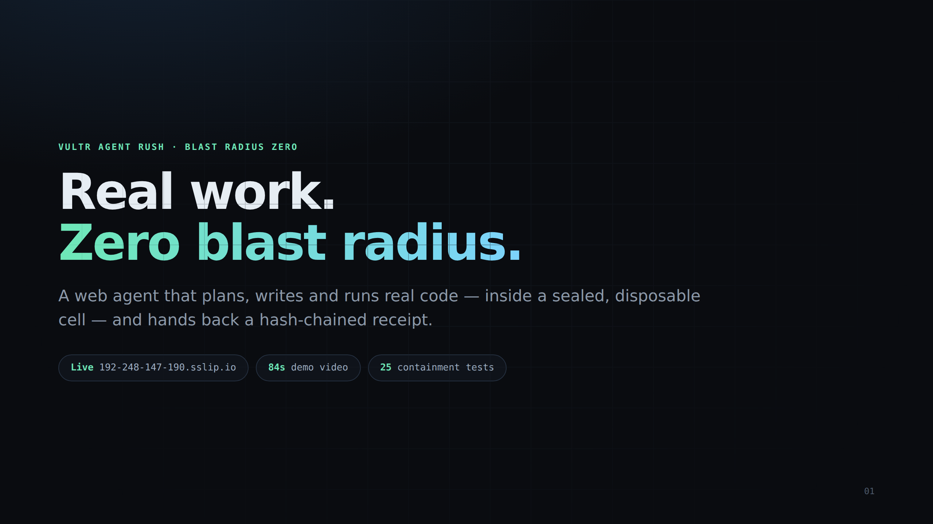
Notes:
SafeCell — real work, zero blast radius. Live at 192-248-147-190.sslip.io, 84s demo video, 25 containment tests.

Slide 2
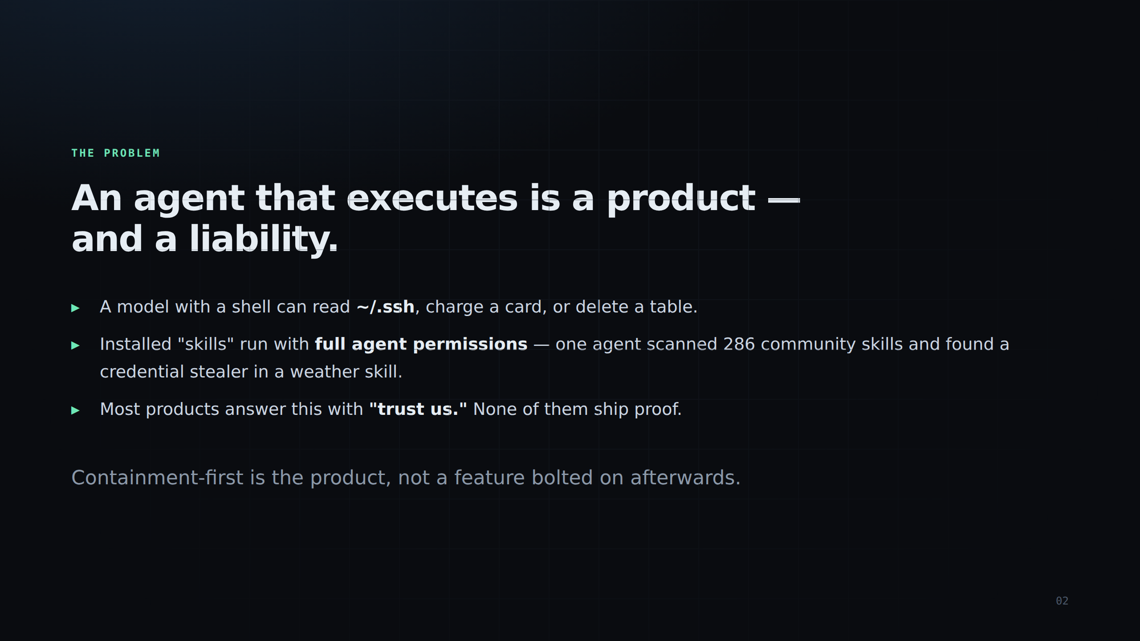
Notes:
The problem: an agent with a shell is a liability. One agent scanned 286 community skills and found a credential stealer disguised as a weather skill. Most products answer this with 'trust us'.

Slide 3
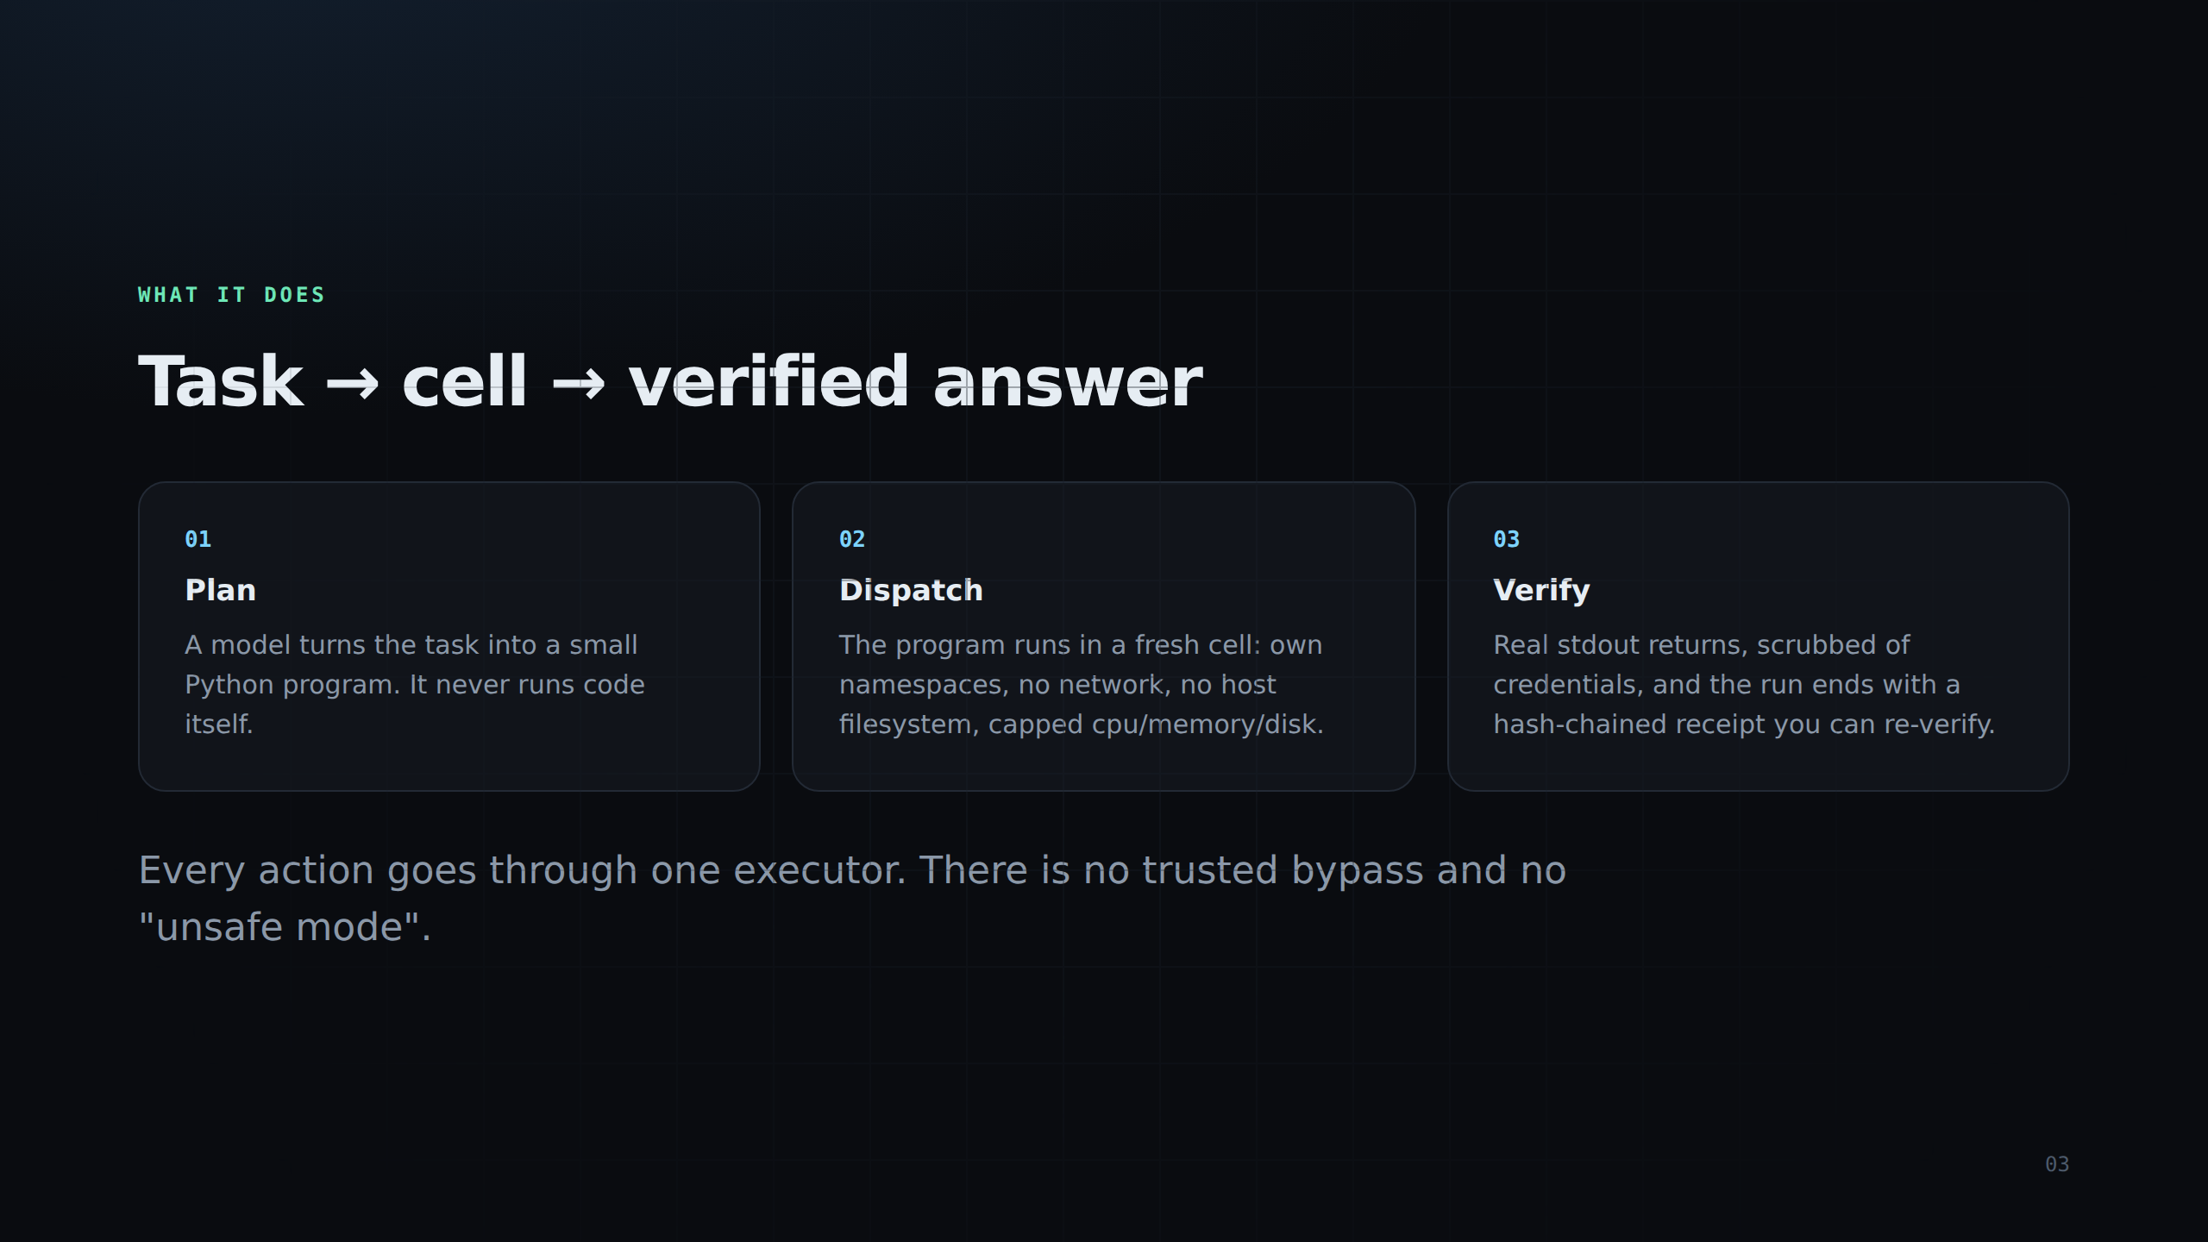
Notes:
Three steps: the model writes code (never runs it), the code runs in a disposable cell, and the run returns a receipt you can re-verify. One executor, no bypass, no unsafe mode.

Slide 4
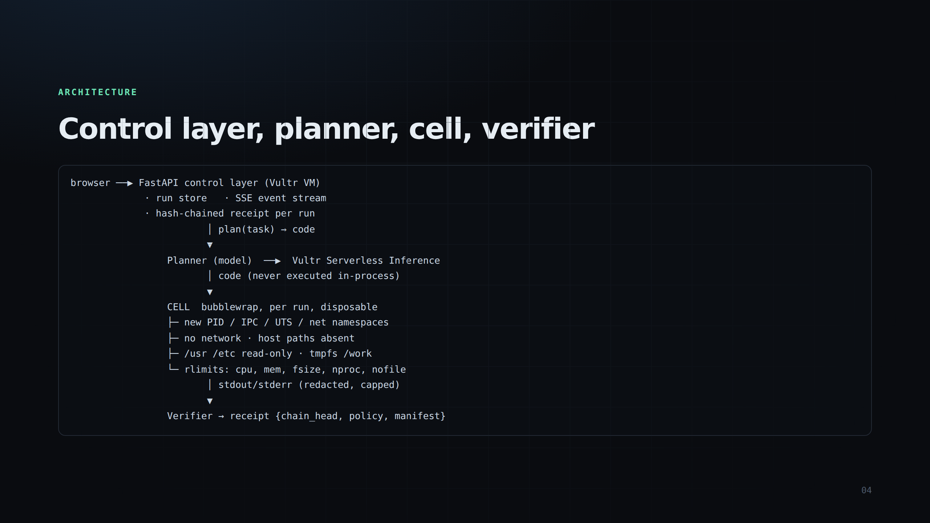
Notes:
Control layer on Vultr, planner via Serverless Inference, cells via bubblewrap, verifier hashes the event log. The app binds a high port; Caddy owns 80/443 for TLS.

Slide 5
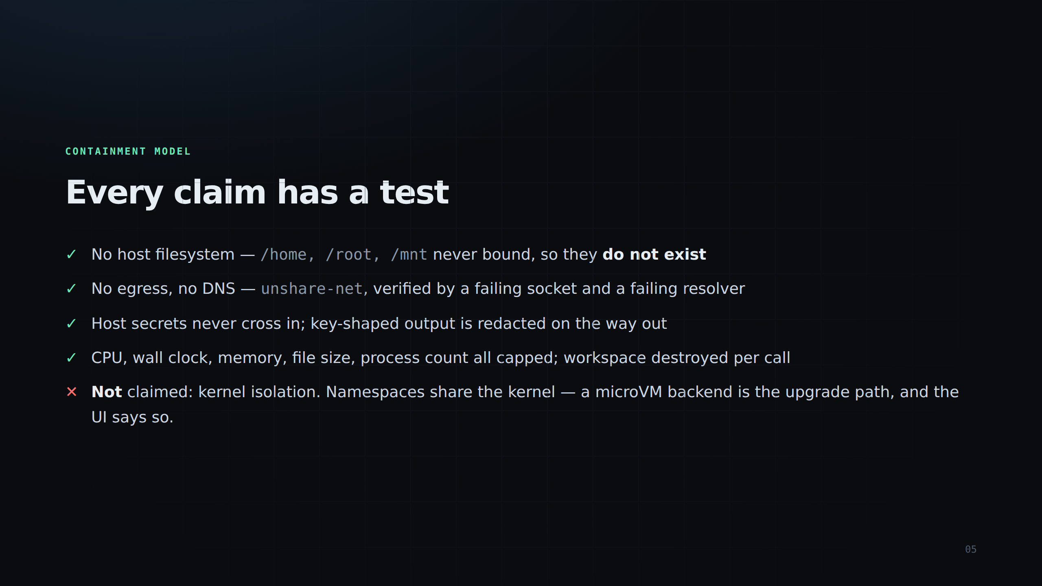
Notes:
Every containment claim has a test that executes real code inside a real cell. Note the last line: kernel exploits are explicitly NOT denied, and the UI says so.

Slide 6
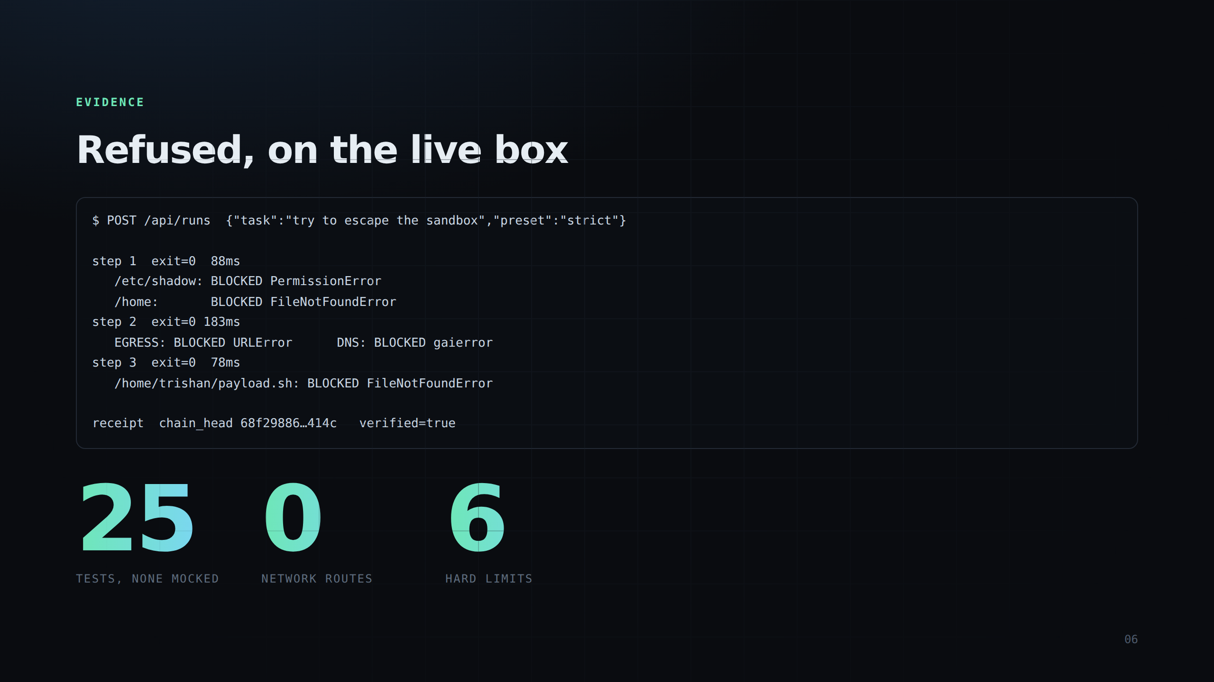
Notes:
Real output from the live box: /etc/shadow permission denied, /home does not exist, egress and DNS blocked, host write refused. Receipt chain verified.

Slide 7
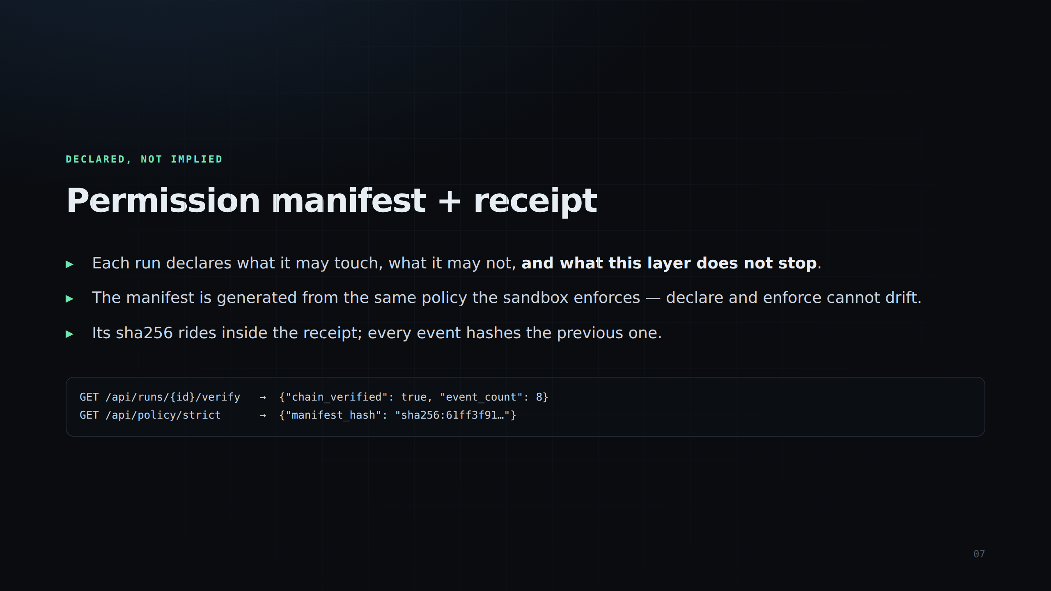
Notes:
The permission manifest is generated from the same policy object the sandbox enforces, so the declaration cannot drift from enforcement. Its hash rides in the receipt.

Slide 8
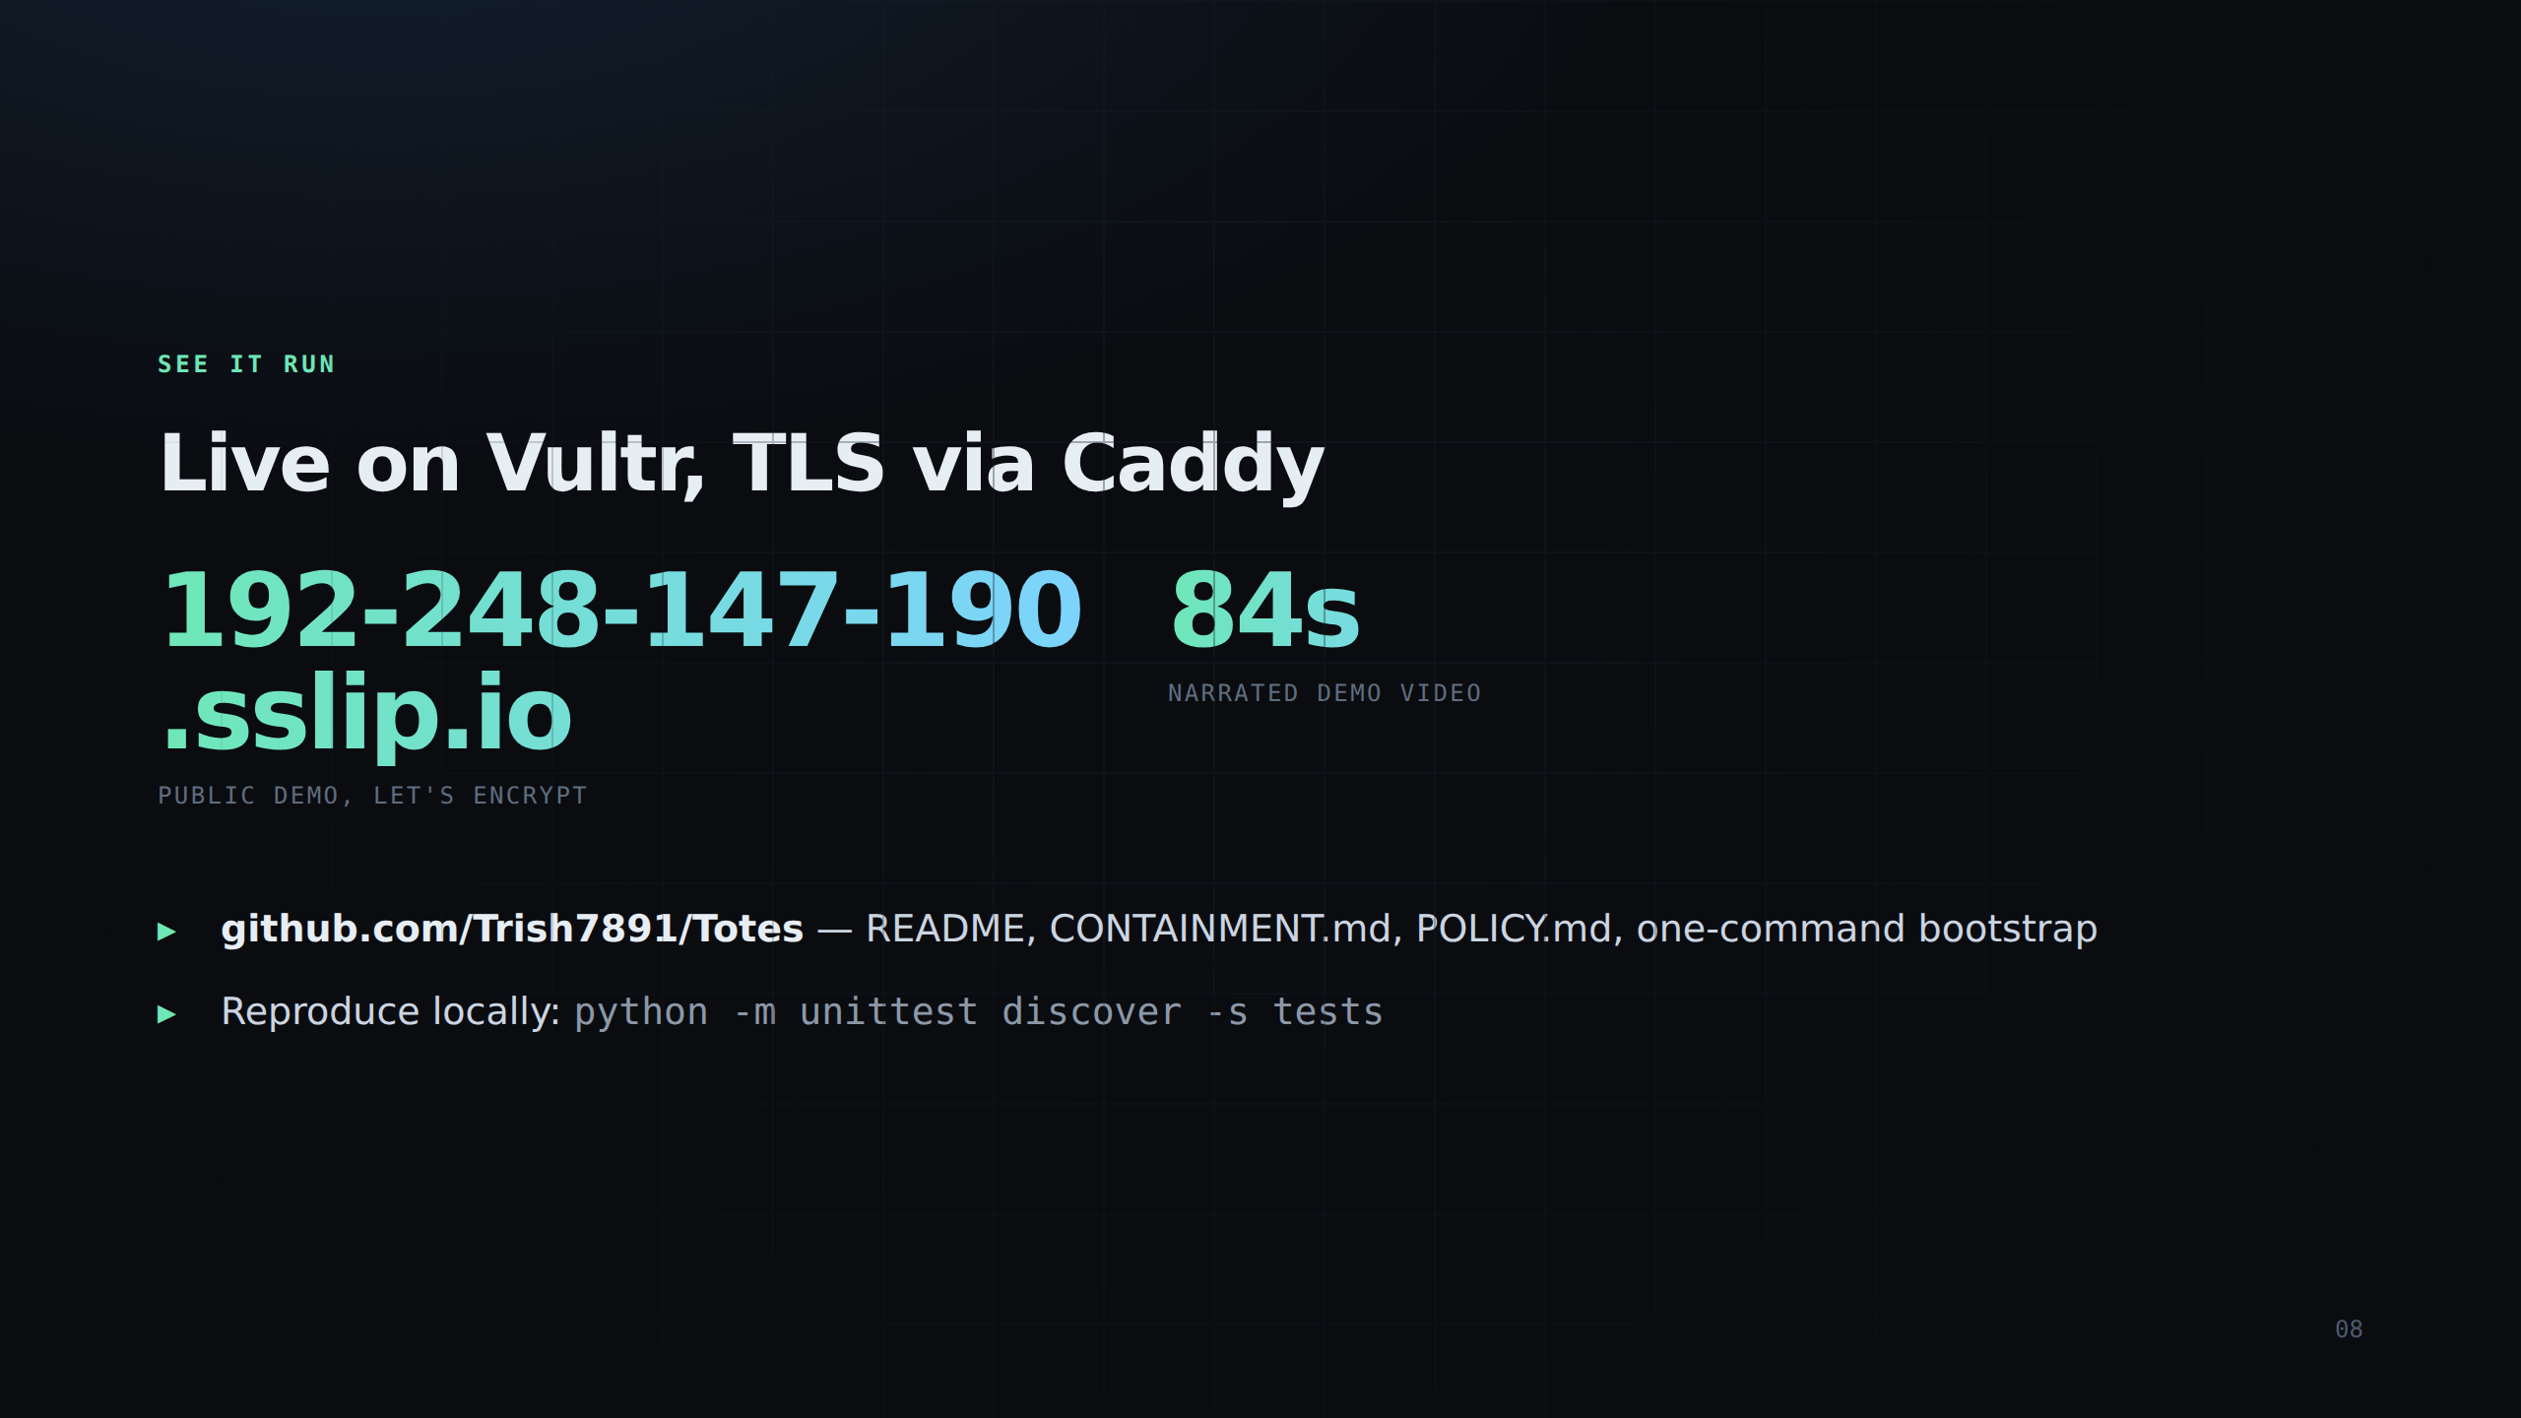
Notes:
Demo URL and repo. Everything is reproducible: clone, pip install, run the test suite.

Slide 9
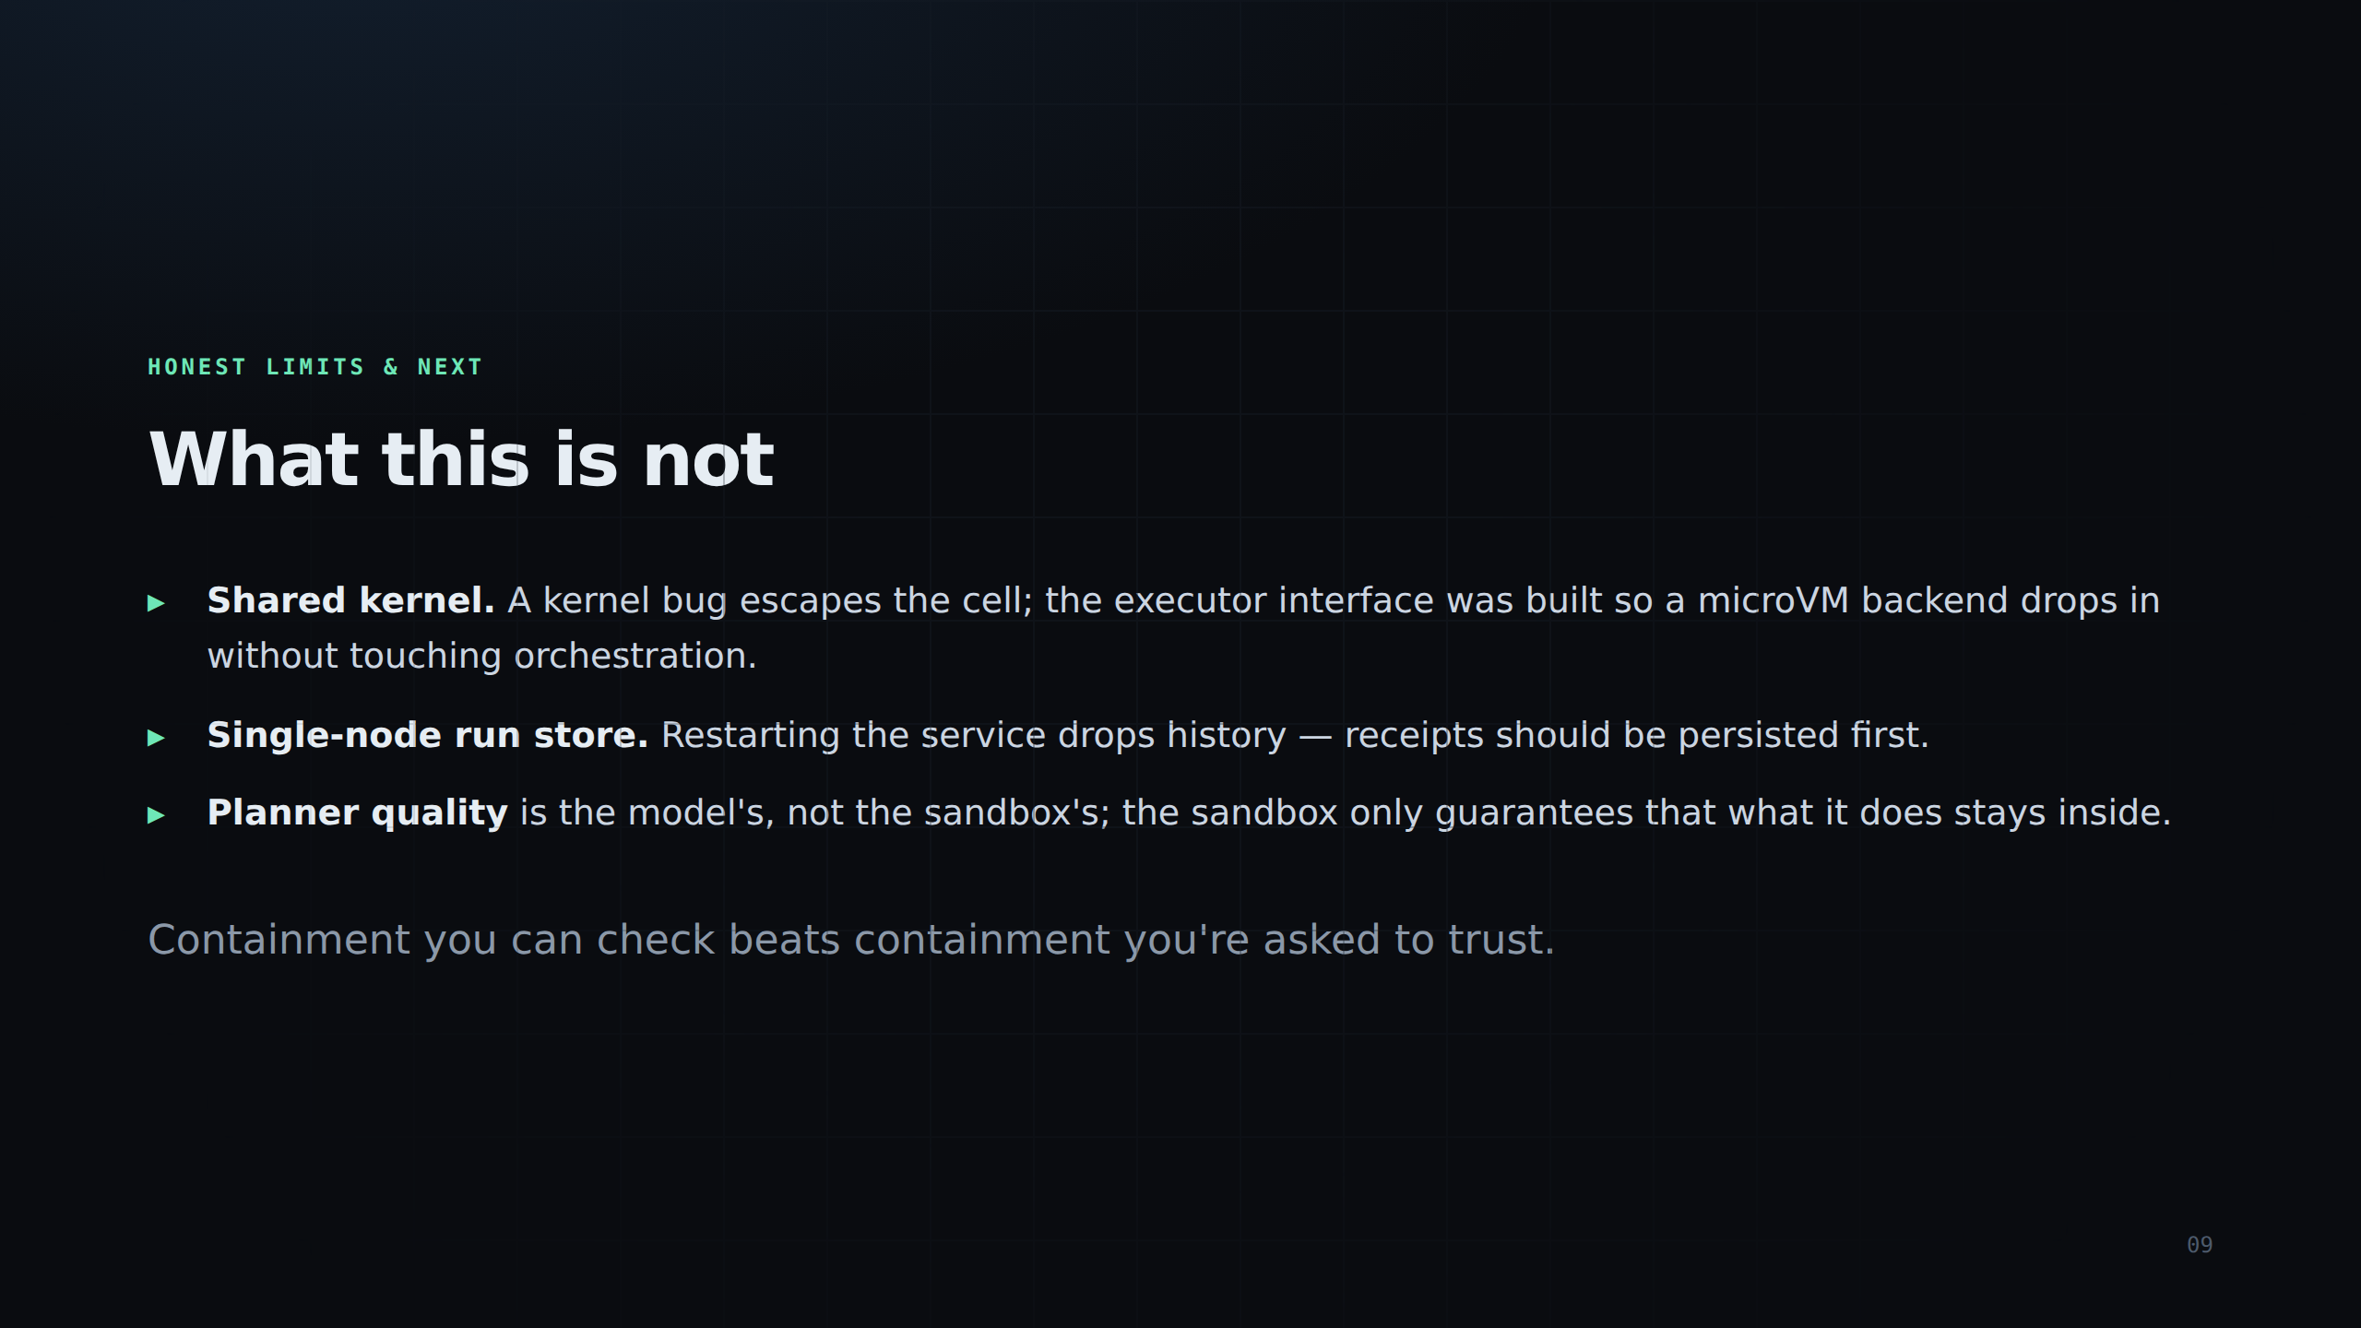
Notes:
Honest limits: shared kernel (microVM is the upgrade path), single-node run store, planner quality belongs to the model. Containment you can check beats containment you trust.

