Slide 1
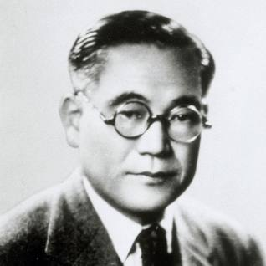
TOYOTA Founder: Kiichiro Toyoda

Slide 2
HISTORY OF TOYOTA
1920s–1930s
The mass-produced Toyoda automated loom, displayed at Toyota Museum in Aichi-gun, Japan
In 1924, Sakichi Toyoda invented the Toyoda Model G Automatic Loom. The principle of jidoka, which means the machine stops itself when a problem occurs, became later a part of the Toyota Production System. Looms were built on a small production line. In 1929, the patent for the automatic loom was sold to the British company Platt Brothers, generating the starting capital for automobile development’
In April 1936, Toyoda's first passenger car, the Model AA, was completed. The sales price was ¥3,350, ¥400 cheaper than Ford or GM cars. The company's plant at Kariya was completed in May. In July, the company filled its first export order, with four G1 trucks exported to northeastern China.On September 19, 1936, the Japanese imperial government officially designated Toyota Automatic Loom Works as an automotive manufacturer.

Slide 3
1940s
Japan was heavily damaged in World War II and Toyota's plants, which were used for the war effort, were not spared. On August 14, 1945, one day before the surrender of Japan, Toyota's Koromo Plant was bombed by the Allied forces. After the surrender, the U.S.-led occupying forces banned passenger car production in Japan. However, automakers like Toyota were allowed to begin building trucks for civilian use, in an effort to rebuild the nation's infrastructure. The U.S. military also contracted with Toyota to repair its vehicles.
By 1947, there was an emerging global Cold War between the Soviet Union and the U.S., who had been allies in World War II. U.S. priorities shifted from punishing and reforming Japan to ensuring internal political stability, rebuilding the economy, and, to an extent, remilitarizing Japan. Under these new policies, in 1949, Japanese automakers were allowed to resume passenger car production, but at the same time, a new economic stabilization program to control inflation plunged the automotive industry into a serious shortage of funds, while many truck owners defaulted on their loans.^{[17]} Ultimately, the Bank of Japan, the central bank of the country, bailed out the company, with demands that the company institute reforms.

Slide 4
1950s
As the 1950s began, Toyota emerged from its financial crisis a smaller company, closing factories and laying off workers. At about the same time, the Korean War broke out, and being located so close to the battlefront, the U.S. Army placed an order for 1,000 trucks from Toyota. The order helped to rapidly improve the struggling company's business performance. In 1950, company executives, including Kiichiro's cousin Eiji Toyoda, took a trip to the United States where they trained at the Ford Motor Company and observed the operations of dozens of U.S. manufacturers. The knowledge they gained during the trip, along with what the company learned making looms, gave rise to The Toyota Way (a management philosophy) and the Toyota Production System (a lean manufacturing practice) that transformed the company into a leader in the manufacturing industry.

Slide 5
Toyopet Crown, the first vehicle fully designed and built by Toyota .Toyota started developing its first full-fledged passenger car, the Toyopet Crown, in January 1952. Prior to the Crown, Toyota had been outsourcing the design and manufacturing of auto bodies, which were then mounted on truck frames made by Toyota.[ The project was a major test for Toyota, who would need to build bodies and develop a new chassis that would be comfortable, but still stand up to the muddy, slow, unpaved roads common in Japan at the time.The project had been championed for many years by founder Kiichiro Toyoda, who died suddenly on March 27, 1952. The first prototypes were completed in June 1953 and began extensive testing, before the Crown went on sale in August 1955.The car was met with positive reviews from around the world. After the introduction of the Crown, Toyota began aggressively expanding into the export market. Toyota began shipping Land Cruiser knock-down kits to Latin America in November 1955,sending complete Land Cruisers to Burma (now Myanmar) and the Philippines in 1956 as part of war reparations provided by the Japanese government, establishing a branch in Thailand in June 1957,and shipping Land Cruisers to Australia in August 1957. Toyota established a production facility in Brazil in 1958, the company's first outside of Japan
Toyota entered the United States market in July 1958, attempting to sell the Toyopet Crown. The company faced problems almost immediately, the Crown was a flop in the U.S. with buyers finding it overpriced and underpowered (because it was designed for the bad roads of Japan, not high-speed performance). In response, exports of the Crown to the United States were suspended in December 1960.

Slide 6
1960s–1970s
At the start of the 1960s, the Japanese economy was booming, a period that came to be known as the Japanese economic miracle. As the economy grew, so did the income of everyday people, who now could afford to purchase a vehicle. At the same time, the Japanese government heavily invested in improving road infrastructure. To take advantage of the moment, Toyota and other automakers started offering affordable economy cars like the Toyota Corolla, which became the world's all-time best-selling automobile.
Toyota also found success in the United States in 1965 with the Toyota Corona compact car, which was redesigned specifically for the American market with a more powerful engine. The Corona helped increase U.S. sales of Toyota vehicles to more than 20,000 units in 1966 (a threefold increase) and helped the company become the third-best-selling import brand in the United States by 1967. Toyota's first manufacturing investment in the United States came in 1972 when the company struck a

Slide 7
deal with Atlas Fabricators, to produce truck beds in Long Beach, in an effort to avoid the 25% "chicken tax" on imported light trucks. By importing the truck as an incomplete chassis cab the vehicle only faced a 4% tariff.^{[33]} Once in the United States, Atlas would build the truck beds and attach them to the trucks. The partnership was successful and two years later, Toyota purchased Atlas.
The energy crisis of the 1970s was a major turning point in the American auto industry. Before the crisis, large and heavy vehicles with powerful but inefficient engines were common. But in the years after, consumers started demanding high-quality and fuel-efficient small cars. Domestic automakers, in the midst of their malaise era, struggled to build these cars profitably, but foreign automakers like Toyota were well positioned .The 1960s also saw the slight opening of the Japanese auto market to foreign companies. In an effort to strengthen Japan's auto industry ahead of the market opening, Toyota purchased stakes in other Japanese automakers. That included a stake in Hino Motors, a manufacturer of large commercial trucks, buses and diesel engines, along with a 16.8 percent stake in Daihatsu, a manufacturer of kei cars, the smallest highway-legal passenger vehicles sold in Japan.

Slide 8
1980s
After the successes of the 1970s, and the threats of import restrictions, Toyota started making additional investments in the North American market in the 1980s. In 1981, Japan agreed to voluntary export restraints, which limited the number of vehicles the nation would send to the United States each year, leading Toyota to establish assembly plants in North America. The U.S. government also closed the loophole that allowed Toyota to pay lower taxes by building truck beds in America.
Also in 1981, Eiji Toyoda stepped down as president and assumed the title of chairman. He was succeeded as president by Shoichiro Toyoda, the son of the company's founder. The two groups were described as "oil and water" and it took years of leadership from Shoichiro to successfully combine them into one organization .Efforts to open a Toyota assembly plant in the United States started in 1980, with the company proposing a joint-venture with the Ford Motor Company. Those talks broke down in July1981

Slide 9
Toyota received its first Japanese Quality Control Award at the start of the 1980s and began participating in a wide variety of motorsports. Conservative Toyota held on to rear-wheel-drive designs for longer than most; while a clear first in overall production they were only third in production of front-wheel-drive cars in 1983, behind Nissan and Honda. In part due to this, Nissan's Sunny managed to squeeze by the Corolla in numbers built that year.
The Lexus LS 400 went on sale in May 1989 and was seen as being largely responsible for the successful launch of Lexus.
Before the decade was out, Toyota introduced Lexus, a new division that was formed to market and service luxury vehicles in international markets. Prior to the debut of Lexus, Toyota's two existing flagship models, the Crown and Century, both catered exclusively for the Japanese market and had little global appeal that could compete with international luxury brands such as Mercedes-Benz, BMW and Jaguar. The company had been developing the brand and vehicles in secret since August 1983, at a cost of over US$1 billion . The LS 400 flagship full-size sedan debuted in 1989 to strong sales, and was largely responsible for the successful launch of the Lexus marque.

Slide 10
1990s
In the 1990s, Toyota began to branch out from producing mostly compact cars by adding many larger and more luxurious vehicles to its lineup, including a full-sized pickup, the T100 , several lines of SUVs, a sport version of the Camry, known as the Camry Solara. They would also launch newer iterations of their sports cars, namely the MR2, Celica, and Supra during this era.
December 1997 saw the introduction of the first-generation Toyota Prius, the first mass-produced gasoline-electric hybrid car. The vehicle would be produced exclusively for the Japanese market for the first two years.
With a major presence in Europe, due to the success of Toyota Team Europe in racing, the corporation decided to set up Toyota Motor Europe Marketing and Engineering, TMME, to help market vehicles in the continent. Two years later, Toyota set up a base in the United Kingdom, TMUK, as the company's cars had become very popular among British drivers. Bases in Indiana, Virginia, and Tianjin were also set up.

Slide 11
Toyota also increased its ownership of Daihatsu during this period. In 1995, Toyota increased its shareholding in the company to 33.4 percent, giving Toyota the ability to veto shareholder resolutions at the annual meeting.In 1998, Toyota increased its holding in the company to 51.2 percent, becoming the majority shareholder.
On September 29, 1999, the company decided to list itself on the New York and London Stock Exchanges.
The later half of the 1990s would also see the Toyoda brothers step back from the company their father had founded. In 1992, Shoichiro Toyoda would shift to become chairman, allowing his brother Tatsuro to become president, a job he held until his retirement in 1995. Shoichiro would step down as chairman in 1999. Both would retain honorary advisory roles in the company. Hiroshi Okuda would lead the company as president from 1995 until 1999 when he became chairman and the President's office would be filled by Fujio Cho.

Slide 12
2000s
In August 2000, exports began of the Prius.In 2001, Toyota acquired its long time partner, truck and bus manufacturer Hino Motors. In 2002, Toyota entered Formula One competition and established a manufacturing joint venture in France with French automakers Citroën and Peugeot. A youth-oriented marque for North America, Scion, was introduced in 2003. Toyota ranked eighth on Forbes 2000 list of the world's leading companies for the year 2005. Also in 2005, Fujio Cho would shift to become chairman of Toyota and would be replaced as president by Katsuaki Watanabe.
In 2007, Toyota released an update of its full-sized truck, the Tundra, produced in two American factories, one in Texas and one in Indiana. Motor Trend named the Tundra "Truck of the Year", and the 2007 Toyota Camry "Car of the Year" for 2007. It also began the construction of two new factories, one in Woodstock, Ontario, Canada, and the other in Blue Springs, Mississippi, USA.
The company was number one in global automobile sales for the first quarter of 2008.

Slide 13
Toyota was hit by the global financial crisis of 2008 as it was forced in December 2008 to forecast its first annual loss in 70 years.In January 2009, it announced the closure of all of its Japanese plants for 11 days to reduce output and stocks of unsold vehicle. Toyota was sued for personal injuries and wrongful deaths, paid US$1 billion to settle a class action lawsuit to compensate owners for lost resale value,and paid a US$1.2 billion criminal penalty to the United States government over accusations that it had intentionally hid information about safety defects and had made deceptive statements to protect its brand image.
Akio Toyoda was named President of Toyota in 2009, pictured in 2011.
Amid the unintended acceleration scandal, Katsuaki Watanabe stepped down as company president. He was replaced by Akio Toyoda, grandson of company founder Kiichiro Toyoda, on June 23, 2009. Akio had been with Toyota since 1984, working jobs in production, marketing and product development, and took a seat on the board of directors in 2000.Akio's promotion by the board marked the return of a member of the Toyoda family to the top leadership role for the first time since 1999.

Slide 14
2020s
By 2020, Toyota reclaimed its position as the largest automaker in the world, surpassing Volkswagen.It sold 9.528 million vehicles globally despite an 11.3% drop in sales due to the COVID-19 pandemic.This includes subsidiaries Daihatsu and Hino Motors.
On April 2, 2020, BYD and Toyota announced a new joint venture between the two companies called BYD Toyota EV Technology Co., Ltd., with the aim of "developing BEVs (Battery Electric Vehicles) that appeal to customers.
In March 2021, Toyota, its subsidiary Hino, and Isuzu announced the creation of a strategic partnership between the three companies. Toyota acquired a 4.6% stake in Isuzu while the latter plans to acquire Toyota shares for an equivalent value. The three companies said they would form a new joint venture by April called Commercial Japan Partnership Technologies Corporation with the aim of developing fuel cell and electric light trucks. Toyota would own an 80% stake in the venture while Hino and Isuzu would own 10% each.In April 2021, Toyota said that it will buy Lyft's self-driving technology unit for $550 million and merge it with its newly created Woven Planet Holdings automation division.

Slide 15
In 2021, Toyota told some of its suppliers to increase their semiconductor inventory levels from the conventional three months to five months in response to the COVID-19 chip shortage.The "just-in-time" supply chain in which parts are only delivered when necessary, had already been revised after the March 11, 2011, earthquake and tsunami in Japan, lifting inventories across the entire procurement network. The time it takes Toyota to turn over its inventory increased by around 40% during the past ten years, to 36.36 days as of March 2021.
In August 2022, Toyota pledged up to $5.6 billion towards production of electric vehicle battery production and announced an increase in investment in its plant near Greensboro, North Carolina. Also in 2022, Toyota managed to maintain its position as the world's best-selling automaker for the third year in a row.
In January 2023, Toyota CEO and President Akio Toyoda announced that he was stepping down and passing the position on to Koji Sato. Akio is the great-grandson of company founder Rizaburo Toyoda. Sato had previously run Lexus, Toyota's luxury car brand. The change is set to take effect on April 1, 2023.

Slide 16
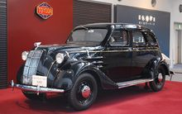
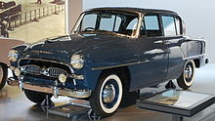
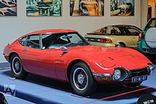
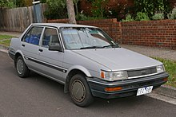

Slide 17
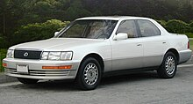
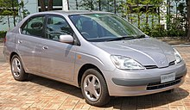
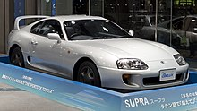

Slide 18
BOARD OF DIRECTORS
Chairman: Akio Toyoda (since April 2023)
Vice chairman: Shigeru Hayakawa
President & CEO: Koji Sato (since April 2023)
Members:
Takeshi Uchiyamada
James Kuffner
Kenta Kon
Masahiko Maeda
Ikuro Sugawara
Sir Philip Craven
Teiko Kudo

Slide 19
LIST OF FORMER DIRECTORS
In 1950, Toyota was split into Toyota Motor Co. and Toyota Motor Sales Co. (sales arm of Toyota); the two companies merged in 1982 to create one unified company, with then-Toyota Motor Co. President Eiji Toyoda becoming chairman. Chairmen listed prior to 1982 below were for the pre-merger Toyota Motor Co. only.
Rizaburo Toyoda (1937–1948)
Taizo Ishida (1948–1952)
Shoichi Saito (1952–1959)
Masaya Hanai (1959–1982)
Eiji Toyoda (1982–1994)
Shoichiro Toyoda (1994–1999)
Hiroshi Okuda (1999–2006)
Fujio Cho (2006–2013)
Takeshi Uchiyamada (2013–2023

Slide 20
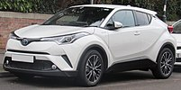
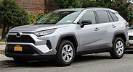
SUVs AND CROSSOVERS
Toyota C-HR Toyota RAV4

Slide 21
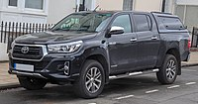
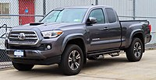
PICKUP TRUCKS
Toyota Hilux
Toyota Tacoma
Toyota Tacoma (US/Canada)
Toyota Hilux

Slide 22
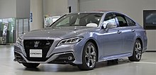
LUXURY VEHICLES
Toyota Crown RS (fifteenth generation, S220; 2018)

Slide 23
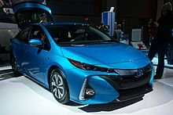
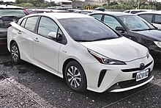
TECHNOLOGY
Hybrid Electric Plug-in hybrids
Vehicles

Slide 24
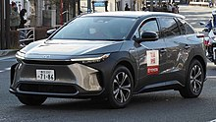
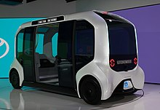
Battery electric vehicle
Autonomous vehicle

Slide 25
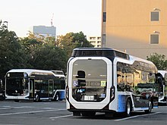
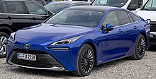
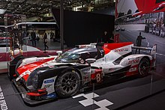
Hydrogen fuel-cell
Motorsports

Slide 26
THANK YOU

