Slide 1
Towards OpenVAD- Improvement
Created By: Trisha

Slide 2

Summary
The improvement model substitutes the Inverse Autoregressive Model with the Masked Autoregressive Model.
The benefit of using masking MAF is that it enables transforming from data x to random numbers u and thus calculating p(x) in one forward pass through the flow, thus eliminating the need for sequential recursion as in Equation-
where μi = fμi (x1:i−1) and αi = fαi (x1:i−1), f is an invertible function and x are the data points.
The substitution demonstrates a significant improvement in the training AUC-PR score of 92%.

Slide 3
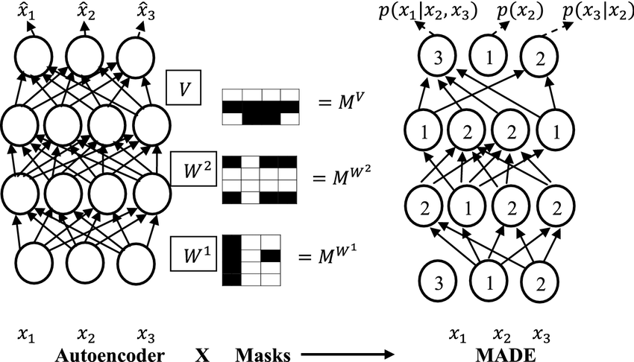
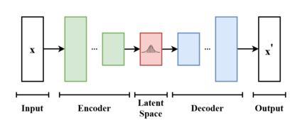
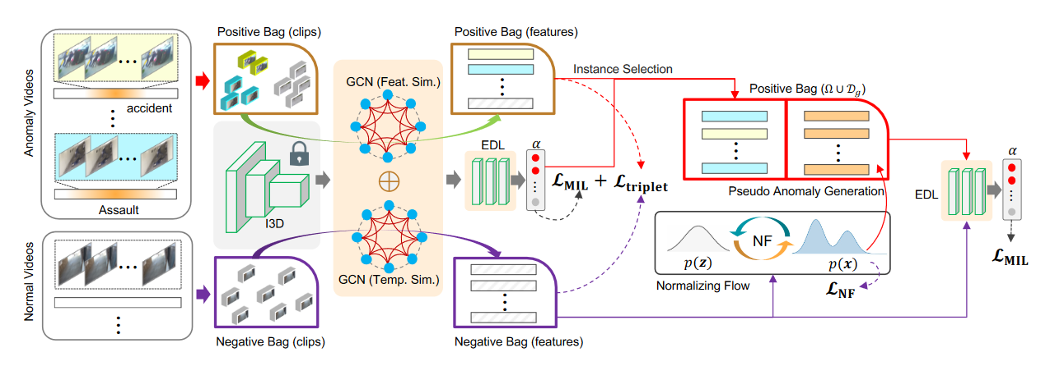
Architecture
Methodology
Fig 1. Block diagram of the Model
Masked Autoencoder for Distribution Estimation
Variational Autoencoder

Slide 4
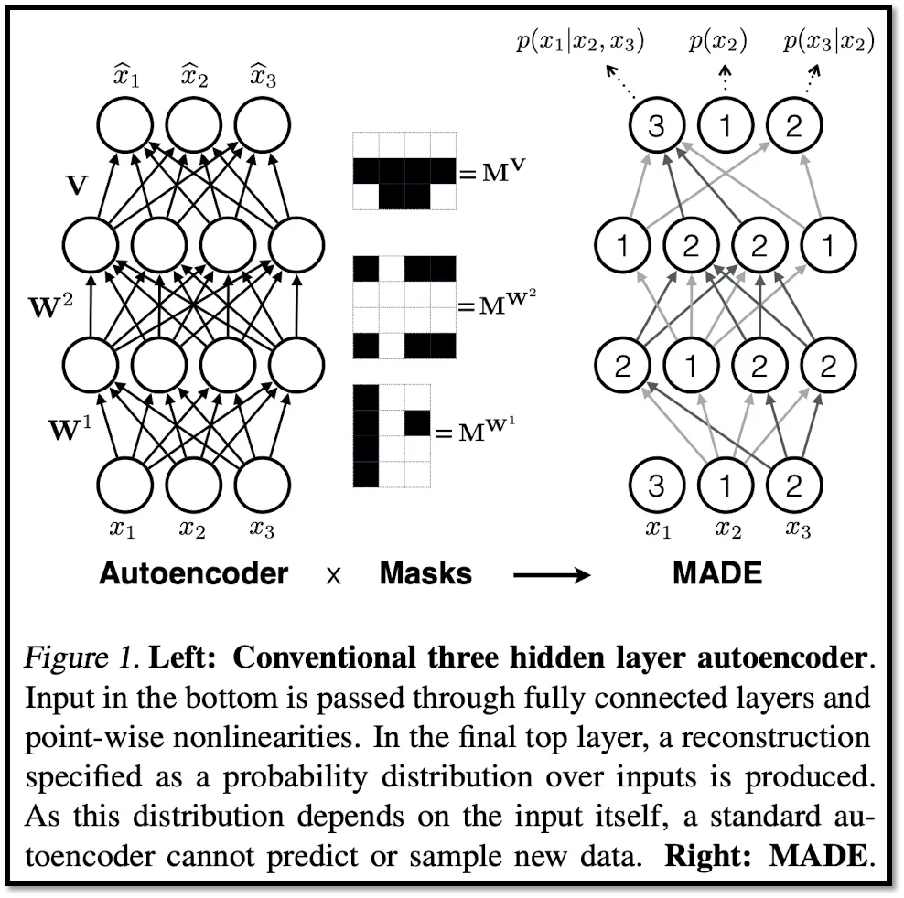
Architecture of Normalising Flow
Methodology
Fig 1. Block diagram of the Model
The Masked Autoregressive Flow is constructed with a single layer of MADE with Gaussian Conditionals.
ADE is a feedforward network that takes x as input and outputs μi and αi for all i with a single forward pass. The autoregressive property is enforced by multiplying the weight matrices of MADE with suitably constructed binary masks. [1]
The benefit of masking is that it enables transforming from data x to random numbers u and thus calculating p(x) in one forward pass through the flow, thus eliminating the need for sequential recursion used in IAF.
Finally, it uses the VAE architecture to produce the features of pseudo anomalies.
Normalising Flow using MAF architecture
Masked Autoencoder for Distribution Estimation
Variational Autoencoder
Source – clipped from paper and referenced in [8]

Slide 5
Comparison
Comparison table results of Towards OpenVAD (XD-Violence) with 4 seen anomaly types
Comparison table results of Towards OpenVAD (UCF Crimes Dataset) (9 seen anomaly types)
Comparison table results of Towards OpenVAD (ShanghaiTech Dataset) (first 25 anomaly seen videos)
AUC | Loss | Ours-AUC | Ours Loss
0.69 | NA | 0.9224 | 0.5885
AUC | Loss | Ours-AUC | Ours Loss
0.85 | NA | 0.9204 | 0.6489
AUC | Loss | Ours-AUC | Ours Loss
0.93 | NA | 0.8986 | 0.69

Slide 6
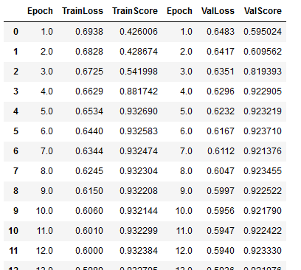
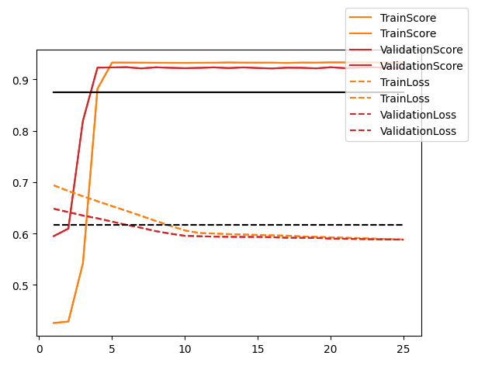
Results
Results: Screenshots of Training results and graphs over XD-Violence Dataset
Fig.1 Training results of the final training loop
Fig.1 Training graph of the final training loop
The training loop presented for XD Violence dataset is trained on 4 seen anomaly types.
The loop runs for 25 epochs with a best score of 92.25 (AUC-PR). It is a steep learning curve for first 5 epochs, after which it follows a gradual and linear curve. The

Slide 7
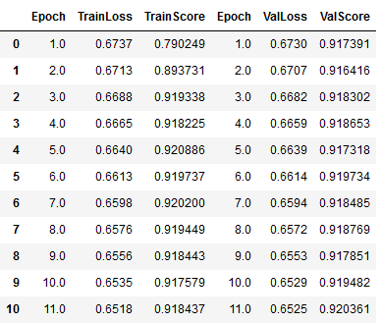
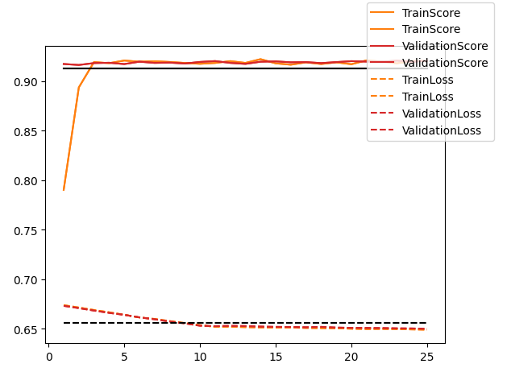
Results
Results: Screenshots of Training results and graphs over UCF-Crimes Dataset
Fig.1 Training results of the final training loop
Fig.1 Training graph of the final training loop
The training loop presented for UCF Crimes dataset is trained on 10 seen anomaly types. “We have left out Abuse, Fighting and Shooting values in training.
The loop runs for 25 epochs with a best score of 92.04 (AUC-PR). It is a steep learning curve for first 5 epochs, after which it follows a gradual and linear curve.

Slide 8
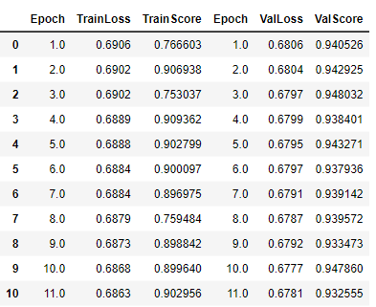
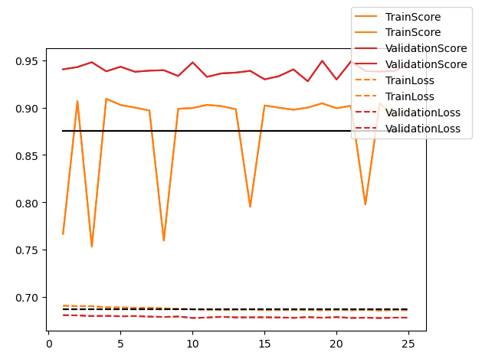
Results
Results: Screenshots of Training results and graphs over ShanghaiTech Dataset
Fig.1 Training results of the final training loop
Fig.1 Training graph of the final training loop
The training loop presented for Shanghai Tech dataset is trained on 25 seen anomaly videos.
The loop runs for 25 epochs with a best score of 89.68 (AUC-PR).
The model performance seems to fluctuate and we understand that there is noisy data in the dataset. The annotation of the files happen to be on the basis of first 63 videos in the training set as anomaly.
Secondly, the dataset is also highly imbalanced with more of normal features.

Slide 9
Literature Survey Comparison with other works with results
Figure 1: Comparison table with other works (XD Violence)
Figure 2: Comparison table with other works (UCF Crimes)
OCSVM (unsupervised) [3] | 27.25
Conv-AE (unsupervised) [4] | 30.77
WU et. al. (online) [5] | 67.77
Wu et. al. (offline) | 64.29
RFTM [6] | 63.65
OpenVAD (IAF-VAE) [2] | 69.61
OpenVAD (MAF-VAE) | 92.24
GODS (unsupervised) [7] | 70.46
Conv-AE (unsupervised) [4] | 50.60
WU et. al. (online) [5] | 79.11
Wu et. al. (offline) [5] | 79.96
RFTM [6] | 79.55
OpenVAD (IAF-VAE) [2] | 80.14
OpenVAD (MAF-VAE) (3 unseen) | 92.04

Slide 10
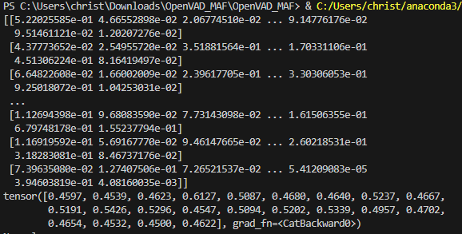
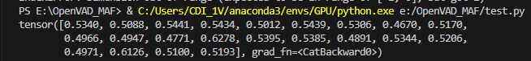
Testing with other downloaded video
Data pipeline –
Video file
I3D Feature Extractor (every 64th frame)
OpenVAD Architecture
GCN>EDL
Scores per feature instance
Video Level labels
Check for top 3 instance values
Threshold value – 0.62
<0.62 = Normal
>0.62 = Anomaly

Slide 11
Reference Links
[1] G. Papamakarios, T. Pavlakou, and I. Murray, “Masked Autoregressive Flow for Density Estimation,” arXiv.org, Jun. 14, 2018. https://arxiv.org/abs/1705.07057 (accessed Oct. 24, 2023).
[2] Y. Zhu, W. Bao, and Q. Yu, “Towards Open Set Video Anomaly Detection,” arXiv.org, Aug. 23, 2022. https://arxiv.org/abs/2208.11113 (accessed Oct. 24, 2023).
[3] Smeureanu, S., Ionescu, R.T., Popescu, M., Alexe, B.: Deep appearance features for abnormal behavior detection in video. In: International Conference on Image Analysis and Processing. pp. 779–789. Springer (2017)
[4] Hasan, M., Choi, J., Neumann, J., Roy-Chowdhury, A.K., Davis, L.S.: Learning temporal regularity in video sequences. In: Proceedings of the IEEE conference on computer vision and pattern recognition. pp. 733–742 (2016)
[5] Wu, P., Liu, J., Shi, Y., Sun, Y., Shao, F., Wu, Z., Yang, Z.: Not only look, but also listen: Learning multimodal violence detection under weak supervision. In: European Conference on Computer Vision. pp. 322–339. Springer (2020)
[6] Tian, Y., Pang, G., Chen, Y., Singh, R., Verjans, J.W., Carneiro, G.: Weakly supervised video anomaly detection with robust temporal feature magnitude learning. In: Proceedings of the IEEE/CVF international conference on computer vision (2021)
[7] Wang, J., Cherian, A.: Gods: Generalized one-class discriminative subspaces for anomaly detection. In: Proc. of ICCV. pp. 8201–8211 (2019)
[8] K. Sachdeva, “MADE- Masked Autoencoder for Distribution Estimation,” Feb. 18, 2021. https://towardsdatascience.com/made-masked-autoencoder-for-distribution-estimation-fc95aaca8467
Source code for MAF-model –
https://github.com/e-hulten/maf

