Slide 1
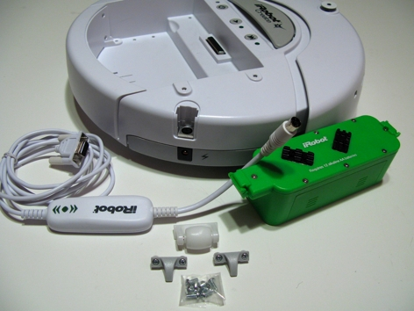
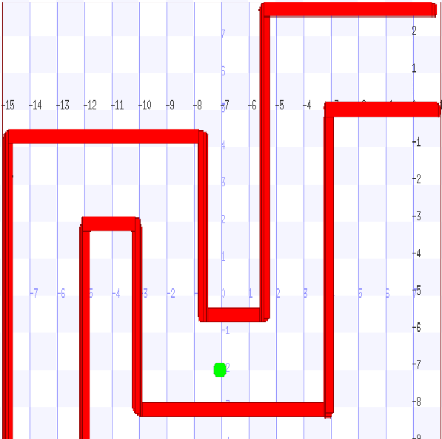
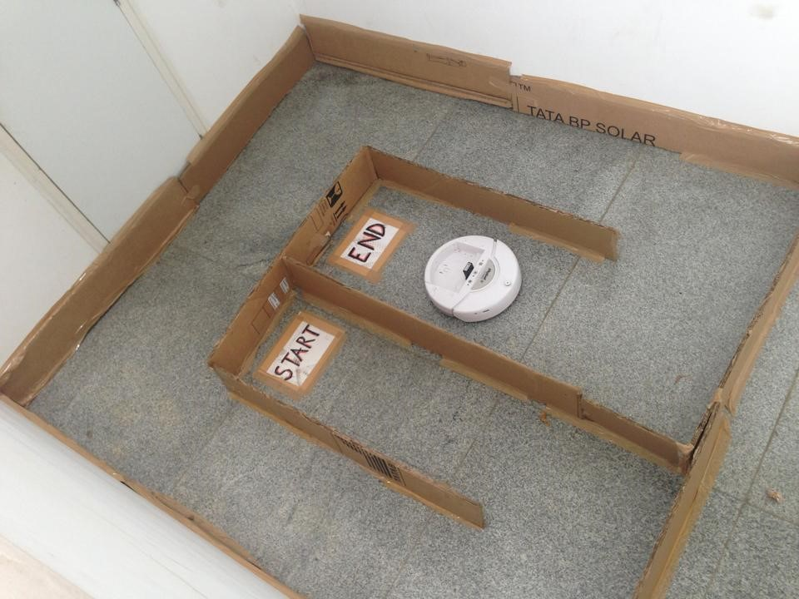
ROBOMAZE
B.Laasya , S.Sharanya , Simran Dokania , Sneha A , Soma Ravali , Trisha Mittal
International Institute of Information Technology, Bangalore
Introduction
The main objective of the project is to program an iRobot Create to find its way out of the maze using a set of inbuilt sensors.
To program the same on simulation and testing for a set of mazes of increasing complexity as required.
Results
Conclusions and future work
Working on the project was a highly enriching and a great learning experience.
The iRobot Create is a preliminary programmable robot with a limited set of in-built sensors. For instance, absence of cliff sensors and infrared sensors proved to be a barrier in the project.
Though the robot works perfectly in simulation , it fails to take into account the real world factors and hence sometimes fails to work appropriately.
Despite the setbacks in the project, the aim was achieved partly. Future work will involve fulfilling the aim and exploring other programmable robots (like Arduino) which are more suitable and equipped with required sensors.
// Create and subscribe to a bumper device.
bumper=playerc_bumper_create(client,0);
(playerc_bumper_subscribe(bumper, PLAYER_OPEN_MODE))
{
printf("Subscribing to bumper failed\n");
}
Materials & methods
For simulation PlayerStage-3.0.2 was used to program the robot. The robot detected the walls using laser sensors and avoiding them the robot came out of the maze.
For the real robot, a maze was constructed using cardboards. The robot used bump sensors to detect walls.
References
Writing Player/Stage Drivers -
Bue Petersen, Jonas Fonesca
How to Use Player/Stage -
Jennifer Owen
Acknowledgments
We take this opportunity to thank our Director Prof. Sadagopan for exposing us to the iMTech curriculum which involves such innovative projects. We express our gratitude to Prof. Madhav Rao who introduced us to this emerging field of Robotics at such an early stage. We would like to thank our classmates, debates and discussions with whom proved challenging yet helpful making this journey of the project so memorable.
Notes:
Copyright Colin Purrington (http://colinpurrington.com/tips/academic/posterdesign).
<number>

