Slide 1
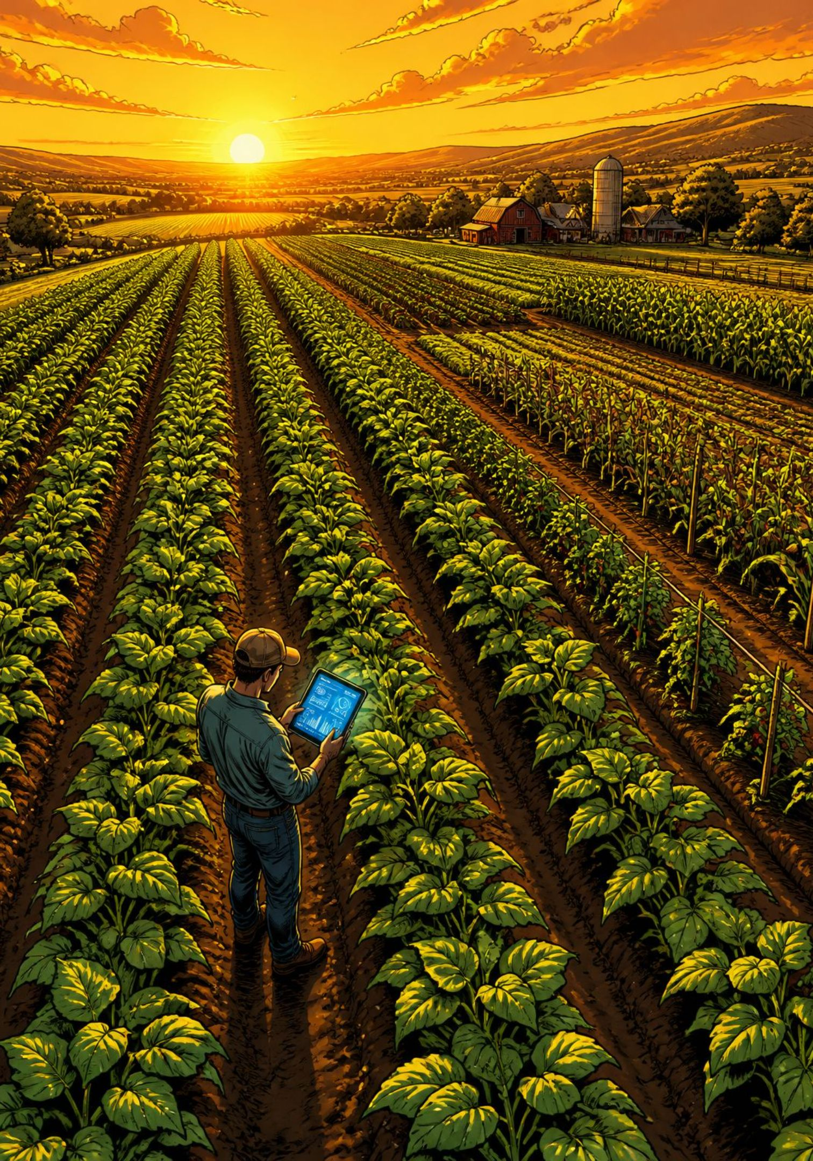
Smart Farm Management Platform
A full-cycle agritech solution — from farmer onboarding to harvest profit analysis — powered by AI-driven insights and structured seasonal record-keeping.
AGRITECH PLATFORM
AI-POWERED

Slide 2
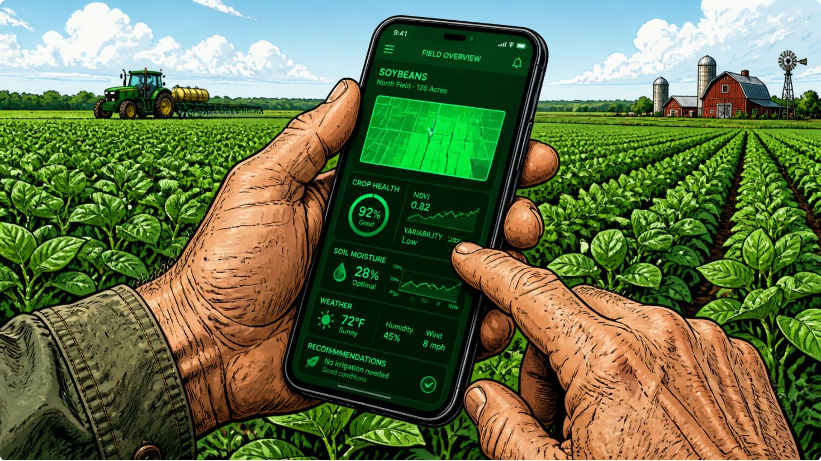

Onboarding: Registration & Login
Secure, role-based access for every user type on the platform.
Farmer Registration
Phone or email-based sign-up with OTP verification. Profile creation includes name, location, and contact details.
Admin Portal
Separate admin login for platform oversight — manage users, verify farm data, and monitor system health.
Session Security
Token-based authentication with auto-expiry and password recovery flows built in from day one.

Slide 3
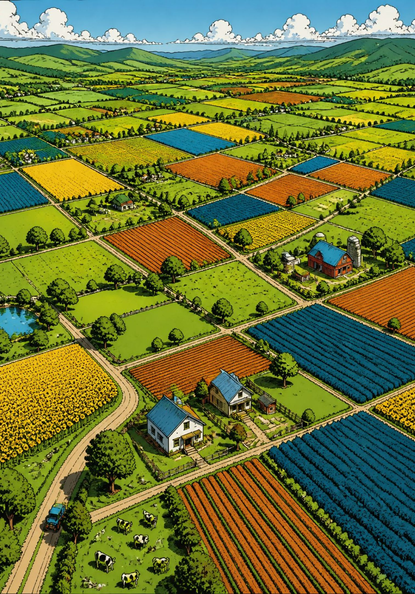
Farmer Profile & Farm Details
Every farmer gets a structured digital identity. Multiple farm lands are stored as separate records — each with its own location, size, and history.
🧑‍🌾 Farmer Profile
📍 Farm Land Records
Personal info, contact, location, and farming experience
GPS coordinates, area (acres), soil type, and land history
🗂️ Multi-Farm Support
One farmer can own and manage multiple distinct farm parcels

Slide 4

Farming Seasons & Soil Data
Season-Wise Records
Soil Report Entry
Each growing season is created as a distinct record — keeping all activities, inputs, and outcomes isolated and traceable year over year.
Soil data fuels the AI crop recommendation engine. Farmers or agronomists input lab results directly into the platform.
Define season name, start & end dates
Link season to specific farm land
Carry forward historical data for trend analysis
N, P, K Levels
Temperature
Humidity
pH & Texture

Slide 5
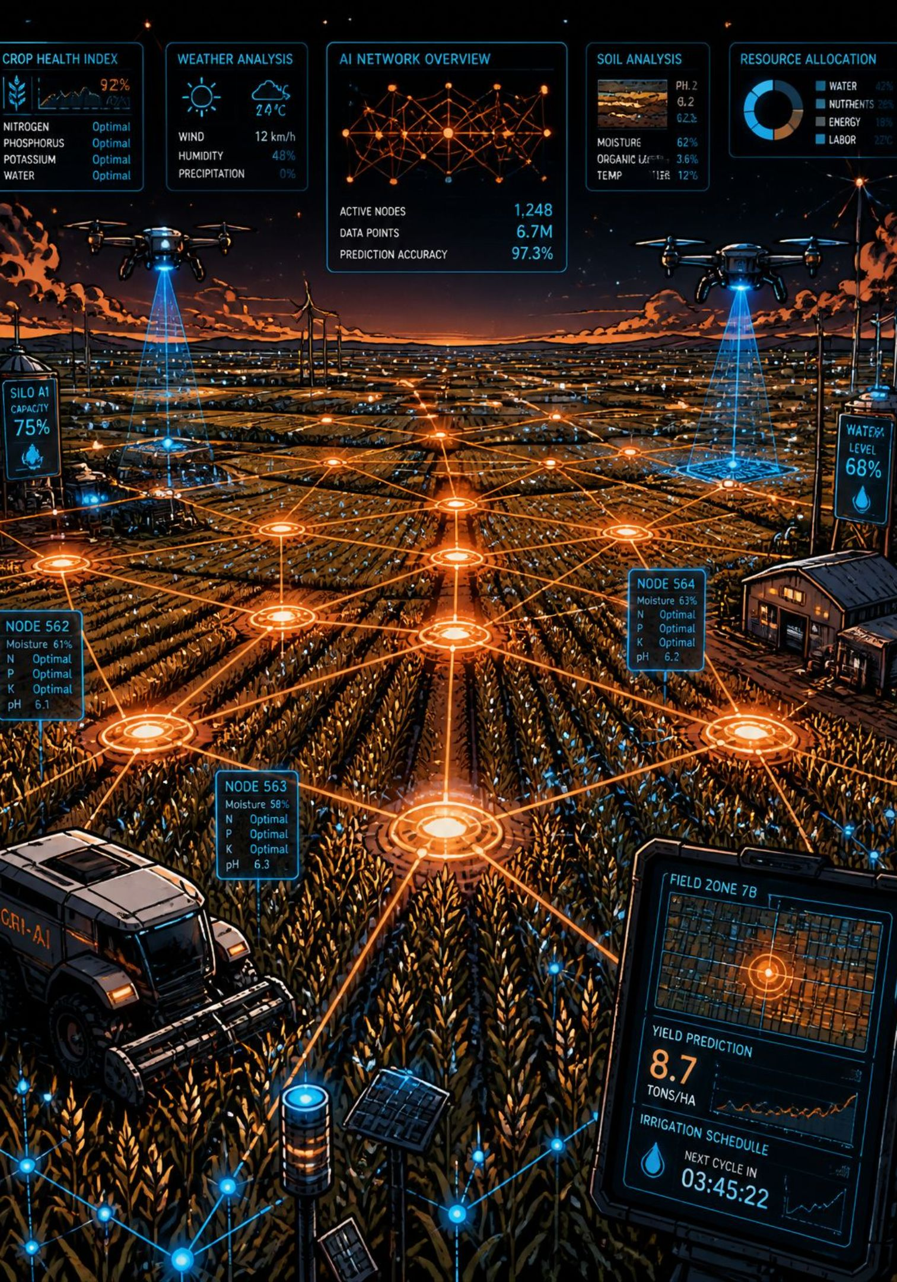
AI Crop Recommendation Engine
The platform recommends the best crop for each farm based on soil data, climate, and historical yield — using a two-tier ML strategy.
Step 1 — Train on Dataset
Step 2 — Fine-Tune Pretrained Model
Use labeled regional crop-soil-yield datasets to train a custom recommendation model.
If data is insufficient, fine-tune an existing pretrained agricultural AI model for the local context.
Step 3 — Deliver Recommendations
Output ranked crop suggestions with confidence scores and expected yield ranges.

Slide 6
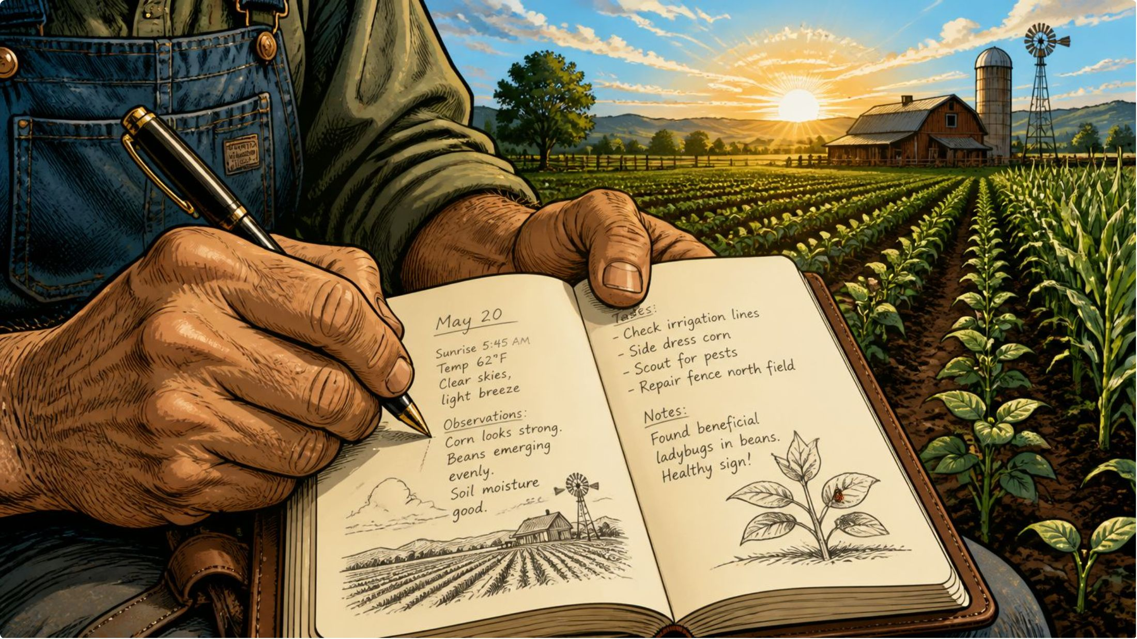
Farm Activity Diary
A chronological log of every action taken on the farm — creating a complete, auditable cultivation history for each season.
01
02
Land Preparation
Sowing & Seeding
Tilling, leveling, bed formation
Seed variety, spacing, date
03
04
Irrigation Events
Inputs Applied
Method, duration, water source
Fertilizer, pesticide, herbicide — type & quantity

Slide 7




Expense Tracking
Every rupee spent on cultivation is captured and categorized — enabling accurate cost-of-production calculations and profit analysis at season close.
Seed & Input Costs
Irrigation & Labor
Seeds, fertilizers, pesticides, and soil amendments tracked per farm and season.
Water usage costs, pump electricity, and daily wage labor entries.
Equipment & Operations
Season Summary
Machine rental, fuel, transport, and miscellaneous operational expenses.
Auto-aggregated total investment per season for instant cost visibility.

Slide 8

Weather Advisory & Yield Prediction
🌦️ Weather Advisory
🌾 Yield Prediction
Live weather data via API helps farmers make smarter daily decisions.
Before harvest, the platform estimates expected crop output using soil data, weather history, and activity logs.
Smart Tip: If rain is forecasted tomorrow, the system advises skipping irrigation — saving water and cost.
Rainfall forecast & alerts
Temperature & humidity trends
Irrigation scheduling suggestions
Input Factors
Output
Soil health, rainfall, crop type, farm history
Estimated yield in kg/acre with confidence range

Slide 9
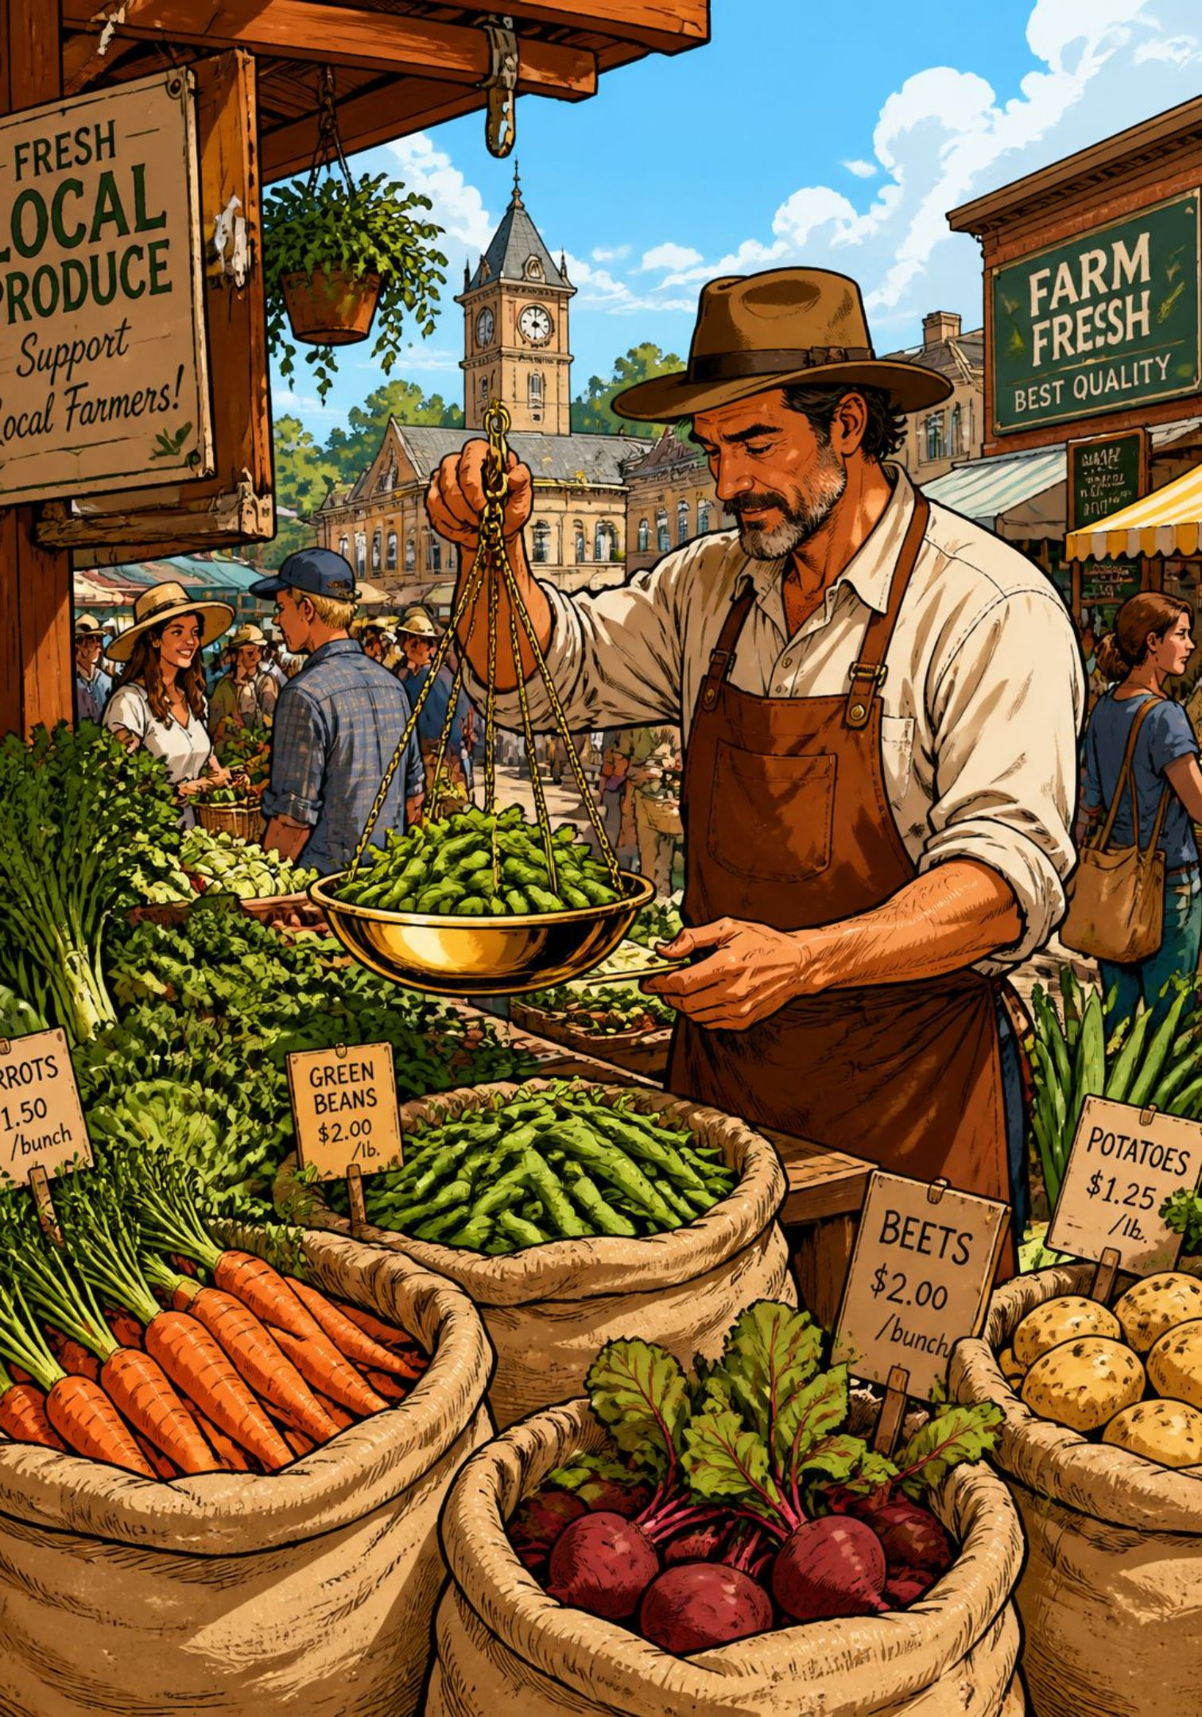
Harvest Details & Profit Analysis
When the season ends, the platform turns raw data into financial clarity — from harvest logging to final profit calculation.
📦 Harvest Logging
💰 Price & Sales
Record total yield quantity, harvest date, and crop grade per farm land.
Set selling price per unit, track buyer info, and log total revenue earned.
📊 Profit Analysis
Auto-calculated profit = Revenue − Total Expenses. Viewable per season, per farm, or aggregated.

Slide 10
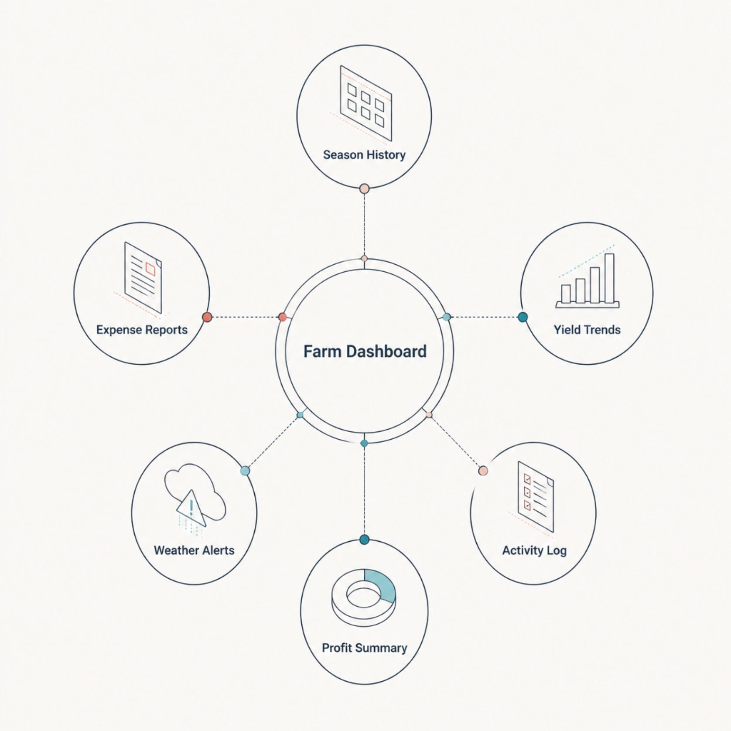

Dashboard & Season History
Your Farm, At a Glance
The dashboard is the command center — surfacing the most critical insights across all farms and seasons in one view.
Season History: Multi-year records for trend analysis and decision support
Quick Reports: Exportable summaries of expenses, yield, and profit per season
Alerts Panel: Weather warnings, upcoming tasks, and data gaps flagged proactively
Performance Trends: Visual charts comparing yield and profit across seasons
Every season's data compounds — the longer a farmer uses the platform, the smarter and more valuable it becomes.

