Slide 1
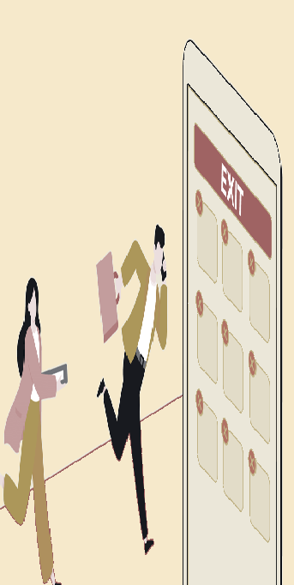


Slide 2

CUSTOMER CHURN is the percentage of customers that stop using a company's product or service during a certain time frame
Discovery Workshops and Business Questions Identify opportunities for analytics
Data Sources
Exploratory Data Analysis (EDA)
Model Development and Validation

Slide 3
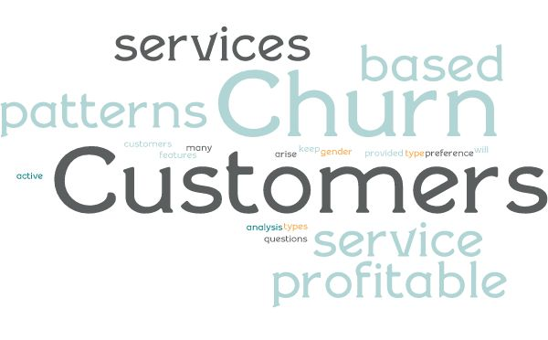


What's the % of Churn Customers and customers that keep in with the active services?
Is there any patterns in Churn Customers bed on the gender?
Is there any patterns/preference in Churn Customers bed on the type of service provided?
What's the most profitable service types?
Which features and services are most profitable?

Slide 4

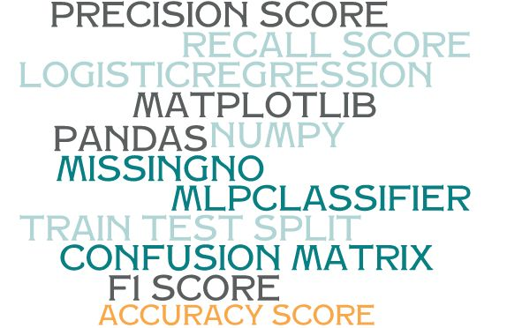
Pandas
Numpy
Matplotlib
Standardscaler,labelencoder
Randomforestclassifier
Mlpclassifier
Logisticregression
Train_test_split
Accuracy_score
Classification_report

Slide 5

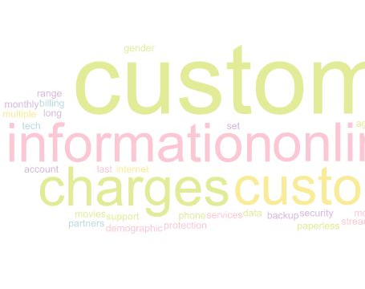
The data set includes information about
Customers who left within the last month
Services that each customer has signed up for – phone, multiple lines, internet, online security, online backup, device protection, tech support, and streaming TV and movies
Customer account information - how long they’ve been a customer, contract, payment method, paperless billing, monthly charges, and total charges
Demographic info about customers – gender, age range, and if they have partners and dependents

Slide 6
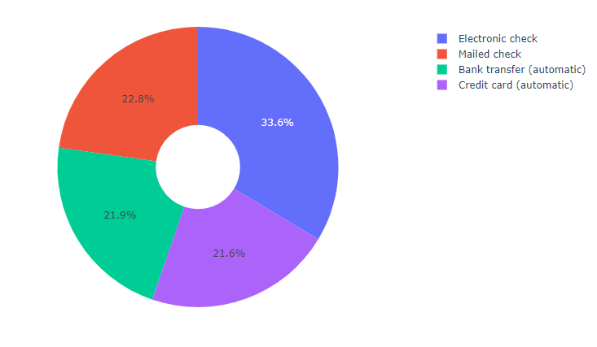
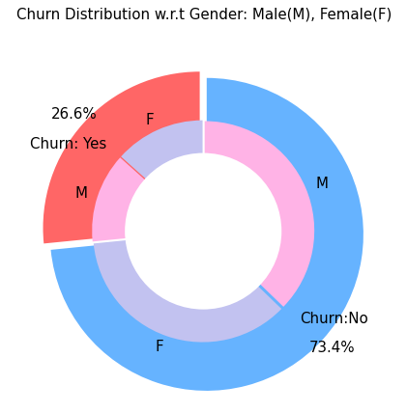

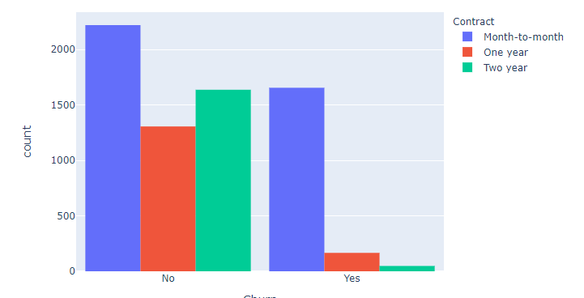
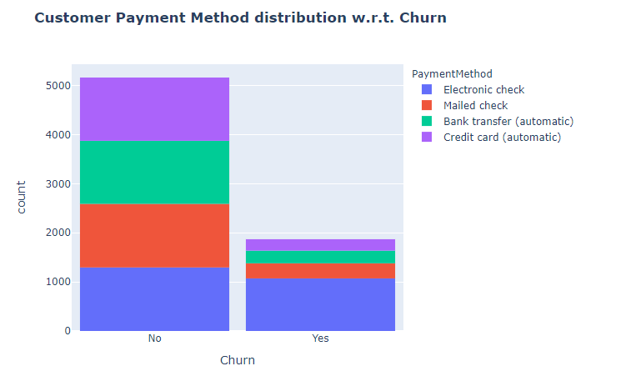

Slide 7
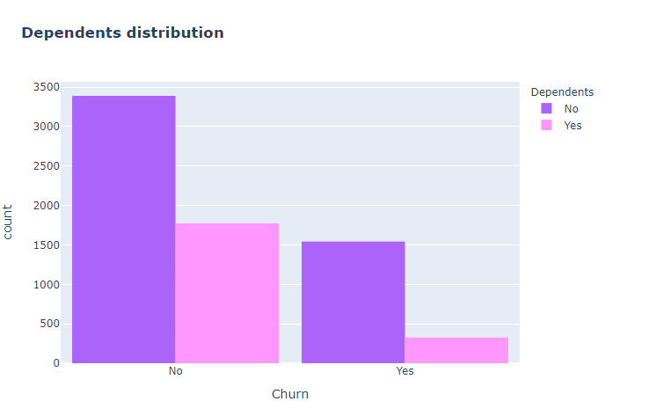
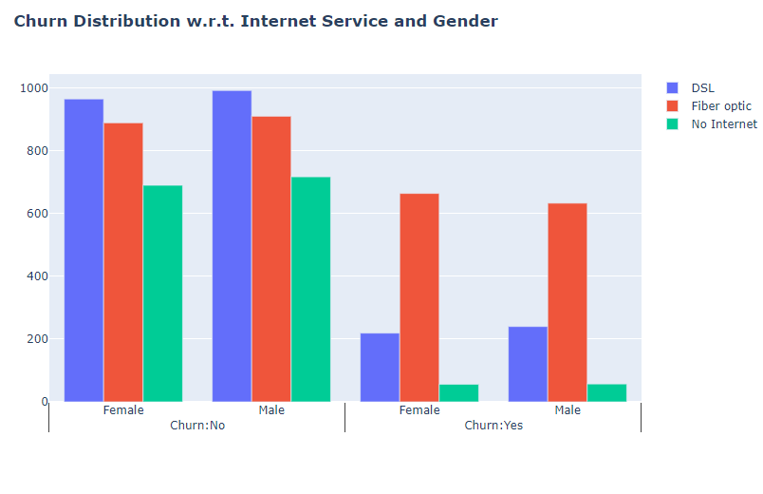
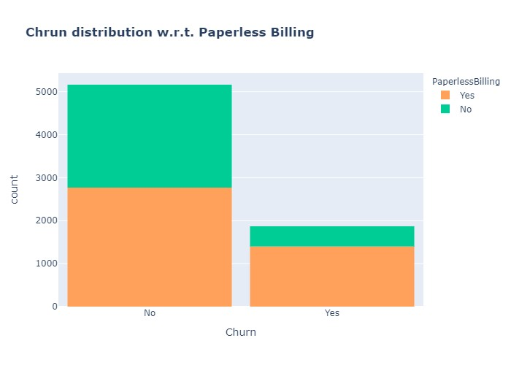
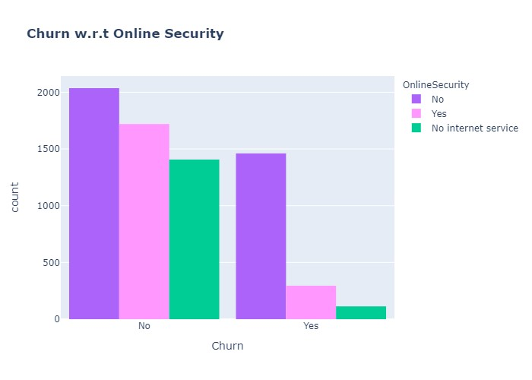

Slide 8
