Slide 1


Sales Performance Analysis & Strategic Insights
-Trishala Shivashankara

Slide 2


Executive Summary
Total dataset covers 10 outlet types, 16 item categories, and spans outlets established from 1985 to 2009.
Snack Foods lead the revenue chart, contributing 19.7% of total MRP sales.
Low Fat items outperform Regular, accounting for 58% of sales.
Supermarket Type3 sells at the highest average MRP: ₹143.8.
Business trend shows consistent MRP growth with outlet expansion.

Slide 3
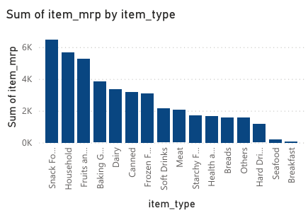

Slide 4
Top Performing Product Categories
Snack Foods and Frozen Foods together contribute over 35% of total MRP — clear consumer favorites.
Top 5 expensive items include FDA15, DRE49, FDX07 — positioned as premium SKUs.
Products in the Health & Hygiene category have high average MRP: ₹135+, though lower volume.

Slide 5

Customer Preferences & Behavior
Low Fat products consistently show higher average visibility across all outlets — brands likely prioritize them.
Visibility-MRP analysis shows no strong correlation, suggesting niche items may be priced high despite low shelf presence.
Item type mix in Tier 1 cities leans heavily on Household, Frozen Foods, and Dairy, indicating an urban health-conscious demand.

Slide 6
Outlet Network Insights
Most outlets were established in 1985 — accounting for 27% of total store count.
Tier 3 locations dominate with 40%+ of outlets — mostly small to medium-sized.
Supermarket Type3 consistently shows highest average item price — potential for premium sales model replication.

Slide 7

Trends & Time-Based Analysis
Sales (MRP) trend rises steadily with newer outlets — 2009 outlets show ~20% higher MRP total than 1985 ones.
Product diversity (item_type count) increases in later years, indicating expansion in inventory variety.
Most sold item type by volume: Snack Foods, followed by Fruits and Dairy.

Slide 8

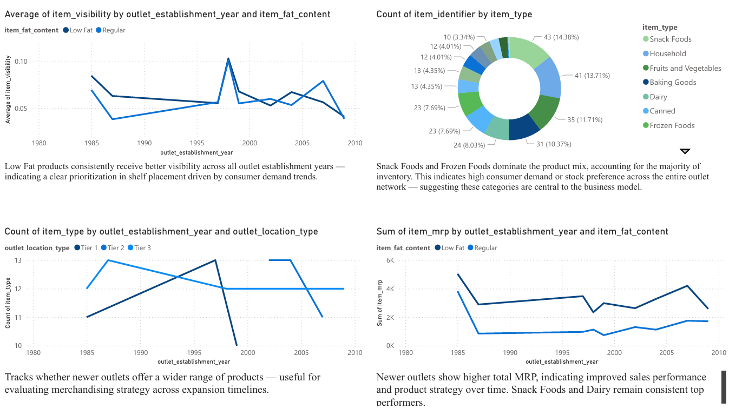

Slide 9
Key Takeaways & Recommendations
Double down on Snack Foods and Frozen Foods with targeted promotions and prime shelf space.
Expand Low Fat product lines — capitalize on strong visibility and health trend.
Modernize or re-evaluate older outlets (pre-1990), as they lag in revenue contribution.
Replicate Supermarket Type3’s premium pricing strategy in high-income urban locations.
Expand into Tier 1 cities where outlet presence is low but item MRP is highest — maximize margins.

Slide 10
Thank you

