Slide 1
Research project on Big data and NoSQL system(Apache Spark)
Trishala Patne

Slide 2
Emergence of Big data and NoSQL
Different types of data (Key value pairs, graph)
Volume, variety and velocity of data
Need of analysis to gain insight of business
Offers feature like CAP, low latency, cost effective etc.
E.g Hadoop, Apache spark, MangoDB

Slide 3
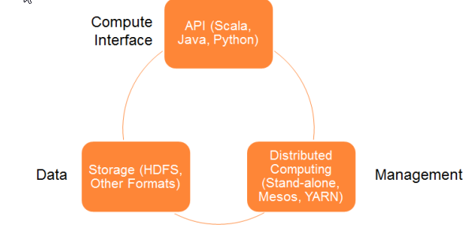
Apache Spark-Architecture

Slide 4
Netflix- Need for NoSQL systems
Huge number of customer base
Improve customer engagement
To make critical business decisions about upcoming shows and movies
To present user personalized recommendations
Need for analyzing variety of unstructured data to improve user experience on Netflix website

Slide 5
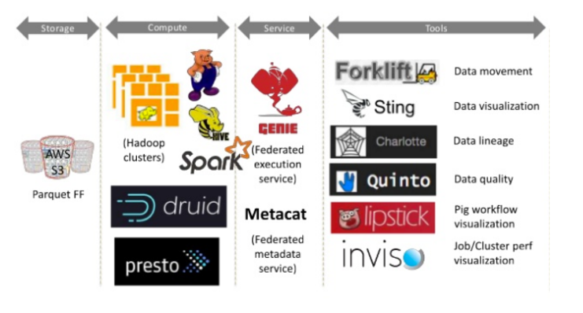
NoSQL and Big data technologies used by Netflix

Slide 6
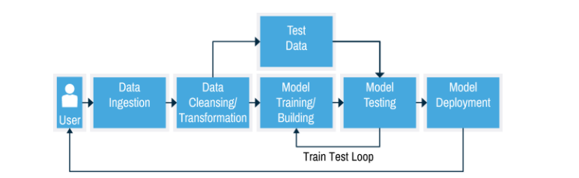
Movie Recommendation Algorithm

Slide 7
Movie Recommendation Algorithm - Components
System: Apache Spark 2.0
Language: Python
Collaborative filtering
Alternating least square method
Predictions

Slide 8
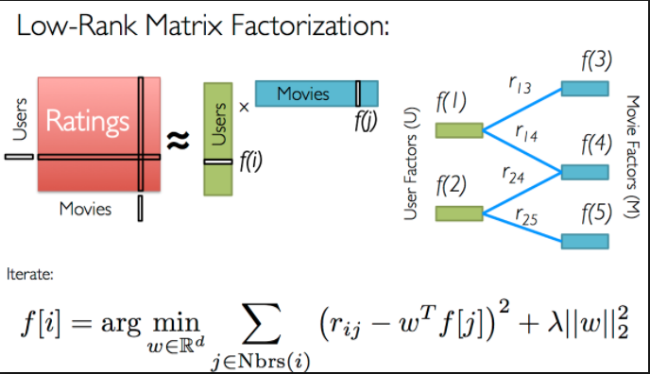
Alternating Least Square Method

Slide 9


Slide 10
References
Spark: Cluster Computing with working Sets, Matei Zaharia, Mosharaf Chowdhury, Michael J. Franklin, Scott Shenker, Ion Stoica, University of California, Berkeley
https://github.com/SparkTC/spark-ref-architecture/blob/master/data-pipelines/README.md
https://mapr.com/ebooks/spark/03-apache-spark-architecture-overview.html
https://www.infoq.com/articles/apache-spark-introduction
https://blog.kissmetrics.com/how-netflix-uses-analytics/
https://databricks-training.s3.amazonaws.com/movie-recommendation-with-mllib.html

