Slide 1
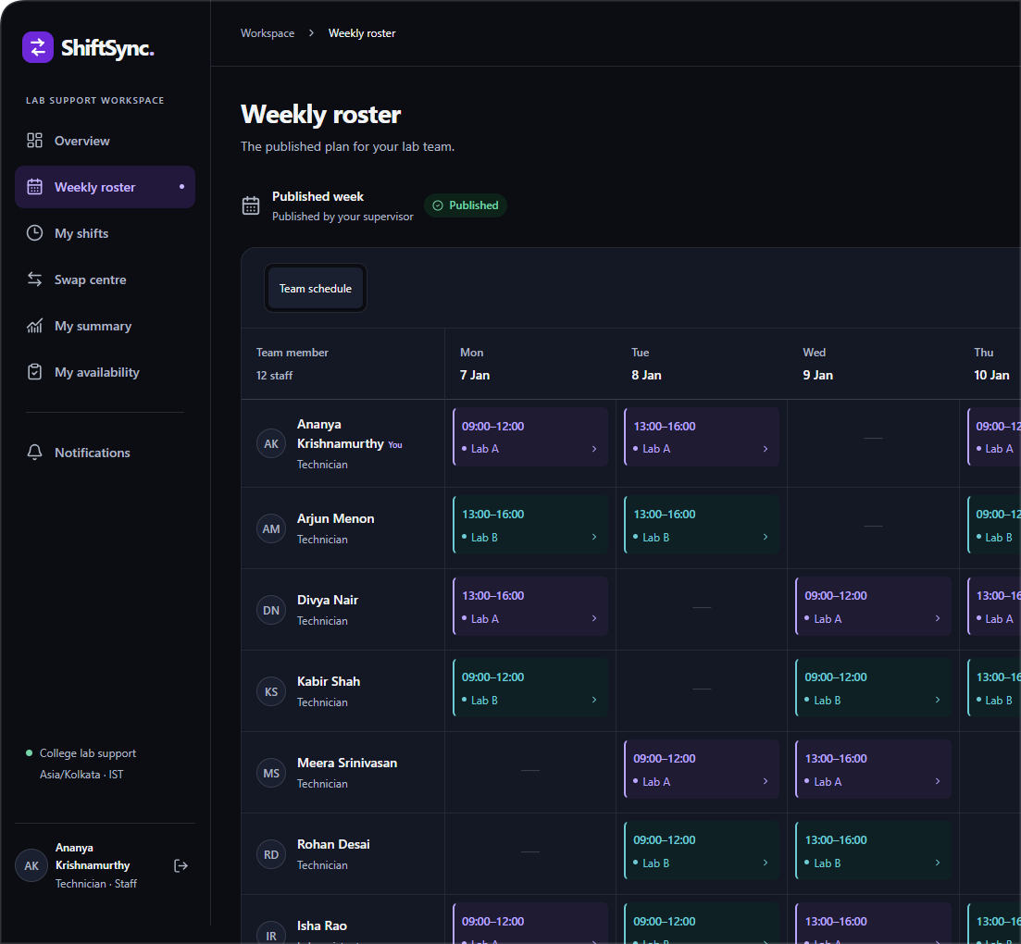

ShiftSync
A clearer week. A covered lab.
Duty roster management with coverage validation and approved shift exchanges
College web programming project
PHP · React · Vite · Bootstrap · JSON file storage
Notes:
Time: 30 seconds. ShiftSync is a duty roster system for a college computer-lab support team. Staff say when they can work, a supervisor builds a fully covered week, and shift exchanges only take effect after both people and both labs have been checked. All people shown in this deck are fictional. Screens come from an isolated test store, which is why they show January 2030 dates.

Slide 2



Lab rosters break in ways a glance can't catch
THE PROBLEM
Silence is read as yes
Full headcount, no technician
A private swap breaks coverage
Someone never answers, gets scheduled anyway, and the lab finds out on the day.
Two assistants fill the slot. The count looks right, but nobody qualified is on duty.
Two colleagues agree to trade. Nobody checks what that does to either lab.
SHIFTSYNC'S RULE
SHIFTSYNC'S RULE
SHIFTSYNC'S RULE
Only an explicit “available” counts.
People and technicians are checked separately.
Both directions are rechecked at approval.
Notes:
Time: 1 minute. Each of these failures looks fine on a simple roster sheet, which is why they get caught late. Each card pairs a failure with the rule ShiftSync enforces on the server. The rest of the deck shows those rules in the product.

Slide 3
Every week is 20 slots, and each must pass
THE RULE
20
Mon
Tue
Wed
Thu
Fri
Lab A
Morning
09–12
09–12
09–12
09–12
09–12
duty slots every week
Lab A
Afternoon
13–16
13–16
13–16
13–16
13–16
2
Lab B
Morning
09–12
09–12
09–12
09–12
09–12
people per slot by default
Lab B
Afternoon
13–16
13–16
13–16
13–16
13–16
1
Drafts may have gaps. Publishing needs all 20 complete, and all in the future.
Times in Asia/Kolkata. A technician counts once as a person and once toward the technician minimum.
technician per slot by default
Notes:
Time: 1 minute. Two labs, five days and two blocks a day give exactly 20 stable slots per week. The default requirement is two people including one technician. Two assistants would meet the headcount but fail the technician minimum. Technician is a qualification, not a permission role, and the supervisor is never assigned a duty.

Slide 4
From availability to an approved exchange
THE WORKFLOW
PLAN THE WEEK
EXCHANGE A DUTY
Staff
1
Submit availability
5
Request exchange
6
Colleague accepts
Supervisor
2
Build draft roster
4
Publish roster
7
Review and approve
PHP server
3
Check coverage
8
Swap, notify, audit
Steps 5 and 6 change nothing on the roster. Only step 8 does, in one saved transaction.
Notes:
Time: 90 seconds. Read left to right. Planning is steps 1 to 4: staff give availability, the supervisor drafts, the server checks coverage, and only then can the supervisor publish. Exchanges are steps 5 to 8: a staff member asks, the colleague accepts, the supervisor reviews, and PHP swaps the two owners while saving notifications and the audit entry together. Consent is not approval.

Slide 5
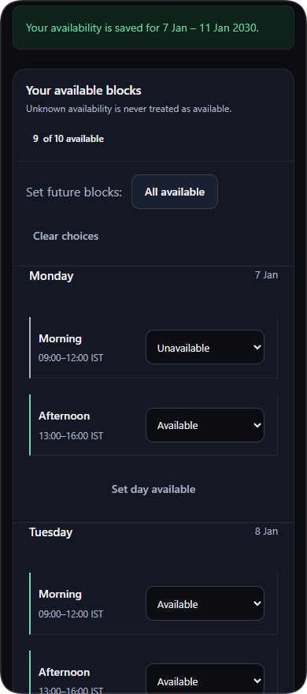
Unknown availability is never a yes
STEP 1: AVAILABILITY
The only state that can be assigned.
Available
Blocked. The person said no.
Unavailable
Also blocked. Silence isn't consent.
Not submitted
A real PHP form enhanced with vanilla JavaScript. It still saves with JavaScript off, and a stale tab gets HTTP 409 with its choices kept.
Notes:
Time: 1 minute. Availability is three states rather than a boolean because a missing answer is different from a yes. Only available qualifies for assignment. This page is deliberately server-rendered PHP with vanilla JavaScript: variables, loops, events and DOM updates from the syllabus. Past blocks cannot change, and a currently assigned cell stays protected.

Slide 6
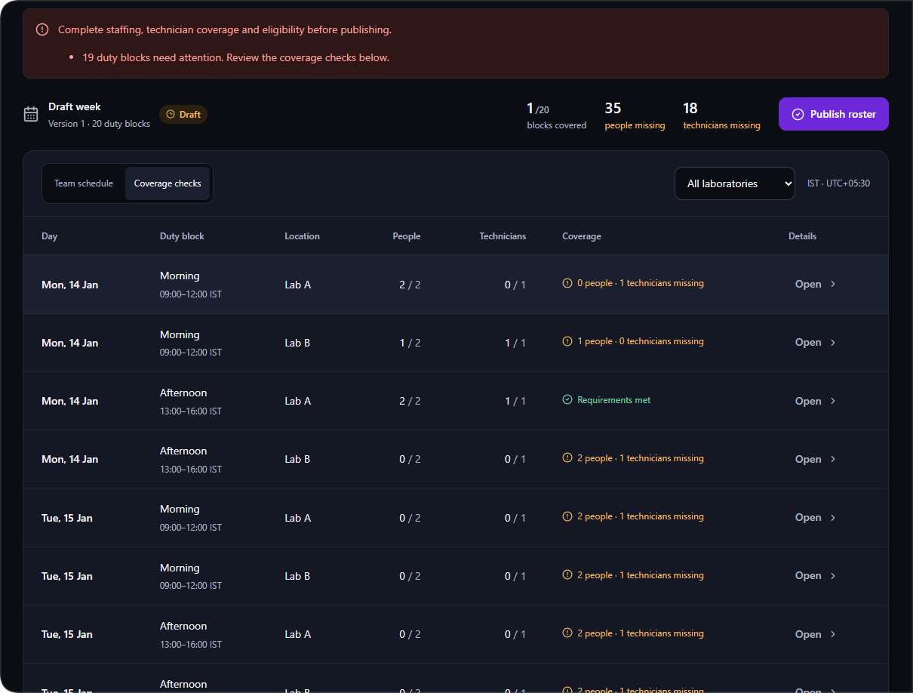



A roster can't publish with a gap
STEPS 2 TO 4: COVERAGE
Two separate counts
Missing people and missing technicians are reported apart.
Reasons on each slot
The supervisor sees exactly which slot fails, and why.
Checked on the server
Publish revalidates everything. Published weeks then can't be edited.
Notes:
Time: 1 minute. This draft is deliberately incomplete. Look at the header: 1 of 20 blocks covered, 35 people missing, 18 technicians missing. The first row has two people but no technician, so it fails. The second has a technician but only one person, so it also fails. In the live demo, prepare most of the draft in advance and leave these two gaps to fix.

Slide 7
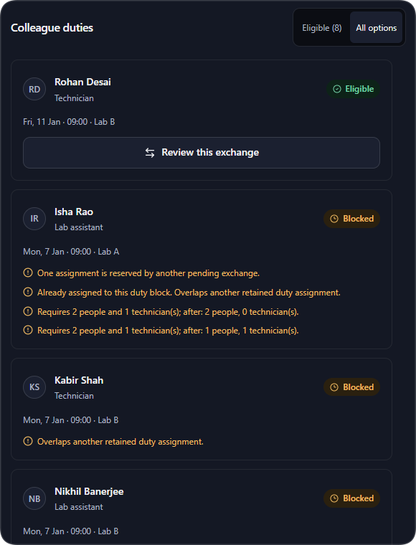



Blocked options explain exactly why
STEP 5: REQUEST AN EXCHANGE
No availability
Overlapping duty
The person marked the block unavailable, or never answered.
Checked across both labs and draft rosters. Adjacent blocks are fine.
Coverage would fail
Already reserved
The swap would leave a slot short of people or a technician.
An active request holds both of its duties until it ends.
Notes:
Time: 1 minute. Instead of hiding bad options, the screen shows them with the reason they fail, so staff don't have to guess. Overlap uses startA < endB and endA > startB, so a duty ending exactly when another begins is allowed. The list is a preview: the server decides again at every later step.

Slide 8
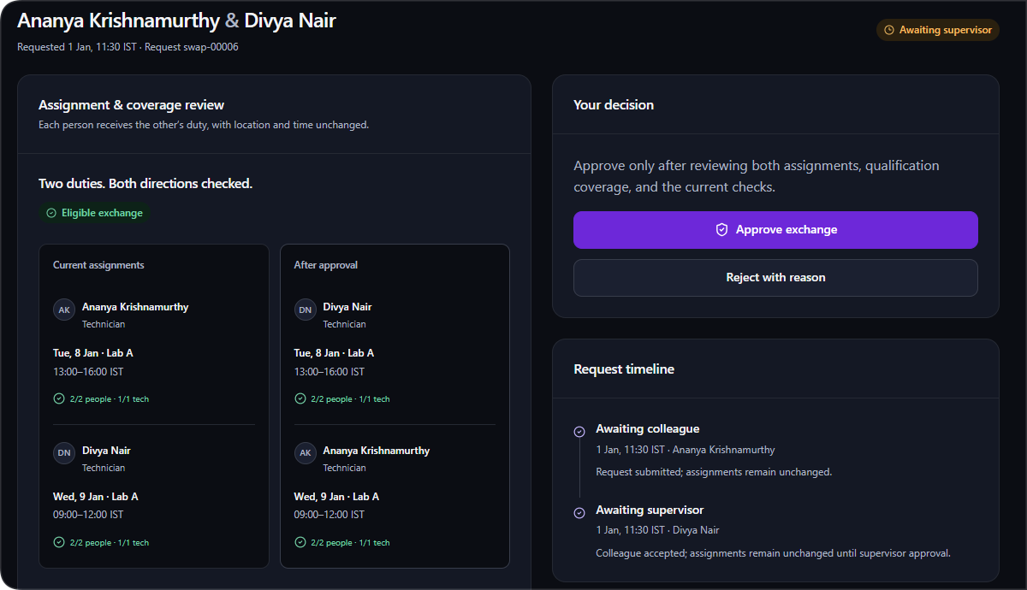
The supervisor sees both sides first
STEPS 6 AND 7: APPROVAL
Same published week
Two different staff members
Distinct, non-overlapping blocks
Both duties start in the future
Neither duty in another exchange
Owners and versions still match
Requester can cover the other duty
Colleague can cover the other duty
Coverage kept in the first slot
Coverage kept in the second slot
Ten checks shown. PHP repeats them when the decision commits, so an old green preview can't approve a change that has since become invalid.
Notes:
Time: 1 minute. On the left of the screenshot, current assignments; next to it, the result after approval. Times and locations stay fixed, only the owners change. Hours for equal blocks stay equal: 12 and 9 in this example, before and after. The preview is advisory. The real check runs inside the transaction when the supervisor approves.

Slide 9
Agreeing to a swap changes nothing yet
THE REQUEST LIFECYCLE
ROSTER OWNERS UNCHANGED
BOTH OWNERS EXCHANGE TOGETHER
Awaiting colleague
Awaiting supervisor
Approved
Five endings that leave the roster untouched
Declined
Rejected
Withdrawn
Expired
Invalidated
Colleague says no
Supervisor gives a reason
Requester cancels
The earlier duty begins
A later change makes it unsafe
Every ending stays in history. Assignment IDs, times and locations never change, and approval is all-or-nothing.
Notes:
Time: 1 minute. A key design decision: consent is not approval. Request and accept never touch the roster. Only final supervisor approval swaps the two staff IDs, increments versions, and writes the audit and notices in one transaction. Terminal records remain in history, so nothing is silently lost.

Slide 10
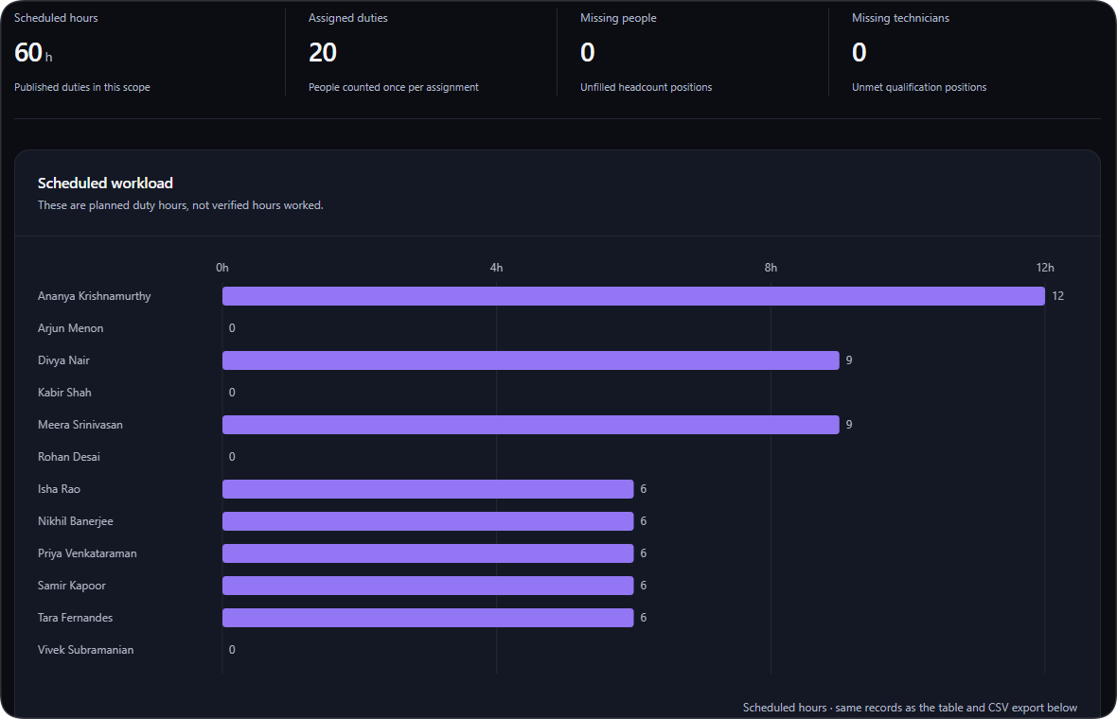


Reports show the plan, not attendance
REPORTS
One set of rows
The Canvas chart, HTML table and CSV all use the same report data.
Safe CSV export
PHP generates the file and neutralises formula-like text.
Swaps add no hours
An exchange changes owners, not total filled places.
Lab A, one test week: 60 scheduled hours, 20 assigned duties, nothing missing.
Notes:
Time: 45 seconds. The numbers check out: 10 Lab A slots times 2 people times 3 hours is 60 scheduled hours. The chart uses native Canvas, with an HTML table beside it for accessibility. The wording is careful: these are scheduled hours, not verified hours worked. This is not an attendance or payroll system.

Slide 11

PHP owns the rules, React owns the interface
ARCHITECTURE
Served to the web
Never served
Browser
public/
src/
storage/
Runs on each device
The only web root
PHP services
Private data
React workspace
HashRouter routes
Canvas chart
PHP availability page
app.php, login.php
api/index.php router
handlers/ for forms
build/ React assets
Auth and Csrf
Domain: every rule
Store: locks and saves
Time: IST to UTC
state.json snapshot
state.lock
sessions/
login-throttle.json
Build time only: Vite compiles frontend/src into public/build/. Node never runs in production, and one PHP origin serves everything.
Notes:
Time: 90 seconds. The browser never holds business truth. React is the interface for the protected workspace. PHP validates, authenticates and persists. One origin makes cookies and API calls simple. Everything under src and storage lives outside the web root, so even a misconfigured URL can't reach the data. No framework: there are no empty layers just to match a pattern.

Slide 12



Every write is locked, validated and atomic
DATA INTEGRITY
Lock
Exclusive, bounded wait
Load
Read the full JSON snapshot
Validate
Permission, version, rules
Apply
One Domain command
Replace
Temp file, flush, then swap in
What happens when things go wrong
A form goes stale
Approve is clicked twice
Two PHP workers collide
The save is refused with HTTP 409 and what you typed stays on screen.
The saved result comes back. Owners are not swapped back, and nothing is duplicated.
The second waits for the lock, then sees the committed record. Tested with separate processes.
Notes:
Time: 90 seconds. Without a database, the file store has to provide these guarantees itself. Reads take a shared lock on a stable sibling lock file; writes hold an exclusive lock across load, validate, mutate and save. If replacing the file fails, the old file survives. This is honest about its limits: it's a cooperative single-server design, not a distributed database.

Slide 13






Hiding a button isn't security, so PHP checks
SECURITY
Actor from the server
CSRF on every change
Sessions that expire
Role and qualification come from stored users. Submitted values grant nothing.
All mutations need a valid token. Ambiguous network failures aren't replayed.
New ID at login, HttpOnly, SameSite=Lax. 30-minute idle and 8-hour absolute limits.
Careful passwords
Private by location
Escaped output
bcrypt cost 12, a 12–72 byte policy, login throttling, and resets that end old sessions.
State and hashes sit outside public/. Staff never receive hashes or coworkers' emails.
JSX and PHP escape text. CSV export prefixes formula-like values.
Notes:
Time: 1 minute. The principle: the interface can hide a button, but only the server can enforce a rule. Domain::command re-resolves the actor from stored users, so a forged role in a request has no effect. Background polling carries a special header so it doesn't keep idle sessions alive. Demo passwords are generated per install and never committed.

Slide 14
Each syllabus topic is a working feature
SYLLABUS COVERAGE
Topic | Where it lives
HTML5 | Semantic PHP pages, labelled forms, captioned tables
CSS | Design tokens, external stylesheets, print rules
Responsive | Roster grid becomes an agenda list on phones
JavaScript | Availability form: events, validation, DOM updates
Canvas | Workload chart with an equivalent HTML table
PHP | Domain and Time services, sessions, POST handlers
Topic | Where it lives
Files | JSON store with flock, temp file, atomic replace
Bootstrap | Local grid, forms, tables, Collapse help panel
JSX, props | AppLayout, RosterGrid, DutyBlock, DataTable
State, hooks | useApi with abort and request sequencing
Lifecycle | NextShiftCountdown class with timer cleanup
Router, build | HashRouter routes, Vite build with a manifest
Notes:
Time: 1 minute. This is the mapping from docs/SYLLABUS_MAPPING.md. These aren't separate exercises; each topic is doing real work in the app. Good examples to open if asked: updateAvailability in availability.js, CanvasWorkloadChart in Reports.jsx, Store.php for file handling, and NextShiftCountdown in UI.jsx for class lifecycle methods.

Slide 15
86 test groups passed, with 0 failures
TESTING
86
groups passed across 7 suites
Last run: 3 November 2026
37
PHP files passed syntax checks
Not tested: a real Apache setup (simulated with a PHP alias router), manual testing on physical devices, and sign-in over the public tunnel. No ESLint config exists, so no lint pass is claimed.
Notes:
Time: 1 minute. All seven suites were re-run on 3 November 2026 with these results. Tests use temporary stores and a fixed test clock, so they never touch the demo data. The browser suites drove real Chrome through Playwright, with separate sessions for staff and supervisor. Saying what wasn't tested is deliberate: it's more credible than claiming everything is covered.

Slide 16


A focused scope, with a clear path forward
SCOPE
Left out on purpose
Where it could go next
Payroll and verified hours worked
Biometric attendance and GPS tracking
Automatic or AI roster generation
Overnight shifts
Multiple institutions
Distributed, multi-server writes
One-way handovers
Open-shift pickup
MySQL storage, keeping validation on the server
A permanent HTTPS deployment
Stated openly: this is a single-server academic scheduler with cooperative file locks, not a distributed database.
Notes:
Time: 45 seconds. The exclusions come from the original brief and keep the project honest about what it is: a single-server academic scheduler. A future database would improve scale without moving business validation into the browser.

Slide 17


A clearer week. A covered lab.
Coverage is enforced
Exchanges are safe
The server decides
A week can't publish until all 20 slots have the right people.
Both people and both labs are checked before anything changes.
Rules, permissions and data all live in PHP, behind one lock.
NEXT: LIVE DEMO
Availability
Coverage
Candidates
Colleague accepts
Approval
Reports
Thank you. Questions are welcome after the demo.
Notes:
Time: 30 seconds, then the demo takes 5 to 7 minutes. Follow docs/DEMO_SCRIPT.md, with separate browser sessions for staff, colleague and supervisor. Never project storage/demo-credentials.txt. Before presenting, seed a future week, because the current demo week has already started: back up first, then run scripts/seed-demo.php --reset. Likely viva questions and answers are in docs/VIVA_GUIDE.md.

