Slide 1
Smoke Ledger
You cannot see
what it cost.
Just after a cigarette, or late at night.
An adult, in India. The day is India time.
Without that record, the only thing they have is guilt.
How many sticks, and what they cost in rupees.
Notes:
I want to start with one person.
They are an adult. They live in India. They smoke. The moment is small and private: just after a cigarette, or late at night, when the room is quiet. They can feel the guilt. What they cannot produce is the record. How many sticks this week. What those sticks cost, in rupees.
Without that record, the only thing they have is guilt.
The account does not open for someone under eighteen. The day on the ledger is India time. The money is rupees.
That is the stake I am bringing into this room. One adult, and two facts they already care about, with nowhere those facts are written down in a way they trust.
If you stop me on this slide, the line is this: they cannot see what it cost.

Slide 2
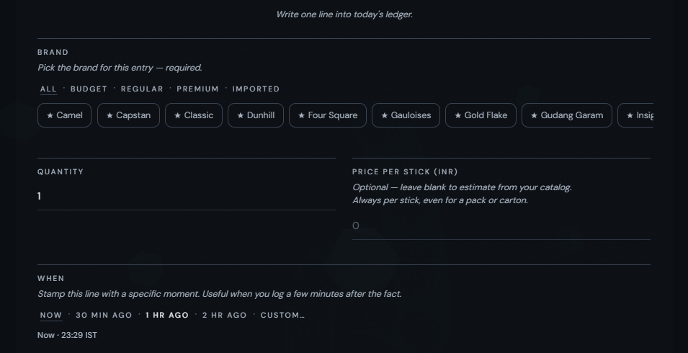
One log. Three readings.
One person’s own ledger. Not a customer base.
Today’s sticks
Today’s rupees
The week, against your own
recent baseline
One tap, or the full line.
Free. No ads. The data is not sold.
Notes:
This is the whole product. A record they write themselves. The frame beside me is one person's own ledger. It is not a customer base.
You log a stick with one tap, or you open the line and write it in full. The brand is required. You pick from brands a person in India buys. You set a quantity, a price in rupees, and the time, in India time. Trigger, mood, and context can wait. The brand carries forward from the last entry, so the moment can stay short.
From that log the screen owes them three readings. Today’s sticks. Today’s rupees. And the week, set against their own recent baseline: what has been usual for them, drawn from their own history. Those three are the offer. A comparison with their own usual week, not a score against other people.
The core is free. There are no ads. We do not sell the data.
If you stop me here: one log, three readings, and the record belongs to the person who wrote it.

Slide 3
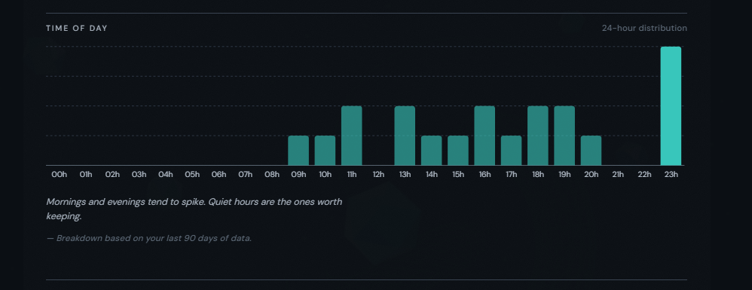
It reads the day back.
One person’s own ledger. Not a customer base.
Mornings and evenings.
Quiet hours.
Today’s sticks. Today’s rupees.
A smoke-free run.
Notes:
It reads the day back. The chart beside me is that same person's last ninety days, by hour. Mornings and evenings show up. Quiet hours show up. The ledger writes that shape in a sentence they can check. One ledger. Not a customer base.
The home screen already does the readings I just named. Today’s sticks. Today’s rupees. It can also show a smoke-free run, a count of quiet days. That run is not a game.
A goal, if they set one, shows where they stand. When they smoke below their own baseline, the ledger shows the rupees they did not spend, with the working beside the sum: sticks below that baseline, times the price of a stick. A timeline passes on what public-health bodies describe in the body after a cigarette. It is information for an adult. It is not medical advice.
If you stop me here: the ledger reads their own day back. It does not invent a crowd.

Slide 4
Built. Free.
Not in a pocket.
The phone and the website share one calculation.
Each person’s rows stay theirs.
Not medical advice. No text-message login.
No customer base. I am an ESSEC student.
The person this is for lives in India.
The core is free.
Notes:
The ledger is built. The phone and the website are one product. The arithmetic is written once, in src/domain, and both use it. Nothing in that calculation calls out to a network. A log is checked, then saved, and the screen reads it back. Each person's rows are visible only to that person. They can export those rows, and they can erase them. The home screen can hide the totals, and it can mask the brand names, when someone else might see the phone.
Hear the limits. It will not give medical advice. It will not sign you in by text message. It is not a compliance certificate.
The site already says the core is free: no ads, no subscription tier, and we do not sell the data. I am standing by that promise. There is no customer base. I will not invent one. I am an ESSEC student. The person on the first slide lives in India. The distance between those two facts is the work left. I could build the ledger alone. Incubation is for that distance, not for building the ledger. Reaching the person it is for is why I am here.
If you stop me here: it is built, it is free, and it is not yet in a pocket.

Slide 5
A seat in ESSEC Ventures.
The Centre’s incubation for a student project.
Coaching, and the school’s network,
to name a first group I can reach.
And to decide what can sit beside a free ledger.
Not a cheque.
Notes:
I am asking for a seat in ESSEC Ventures. That is the Centre’s incubation for a student project.
I am asking for coaching, and for the school’s network. I will use them for two jobs.
The first is to name a group I can actually reach. People who smoke, who will open the ledger, and whom I can speak to. I am not bringing a headcount.
The second is to decide whether anything can sit beside the free ledger, with no ads, with the data unsold, and with no shame for the person who logs. If the honest answer is that the free ledger should stay the whole product, I want to learn that here.
There is no cheque in this ask.
I am an ESSEC student, and I am asking for a seat in ESSEC Ventures.

