Slide 1
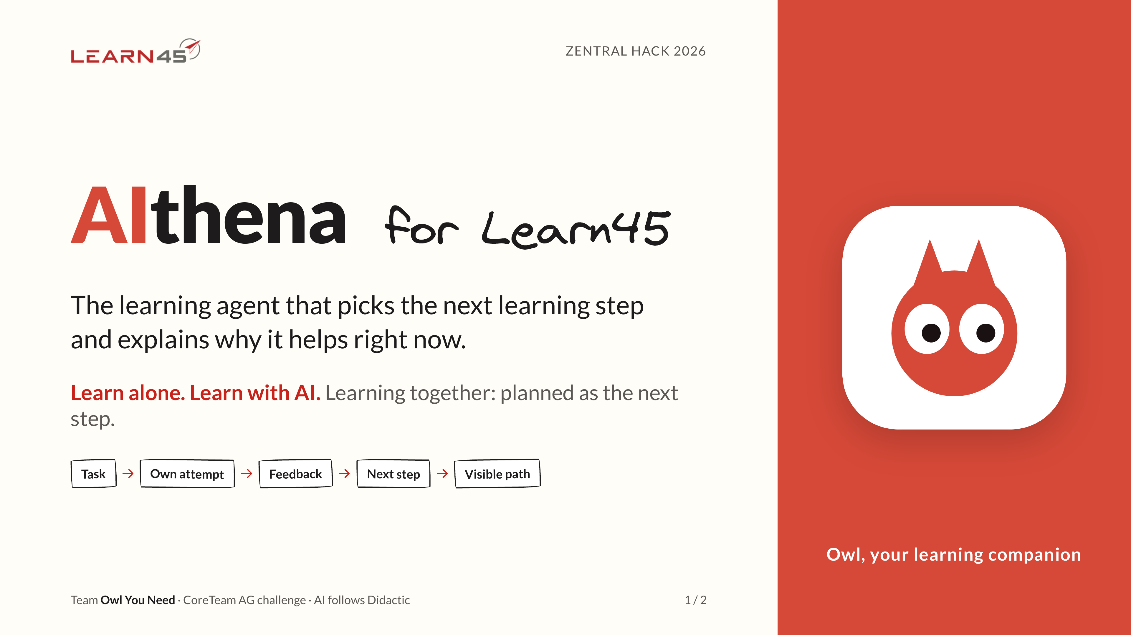
Notes:
AIthena for Learn45: the learning agent that picks the next learning step and explains why it helps right now.
Learn alone. Learn with AI. Learning together, planned as the next step.
Task → own attempt → feedback → next step → visible path.

Slide 2
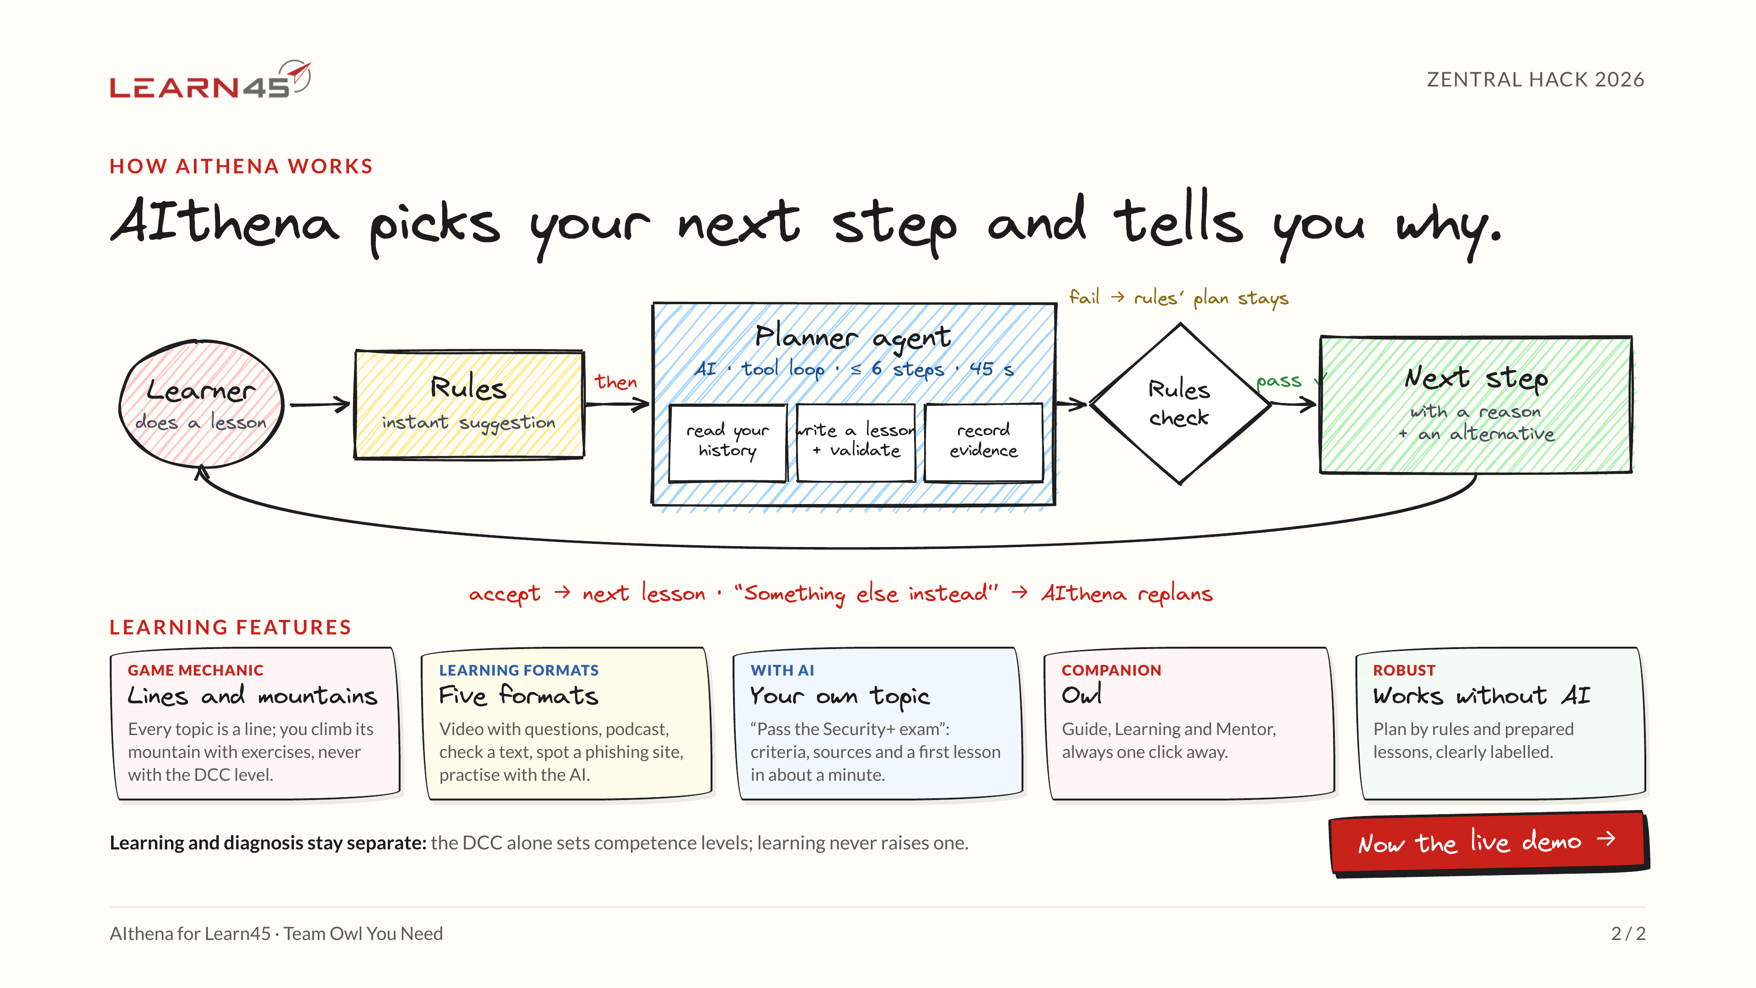
Notes:
How AIthena works: rules answer instantly, then the planner agent (≤ 6 steps, 45 s) reads the history, writes and validates a lesson and records evidence. A rules check passes the next step with a reason and an alternative, or the rules plan stays.
Features: lines and mountains, five formats, your own topic, the owl, works without AI.
Next: the live demo.

Slide 3
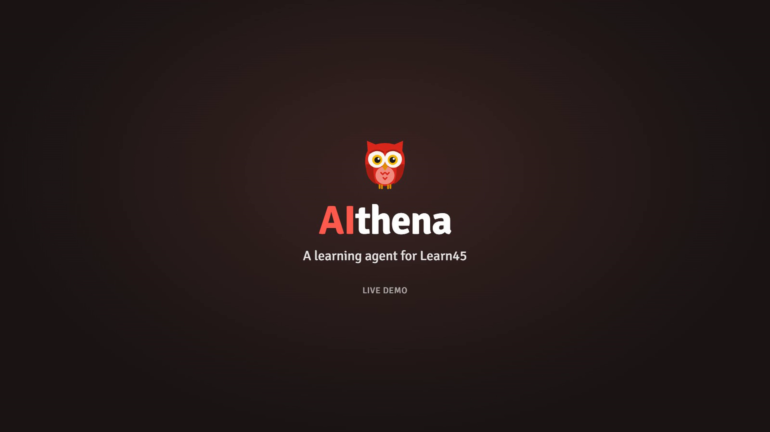
Notes:
Live demo, 2:13, no sound. Click the video to play it.
Login with DCC → home → agent suggests topics → video lesson with knowledge checks → XP and badge → mountain with climber and cable car → AI chat lesson → own topic (Security+) → learning map → owl → settings, English and dark mode.

