Slide 1
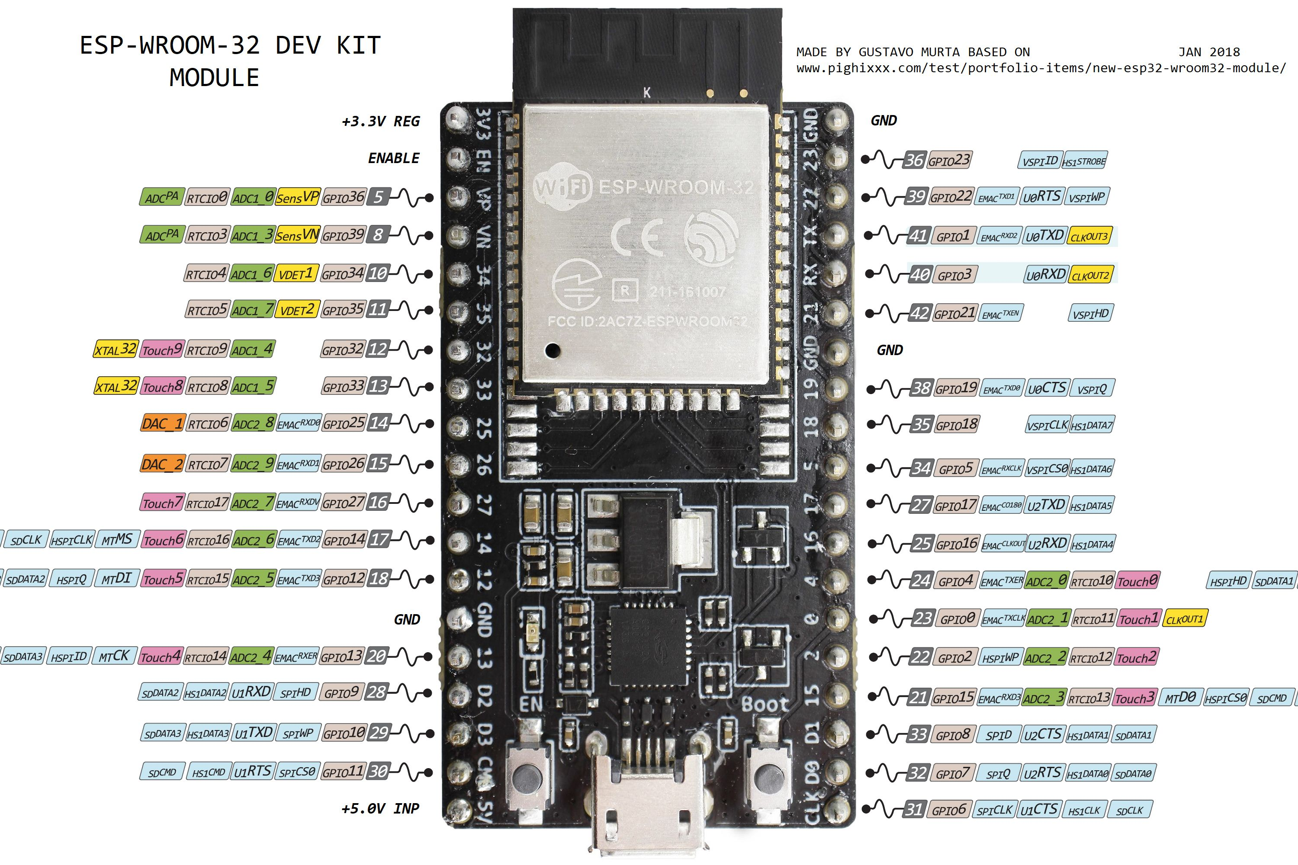
MQ-135 Gas Sensor Data Line
Analog In
OLED Display SCL
Digital (I2C)
OLED Display SDA
Digital (I2C)
Camera EL Servo Signal
PWM Out
Camera AZ Servo Signal
PWM Out
L298 Motor A: ENA
PWM Out
L298 Motor B: ENB
PWM Out
L298 Motor A: IN1
Digital Out
L298 Motor A: IN2
Digital Out
L298 Motor B: IN1
Digital Out
L298 Motor B: IN2
Digital Out
*Power Requirements for peripherals supplied via Keyestudio ESP 32 shield

