Slide 1
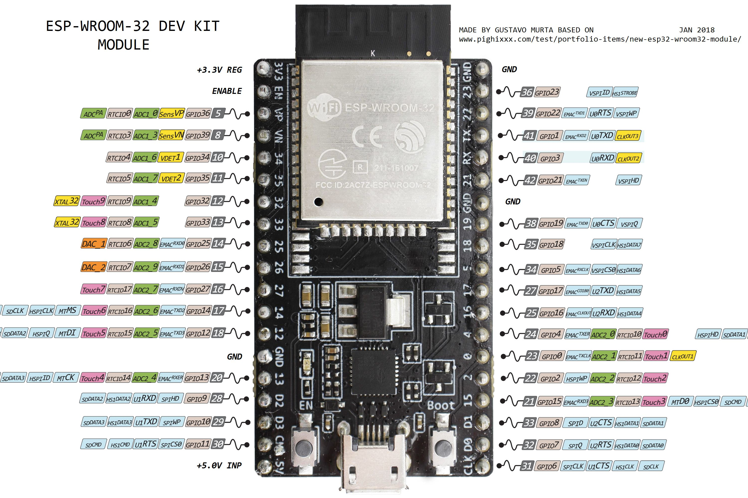
Eg. Ultrasonic Sensor MS515 N°1
Analog In

