Slide 1
 | Basic Set | Basic OLED Set | Starter Set | Advanced Set | Exotic Sensors Set | Premium Set | Deluxe Set
 | 15 € | 19 € | 29 € | 39 € | 49 € | 69 € | 99 € | 35 € | 40 €
vESPrino | 1 | 1 | 1 | 1 | 1 | 3 | 3 |  | 5
vESPrino Bare |  |  |  |  |  |  |  | 5
Light Sensor |  |  | 1 | 1 |  | 1 | 1
Temp + Humidity |  |  | 1 |  | 1 |  | 1
Temp + Pressure | 1 | 1
Temp/Pressure /Humidity |  |  |  | 1 |  | 1 | 1
Display OLED 128x64 BW |  | 1 | 1 | 1 |  | 1 | 2
Display LCD 16x2 |  |  |  | 1 | 1 | 1 | 1
Servo |  |  | 1 | 1 |  | 1 | 1
Relay |  |  |  | 1 |  | 1 | 1
PIR Sensor |  |  | 1 | 1 |  | 1 | 1
Gesture Sensor |  |  |  |  | 1 |  | 1
RFID Reader |  |  |  |  | 1 |  | 1

Slide 2
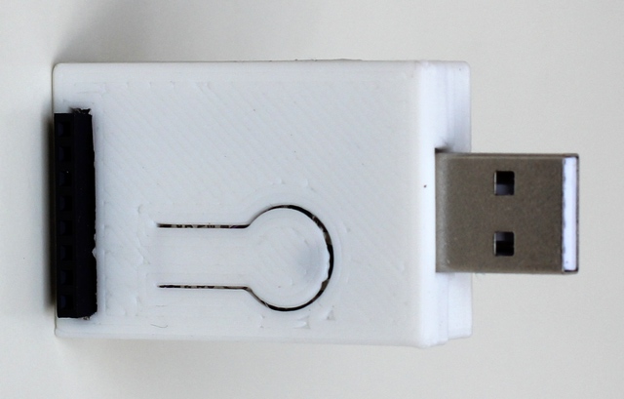
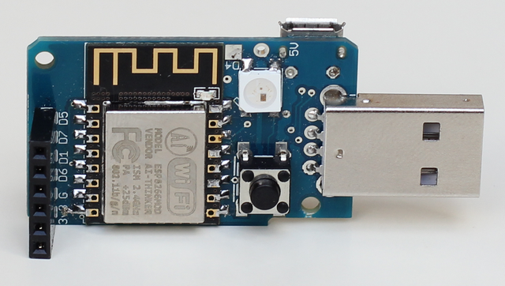
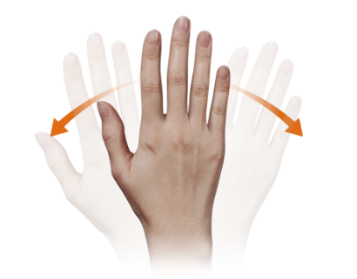
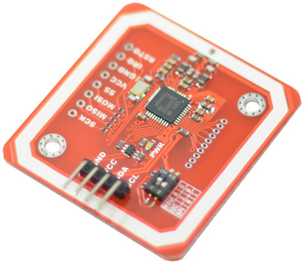
L3
L2
Light Sensors
Environment Sensors
Visible Light – L1 (BH1750)
Temp + Pressure – L1 (BMP180)
Visible + IR Light – L2 (TSL2561)
Better precision
Temp + Humidity – L2 (SI7021)
Temp/Humd/Pressure – L3 (BME280)
Gesture Sensor L5
Gesture Sensor L4
Can detect 6 gestures: UP, DOWN, LEFT, RIGHT, FAR, NEAR
(APDS-9960)
Scan and program NFC and RFID cards (13 Mhz)
(PN 532)

Slide 3
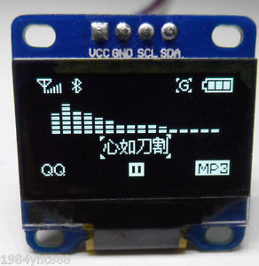
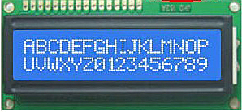
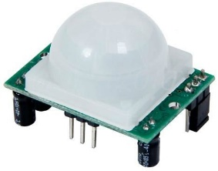
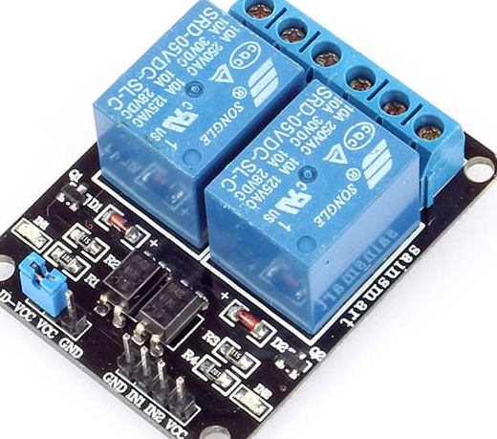
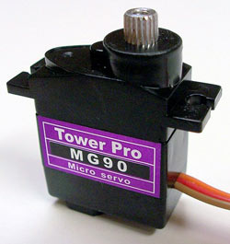
Displays L2
OLED 128x64
White
LCD Character
16x2 Blue/White
Other Gadgets – L1
Motion Sensor
PIR
Relay Module
Micro Servo
(SG90)

