Slide 1



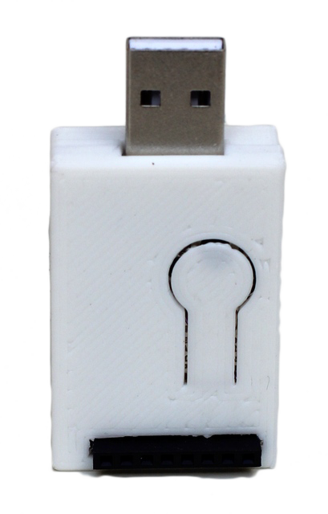
that:
this:
http://dweet.io/dweet/for/{ID}?{COMMAND}
Home Router
http://maker.ifttt.com/trigger/{EVENT}/with/key/{KEY}
http://dweet.io/get/latest/dweet/for/{ID}

Slide 2
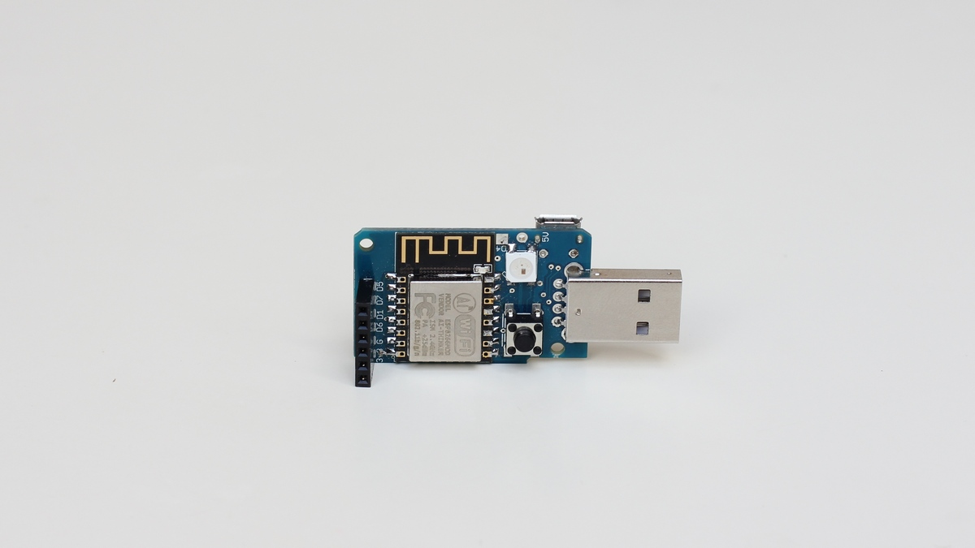
What is inside?
ESP8266
RGB LED
Micro USB
Button
IO Ports

Slide 3
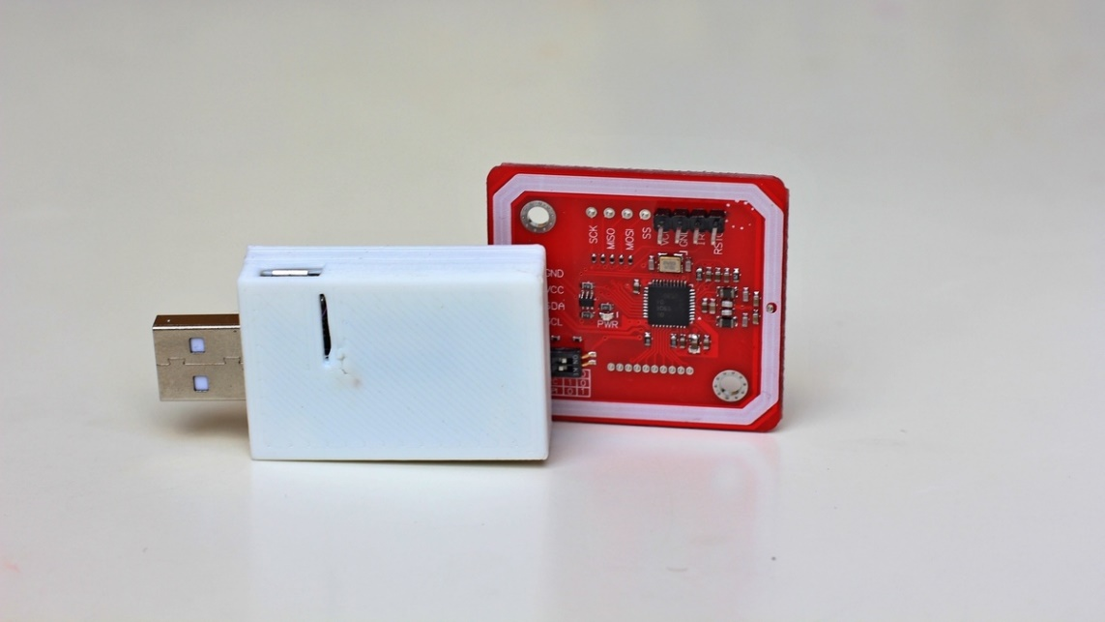
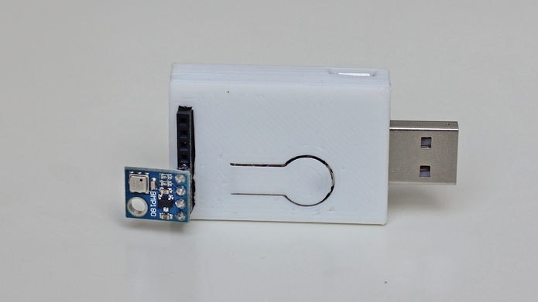
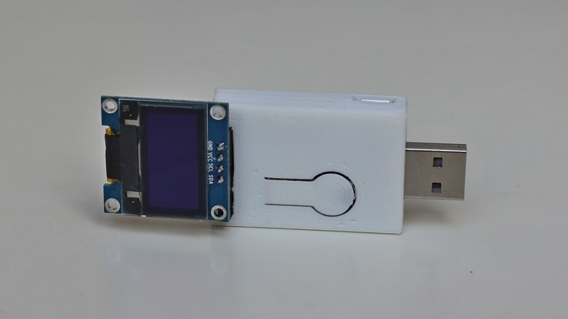
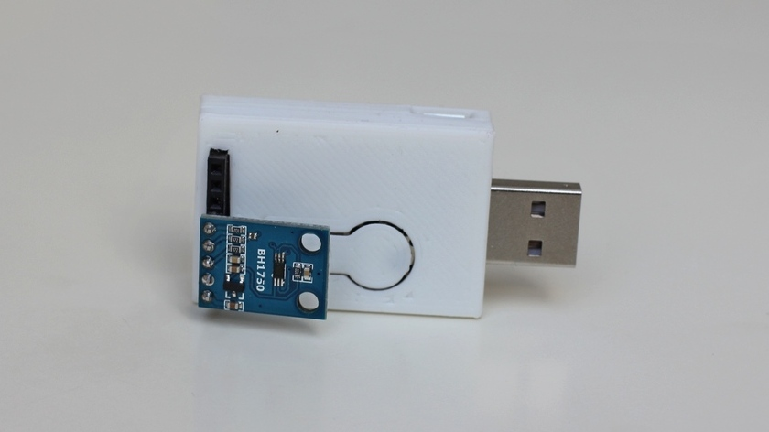
Play with cool Extensions
RFID / NFC
Temperature
... and many more!
OLED
Light

