Slide 1
 | Basic Set | Basic OLED Set | Starter Set | Advanced Set | Exotic Sensors Set | Premium Set | Deluxe Set
 | 15 € | 19 € | 29 € | 39 € | 49 € | 69 € | 99 € | 35 € | 40 €
vESPrino | 1 | 1 | 1 | 1 | 1 | 3 | 3 |  | 5
vESPrino Bare |  |  |  |  |  |  |  | 5
Light Sensor |  |  | 1 | 1 |  | 1 | 1
Temp + Humidity |  |  | 1 |  | 1 |  | 1
Temp + Pressure | 1 | 1
Temp/Pressure /Humidity |  |  |  | 1 |  | 1 | 1
Display OLED 128x64 BW |  | 1 | 1 | 1 |  | 1 | 2
Display LCD 16x2 |  |  |  | 1 | 1 | 1 | 1
Servo |  |  | 1 | 1 |  | 1 | 1
Relay |  |  |  | 1 |  | 1 | 1
PIR Sensor |  |  | 1 | 1 |  | 1 | 1
Gesture Sensor |  |  |  |  | 1 |  | 1
RFID Reader |  |  |  |  | 1 |  | 1

Slide 2
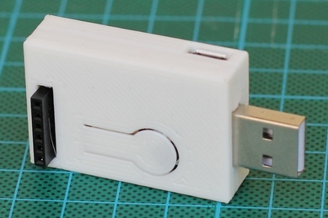
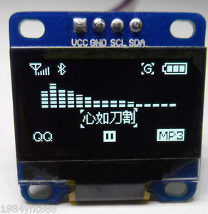
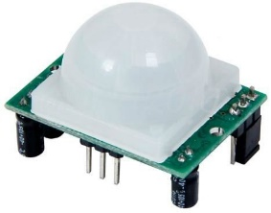
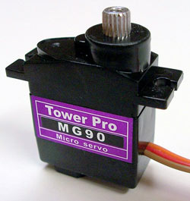
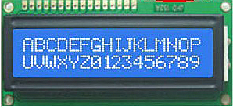
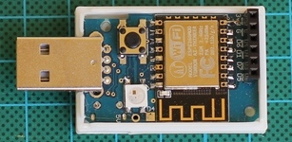
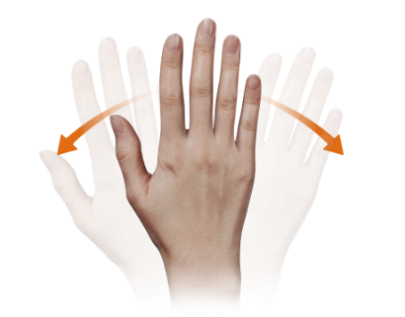
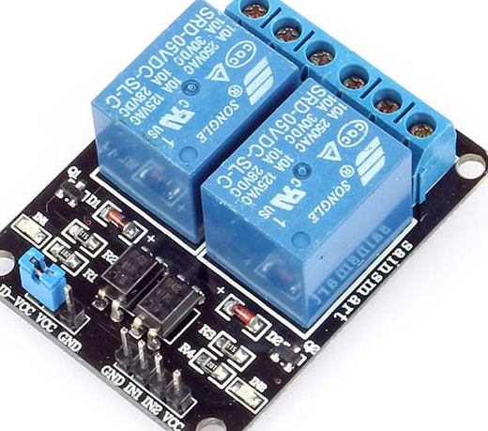
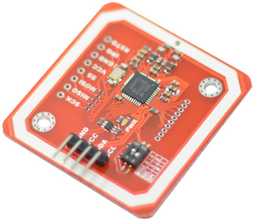
Light Sensor
Environment Sensor
Temp
Humidity
Pressure
Gesture Sensor

