Slide 1
舞伴
TENCENT AGE WELL · GAME TRACK
Ageing well should feel like joining a dance—not taking a test.
Notes:
Open with the human promise: 舞伴 makes healthy ageing feel joyful, social and self-directed.
It is designed as a short game older adults can choose to repeat—not another assessment they must endure.
[Sources]
/Users/kc/Work/DanceBros-Tencent/docs/PRODUCT_REQUIREMENTS.md
/Users/kc/Work/DanceBros-Tencent/docs/product/user-personas.md
[/Sources]

Slide 2
38.77 million people.
EVERYDAY SUPPORT
A national study estimated that 15.5% of adults aged 60+ in China live with MCI—about 38.77 million people. Their dignity, activity and connection matter every day.
FOR THE PERSON
More reasons to move, think, participate and feel capable.
FOR THE CIRCLE OF CARE
A shared activity and a calmer reason to stay connected.
Joy before judgement
A routine worth returning to
Standing or seated participation
Family connection
Community participation
Earlier human conversation
Notes:
A large population is living with mild cognitive impairment, but their quality of life is shaped every day—not only in formal assessment settings.
The published cross-sectional study estimated 15.5% prevalence among adults aged 60+ in China, corresponding to 38.77 million people.
舞伴 addresses the everyday layer: activity, confidence, participation and connection. It does not diagnose MCI or replace clinical assessment.
[Sources]
https://pubmed.ncbi.nlm.nih.gov/33271079/
/Users/kc/Work/DanceBros-Tencent/docs/PRODUCT_REQUIREMENTS.md
/Users/kc/Work/DanceBros-Tencent/docs/adr/0003-wellness-claim-boundary.md
[/Sources]

Slide 3
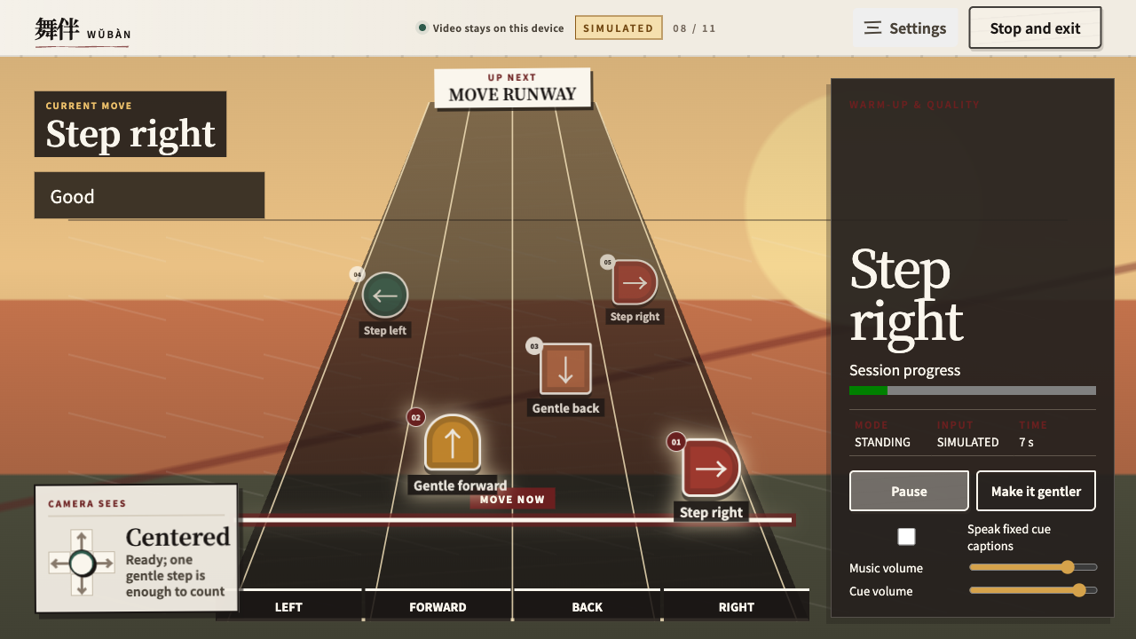
舞伴 turns healthy ageing into something people want to repeat.
ONE FOUR-MINUTE RITUAL
Move gently. Follow the rhythm. Remember short patterns. Finish with a sense of achievement.
Every session brings physical activity, cognitive engagement and joy into the day.
Notes:
The useful behaviour is wrapped in a four-minute ritual that has an immediate emotional payoff: the player moves, remembers, succeeds and finishes.
That repeatability is the social-good engine. It brings gentle physical activity and cognitive engagement into ordinary life in a form people can enjoy together.
The screenshot is an authentic local product capture and remains visibly labelled SIMULATED.
[Sources]
/Users/kc/Work/DanceBros-Tencent/docs/PRODUCT_REQUIREMENTS.md
/Users/kc/Work/DanceBros-Tencent/docs/context/current-project-state.md
/Users/kc/Documents/Codex/2026-08-09/files-mentioned-by-the-user-codex/.codex-agewell-revision.nujoLQ/template-inspect/assets/ppt/media/image1.png
[/Sources]

Slide 4
People living with MCI deserve more than another test.
MOVE + THINK
Gentle steps add physical activity. Rhythm, sequence recall and “freeze” cues engage attention and memory—without a clinical score.
CONNECT + CHOOSE
Play beside family, friends or a community group. A genuine seated hand-gesture path keeps participation open.
Notes:
For people living with MCI, life should not narrow into a sequence of tests. 舞伴 gives them a way to move, think, choose and participate with others.
The product aligns with healthy-ageing behaviours highlighted in WHO guidance: physical activity, cognitive engagement and social participation.
Standing play is bounded and pausable; seated play has its own hand gestures and calibration. This is a wellness experience, not treatment or screening.
[Sources]
https://www.who.int/publications/i/item/9789240123557
https://www.who.int/news-room/fact-sheets/detail/dementia
/Users/kc/Work/DanceBros-Tencent/docs/PRODUCT_REQUIREMENTS.md
/Users/kc/Work/DanceBros-Tencent/docs/product/user-personas.md
[/Sources]

Slide 5
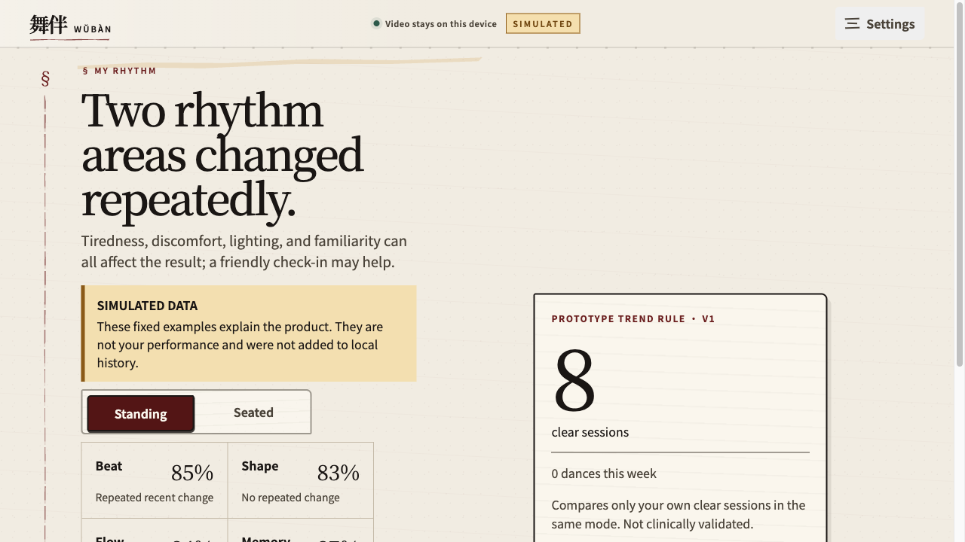
A routine creates context that one isolated moment cannot.
PROGRESS WITHOUT JUDGEMENT
舞伴 compares each person only with their own usual rhythm—not with a population score.
Repeated, clear sessions can support an earlier human conversation. Never a diagnosis or judgement.
Notes:
One difficult session can reflect fatigue, discomfort, lighting, tracking or an unfamiliar rhythm. It should never be treated as evidence of decline.
舞伴 uses only complete, clear sessions and compares the player with their own usual pattern. The purpose is to support a kinder human conversation—not produce a diagnosis, risk score or clinical threshold.
The on-screen history remains explicitly simulated.
[Sources]
/Users/kc/Work/DanceBros-Tencent/docs/PRODUCT_REQUIREMENTS.md
/Users/kc/Work/DanceBros-Tencent/docs/adr/0003-wellness-claim-boundary.md
/Users/kc/Work/DanceBros-Tencent/docs/context/domain-knowledge.md
/Users/kc/Documents/Codex/2026-08-09/files-mentioned-by-the-user-codex/.codex-agewell-revision.nujoLQ/template-inspect/assets/ppt/media/image3.png
[/Sources]

Slide 6
One joyful ritual strengthens a circle of care.
OLDER ADULT
More movement, agency and confidence—without a test result or health grade.
FAMILY + SUPPORTER
A calmer reason to call, visit and listen—without interpreting medical data.
COMMUNITY
One inclusive activity for movement, memory and social connection—with low setup.
Notes:
The product's value is social as well as personal.
The older adult gains activity, agency and confidence. Family gains a calmer reason to connect. Community facilitators gain a low-friction shared activity that can help people participate together.
The sharing model is a consented check-in, not a health alert or a transfer of medical interpretation to the family.
[Sources]
https://www.who.int/health-topics/ageing/reducing-social-isolation-and-loneliness-among-older-people
/Users/kc/Work/DanceBros-Tencent/docs/product/user-personas.md
/Users/kc/Work/DanceBros-Tencent/docs/adr/0004-consented-caregiver-check-in.md
[/Sources]

Slide 7
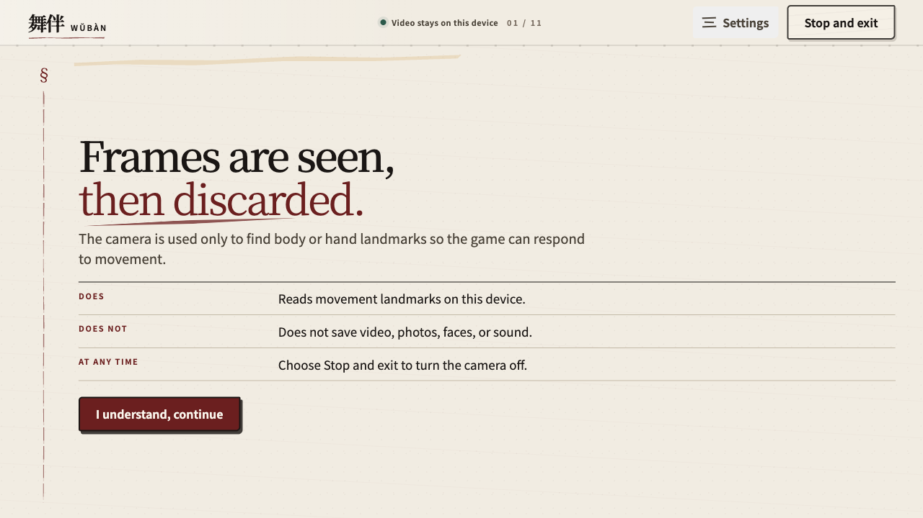
Dignity requires trust.
PRIVACY IS PART OF THE BENEFIT
Camera frames are processed in memory and discarded. Only derived session summaries stay local.
Sharing is separate, revocable and always controlled by the older adult.
Notes:
Privacy is not a technical footnote. It is what allows an older adult to play without feeling watched or graded.
Raw camera frames are processed in memory and discarded. Derived summaries stay local. Supporter sharing is separate, revocable and controlled by the older adult.
This preserves dignity while still enabling a voluntary social check-in.
[Sources]
/Users/kc/Work/DanceBros-Tencent/docs/PRODUCT_REQUIREMENTS.md
/Users/kc/Work/DanceBros-Tencent/docs/adr/0004-consented-caregiver-check-in.md
/Users/kc/Documents/Codex/2026-08-09/files-mentioned-by-the-user-codex/.codex-agewell-revision.nujoLQ/template-inspect/assets/ppt/media/image4.png
[/Sources]

Slide 8
AI powers the experience. Human values govern it.
A BRIEF TECHNICAL VIEW
On-device pose and hand landmarks make the game responsive without sending video to a backend. Explainable scoring, quality gates and personal baselines keep the experience transparent.
On-device pose + hand landmarks
Audio-clock rhythm scoring
Clear-session quality gate
Personal baseline, not population rank
Local summaries + consented sharing
Notes:
Keep this technical explanation brief. AI-assisted perception makes the movement game responsive; deterministic scoring and explicit quality gates keep the interpretation explainable.
Core product flow is local: on-device pose/hand landmarks, audio-clock rhythm scoring, personal baselines and local summaries. Supporter sharing remains a separate adapter and consent decision.
Do not claim open submission gates as complete: real-camera validation, older-adult validation, final owner-account evidence and a real WeChat adapter remain field or owner gates.
[Sources]
/Users/kc/Work/DanceBros-Tencent/docs/context/current-project-state.md
/Users/kc/Work/DanceBros-Tencent/docs/PRODUCT_REQUIREMENTS.md
/Users/kc/Work/DanceBros-Tencent/docs/adr/0003-wellness-claim-boundary.md
/Users/kc/Work/DanceBros-Tencent/docs/adr/0004-consented-caregiver-check-in.md
[/Sources]

Slide 9
Help more older adults move,
remember and stay connected.
舞伴
PILOT: CENTRES · CARE · FAMILIES
Notes:
Close with a concrete ask: pilot 舞伴 with community centres, eldercare programmes and families.
Measure whether a joyful four-minute ritual can help older adults move more, feel more capable and stay more connected—while preserving consent and dignity.
The ambition is social good in daily life, not another clinical score.
[Sources]
/Users/kc/Work/DanceBros-Tencent/docs/PRODUCT_REQUIREMENTS.md
/Users/kc/Work/DanceBros-Tencent/docs/product/user-personas.md
/Users/kc/Work/DanceBros-Tencent/docs/context/current-project-state.md
[/Sources]

