Slide 1
A little number puzzle
Dr. Tristan Allwood
tora@zonetora.co.uk
London Haskell User Group
Lightening Talk
October 23^{rd,} 2013

Slide 2
a and b are two Integers, both between 2 and 99 inclusive
p and s are two participants
p only knows the product, a * b
s only knows the sum, a + b
You overhear a conversation between p and s
p says: “I don't know a and b”
s says: “I know you don't know”
p says: “Ah, in that case, I know what a and b are”
s says: “Oh, ok. So do I.”
What are the values of a and b?
Notes:
Xkcd forum links
Lots of clever ways to solve this using prime numbers, properties of factors, etc. etc. etc.
We're going to use good 'ol brute force.

Slide 3
p and s
p (a,b) = multiplicands (a*b)
s (a,b) = summands (a+b)
multiplicands :: Int -> [(Int, Int)]
multiplicands n
= [ (x,y)
| x <- [2..min 99 (floor . sqrt . fromIntegral $ n)],
(n `mod` x) == 0,
let y = n `div` x,
y >= 2 && y <= 99
]
summands :: Int -> [(Int, Int)]
summands n = [ (x,y)
| x <- [2..min 99 (n `div` 2)],
let y = n - x,
y >= x && y >= 2 && y <= 99
]

Slide 4
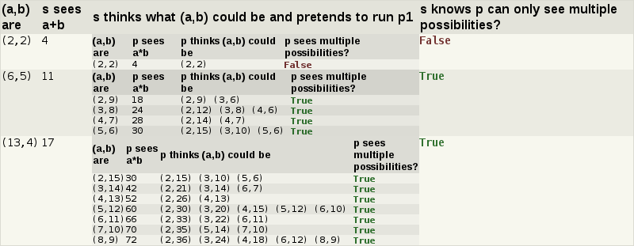
p says: “I don't know a and b”
p (a,b) = multiplicands (a*b)
s (a,b) = summands (a+b)
p1 :: (a,b) -> Bool
p1 = more_than_one . p
s says: “I know you don't know”
s1 :: (a,b) -> Bool
s1 = all p1 . s
more_than_one :: [a] -> Bool
more_than_one = not . null . drop 1
Notes:
References
Xkcd forums
Link to code
Other stuff

Slide 5
p (a,b) = multiplicands (a*b)
s (a,b) = summands (a+b)
p1 = more_than_one . p
s1 = all p1 . s
p says: “Ah, in that case, I know what a and b are”
exactly_one :: [a] -> Bool
exactly_one [_] = True
exactly_one _ = False

Slide 6
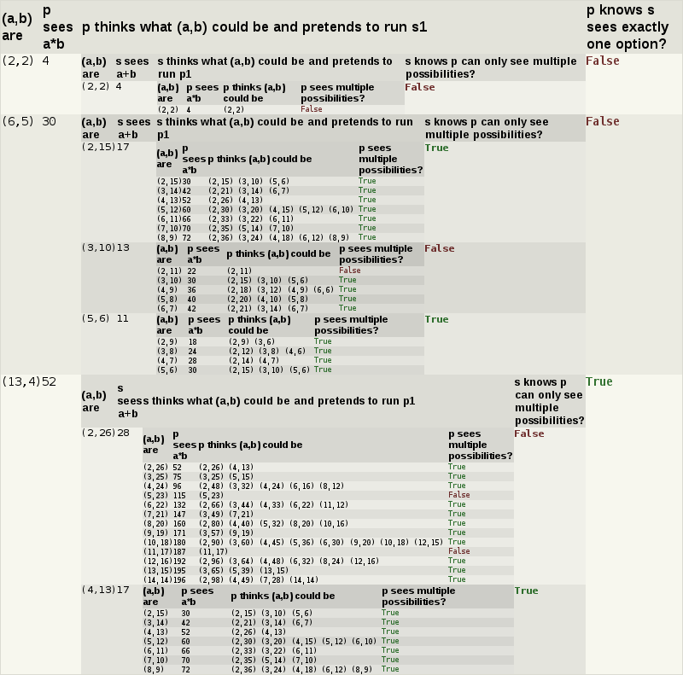

Slide 7
p (a,b) = multiplicands (a*b)
s (a,b) = summands (a+b)
p1 = more_than_one . p
s1 = all p1 . s
p says: “Ah, in that case, I know what a and b are”
p2 = exactly_one . filter s1 . p
exactly_one :: [a] -> Bool
exactly_one [_] = True
exactly_one _ = False

Slide 8
p (a,b) = multiplicands (a*b)
s says: “Oh, ok. So do I.”
s (a,b) = summands (a+b)
s2 = exactly_one . filter p2 . s
p1 = more_than_one . p
s1 = all p1 . s
p2 = exactly_one . filter s1 . p
exactly_one :: [a] -> Bool
exactly_one [_] = True
exactly_one _ = False

Slide 9
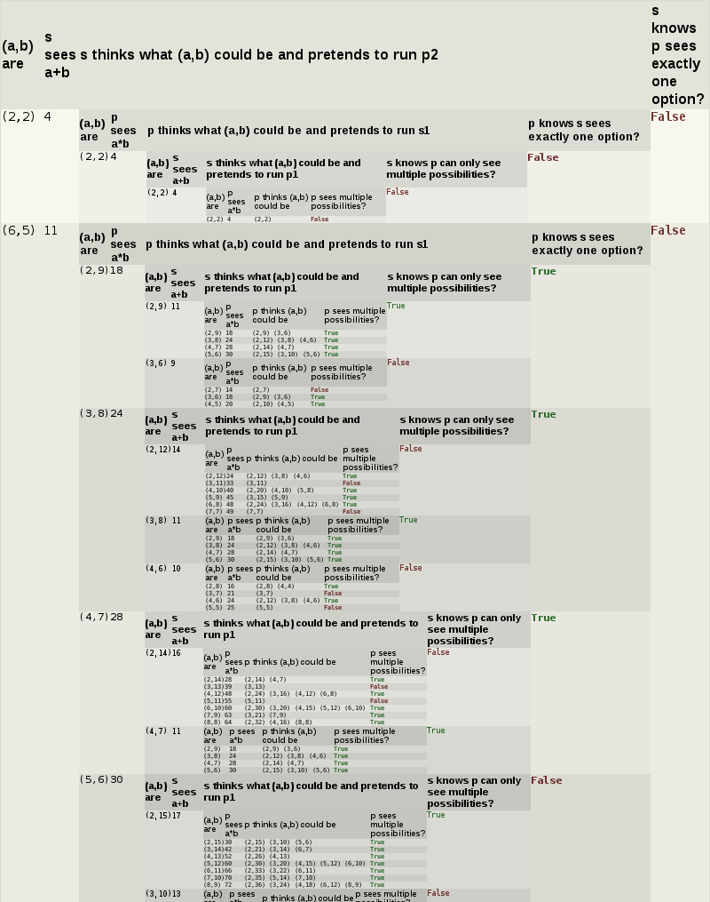

Slide 10
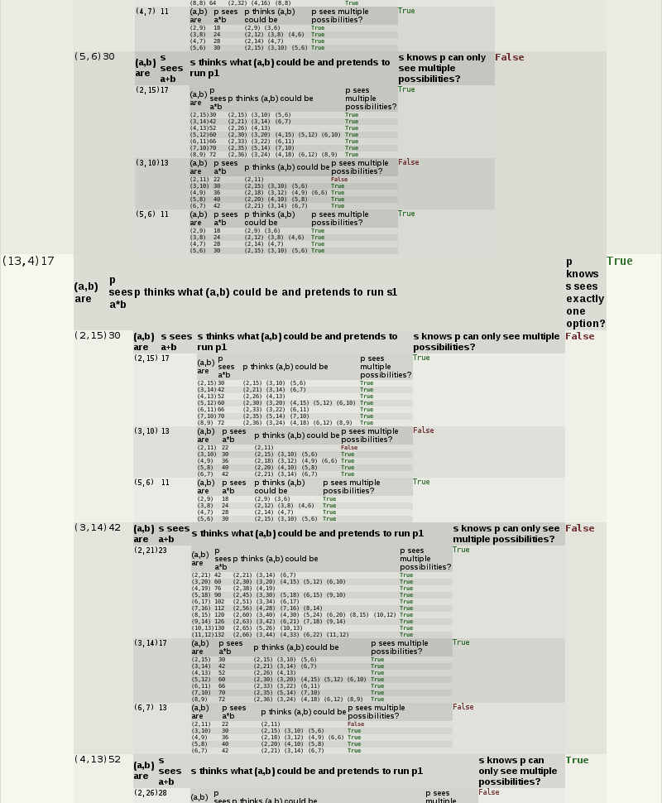

Slide 11
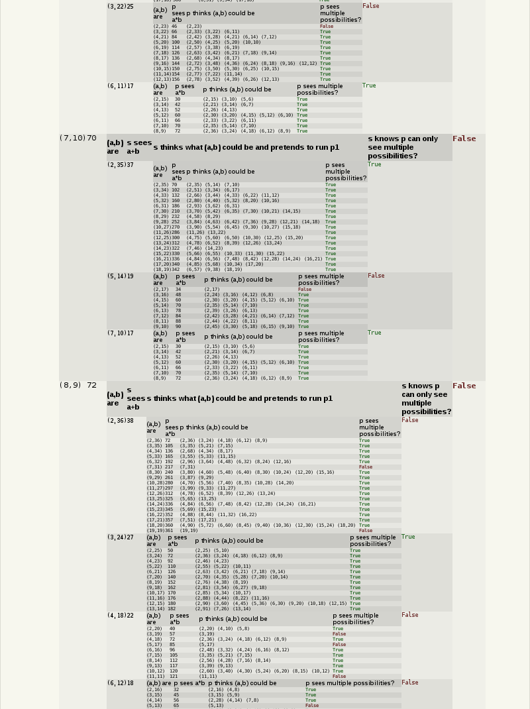

Slide 12


Slide 13
p (a,b) = multiplicands (a*b)
s says: “Oh, ok. So do I.”
s (a,b) = summands (a+b)
s2 = exactly_one . filter p2 . s
p1 = more_than_one . p
s1 = all p1 . s
p2 = exactly_one . filter s1 . p
exactly_one :: [a] -> Bool
exactly_one [_] = True
exactly_one _ = False

Slide 14
p (a,b) = multiplicands (a*b)
What are the values of a and b?
s (a,b) = summands (a+b)
p1 = more_than_one . p
s1 = all p1 . s
p2 = exactly_one . filter s1 . p
s2 = exactly_one . filter p2 . s
solution = [ (a,b)
| a <- [2..99], b <- [2..a]
, p1 (a,b)
, s1 (a,b)
, p2 (a,b)
, s2 (a,b)
]

