Slide 1
Waymo Open Dataset Challenge 2: 3D Camera-Only Detection
By Bandat Tristan, Eggl Jakob, Hitzler Florian and Meingaßner Philipp

Slide 2
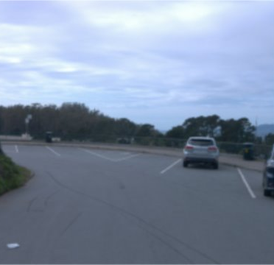
Task
Recognize Cars in Images
Given are:
Camera data
Lidar sensor data
Labels: boxes around cars
Goal:
Put square around every car in each image

Slide 3

Dataset
Only training data was used (800GB)
Structured in 1GB sequences (~200 images each)
Image size: 1920x1280
Labels:
XY-Coordinates of box centers
Height and width of each box
Multiple boxes per image

Slide 4
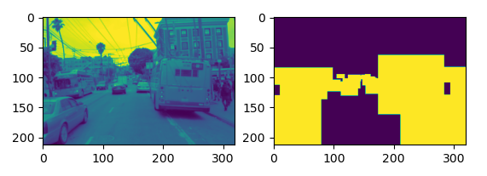
Approach
Reducing the dataset
Only front images
Only 10 pictures per sequence
Convert to greyscale
Reshape the images to 320x213
Converting labels
Place the boxes of each image on an image mask
Mask = Matrix where 1 → car else 0

Slide 5
Helper Functions
Extractor
Extracts randomly 10 frames from a sequence
Transform labels to masks
Compressor
Compresses the images & masks by a factor of 6
Stores data in a Pickle file
Give images & masks to compressor
Convert to greyscale
Convert to tensor

Slide 6
Problems
Complex and huge dataset
Missing experience
Recommended methods too complex

Slide 7
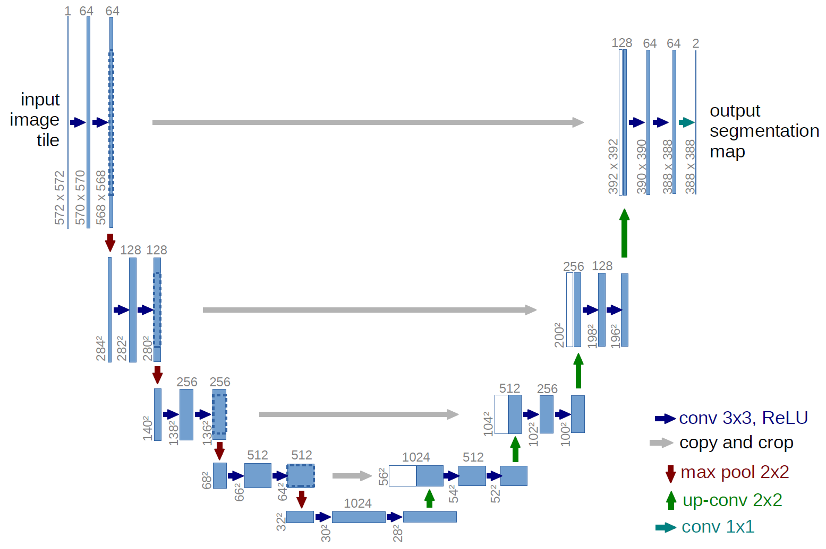
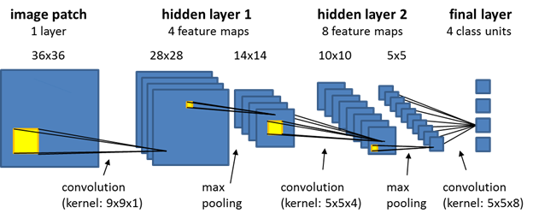
Methods
CNN
U-Net
Simple CNN
5 Layers with ReLU and Dropout
64 Kernels
Padding
Implemented in PyTorch based on a reference repo in GitHub
Has originally the following structure
Example CNN (in this case with a classification layer at the end)
from: https://docs.ecognition.com/v9.5.0/
from https://arxiv.org/pdf/1505.04597.pdf
In our case: Input image is 1 x 320 x 213
We have one input and one output channel

Slide 8
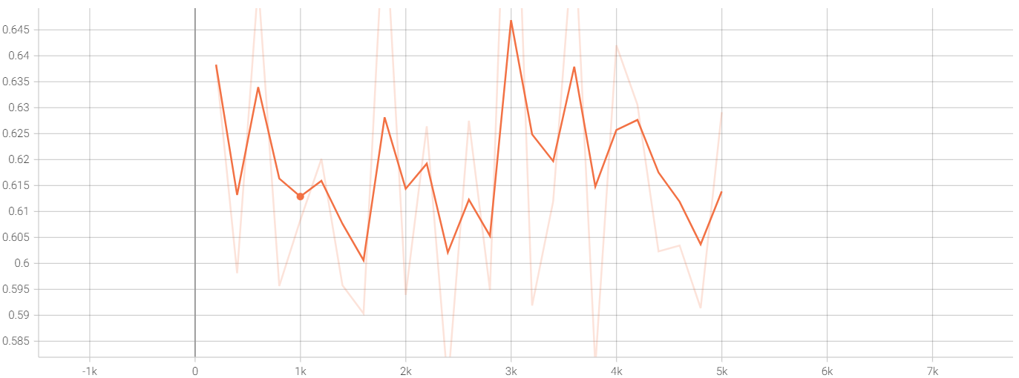
Results CNN
Bad Performance
Further training doesn't show any improvement

Slide 9
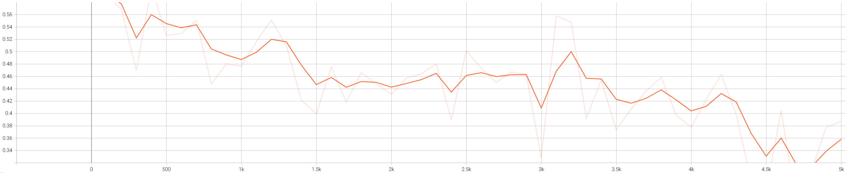
Results U-Net
Better Performance than CNN
Loss curve better, still we have quite a bad result
Possible improvements and reasons for bad performance:
Dataset smaller than original
Boxes are at the wrong positions
Model would perform better with more training (not reasonable for our given/wrong data)
Limited time and resources

Slide 10
Comparison
CNN
U-Net
test loss: 0.636936604976654
validation loss: 0.6169328689575195
training loss: 0.6061648726463318
test loss: 0.5513640642166138
validation loss: 0.5161610841751099
training loss: 0.4466346502304077

Slide 11
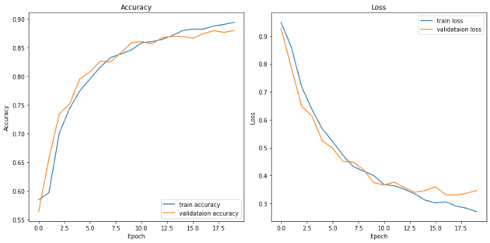
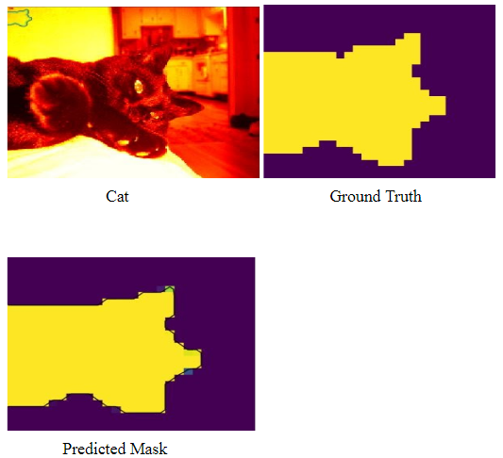
Normal result of an UNet Network
from: https://929687.smushcdn.com/
from: https://analyticsindiamag.com/

Slide 12
Thank you for your attention
https://github.com/TristanBandat/ITS_3D_Camera_only_detection
https://es.wikipedia.org/wiki/Waymo

