Slide 2
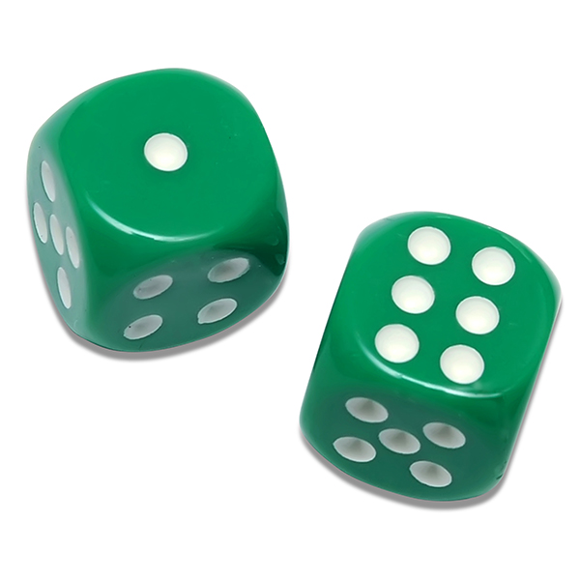

3
0
1
0
1
2
0
1
0
1
2
3
2
3
2
3

