Slide 1

MONACARE
Home care coordination — built around the patient, the care team and the family.
Tristan Doucet – Physiotherapist in Monaco
Monaco, April 2026

Slide 2
A PROJECT BUILT
FROM THE FIELD.
What he kept seeing in practice :
Families calling professionals directly
because no structured channel exists — and receiving incomplete answers.
Updates shared by text message
Not a concept from a whiteboard — an observation from daily practice.
or simply not shared at all. No one has the full picture.
Every professional doing good work in isolation
The founder of MONACARE is a physiotherapist practicing in Monaco. Every day, he helps coordinating care around vulnerable patients alongside nurses, doctors, home companions and legal guardians.
without seeing what the others are doing around the same patient.
Curators managing several cases at once
with no consolidated tool — just spreadsheets and phone calls.
He knows the system from the inside — and he knows precisely what is missing.
Observations and alerts disappearing
into WhatsApp threads, notebooks and informal handovers. Nothing is truly traceable.

Slide 3
When care is uncoordinated, everyone is affected.
Home care involves many professionals — but no shared space connects them.
1
2
3
The family is left in the dark
The team works in silos
Nothing is traceable
Families often do not know what happened during the nurse’s visit, whether the physio came, or what the doctor recommended.
They call. They send messages. They worry. There is no structured way to keep them informed.
A nurse, a physiotherapist, a companion and a doctor can all care for the same patient — without seeing what the others are doing.
No shared record. No shared channel. Just phone calls and informal coordination.
Observations, alerts and recommendations exist — but too often disappear into WhatsApp threads, notebooks, or someone’s memory.
There is no reliable record of what was done, when, and by whom.

Slide 4
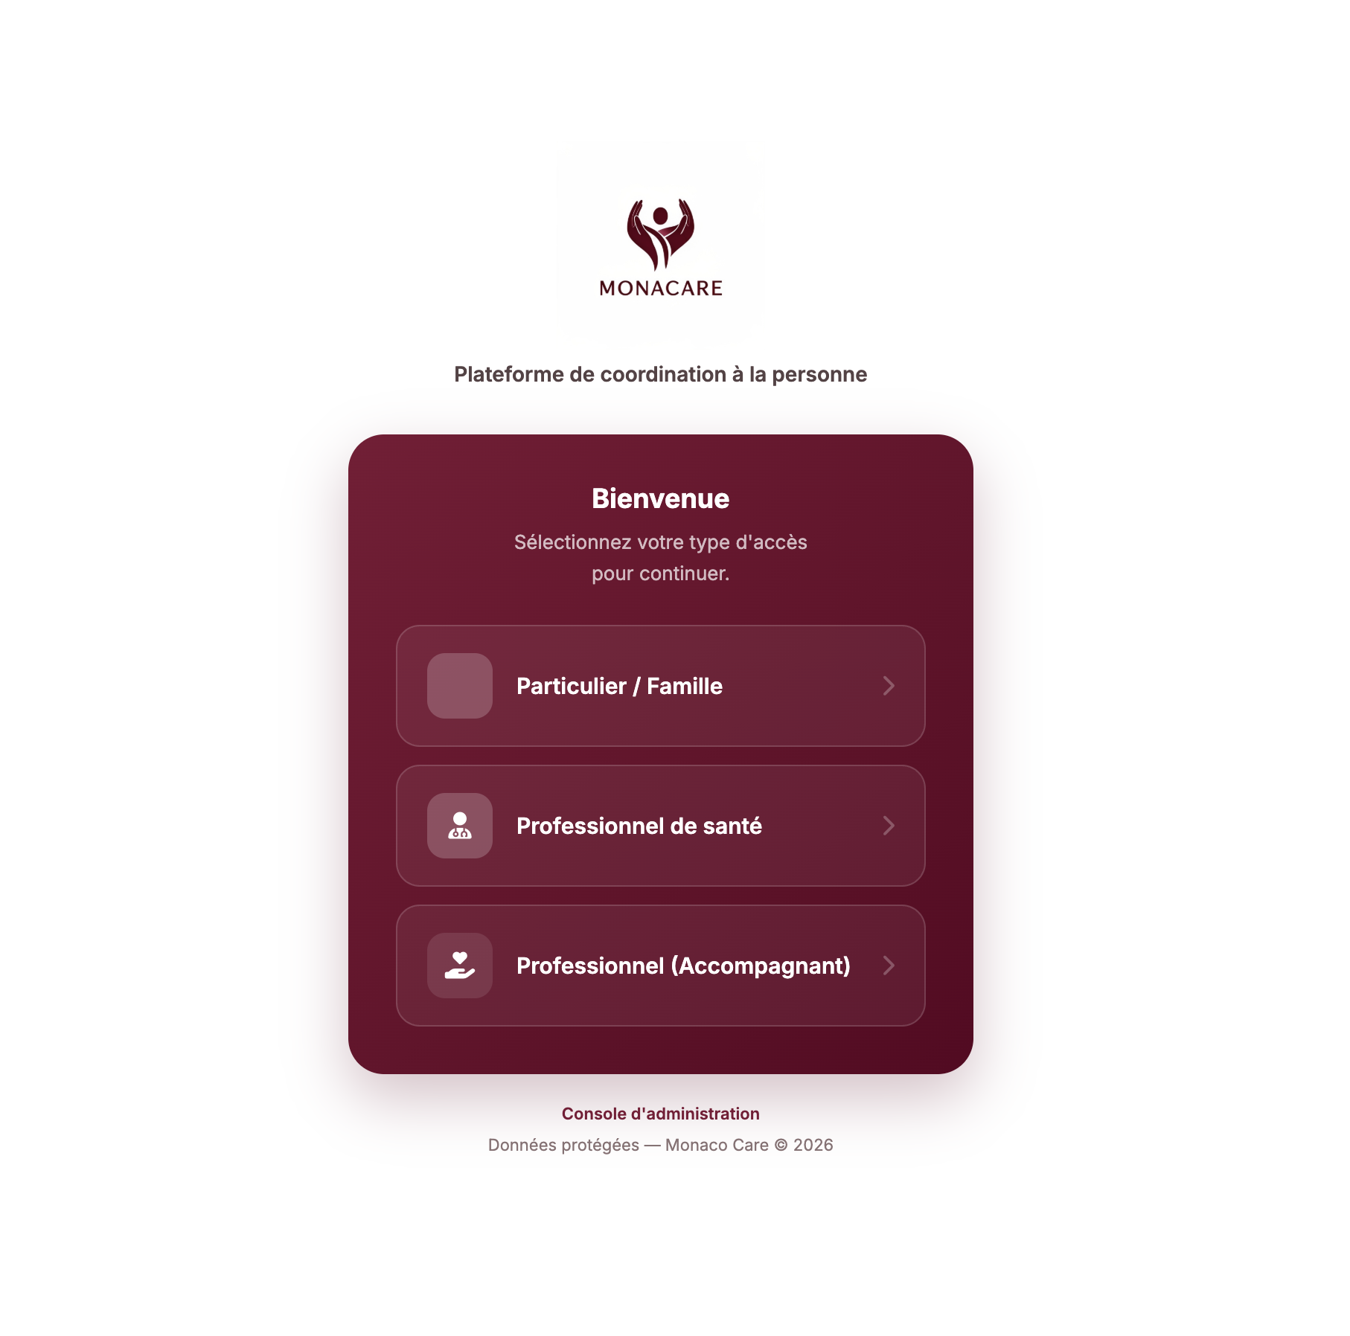
The solution
MONACARE
A shared coordination space for everyone involved in a patient’s care — designed for the realities of home care.
The family stays informed — without having to call anyone.
The care team shares updates in real time, across every intervention.
Every observation is logged, traceable, and available when needed.

Slide 5
How it works
Four functions — each solving a real coordination problem.
The Flux
Shared care feed
Medical Vault
Secure patient record
Each professional logs what they observed or did.
Families see relevant updates.
Medical posts stay restricted to the clinical team. Everyone stays aligned — without a single phone call.
A centralised, biometric-protected space for vital signs, pain tracking and clinical notes.
Voice dictation for busy professionals.
One reliable source of truth — accessible from any device.
Role-Based Access
The right view for each user
Professional Messaging
A clean channel for the teams
Every user — family members, nurse, doctor, or aide — sees only what they need to see.
No self-registration: each account is validated by a platform administrator before first access.
Encrypted, structured messaging organised around the patient.
No personal phones. No WhatsApp threads. A dedicated space for team communication.

Slide 6
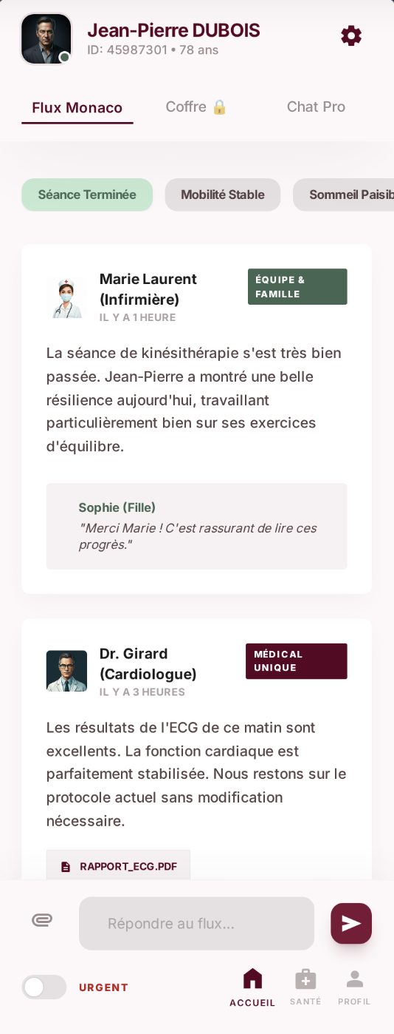
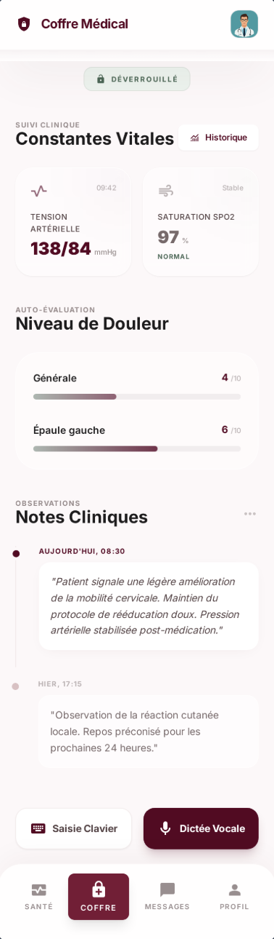
The platform in practice
Working prototype available on web and mobile.
Welcome & Login
The Flux
Medical Vault
Role-based onboarding — each user logs in with the access level assigned to them
Real-time care feed — updates from nurses, physios, companions and family members in one place
Biometric-protected patient record — vital signs, pain tracking and clinical dictation

Slide 7
One platform, four roles.
Each user gets exactly the access they need — no more, no less.
F
H
Family
From EUR29/mo
Healthcare Professional
Always free
Receives a personal access code from the care team. Follows the patient’s updates, sees who visited and when, and can logs vital signs at home. No more calling around for news.
Nurses, doctors, physiotherapists. Account validated before first login. Posts updates to the Flux, consults the Medical Vault, uses voice dictation for clinical notes.
Informed without asking | Home vital log | Approve access
Full Flux + Vault | Voice dictation | Medical-only visibility
C
G
Companion / Aide
Always free
Guardian / Curator
Tiered plan
Non-medical home workers — housekeepers, helpers, etc. Log their daily visits so the whole care team stays in the picture. No access to clinical data.
Legal guardians and professional curators managing several patients at once. A consolidated dashboard across all their cases — with pricing that scales with caseload.
Daily activity log | Flux only | No medical data
Multi-patient view | Tiered pricing | Full oversight

Slide 8
Why Monaco is the right place to start?
Small enough to move fast. Structured enough to support it. A population with real, daily care needs.
38,857
27.2%
14.9%
204,441
RESIDENTS
AGED 65+
AGED 75+
EXTENDED BASIN
Total population of the Principality, 2025
10,574 residents — more than 1 in 4
5,798 residents more likely to require coordinated home support
People 65+ in surrounding municipalities
A structured care ecosystem
A population built for long-term care
Monaco already has the professionals and the infrastructure. What is missing is a coordination layer that connects them.
High life expectancy, engaged families, and a culture of quality care. Home-based support is central to how care is delivered in Monaco.
845 beds & places at CHPG — 443 in geriatric & home care
87.0 years
Life expectancy
Monegasque nationals
4,168 private-sector employees in health & social services
Men 84.0 / Women 90.2 (2022–2024)
IFAS nursing aide training — dedicated local pipeline
Average age of Monegasque nationals: 45.1 years
CCIN / Loi n.1165 — independent data protection authority
Over 15% of Monegasque nationals are 75 or older
Sources: CHPG (chpg.mc) / IMSEE Emploi 2025
Source: IMSEE Observatoire 2024 — data concern Monegasque nationals
Population & basin data: IMSEE Monaco en Chiffres 2025 / imsee.mc

Slide 9
A grounded, step-by-step launch.
Starting with the people who already know the patients — and trust the project.
1
2
3
The professional network
The curators & guardians
The families
The founder’s local network — physios, nurses, doctors and curators — is the natural first entry point.
Professional curators manage multiple patients at once. They have an immediate, practical need for a structured tool.
Once a professional introduces MONACARE, the family receives a simple access code. No complex sales process.
They already work with vulnerable patients and their families. They will be the first users of the platform — and the first to recommend it.
They are natural early adopters and strong multipliers. Each curator can bring several care situations onto the platform.
No technical friction. Just an invitation to stay informed — and a clear reason to subscribe.

Slide 10
A simple, considered model.
Free for professionals. Accessible for families. Scalable for curators.
Family Subscription
Guardian / Curator Plan
Paid by the family — professionals are always free.
Sliding scale — all care professionals included free.
1 patient
EUR29 / month
Up to 10 patients
EUR250 / month
Additional patient
+ EUR15 / month
Up to 30 patients
EUR399 / month
Healthcare professionals & companions
40+ patients
Custom
FREE
Always free — unlimited per patient.
Revenue grows with each patient added to the platform.

Slide 11
VISION
Building the new standard
for coordinated home care.
Starting in Monaco. Built to extend far beyond it.
Where the project is going:
Where we are now:
Monaco
The platform becomes a leading coordination tool across Monaco’s home care network.
Ready
Working prototype, live on Vercel.
Ready
Firebase Auth + Firestore — real-time sync operational.
French Riviera
A selective extension to Nice, Cannes and Antibes using the same network-led approach.
Ready
Role-based access, Medical Vault and Flux all functional.
Long term
A reference model for cities with high care needs across Europe.
Next
CCIN declaration and HDS-certified hosting: compliance step before launch.
Next
iOS & Android native apps: on the roadmap.
Tristan Doucet / tristan0612@hotmail.fr

