Slide 1
Q Learning / Deep Q Learning

Slide 2
Q Learning

Slide 3
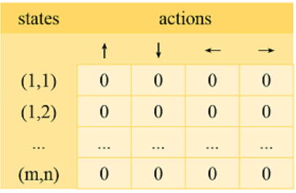

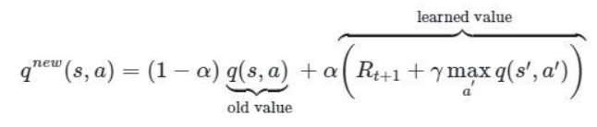
Initiate Q-table
(can be seen as a function of (state, action))
We decide of our reward strategy :
Ex : snake game
reward = -10 if action leads to game_over
reward = + 10 if action leads to eating fruit
else reward = 0
A Q-table indicates the Q-value for each couple (state, action)
In the beginning, we just initialize our Q-table
Ex : Q-table((1,1), ) = 0
At each step of our game :
Perform Action with max Q_value
Calculate current game state
Calculate new game state and reward from action we’ve taken
Read our Q-table for that state
(or random action, exploration/exploitation trade-off with epsilon)
Update Q-value of our Q-table using Bellman’s eq equation :
- alpha : learning rate
- gamma : discount rate (how much future reward matters)
- q(s,a) : Q_value we’ve read in the Q-table (cf third step)
- Rt+1 : reward from the action we’ve taken (cf fourth step)
- maxa’Q(s’,a’) : Max Q_value for the new game state (cf fourth step)

Slide 4
Deep Q learning

Slide 5
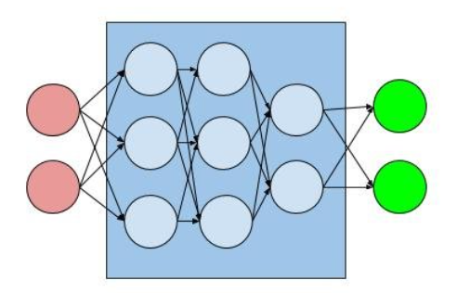
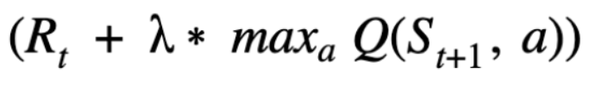
First we create Qnet (which is an approximation of the Q-table, because sometimes there is too many couple (action, state)) :
We decide of :
What the reward is
What a game_state is (a vector that gives relevant information about the current context of the game)
Q_value for Action 1
Game state
Action to perform : Action with max Q_value
Q_value for Action 2
…
Q_value for Action N
QNet
At each step of our game :
Calculate current game state
Calculate Qnet(current game state) = [Q_value_action1, …]
Calculate new game state and reward from action we’ve taken
Calculate target Q_value using bellman’s equation
Perform the action with biggest Q_value in the output of our Qnet
(or random action, exploration/exploitation trade-off with epsilon)
Calculate Loss(target Q_value, max_Q_value of our network)
target Q_value :
Rt : reward after taking our action
Lambda : discount rate
St+1 : new game_state
Q : our QNet
Update model weights accordingly using gradient descent

Slide 6
/!\ : On n’est pas obligé d’update les poids du QNet à chaque step du jeu. En général même, on prend plusieurs actions (N par exemple) et ce n’est qu’après qu’on calcule le loss entre les N dernières Q_values de notre QNetwork et les N dernières targets Q_values de l’équation de Bellman.
Souvent, à chaque step de notre jeu, on enregistre le tuple (actions, états, reward etc) (dans une liste* par ex) qui nous sera utile lorsque l’on entraînera notre Qnet quand la partie est finie.
Quand la partie est finie, en général :
On réentraîne tout notre QNetwork sur N=BATCH_SIZE élément de notre liste* de tuples. On ne prend pas forcément les N=BATCH_SIZE derniers, on les sample plutôt au hasard (random.sample()) car on a observé que ça marchait mieux
Puis on relance une nouvelle partie, jusqu’à ce que notre agent soit suffisamment performant.

