Slide 1
Predicting Likelihood of Depression and depression symptomatology using Machine Learning

Slide 2
Introduction to the research area

Slide 3
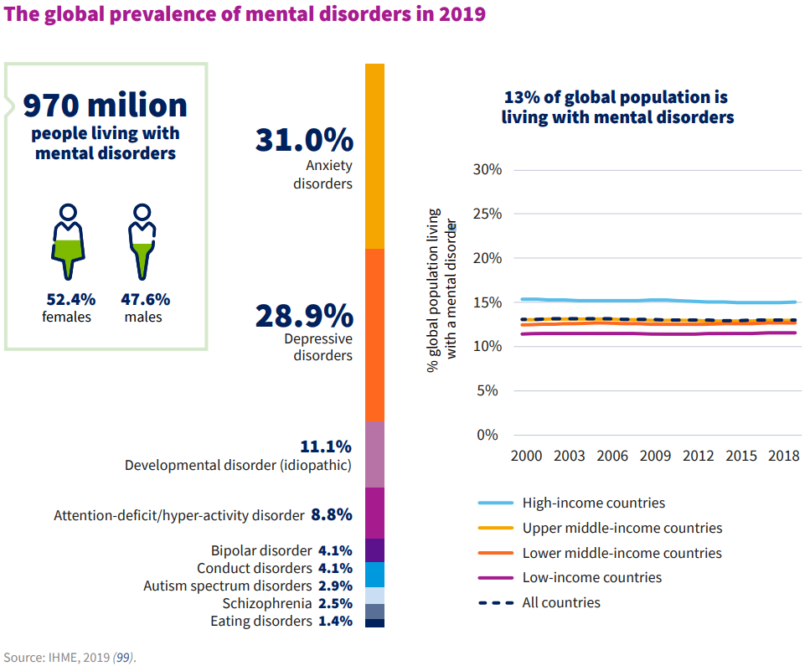
The prevalence of Mental Health Disorders
Statistics from the WHO
According to the World Health Organisation, in 2019, 301 million people globally were living with anxiety disorders; and 280 million were living with depressive disorders (including both major depressive disorder and dysthymia)
Dysthymia is a milder, but long-lasting form of depression and is far less common than depressive disorder.
In 2020, these numbers rose significantly as a result of the COVID-19 pandemic. Prevalence saw an increase of 28% and 26% for major depressive disorders and anxiety disorders, respectively in just one year.

Slide 4
Monitoring Depression
Currently, various methods are being employed to monitor and diagnose depression
Traditionally, Public health departments analyze data from clinical evaluations and self-report measures to identify trends and patterns in the occurrence and prevalence of depression within populations.
Alternatively, newer measures have been implemented, especially because of the increased usage of the internet. This includes sentiment analysis techniques using NLP (Natural Language Processing) and using Machine Learning to make predictions from survey data.
In reality, the issue of dealing with depression in a timely and effective manner stems from our ability as researchers to detect depression in individuals the amount of information we can gain from an individual’s data.

Slide 5

Related work in the field of monitoring depression
Novel Approaches

Slide 6
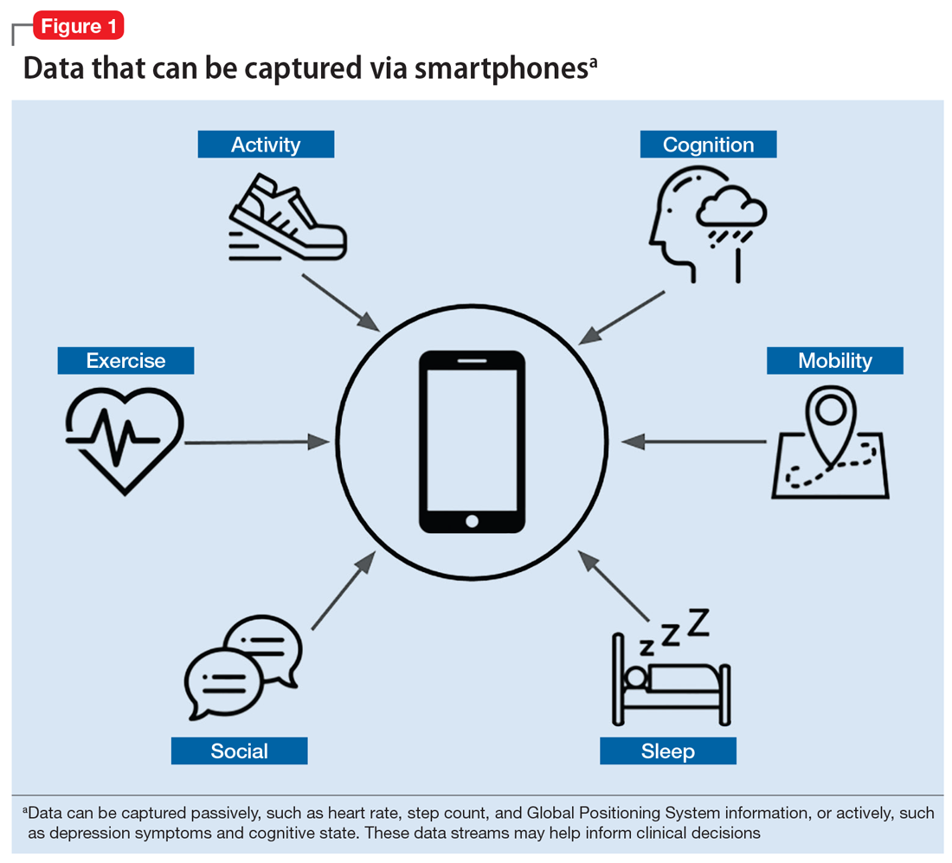
Digital Phenotyping
This involves use of data from smartphones and wearable devices to monitor behavior and physiological signals indicative of depression.
This kind of approach has only evolved due to the proliferation of smart devices and advances in big data.
It provides more continuous and objective data but lacks the depth of clinical interviews for assessing the person’s emotional state.

Slide 7
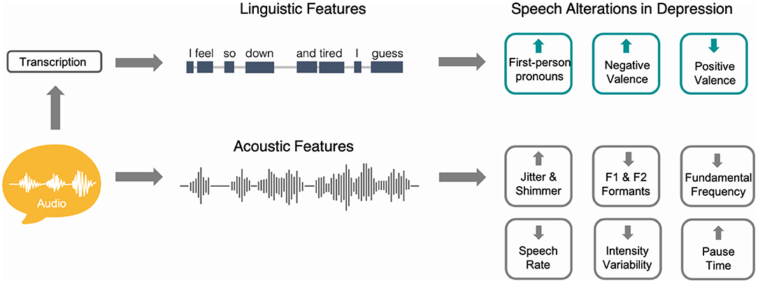
Natural Language Processing (NLP)
https://www.frontiersin.org/journals/psychiatry/articles/10.3389/fpsyt.2021.719125/full

Slide 8
Natural Language Processing (NLP)
NLP is a branch of AI that specifically focuses on understanding, interpreting, and manipulating large amounts of human language and speech data.
For its use in predicting depression, it involves analyzing text from social media, electronic health records, or speech to detect depressive symptoms.
NLP has the potential to capture the speech changes in depression that reflect both physiologic changes at the basic motor level and also higher-level cognitive processing.
It offers insights about depression from naturally occurring language but may lack the structure and reliability of standardized tools like depressive scales.

Slide 9
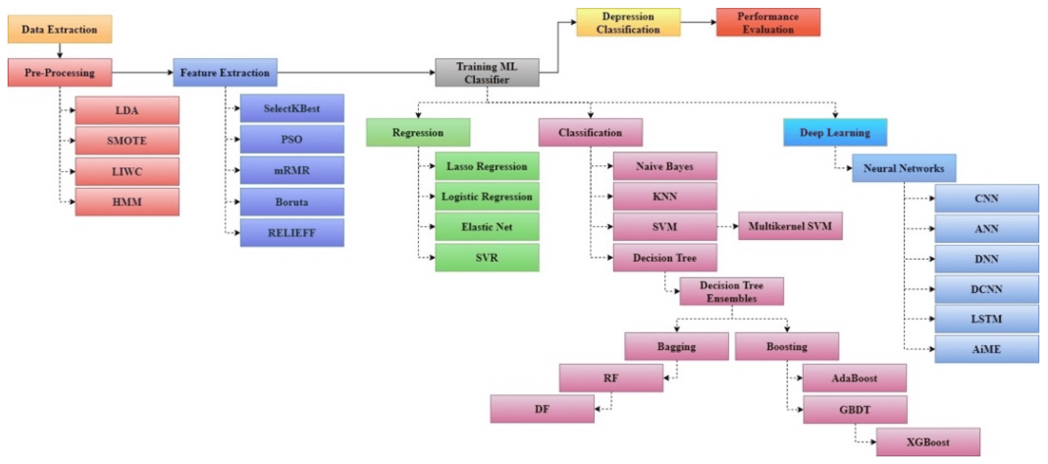
Machine Learning (ML)
https://www.frontiersin.org/articles/10.3389/fdata.2020.00015/full
https://www.mdpi.com/2079-9292/11/7/1111

Slide 10
Machine Learning (ML)
This involves utilizing various ML algorithms to predict depression based on diverse dataset.
Datasets can include surveys, questionnaires, or even datasets extracted from the use of other algorithms or techniques such as health data from digital screening.
There are a number of different types of machine learning models, each with particular strengths and weaknesses based on the aim for the application of the model.
Provides scalability and efficiency but may lack the personalized touch of clinician-administered assessments.

Slide 11
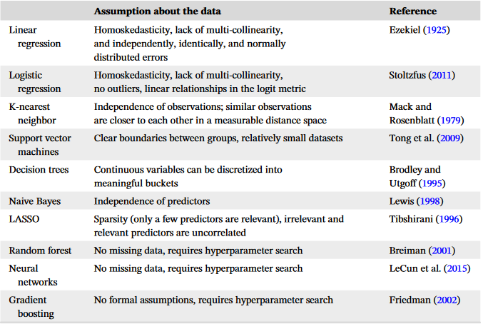
Machine Learning (ML)
https://iaap-journals.onlinelibrary.wiley.com/doi/epdf/10.1111/apps.12435

Slide 12

Motivation for research in the problem area

Slide 13
Depression in south africa
Prevalence of Depression
Depression is a very prevalent and clearly under-diagnosed illness.
The increase in the use of Social Media as well as the effects of Covid-19 are only causing this prevalence to rise.
Mental Health, specifically in South Africa, is quite under-researched when compared to other countries.
Stigma surround depression.
Lack of Research in South Africa
As I’ve shown, there are a number of techniques being used to monitor depression.
To be the best of my knowledge, there aren’t any research papers that specifically use these newer techniques with South African datasets.
Using these newer techniques to analyze South African data for depression could yield great contributions and insights.
South Africa is a culturally complex country and has seen all sorts of changes in its history. Research in depression in a South African context is very valuable for the future of monitoring and dealing with mental health issues.

Slide 14
Research Methodology

Slide 15
Structure of the Research Methodology
Data Collection
Feature selection and labelling
Data Cleaning and Preprocessing
Creation of Machine Learning models (Yet to fully decide on)
Validation of models
Evaluation and comparison of models
Reporting and discussion of findings
Aim:
To investigate the efficacy of using Machine Learning to predict symptoms or likelihood of depression in South Africans from survey data.

Slide 16
Data collection
I intend to use a dataset from the National Income Dynamics Study (N.I.D.S.)
This study includes a longitudinal survey conducted every 3-4 years on over 30000 South African individuals. The survey has questions about demographic data such as age, marital status etc. and has a focus on socioeconomic data such as income, remittance expenditure etc.
Data from the first 3 waves will be used as training data, the 4th as validation data and the final wave as testing data.
In the survey, there are questions relating to the participants’ emotional state. These questions are also found on something known as the CES-D scale, which is a scale used to self-report depression.

Slide 17
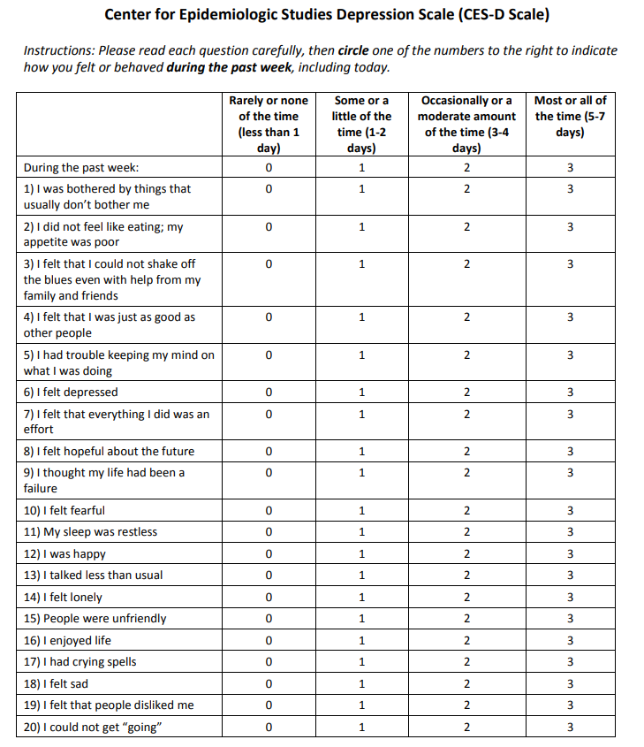
The ces-d scale
10 of the questions on this scale are found in the survey. Therefore, for the purpose of my study, I will be using the 10-item abridged version.
The scoring for each question is simply the person’s answer, so an answer to question 1 would have a score of 3 if the person is frequently bothered by things that usually don’t bother them. Some questions have reverse scoring, like question 12 since that question has a more positive connotation for a more frequent answer.
By taking a cutoff score of 10 as a high likelihood that a person is depressed, we now have a systematic way to self-report participants in the survey as being depressed.
This will serve as our labels for the target variable in the models.

Slide 18
Feature engineering and data preprocessing
Standard practice for data preprocessing will be used to ensure the quality of the data is high. There are also a number of missing values in the dataset, so that will have to be addressed, either by deleting these rows or calculating median/mean values (Imputation).
Sampling is also going to be useful in this case since it is more likely that participants won’t have depression. This leads to a class imbalance which can be addressed by using oversampling or other sampling methods.
Feature selection is also an important process here since we will need to extract the most predictive features for predicting depression from the dataset. This decision will be facilitated by other research into this area.

Slide 19
Validation of ML Models
Validation and tuning of these models is particularly important here because the dataset contains longitudinal data (data that is collected through a series of repeated observations of the same subjects over some time frame)
Cross-validation involves training and testing the model on certain samples of the data and then shuffling the samples. This is done until an asymptote is reached for accuracy on the validation data. This helps prevent the overfitting that is expected to occur since the features used in the CES-D scale to label participants might be used in training the model. We don’t want the machine to just learn how to use the scale, we want it to find associations between different characteristics and a person’s likelihood of depression.

Slide 20
Evaluation and comparison of models
Each model will be evaluated using the standard machine learning evaluation metrics such as Accuracy, Precision, Recall, Confusion Matrices etc. Some metrics may be seen as more important than others like Recall since researchers perhaps would not want the model to incorrectly diagnose someone as not being depressed when they actually are.
All of these metrics will be compared to obtain the best model to prediction in each respect.

Slide 21
Reporting and discussion of findings
This will include a discussion of all of my results across the different models.
Importantly, depending on the different ways that we shape the target variable for each model. We gain different insights. If we get the model to predict peoples’ answers to the CES-D questions, we are learning the association between individual factors and depression symptomatology.
Whereas if we use the model to predict if the person is depressed or not, we now include associations with emotional factors. There is no right or wrong, rather just a decision that depends on the overall goal. My aim is to showcase these different insights.

Slide 22
Limitations of the research
Importantly, I used the CES-D scale to self-report participants for depression. This scale in of itself might have limitations in terms of its accuracy for real diagnoses of depression individuals. Other papers using this dataset have also used this scale and the scale is reported to be very accurate results for actual diagnosis of depression.
Depending on which approach I use for shaping the target variable/s, each approach has different limitations. If I use the CES-D questions in training, the limitations of the scale then weigh in more. If I don’t use the questions in training, then the machine loses information about the person’s emotional state which should be a very indicative feature for predicting depression.
Machine Learning algorithms likely cannot simply replace current monitoring methods for depression. But it’s use can supplement and build on already existing methods which can be seen as outdated since they do not utilize the strengths of these newer, more powerful algorithms.

Slide 23
Thank you
Tristan Dos Remendos

