Slide 1
ST7 – Marchés Financiers
ST7: Minimisation des risques sur les marchés
Quant Research Group – R. Perchet
Paris - February 2024

Slide 2
Build your own investment strategy
Asset manager provides funds with specificities to clients
Investment on US equities market
Investment on Maturity funds for retirement
Passif (ETF):
An asset manager provides an ETF on S&P 500 i.e. the funds is buying the 500 stocks of US equity according the size of the company (Market Caps) for the client and the client just invest his cash in the funds
Actif (OPCVM):
An asset manager provides a funds on S&P 500 i.e. the funds manager is selecting the best stocks (“according to him”) in the investment universe of S&P 500
The goal is to outperform the S&P 500
Projet:
Investment universe US equity market!
Build your own investment strategy (Actif) using different optimization technics and compare this results to a investment in the US equity market (Passif investment)
Using historical data, you will test your strategy in the past

Slide 3

Where is the project in an investment process?
Define the right strategic allocation to chose appropriate risk return trade-off
Adapt the strategic allocation to market conditions: dealing with risk, political events…
Using brick [investment vehicles] to generate alpha
Time horizon: 10, 20 years
Define target risk return trade-off:
5.0%, 10% or 15% of volatility
2.0%, 5.0% or 10% of return
Example:
25% US equities
25% Europe Equities
50% Bonds
Time horizon: 6 months, 1Y
Manage the short term events, crisis & opportunities
Euro zone crisis
Example:
20% US equities
10% Europe Equities
50% Bonds
20% Cash
Choose investment vehicles to implement the strategy: futures, ETF, Fund or fund managed in risk
US market
Facebook
Microsoft
Apple
Goldman Sachs
Air Products & Chemicals
IBM

Slide 4
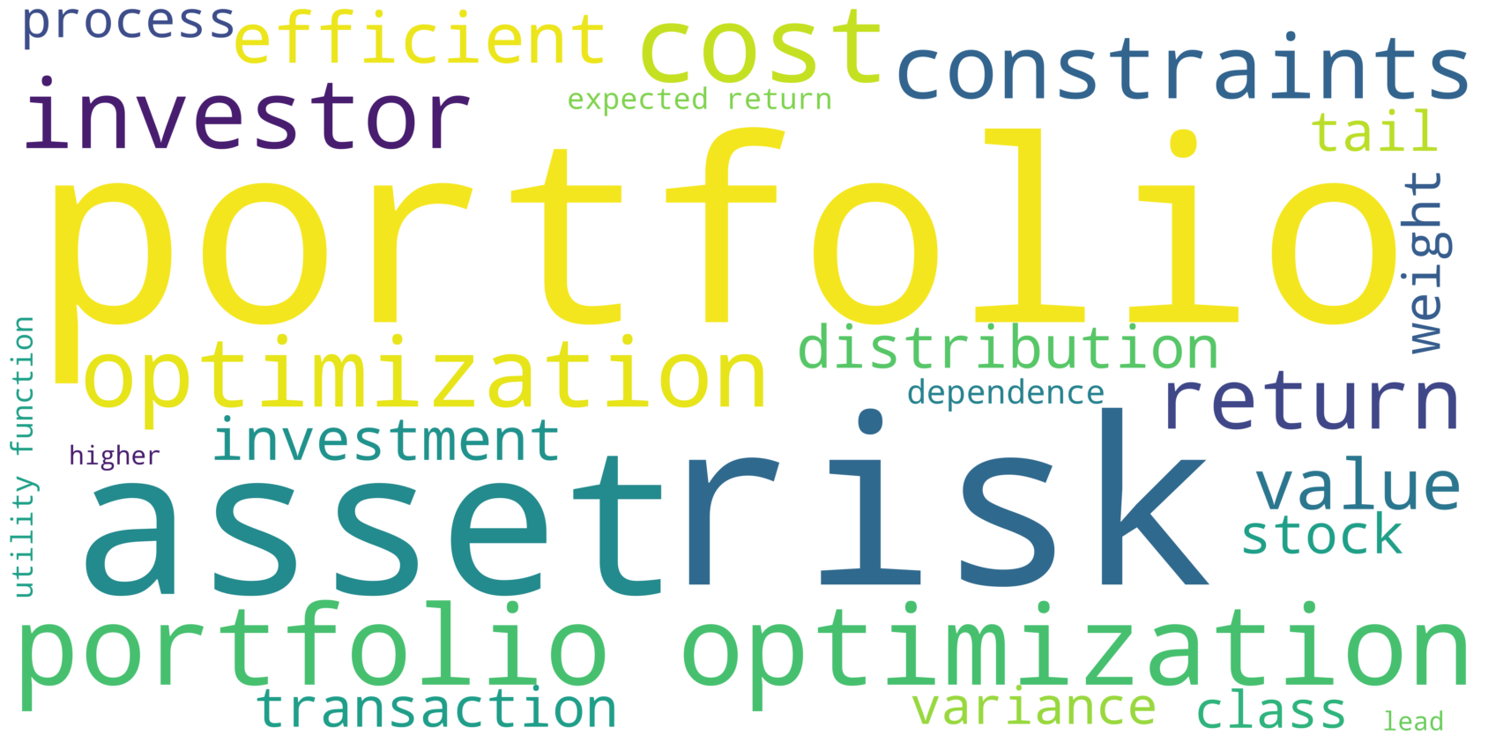
“Portfolio optimization” 25 most frequent words in Wikipedia definition

Slide 5
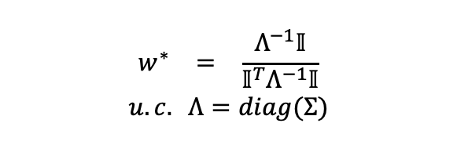
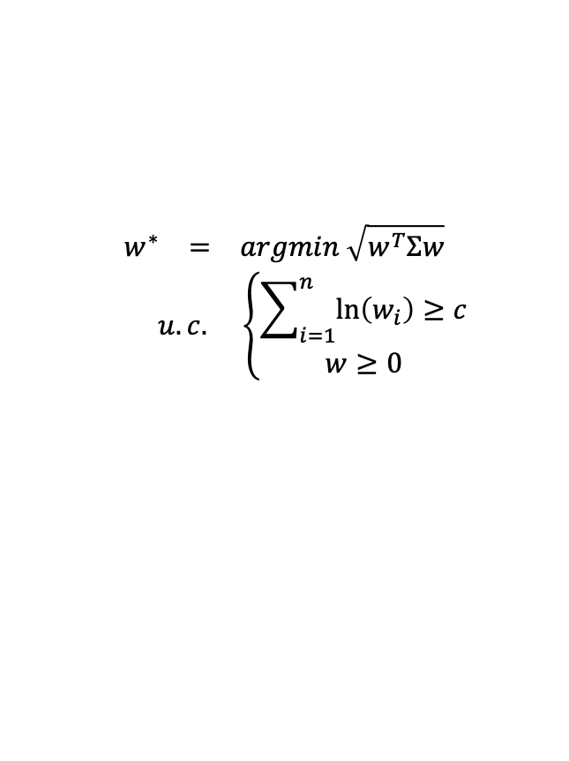
Solve different utility functions
$$\begin{matrix}\begin{matrix}w^{∗} & = & \frac{Λ^{−1}𝕀}{{𝕀^{T}Λ}^{−1}𝕀}\end{matrix} \\ u.c. Λ=diag(Σ)\end{matrix}$$
1
$$\begin{matrix}\begin{matrix}w^{∗} & = & argmin \sqrt{w^{T}Σw}\end{matrix} \\ \begin{matrix} & u.c. & \left\{\begin{matrix}\sum_{i=1}^{n}{\ln\left(w_{i}\right)≥c} \\ w≥0\end{matrix}\right.\end{matrix}\end{matrix}$$
2
Do you allow leverage (yes / no) ? Impact on the utility function?
Do you allow short (yes / no) ? Impact on the utility function?
Look at different utility functions, in the past, advantage & drawback …

Slide 6
Inputs & outputs
Solve the utility function every week, every months with updated data
Inputs | Expected return | Sharpe ratio | Volatility | European equity | US equity | Emerging equity | Euro zone sov. bonds | Euro zone IG corp. bonds | Euro zone HY corp. Bonds | Cash
European equity | 7.2% | 0.40 | 18.0% | 1.00 | 0.80 | 0.78 | 0.00 | 0.25 | 0.50 | 0.00
US equity | 6.3% | 0.42 | 15.0% |  | 1.00 | 0.85 | 0.00 | 0.20 | 0.45 | 0.00
Emerging equity | 8.4% | 0.40 | 21.0% |  |  | 1.00 | 0.00 | 0.30 | 0.55 | 0.00
Euro zone sov. bonds | 2.2% | 0.32 | 7.0% |  |  |  | 1.00 | 0.85 | 0.65 | 0.00
Euro zone IG corp. bonds | 1.8% | 0.35 | 5.0% |  |  |  |  | 1.00 | 0.60 | 0.00
Euro zone HY corp. Bonds | 3.4% | 0.38 | 9.0% |  |  |  |  |  | 1.00 | 0.00
Cash | 0.0% | 0.00 | 1.0% |  |  |  |  |  |  | 1.00
Outputs | Passif | Stragegy 1 | Stragegy 2
Stock 1 | 14.3% | 8.9% | 11.7%
Stock 2 | 14.3% | 10.7% | 14.2%
Stock 3 | 14.3% | 7.6% | 9.7%
Stock 4 | 14.3% | 22.9% | 37.1%
Stock 5 | 14.3% | 32.1% | 41.6%
Stock 6 | 14.3% | 17.8% | 20.3%
Stock 7 | 14.3% | 0.0% | 0.0%
 | 100.0% | 100.0% | 134.0%

Slide 7
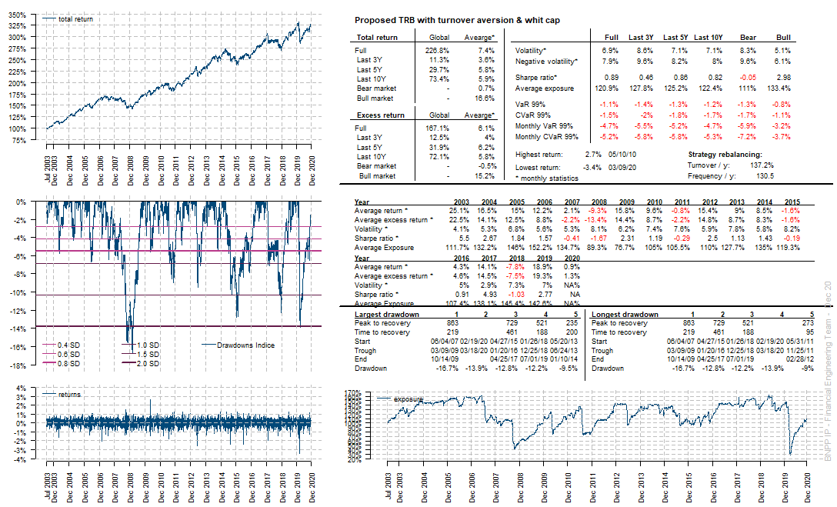
Performance & risk indicators
1- Performance
3 – Ratio perf. risk
2- Risk with confidence level
5 – perf. & risk year by year
4 – Max. drawdown

Slide 8
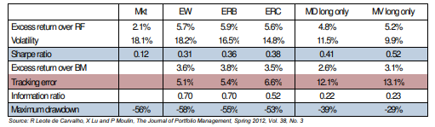
Analysing risk-based strategies’ properties
Equity-riskbased strategies outperformed the market cap index with lower risk!
All risk-based strategies above have much higher risk-adjusted return
Why? Cannot be explained by an increase in diversification! There must be alpha

Slide 9

Questions

Slide 10
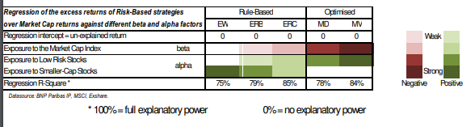
Providing a clear explanation
We show that risk-based strategies invest in portfolios that deviate from the market cap weights to create exposures to:
Low risk stocks in the case of optimized risk-based strategies
Low risk stocks and smaller-cap stocks in the case of rule-based strategies
What is the impact on sector allocation?

Slide 11
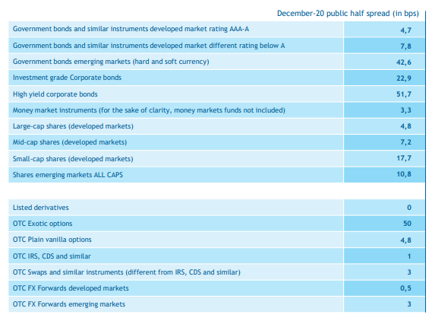
Impact of transaction cost on strategies

Slide 12
Disclaimer
BNP Paribas Asset Management France, “the investment management company,” is a simplified joint stock company with its registered office at 1 boulevard Haussmann 75009 Paris, France, RCS Paris 319 378 832, registered with the “Autorité des marchés financiers” under number GP 96002.
This material is issued and has been prepared by the investment management company.
This material is produced for information purposes only and does not constitute:
1. an offer to buy nor a solicitation to sell, nor shall it form the basis of or be relied upon in connection with any contract or commitment whatsoever or
2. investment advice.
This material makes reference to certain financial instruments authorised and regulated in their jurisdiction(s) of incorporation.
No action has been taken which would permit the public offering of the financial instrument(s) in any other jurisdiction, except as indicated in the most recent prospectus and the Key Investor Information Document (KIID) of the relevant financial instrument(s) where such action would be required, in particular, in the United States, to US persons (as such term is defined in Regulation S of the United States Securities Act of 1933). Prior to any subscription in a country in which such financial instrument(s) is/are registered, investors should verify any legal constraints or restrictions there may be in connection with the subscription, purchase, possession or sale of the financial instrument(s).
Investors considering subscribing to the financial instrument(s) should read carefully the most recent prospectus and Key Investor Information Document (KIID) and consult the financial instrument(s’) most recent financial reports. These documents are available on the website.
Opinions included in this material constitute the judgement of the investment management company at the time specified and may be subject to change without notice. The investment management company is not obliged to update or alter the information or opinions contained within this material. Investors should consult their own legal and tax advisors in respect of legal, accounting, domicile and tax advice prior to investing in the financial instrument(s) in order to make an independent determination of the suitability and consequences of an investment therein, if permitted. Please note that different types of investments, if contained within this material, involve varying degrees of risk and there can be no assurance that any specific investment may either be suitable, appropriate or profitable for an investor’s investment portfolio.
Given the economic and market risks, there can be no assurance that the financial instrument(s) will achieve its/their investment objectives. Returns may be affected by, amongst other things, investment strategies or objectives of the financial instrument(s) and material market and economic conditions, including interest rates, market terms and general market conditions. The different strategies applied to financial instruments may have a significant effect on the results presented in this material. Past performance is not a guide to future performance and the value of the investments in financial instrument(s) may go down as well as up. Investors may not get back the amount they originally invested.
The performance data, as applicable, reflected in this material, do not take into account the commissions, costs incurred on the issue and redemption and taxes.
All information referred to in the present document is available on www.bnpparibas-am.com
P170000_AM Studio

