Slide 1

– Group 1 –
Volatility-Managed
Portfolio Analysis
By Tristan Leiter, Filip Kindermann

Slide 2



Part I: Volatility-Managed Portfolio - Regression
Generating alpha and reducing market exposure with volatility-managed portfolios
Data & Methodology:
Based on the paper from Moreira & Muir (2017) – adjusting the realized variance estimate by using all daily returns within that month
Data:
Estimate monthly realized variance and monthly excess returns:
Construct the volatility-managed portfolio:
Sort months into variance quintiles:
U.S. stock market data from Kenneth French’s data library
From 1926 to 2015
Using all daily returns within that month
Different than in Moreira & Muir (2017)
$$f_{t+1}^{σ}=\frac{c}{{\hat{σ}}_{t}^{2}(f)}f_{t+1}$$
Compute the 0.2, 0.4, 0.6 and 0.8 quantiles by lagged variance
Label groups from “Low Vol” (lowest variance) to “High Vol” (highest variance)
$$with c=sd(f)/sd\left(\frac{1}{{\hat{σ}}_{t}^{2}\left(f\right)}f_{t+1}\right)$$
Regression on original portfolio:
Key Insights:
Volatility-managed returns explained by original returns
Results are annualized and in percent
Standard errors are Newey-West corrected due to heterogeneity in returns
Significant Alpha: The intercept of 4.80% represents a large, statistically significant alpha, indicating that the strategy generated excess returns not explained by the market.
Reduced Market Risk: The slope (beta) of 0.61 shows that the portfolio has significantly less market exposure than a buy-and-hold strategy, confirming the volatility timing mechanism works.
Strategy vs. Market: The R-squared of 37.22% means the market explains less than 40% of the strategy's performance, proving that the volatility-timing component itself is a major driver of the results.
Model Fit: The regression is robust, based on 1073 observations, with an RMSE (residual standard error) of 51.31.
$$f_{t}^{σ}=α+βf_{t}+ε_{t}$$
 | Coefficient | Std. error | p-value
Intercept (%) | 4.80 | 1.69 | 0.004 ***
Original Return | 0.61 | 0.08 | 0.000 ***
R² | # of obs. | RSME
37.22 % | 1073 | 51.31

Slide 3
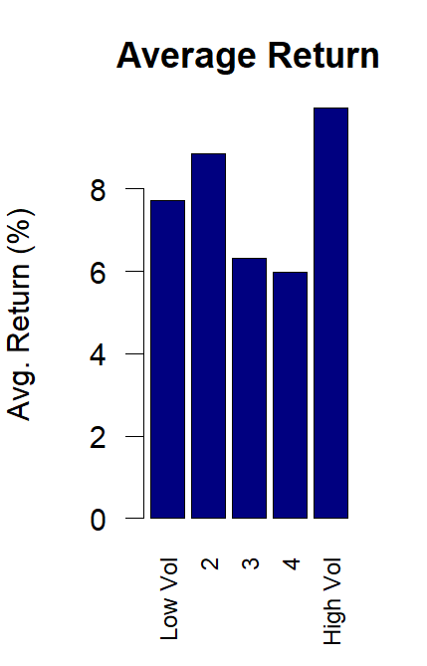
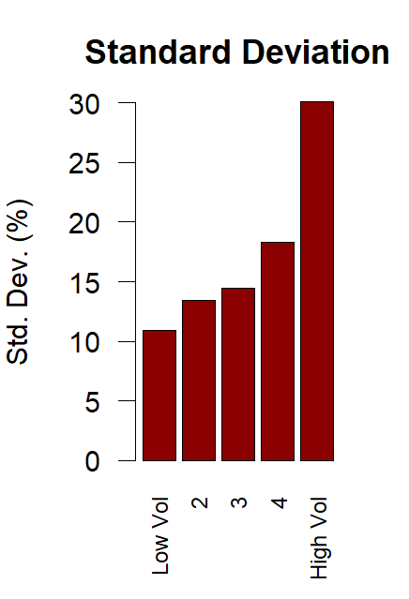
Part I: Volatility-Managed Portfolio – Quintile Analysis
Deconstructing the Anomaly: Volatility is Predictable, Compensation is Not
Quintile analysis (annualized)
Key Insights:
No Simple Risk-Return Trade-off:
  The "Average Return" plot shows no clear, positive relationship. While the highest volatility quintile has high returns, so does the lowest, and the relationship is not monotonic. This suggests investors are not proportionally compensated for bearing more (predictable) volatility.
Volatility is Highly Predictable:
  The "Standard Deviation" plot shows a strong, monotonic increase. This confirms that sorting by the previous month's volatility is an effective way to forecast the next month's volatility.

Slide 4
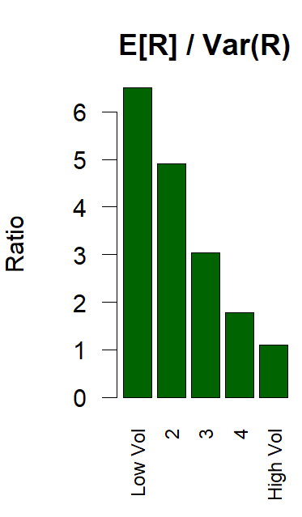
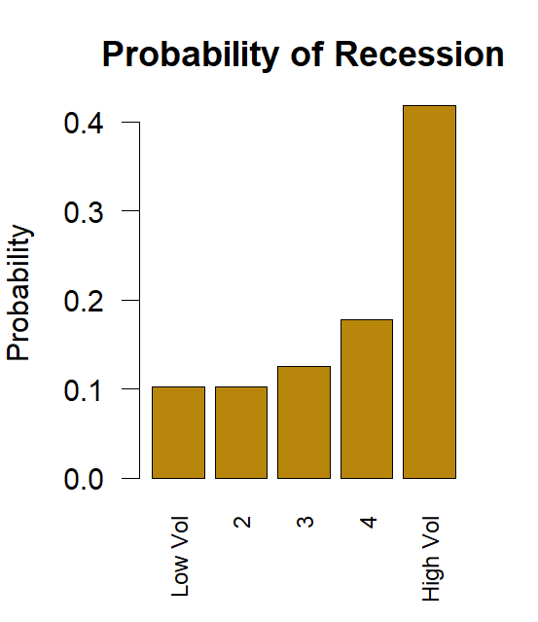
Part I: Volatility-Managed Portfolio – Quintile Analysis
Exploiting the Anomaly: Risk-Adjusted Returns Collapse as Recession Risk Rises
Quintile analysis (annualized)
Key Insights:
The Core Anomaly:
  The "E[R]/Var(R)" plot is the key. It shows the risk-return trade-off (the reward per unit of risk) is excellent when volatility is low and collapses when volatility is high. This is the inefficiency the strategy exploits.
Volatility is "Bad Times":
  The "Probability of Recession" plot shows that high volatility periods are strongly correlated with NBER recessions. This means the risk-return trade-off is worst precisely during bad economic times.

Slide 5

Part II
Volatility-managed portfolios increase Sharpe ratios & decrease drawdowns
Data & Methodology:
Compared to Part I, we adapt the realized variance calculation and add the value factor into our dataset
Adjustments to part I
Data:
Estimate monthly realized variance and monthly excess returns:
Construct the volatility-managed portfolio:
Compare metrics
Daily returns of
  U.S. stock market
  Momentum factor
From 1926 to 2024
For month t, using last D = 17 daily returns to end of that month
$$f_{t+1}^{σ}=\frac{c}{{\hat{σ}}_{t}^{2}(f)}f_{t+1}$$
Investigate differences between original portfolios and volatility-managed portfolios
Metrics: SR, Max drawdown, alphas
$$with c=sd(f)/sd\left(\frac{1}{{\hat{σ}}_{t}^{2}\left(f\right)}f_{t+1}\right)$$
Results Sharpe Ratios and Maximum Drawdown
Key Insights:
 | SR (monthly) | SR (annualized) | Max. Drawdown
Original Market | 0.1022 | 0.3647 | -84.73 %
Managed Market | 0.1176 | 0.4219 | -60.14 %
Original Mom | 0.0731 | 0.2567 | -75.11 %
Managed Mom | 0.1991 | 0.7166 | -39.94 %
Market Portfolio (Success): Volatility management continues to work for the market portfolio.
  Risk-Adjusted Return: SR increases from 0.3647 to 0.4219 p.a.
  Downside Protection: improving Max Drawdown from -84.73% to
  -60.14%
Momentum Portfolio (Major Success): The D=17 strategy is extremely effective for the Momentum factor
  Risk-Adjusted Return: SR nearly triples, jumping from 0.2567 to a very high 0.7166
  Downside Protection: almost halving the Max Drawdown from -75.11% to -39.94%

Slide 6
Part II
Volatility-managed portfolios generate significant alpha for both market and momentum
Alpha relative to the market and to original portfolio respectively:
Key Insights:
Standard errors and p-values are adjusted using Newey-West (lag = 6)
Managed Market (Success): The D=17 strategy works for the market.
  The managed portfolio generates a statistically significant alpha of 4.24% (p = 0.01) relative to the original, unmanaged market. This confirms the strategy itself is adding value.
Managed Momentum (Success): The strategy is also highly successful for the momentum factor.
  The bottom table shows the key result: the "Managed Momentum" portfolio generates a massive, statistically significant alpha of 7.40% (p < 0.001) relative to the "Original Momentum" portfolio.
  This proves the management process itself adds substantial, statistically significant value on top of the existing momentum strategy.
On market | Alpha (%) | t value | p-value
Original Market | 0 | n/a | n/a
Managed Market | 4.24 | 2.64 | 0.01 ***
Original Mom | 5.95 | 6.03 | 0.00 ***
Managed Mom | 9.35 | 7.57 | 0.00 ***
On orig. portfolio | Alpha (%) | t value | p-value
Original Market | 0 | n/a | n/a
Managed Market | 4.24 | 2.64 | 0.01 ***
Original Mom | 0 | n/a | n/a
Managed Mom | 7.4 | 6.65 | 0.00 ***
This specific (D=17) volatility scaling rule proved highly effective, clearly improving Sharpe ratios, reducing maximum drawdowns, and generating significant, positive alpha for both the market and the momentum factor

