Slide 1

Group 17 –
Factor Data Analysis
By Tristan Leiter, Filip Kindermann

Slide 2

Factor interpretation.
Intuition and economic interpretation of the selected factors
Quality minus Junk - profitability:
Momentum (t-12 to t-1):
Sales growth (3 years):
First Publication:
Asness et al. (2019)
Jegadeesh et al. (1993)
Lakonishok et al. (1994)
Underlying
observation:
Firms with high quality scores earn higher excess returns than those with low quality scores (junk)
Stocks that performed well in the last 3 to 12 months tend to outperform in the near-term future
Firms with the lowest past sales growth outperform those with the highest.
Methodology
for this analysis:
Quality is measured by several profitability measures
Sorting firms based on their quality scores
Long in the top 33% of firms (high quality)
Short in the bottom 33% (junk firms)
Each month, stocks are ranked based on their performance in the last 12 months (excluding last month)
Long in the winner portfolios (highest tercile)
Short in the loser portfolios (lowest tercile)
stocks are ranked based on past sales growth figures over 3 years
Long in the low sales growth firms (lowest tercile)
Short in the high sales growth firms (highest tercile)
QMJ $=High Quality−Low Quality$
Mom $=Past winner−past loser$
S$ales growth=lowest sales growth−highest sales growth$
Economic
interpretation:
Idea: quality companies (those with strong fundamentals) should command higher prices
But markets often underprice them
Analysts are too optimistic about junk stocks and too pessimistic about quality
Interpretation is based on behavioral patterns
  underreaction to news
  delayed overreaction (Daniel et al, 1998)
  investor herding behavior (Barberis et al., 1998)
Idea: Stocks with high past sales growth are often overvalued under the assumption that such growth will continue
But past sales growth exhibits poor predictability, which makes this assumption flawed
Further
observations
The evidence challenges risk-based explanations and aligns rather with mispricing
Li et al. (2023) find that seasonality effects and investor sentiment contribute to the persistence of the QMJ factor.
The momentum factor is prone to large drawdowns, as first documented by Daniel and Moskowitz (2016), who show that momentum crashes occur primarily during sharp market recoveries.
The sales growth factor is conceptually similar to the value factor (HML), as both bet against "glamour" stocks and favor "cheap" or "neglected" stocks.

Slide 3
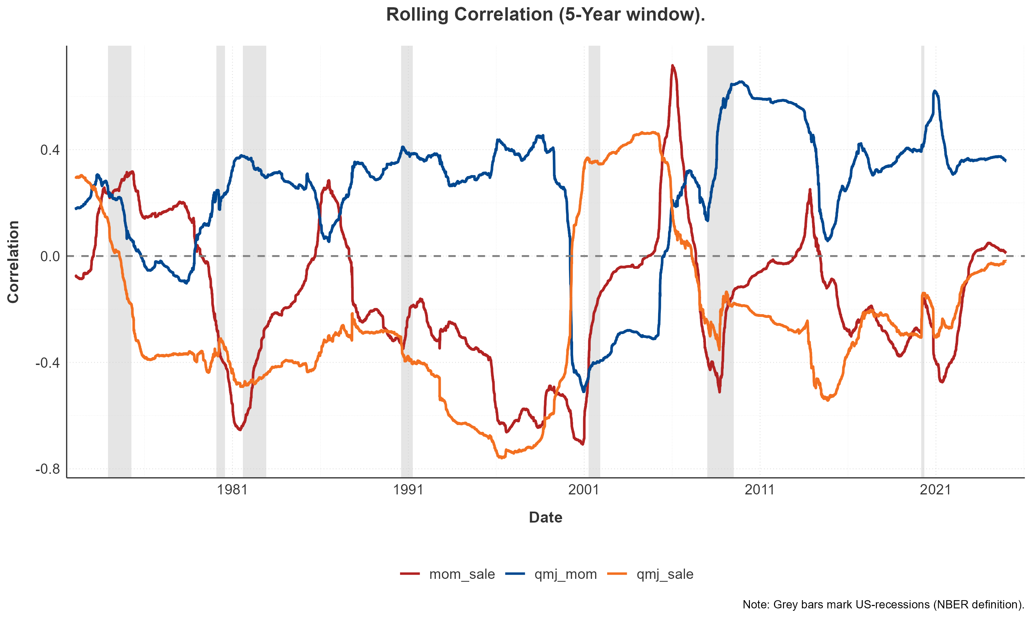
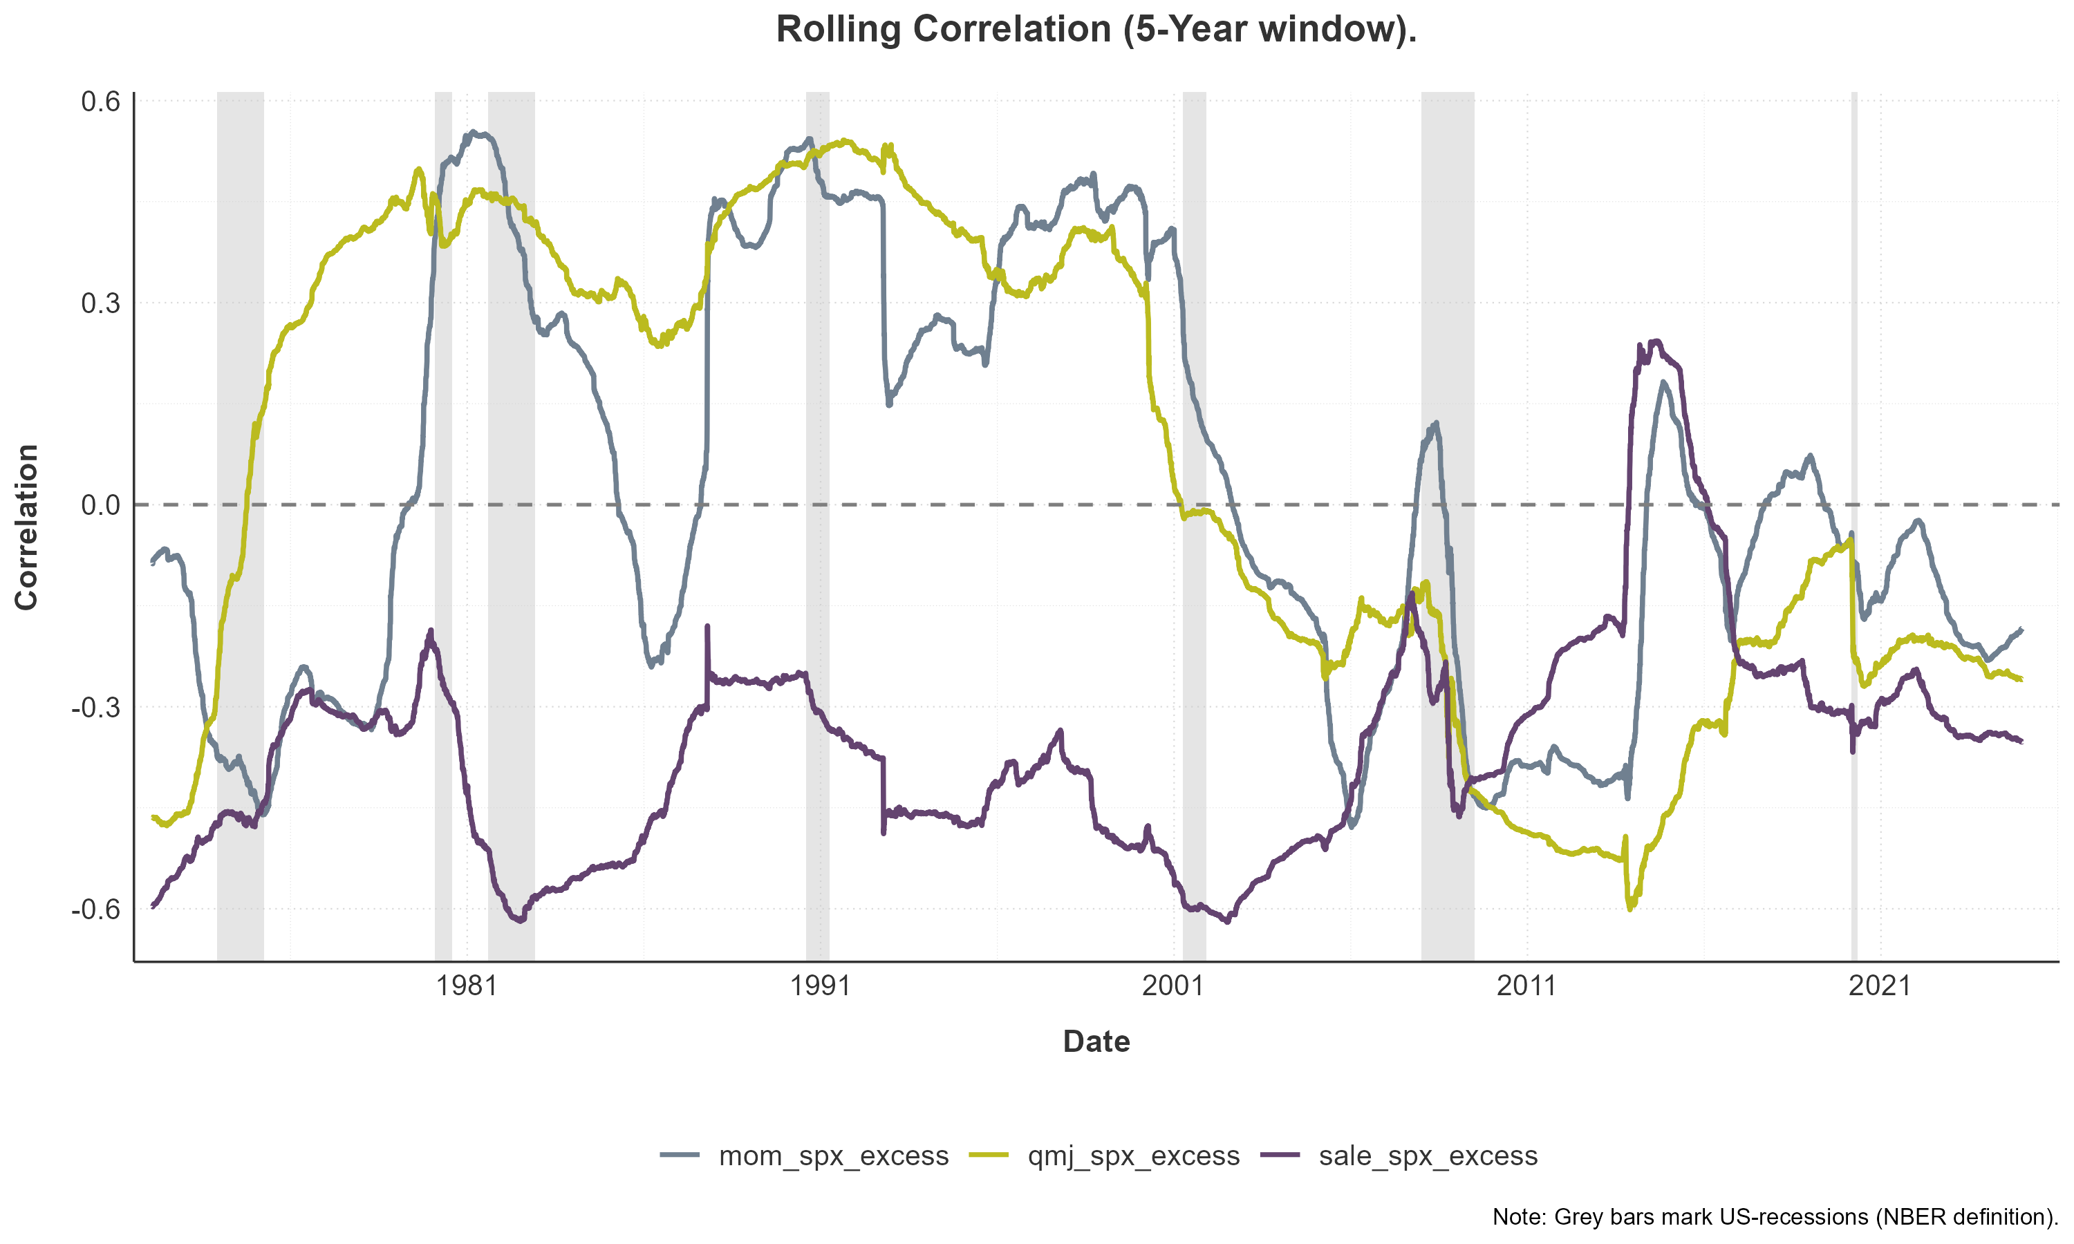
Factor interpretation.
Factor interactions, conceptual relation and co-movements
Rolling Correlation across factors (5-year window)
QMJ: profitability and momentum
QMJ: profitability and momentum
Conceptual
Relation:
Lowly correlated and often complementary in portfolios
Economic
Relation:
Interaction effects as factors exhibit momentum themselves (Arnott et al. (2018)). Ma et al. (2024) find that stocks with accelerating quality metrics tend to earn higher subsequent returns, which highlights a partially positive relation to momentum.
0.4
Correlation
0.0
QMJ: profitability and sales growth
-0.4
QMJ: profitability and sales growth
Conceptual
Relation:
Negative relationship between qmj and HML (Asness et al. (2019)), which conceptually is closely related to sale.
-0.8
1981
1991
2001
2011
2021
Economic
Relation:
The QMJ: profitability factor is loading on the most profitable firms with high prices whilst sale is typically long cheap firms with little “glamour”.
Date
Rolling Correlation with S&P 500 (5-year window)
0.6
Momentum and Sales growth
Momentum and Sales growth
Conceptual
Relation:
Contrarian co-movements (Asness et al. (2013)) as sales growth is long on low sales-growth stocks, which is similar to a value strategy whilst momentum favors recent winners, which can contribute to a high exposure to growth stocks.
0.3
Correlation
0.0
Economic
Relation:
Empirical finding support the conceptual claim. Yet, their correlation structure is prone to sudden changes. Economically, both momentum and sales growth factors tend to underperform during market recoveries—momentum due to reversals, and sales growth because its value-like tilt proves ineffective when markets rebound sharply from troughs.
-0.3
-0.6
1981
1991
2001
2011
2021
Date
Note: Grey bars mark US Recessions (NBER definition)

Slide 4
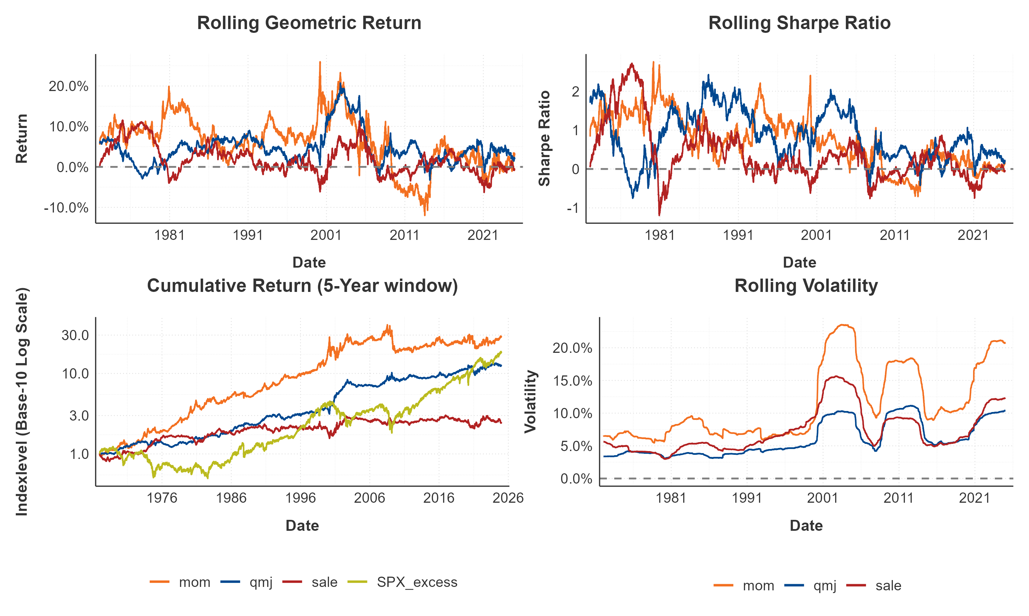
Historic Performance and Risk Analysis
Key-risk return characteristics and rolling-window analysis
Momentum (mom) delivered the highest geometric return (5.93%) but also exhibited the highest volatility (12.65%) and the largest max. drawdown (-55.44%) among the three. Its negative skewness (-1.22) also points to a propensity for larger negative surprises. The higher likelihood of severe crashes compared to the other factors is a key characteristic for the momentum factor (Daniel and Moskowitz (2016)).
Quality-minus-Junk Profitability (qmj) achieved a geometric return of 4.45% with substantially lower volatility (6.51%) than mom, resulting in the highest Sharpe Ratio (0.68) of the three factors. Its max. drawdown (-25.24%) was also the most contained.
Sales Growth (sale) offered the lowest geometric return (1.55%) and Sharpe Ratio (0.19).
Within the period from 1967 to 2024 all three factors imply a relatively high autocorrelation (lag 1) ranging from 0.09 to 0.17.
 | qmj | mom | sale | SPX excess | TBIL3M | TBOND10Y
Geometric Return | 4.45 | 5.93 | 1.55 | 5.11 | 4.52 | 6.05
Volatility | 6.51 | 12.65 | 7.99 | 16.85 | 0.2 | 0.19
Sharpe Ratio | 0.68 | 0.47 | 0.19 | 0.3 | n/a | n/a
Information Ratio | 0.01 | 0.1 | -0.1 | -0.36 | 0 | 0.08
Max. DD | -25.24 | -55.44 | -38.40 | -59.96 | 0 | 0
Skewness | -0.33 | -1.22 | -0.22 | -0.6 | 0.57 | 0.55
AC1 | 0.09 | 0.17 | 0.12 | -0.01 | 1.0 | 1.0
Time-variability of factor returns:
The rolling geom. return and Sharpe-Ratio both show signs of time-variability in the factor returns. The returns of qmj and mom seem to spike during periods of broad market downturns (1970s, dot-com bubble and GFC 2008). Even though qmj and mom performed well during the GFC, they were subsequently not able to benefit from the broad market recovery. All factors show a decay of factor returns after the GFC.
Volatility clustering:
Common spikes in volatility persist across all three factors during market crises, though the magnitude and persistence differ considerably, ranging from rather low volatility of the qmj factor to the momentum crashes of the mom factor.

Slide 5
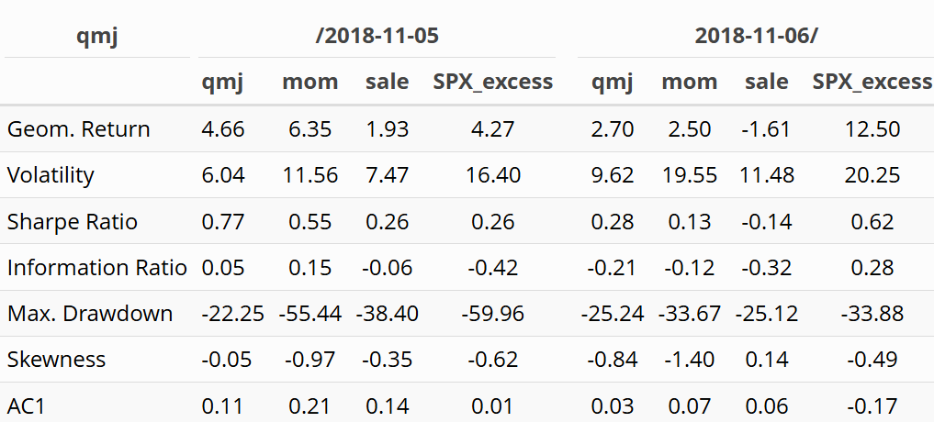
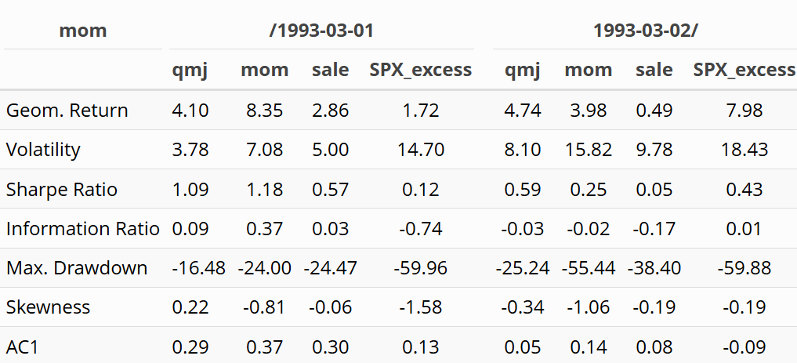
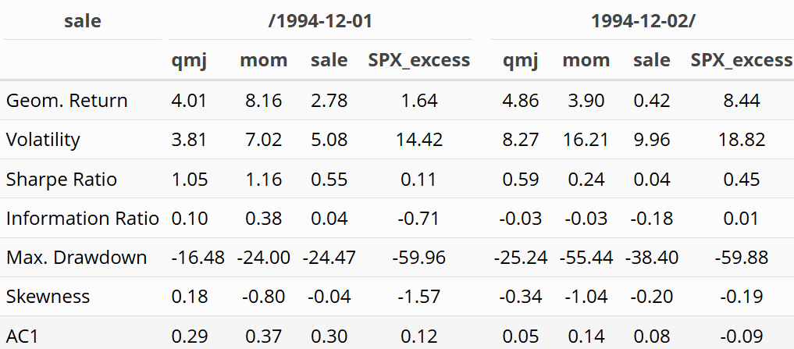
Historic Performance and Risk Analysis.
Historical performance prior/post publication
QMJ:
Mom:
Sales:
Quality-minus-Junk Profitability:
Prior to publication the qmj factor showed a
2% higher geometric return than post publication. The risk profile worsened post publication as well with the skewness decreasing by 0.8.
Momentum:
Among all factors, the mom factor’s geometric return decreased the most after publication (-4.37%). The volatility more than doubled whilst the max. drawdown worsened from -24.00% to -55.44%. The 1st autocorrelation decayed from 0.37 to 0.14, suggesting less predictability.
Sales Growth 3 Years:
Post publication, the sales factor records little to no performance anymore (0.42% p.a.). Additionally, the Sharpe Ratio decreased from 0.55 to 0.04. The autocorrelation numbers also imply a drastic decrease in factor return predictability.
Relation to literature:
Factor crowding after publication.
Among others, Feng et al. (2020) find persistency in the factor.
Time-variability of the qmj-risk premium, to which Asness et al. (2019) refer to as the “price of quality”:
  Since 2018, the market has recorded an above-average geometric return.
  qmj has performed well during periods with high uncertainty (2022/2023).
Relation to literature:
Factor crowding after publication.
Momentum as a persistant risk-premium, but also times other factors (Randl et al. (2023)),
Momentum crashes (Ehsani & Linnainmaa (2022)) dominated the factor performance since 2007:
  GFC -55.44% drawdown.
  2017 -23.33% drawdown.
  2020 -22.86% drawdown.
  2022 -21.56% drawdown.
Relation to literature:
Weak explanatory power as more comprehensive and robust factors have been identified, which target similar economic drivers (Feng et al. (2020)).
High aggregate sales growth negatively predicts future returns (Garfinkel et al. (2025)). The factor was likely a result of mispricing due to errors in expectations of the cash flow channel.

Slide 6
Spanning regressions
Explanatory power of asset pricing models
Quality minus Junk: profitability:
 | CAPM | FF3 | aug. q-factors | FF5+Mom.
APT alpha: | 5.01% | 6.62% | 1.34% | 3.69%
(t-statistic) | 5.32 | 8.19 | 1.87 | 5.77
R² | 2% | 33% | 44% | 55%
Adj. R² | 2% | 33% | 44% | 55%
AIC | -119,348 | -124,803 | -127,475 | -130,757
BIC | -119,326 | -124,765 | -127,422 | -130,696
Key insights:
The figures include a Newey-West correction with a sample period from 1967-2024
CAPM and FF3 models show limited explanatory power, with low R² and higher residual alphas, indicating they fail to fully capture cross-sectional return patterns.
Alpha magnitudes shrink substantially as models expand, suggesting that the augmented q-factor model and FF5+Momentum absorb much of the anomaly-related mispricing.
FF5+Momentum explains the most variation across factors (highest R² and adj. R²), particularly for Momentum and Sales Growth, highlighting its strong fit.
The augmented q-factor model better absorbs mispricing for Profitability (reduces alpha effectively) but leaves more variance unexplained compared to FF5+Momentum.
Factor differences:
  Momentum is almost fully explained by FF5+Momentum (R² ~86%, alpha near zero), as it includes a momentum factor.
  Profitability shows persistent alpha across models, suggesting some pricing power remains unexplained.
  Sales Growth is well-explained by FF5+Momentum and augmented q-factor model
AIC/BIC favor expanded models, validating the better model fit despite added complexity.
Conclusion: FF5+Momentum provides the most comprehensive explanation for cross-sectional returns, while the q-factor model performs well for profitability-related anomalies.
Momentum:
 | CAPM | FF3 | aug. q-factors | FF5+Mom.
APT alpha: | 6.90% | 8.54% | 0.01% | 0.40%
(t-statistic) | 3.71 | 4.8 | 0.01 | 0.59
R² | 0% | 9% | 18% | 86%
Adj. R² | 0% | 9% | 18% | 86%
AIC | -99,683 | -101,047 | -102,507 | -127,995
BIC | -99,661 | -101,009 | -102,454 | -127,934
Sales growth (3 years):
 | CAPM | FF3 | aug. q-factors | FF5+Mom.
APT alpha: | 3.34% | 1.74% | -0.40% | -1.14%
(t-statistic) | 3.25 | 2.19 | -0.52 | -1.72
R² | 18.00% | 48.00% | 58.00% | 67.00%
Adj. R² | 18.00% | 48.00% | 58.00% | 67.00%
AIC | -115,920 | -122,629 | -125,769 | -129,025
BIC | -115,897 | -122,591 | -125,716 | -128,965

Slide 7
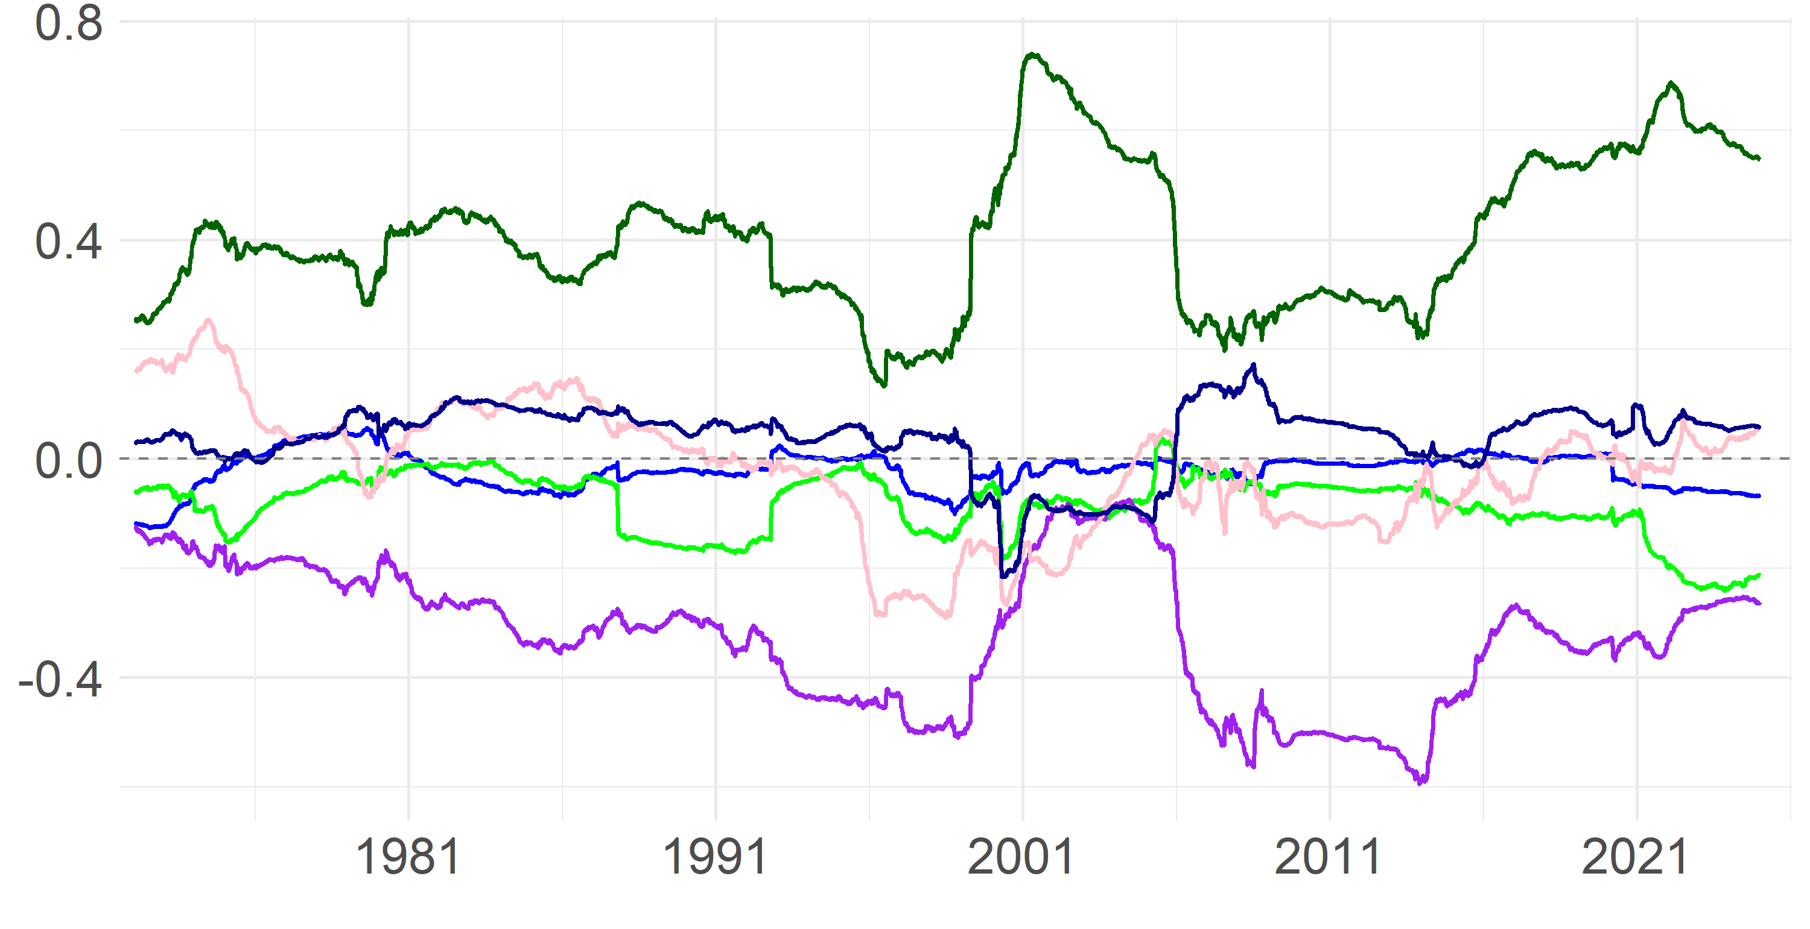
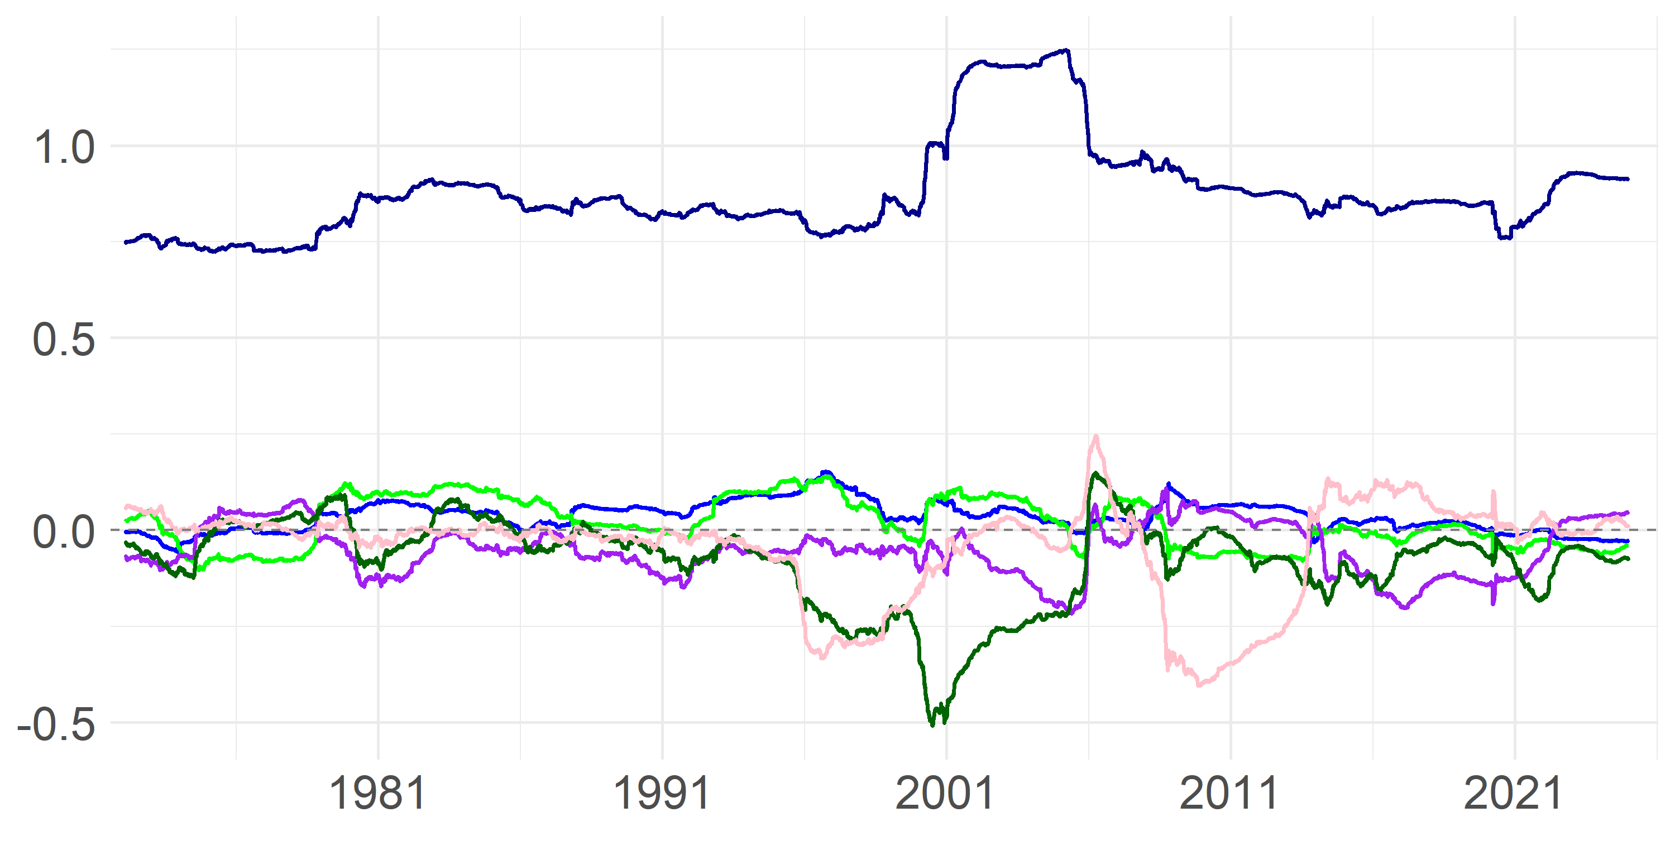
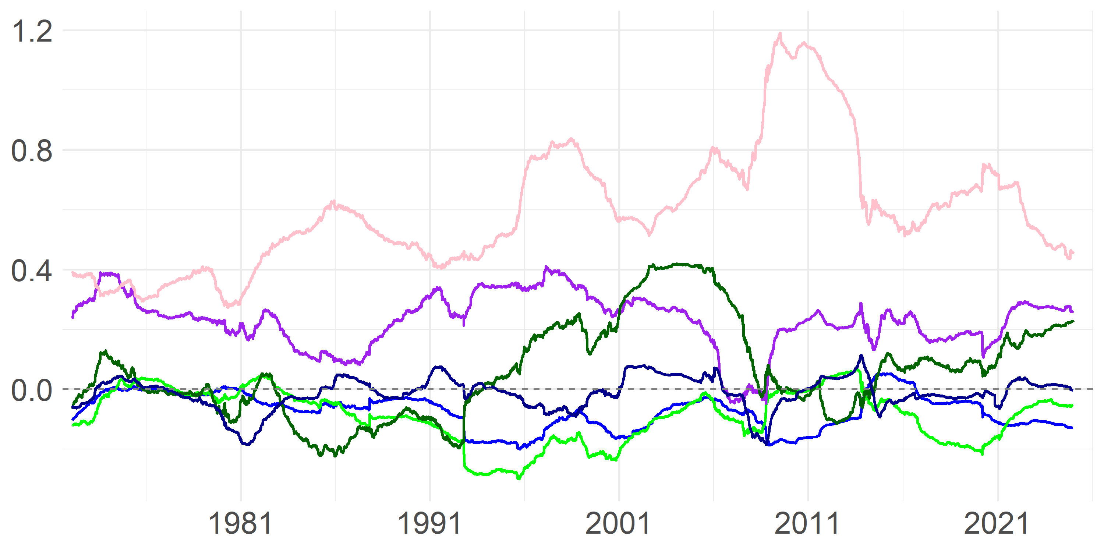

Spanning Regressions
Factor exposures to Fama-French 5 factor + momentum model
FF5 + Momentum:
Quality minus Junk - profitability:
Momentum (t-12 to t-1):
Sales growth (3 years):
Significant factors*:
MKT | SMB | HML | RMW | CMA | MOM
MKT | SMB | HML | RMW | CMA | MOM
MKT | SMB | HML | RMW | CMA | MOM
Rolling exposure to factors (5 years):
Most sizeable exposures:
Highest exposure to the profitability factor
Correction exposure to the value factor
Other factor exposure a little in magnitude
Highest exposure to the momentum factor
Temporarily smaller corrections by investment and profitability factor
Note: Fama French momentum factor has specifications 2-12
Highest exposure to the investment factor
Followed by the value factor and temporarily the profitability factor
Auxiliary regressions:
$$r_{QMJ}=α+β_{1}r_{Mom}+β_{2}r_{Sales}+ε$$
$$r_{Mom}=α+β_{1}r_{QMJ}+β_{2}r_{Sales}+ε$$
$$r_{Sales}=α+β_{1}r_{QMJ}+β_{2}r_{Mom}+ε$$
Summary:
APT α | β Mom. | β Sales | R²
3.9% | 0.1 | -0.03 | 4.6%
APT α | β QMJ | β Sales | R²
5.0% | 0.40 | -0.14 | 5.2%
APT α | β QMJ | β Mom. | R²
2.5% | -0.05 | -0.06 | 1.1%
Key insights:
Little explanatory power
Momentum is significant
Exposure low in magnitude
Little explanatory power
Both are significant
Exposure to QMJ rather high
Little explanatory power
Momentum is significant
Exposure low in magnitude
*measured over the full sample period at a 5% significance level; grey box illustrates not-significant factors

Slide 8
Bibliography
Arnott, R., Clements, M., Kalesnik, V., & Linnainmaa, J. (2018). Factor momentum [Working paper]. SSRN. https://ssrn.com/abstract=3116974
Arnott, R. D., Kalesnik, V., & Linnainmaa, J. T. (2023). Factor momentum. The Review of Financial Studies, 36(8), 3034–3070.
Asness, C. S., Frazzini, A., & Pedersen, L. H. (2019). Quality minus junk. Review of Accounting Studies, 24(1), 34–112.
Asness, C. S., Moskowitz, T. J., & Pedersen, L. H. (2013). Value and momentum everywhere. The Journal of Finance, 68(3), 929–985.
Barberis, N., Shleifer, A., & Vishny, R. (1998). A model of investor sentiment. Journal of Financial Economics, 49(3), 307–343.
Daniel, K., Hirshleifer, D., & Subrahmanyam, A. (1998). Investor psychology and security market under- and overreactions. The Journal of Finance, 53(6), 1839–1885.
Daniel, K., & Moskowitz, T. J. (2016). Momentum crashes. Journal of Financial Economics, 122(2), 221–247.
Ehsani, S., & Linnainmaa, J. T. (2022). Factor momentum and the momentum factor. The Journal of Finance, 77(3), 1877–1919.
Fama, E. F., & French, K. R. (1992). The cross-section of expected stock returns. The Journal of Finance, 47(2), 427–465.
Fama, E. F., & French, K. R. (2004). The capital asset pricing model: Theory and evidence. Journal of Economic Perspectives, 18(3), 25–46.
Fama, E. F., & French, K. R. (2015). A five-factor asset pricing model. Journal of Financial Economics, 116(1), 1–22.
Feng, G., Giglio, S., & Xiu, D. (2020). Taming the factor zoo: A test of new factors. The Journal of Finance, 75(3), 1327–1370.
Garfinkel, J. A., Hribar, P., & Hsiao, L. (2025). Aggregate sales growth and stock market returns [Working paper]. SSRN.
Hou, K., Mo, H., Xue, C., & Zhang, L. (2021). An augmented q-factor model with expected growth. Review of Finance, 25(1), 1–41. https://doi.org/10.1093/rof/rfaa004
Jegadeesh, N., & Titman, S. (1993). Returns to buying winners and selling losers: Implications for stock market efficiency. The Journal of Finance, 48(1), 65–91.
Lakonishok, J., Shleifer, A., & Vishny, R. W. (1994). Contrarian investment, extrapolation, and risk. The Journal of Finance, 49(5), 1541–1578.
Li, R., Liu, R., Zhang, Z., & Zhao, X. (2023). Junk stocks vs quality stocks, a perspective from mood seasonality. Applied Economics Letters, 30(3), 349–354.
Ma, Y., Yang, B., & Ye, T. (2024). Quality acceleration and cross-sectional returns: Empirical evidence. Research in International Business and Finance, 69, 102269. https://doi.org/10.1016/j.ribaf.2024.102269
Madura, J., & Richic, N. (2004). Overreaction of exchange-traded funds during the bubble of 1998-2002. Journal of Behavioral Finance, 5(2), 91–104.
Moskowitz, T. J., Ooi, Y. H., & Pedersen, L. H. (2012). Time series momentum. Journal of Financial Economics, 104(2), 228–250.
Neuhierl, A., Randl, O., Reschenhofer, C., & Zechner, J. (2023). Timing the factor zoo (SSRN Working Paper Series No. 4376898). SSRN.

Slide 9
Glossary
Term | Full Form / Meaning | Context
QMJ | Quality Minus Junk (Profitability) | Factor measuring profitability anomaly
MOM | Momentum | Factor measuring past winners vs. losers
SALE | Sales Growth (3 Years) | Factor based on past sales growth
CAPM | Capital Asset Pricing Model | Asset pricing model (Sharpe, 1964)
FF3 | Fama-French 3-Factor Model | Model with market, size, value factors
FF5 | Fama-French 5-Factor Model | FF3 + profitability + investment factors
FF5+Momentum | Fama-French 5-Factor Model plus Momentum | FF5 model augmented with MOM factor
Q5 | Augmented q-Factor Model (Hou et al., 2021) | Q factor model augmented with EG factor
GFC | Global Financial Crisis | 2008–2009 market crisis
HML | High Minus Low (Value factor in FF models) | Value factor: high vs. low book-to-market
AIC/BIC | Akaike/Bayesian Information Criterion | Model selection criteria in regressions
t-12 to t-1 | Time period: 12 months ago to 1 month ago | Used in Momentum calculation

