Slide 1
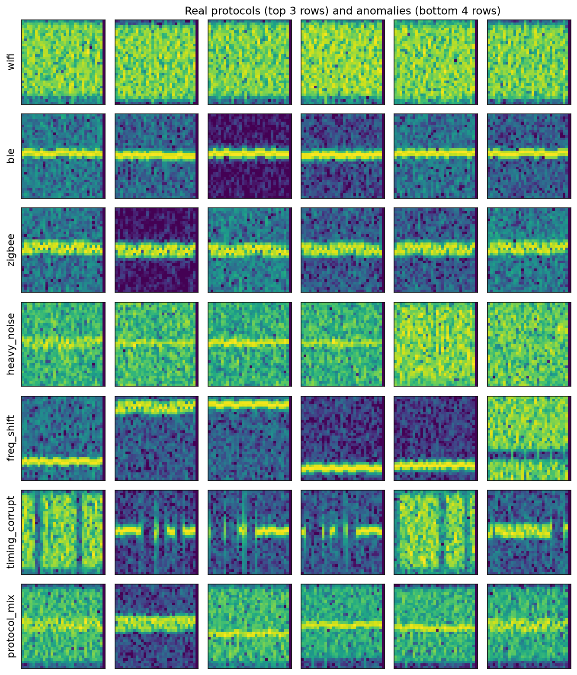
ECE 1508 · COURSE PROJECT
Deep Generative Models for
Synthetic RF Signals & Anomaly Detection
Comparing a VAE, a Flow, a Diffusion Model, and Mamba
Tristan Ruel · Student No. 1012867710
University of Toronto
3 protocols (top) · 4 anomaly types (bottom)

Slide 2
The Problem & The Data
Realistic RF datasets are hard to collect, label, and balance — corrupted, malformed, and protocol-inconsistent transmissions are rare. Can a model learn the distribution of valid signals well enough to both generate realistic samples and flag ones that do not fit?
1
Synthetic, reproducible corpus
Wi-Fi (OFDM), BLE (GFSK), ZigBee (O-QPSK/DSSS) — pure-NumPy I/Q, seeded.
2
Shared 32×32 spectrograms
One log-STFT representation for every model → a fair comparison.
3
Four anomaly types (test-only)
Heavy noise · frequency shift · timing corruption · protocol mixing.

Slide 3
Four Generative Models
All class-conditional. Anomaly score = min over classes of each model's native score.
V
F
D
M
Conditional VAE
RealNVP Flow
Conditional DDPM
Mamba (I/Q)
LATENT-VARIABLE
EXPLICIT LIKELIHOOD
DENOISING / DIFFUSION
AUTOREGRESSIVE SSM
Conv encoder–decoder; maximise the ELBO.
Logit + 8 coupling layers; exact log p(x).
Class-cond. U-Net predicts added noise.
Selective SSM over raw I/Q tokens; exact discrete p(x).
score: neg. ELBO
score: neg. log-likelihood
score: denoising error
score: neg. log-likelihood
Inputs: VAE / flow / DDPM share a peak-normalised 32×32 STFT spectrogram; Mamba is autoregressive over the raw I/Q sequence. All train on normal signals only; anomalies are held out.

Slide 4
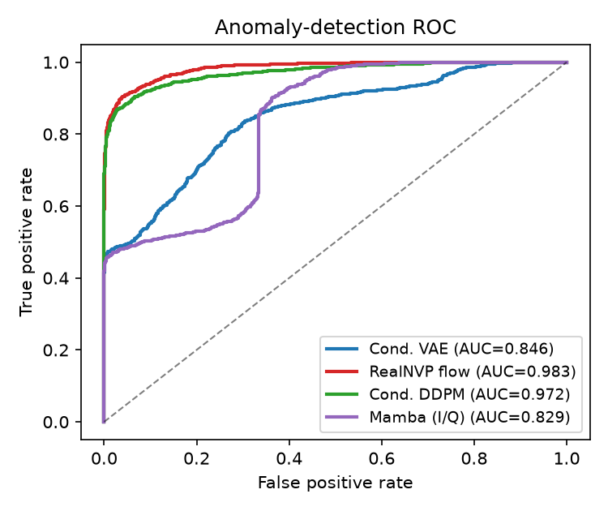
Results
Anomaly-detection ROC-AUC (trained on normal signals only)
0.983
RealNVP flow
explicit likelihood — best detector
0.972
Conditional DDPM
denoising — best fidelity (Fréchet 0.16)
0.846
Conditional VAE
latent — cheapest, but over-smooths
0.829
Mamba (raw I/Q)
autoregressive — clean discrete likelihood
Class-conditional generation succeeded for all four (100% classifier accuracy).

Slide 5
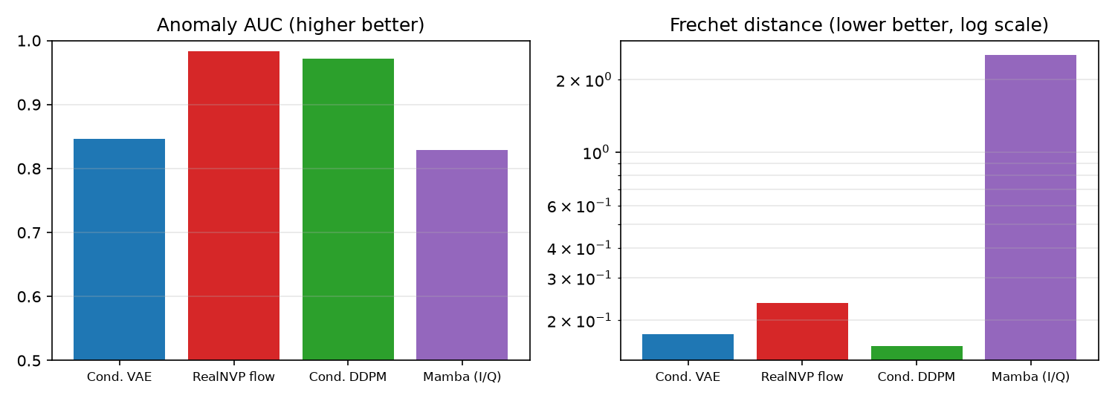
Conclusion
For RF anomaly detection under limited data, prefer likelihood-based or denoising models over the VAE.
Flow
Best detector (AUC 0.983) and exact likelihoods; largest model.
Diffusion
Near-best detection (0.972) + most realistic samples; slow sampling.
VAE
Cheapest & fastest with an encoder; weak detector, blurry samples.
Anomaly AUC ↑ · Fréchet ↓
github → reproducible pipeline · report · demo notebook
Mamba (I/Q)
Raw-I/Q autoregressive; clean discrete likelihood, but weakest detector & costliest.
Future: raw-I/Q flows · over-the-air capture · flow-detector + diffusion-generator hybrid

