Slide 1
Boggle Design
Tristin Glunt
tglunt@unm.edu
CS 351: Project 2

Slide 2
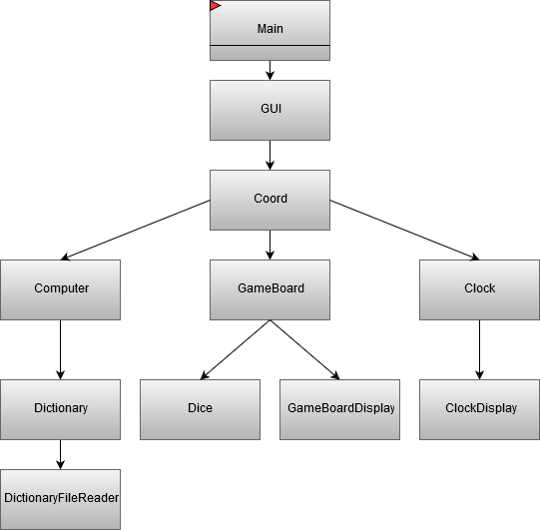
Boggle Design

Slide 3
