Slide 1
Domino Design
CS 351 UNM: Project 1
9/14/2017
Tristin Glunt

Slide 2
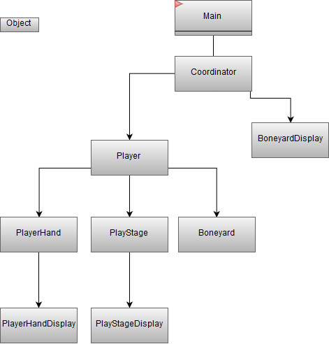
One Player

Slide 3
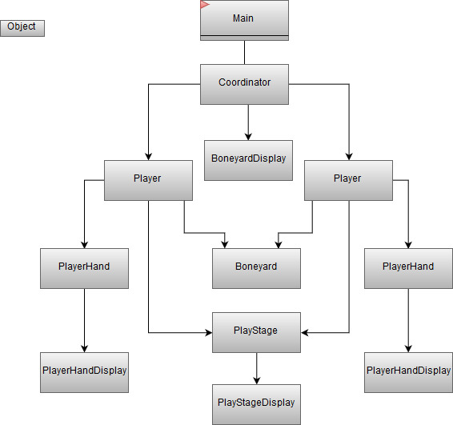
Two Players

