Slide 1
SpaceX Falcon 9
First-Stage Landing Prediction
IBM Data Science Capstone Project
Final presentation | Data collection, analysis, interactive visualization, and machine learning
Dataset period: 2010-2020
Notes:
[Sources]
- User-provided completed notebooks in C:/Users/Administrator/Downloads/completed/ipynb.

Slide 2
GITHUB PROJECT URL
GitHub Repository URL
Public project repository
https://github.com/TristinWen/spacex-falcon9-landing-prediction
Repository evidence
Seven completed notebooks • Dash source and screenshots • Folium map • Final PPTX/PDF • Final DOCX/PDF report
Notes:
[Sources]
- https://github.com/TristinWen/spacex-falcon9-landing-prediction

Slide 3
EXECUTIVE SUMMARY
The analysis identifies where and when Falcon 9 landings succeed
A reusable first stage lowers launch cost, so predicting landing success supports competitive bid estimates.
90
87.8%
83.3%
41.7%
Falcon 9 launches
successful landings in prepared labels
test accuracy across four models
share of all successful launches at KSC LC-39A
Key implication
Operational history and launch context provide useful predictive signal, while launch site, orbit, payload, and booster configuration explain meaningful differences in outcomes.
Notes:
[Sources]
- Data Wrangling notebook: class mean 0.8777778.
- Machine Learning notebook: model_scores output.
- Dash screenshot: All Sites success share.

Slide 4
INTRODUCTION: BACKGROUND AND PROBLEM
Predicting first-stage landing success supports launch-cost estimates
Business context
Analytical problem
SpaceX can offer lower launch prices partly because Falcon 9 first stages are designed for recovery and reuse.
Determine which mission characteristics are associated with a successful landing and compare classification models that predict the outcome.
Target variable: Class = 1 for successful landing; Class = 0 for unsuccessful landing.
Notes:
[Sources]
- IBM Data Science Capstone project problem statement and completed Data Wrangling notebook.

Slide 5
METHOD
The project combines seven analytical stages
01
02
03
04
05
06
07
API collection
→
Web scraping
→
Wrangling
→
EDA + SQL
→
Folium + Dash
→
Feature engineering
→
Model selection
Evidence was retained in executed notebooks, dashboard screenshots, and an interactive Folium HTML map.
Notes:
[Sources]
- Completed notebooks and spacex-dash-app.py supplied by the user.

Slide 6
DATA COLLECTION: SPACEX API
SpaceX API data collection produces 90 Falcon 9 launch records
Request and parse launch JSON
90
• Request past launches from the SpaceX REST API
• Normalize JSON into a Pandas DataFrame
• Resolve rocket, payload, launchpad, and core IDs
• Retain booster, payload, orbit, site, outcome, reuse, and coordinates
Falcon 9 launch records
17 analytical fields
Notes:
[Sources]
- API collection notebook Tasks 1-3 and final Falcon 9 DataFrame.

Slide 7
DATA COLLECTION: WEB SCRAPING
Web Scraping extracts 121 historical launch-table rows
BeautifulSoup parsing workflow
121
• Request the Wikipedia Falcon 9 launch snapshot
• Extract HTML table headers
• Parse flight, date, booster, site, payload, orbit, customer, outcome, and landing
• Convert the launch dictionary to a Pandas DataFrame
parsed launch rows
11 output columns
Notes:
[Sources]
- Web scraping notebook Tasks 1-3 and parsed DataFrame output.

Slide 8
DATA WRANGLING
Data Wrangling creates a consistent landing-success target
Launches by site
Wrangling steps
CCAFS SLC 40
55
• Replace missing PayloadMass with the mean
• Retain LandingPad nulls as meaningful “no pad” values
• Map unsuccessful outcomes to Class = 0
• Map remaining outcomes to Class = 1
KSC LC 39A
22
VAFB SLC 4E
13
Result: 90 rows, no missing PayloadMass values, and an 87.8% success share.
Notes:
[Sources]
- Data Wrangling notebook Tasks 1-4.

Slide 9
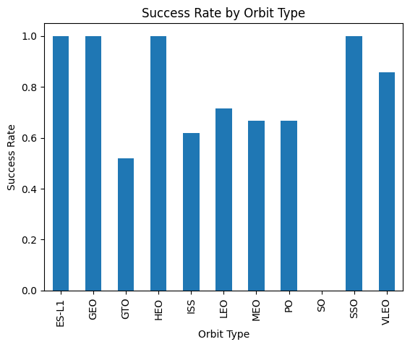
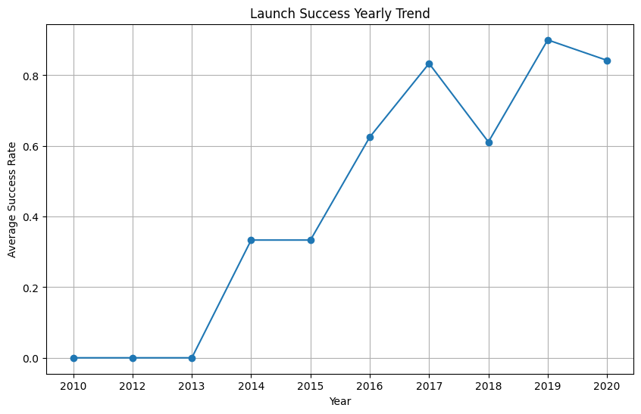
EXPLORATORY DATA ANALYSIS WITH DATA VISUALIZATION
EDA with Visualization shows success improving over time
Yearly Launch Success Trend
Success Rate by Orbit Type
Notes:
[Sources]
- EDA visualization notebook Tasks 3 and 6.

Slide 10
EXPLORATORY DATA ANALYSIS WITH SQL
EDA with SQL confirms milestones and payload patterns
NASA CRS payload
45,596 kg
Avg. F9 v1.1 payload
2,928.4 kg
First ground-pad success
22 Dec 2015
Successful missions
100*
Drone-ship successes, 2010-2017
5
SQL Tasks 1-10 completed; *source records include “Success” and “Success ” as separate values.
Notes:
[Sources]
- SQL notebook Tasks 1-10.

Slide 11
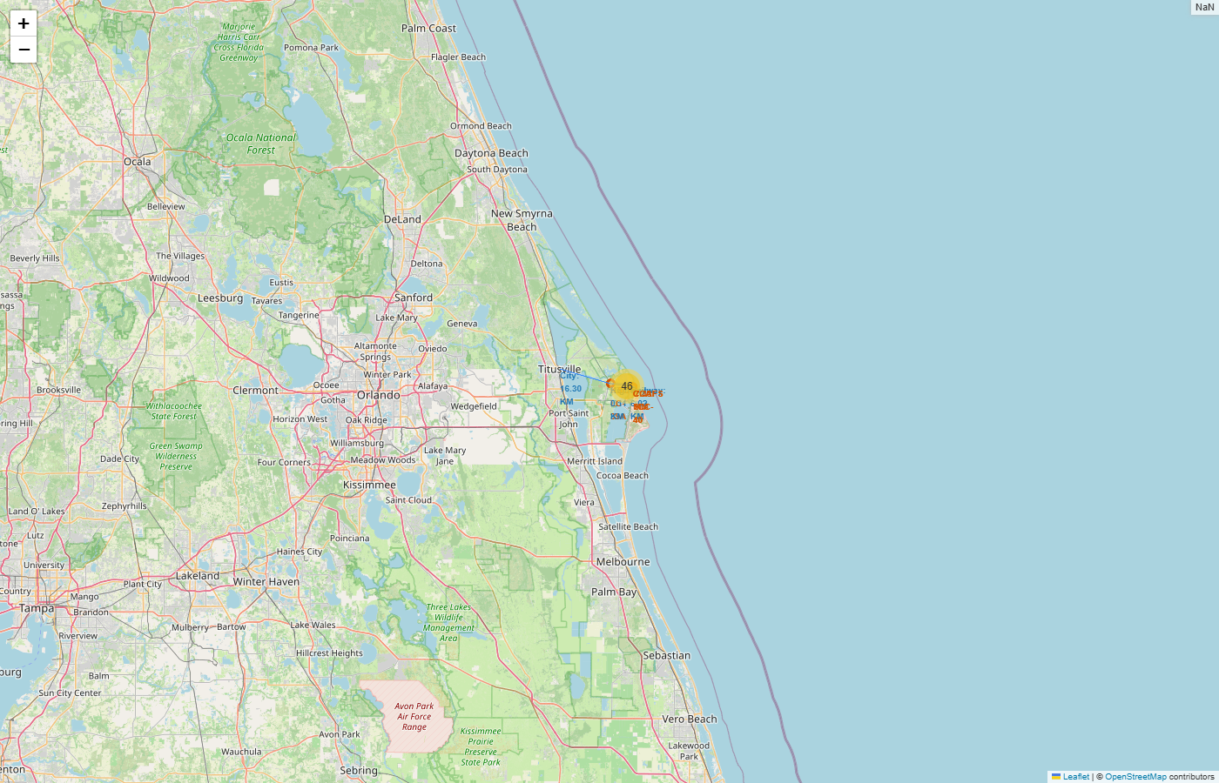
INTERACTIVE VISUAL ANALYTICS: FOLIUM
Interactive Visual Analytics with Folium maps launch-site proximity
Required Folium evidence
• All launch sites marked
• Success and failure markers clustered
• Distance to coastline calculated
• Lines to city, railway, and highway proximities
Notes:
[Sources]
- Folium notebook Tasks 1-3 and spacex_launch_site_proximity_map.html.
- OpenStreetMap tiles rendered from the interactive map.

Slide 12
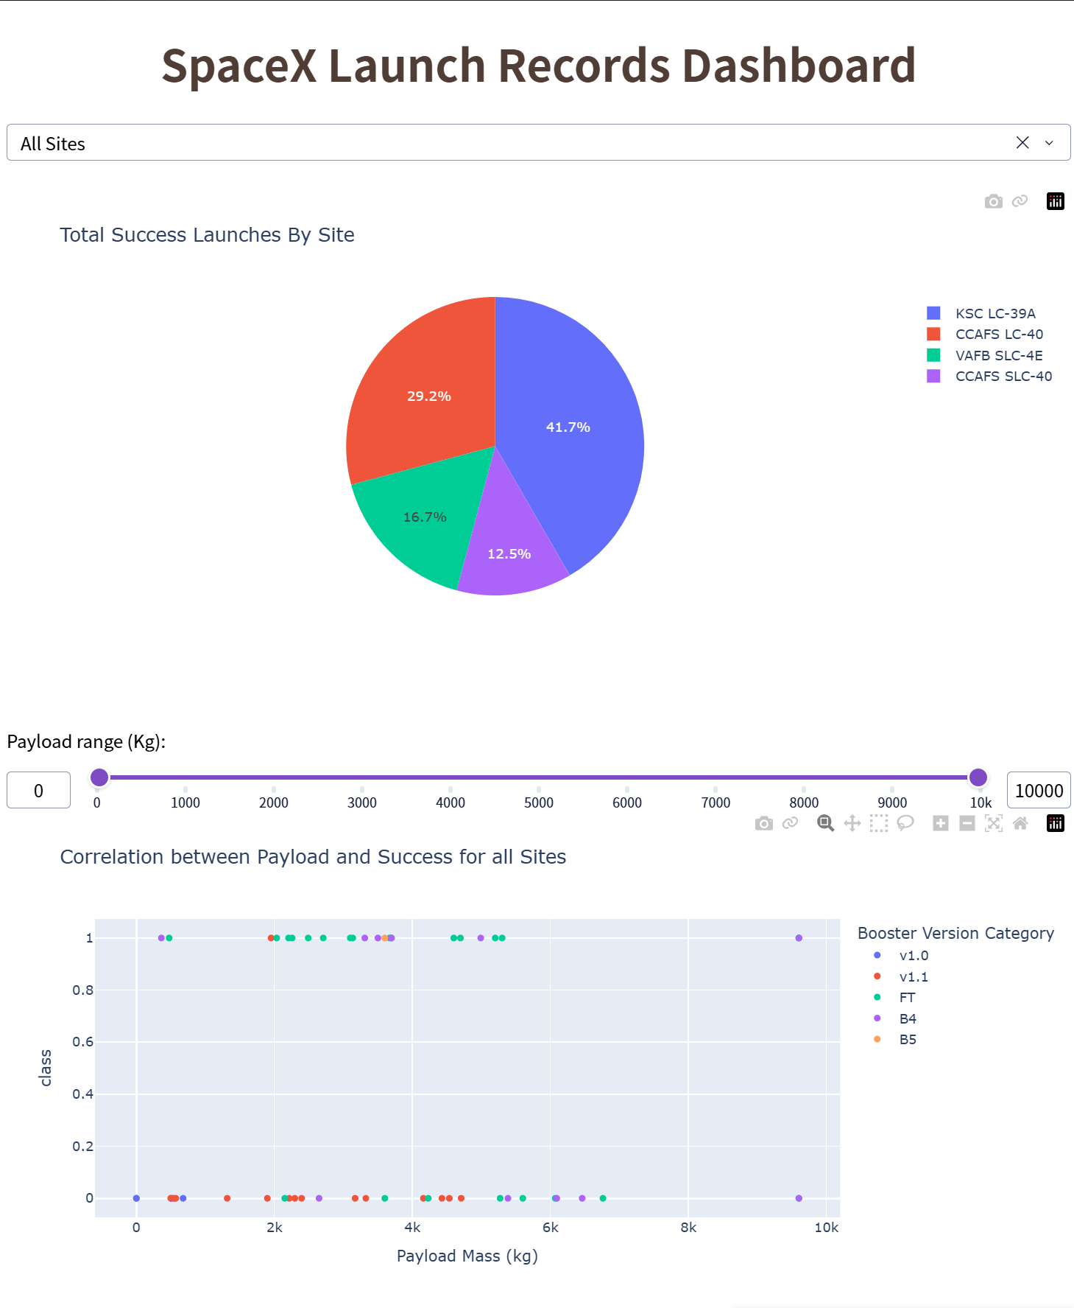
INTERACTIVE VISUAL ANALYTICS: PLOTLY DASH
Plotly Dash: All-Sites Success Pie Chart
41.7%
KSC LC-39A has the largest share of successful launches
Evidence: launch-site dropdown, success pie chart, payload range slider, and payload-versus-outcome scatter plot.
Notes:
[Sources]
- User-provided spacex-dash-app_1.png.

Slide 13
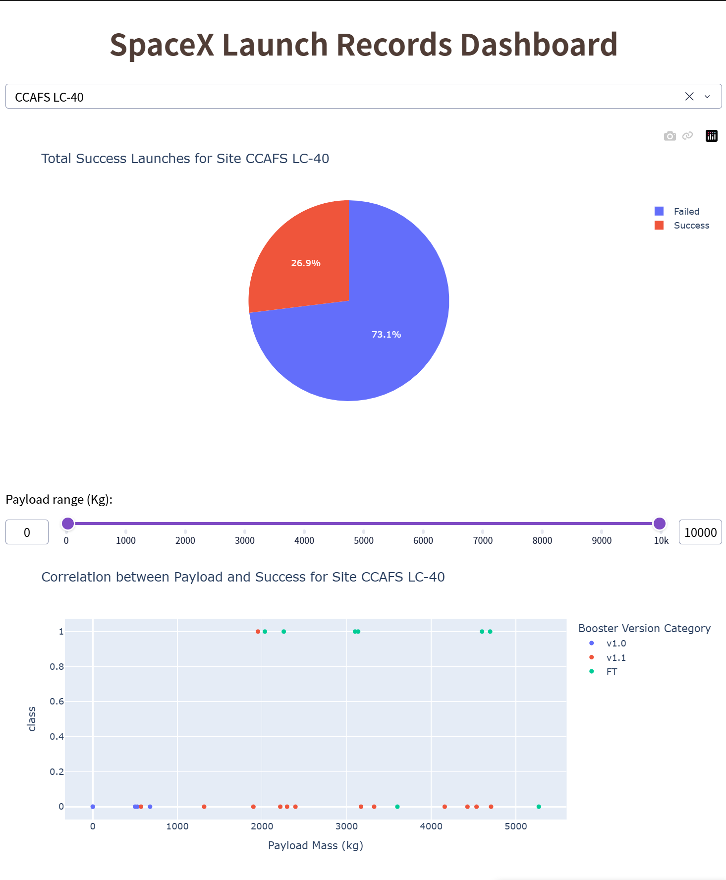
INTERACTIVE VISUAL ANALYTICS: PLOTLY DASH
Plotly Dash: Site Filter and Payload Scatter Plot
26.9%
CCAFS LC-40 successful launches
73.1% failed
Selecting a site updates both the success/failure pie chart and payload-versus-launch-outcome scatter plot.
Notes:
[Sources]
- User-provided spacex-dash-app_2.png.

Slide 14
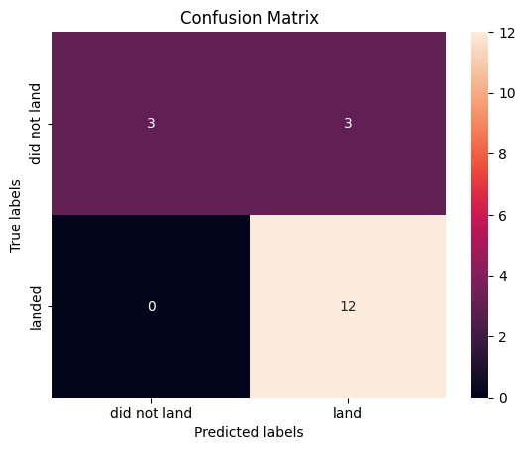
PREDICTIVE ANALYSIS WITH MACHINE LEARNING
Predictive Analysis: all four models reach 83.3% test accuracy
Model
CV accuracy
Test accuracy
Logistic regression
84.6%
83.3%
Support vector machine
84.8%
83.3%
Decision tree
92.9%
83.3%
K-nearest neighbors
84.8%
83.3%
Models evaluated: Logistic Regression, SVM, Decision Tree, and K-Nearest Neighbors.
Decision tree leads cross-validation, while identical test scores reflect the small 18-case test set.
Notes:
[Sources]
- Machine Learning notebook Tasks 1-12, model_scores output, and confusion matrices.

Slide 15
RESULTS, FINDINGS, AND CONCLUSION
Results and Findings: landing success reflects operational maturity
01
Performance improves over time
Later flights show stronger landing outcomes as operations mature.
02
Site and orbit matter
KSC leads successful launches; outcome rates differ across sites and orbit profiles.
03
Reusable hardware features carry signal
Grid fins, legs, reuse history, block, orbit, and payload contribute to prediction.
04
Models require broader validation
83.3% test accuracy is promising, though the test set contains only 18 launches.
Notes:
[Sources]
- Synthesis of user-provided EDA, dashboard, SQL, Folium, and ML outputs.

Slide 16
PROJECT ASSETS
Submission package maps directly to the capstone rubric
Included
Public GitHub repository
• API collection notebook
• Web scraping notebook
• Data wrangling notebook
• EDA visualization notebook
• SQL notebook
• Folium notebook + HTML map
• Dash application + screenshots
• Machine learning notebook
All completed notebooks, dashboard code, screenshots, map, presentation, and report are available in the repository.
https://github.com/TristinWen/spacex-falcon9-landing-prediction
Notes:
[Sources]
- Local project assets supplied by the user.
- https://github.com/TristinWen/spacex-falcon9-landing-prediction

Slide 17
IBM CAPSTONE AUTOMATED-GRADING INDEX
Rubric Evidence Index
GitHub Repository URL
Slide 2
EDA with SQL
Slide 10
Executive Summary
Slide 3
Folium Interactive Map
Slide 11
Introduction / Business Problem
Slide 4
Plotly Dash - All Sites
Slide 12
Methodology
Slide 5
Plotly Dash - Site & Payload
Slide 13
SpaceX API Data Collection
Slide 6
Predictive Analysis / ML
Slide 14
Web Scraping Data Collection
Slide 7
Results and Findings
Slide 15
Data Wrangling
Slide 8
Project Assets
Slide 16
EDA with Visualization
Slide 9
Complete Presentation PDF
17 slides
Notes:
[Sources]
- Index created to make each IBM capstone rubric item directly identifiable.

