Slide 1
PURPLE
It’s meaning and uses

Slide 2

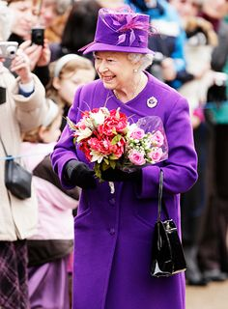
MEANING
Purple is a secondary color between red and blue
Purple is often associated with Royalty.
Other associations include Rarity, Magic, Mystery, and Piety (religious devotion, spirituality, and humility)
Purple is most favorited by women and is symbolic of the feminist movement and female empowerment.

Slide 3
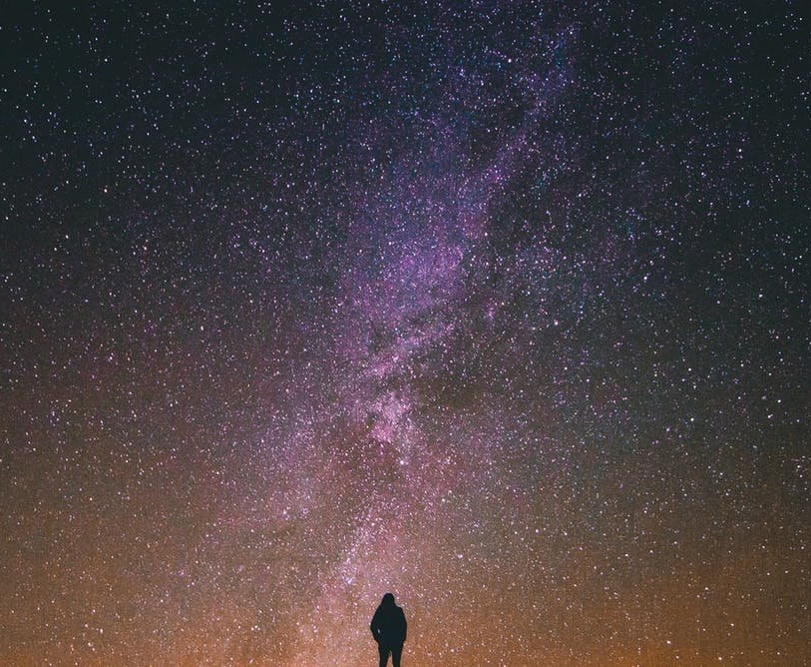
Uses in art
In art and paintings Purple has many uses.
Darker purple can be used for sadness and mourning or seduction
Lighter shades can be used for mystery, royalty and magic

Slide 4
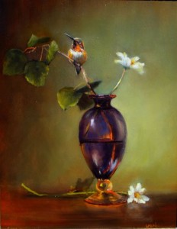
Cultural differences
Western Culture: in western culture Purple is used for royal garments to portray wealth and fame. In the US it is also associated with honor and its highest military reward is the purple heart.
Asian Culture: in Asian culture purple is mostly associated with royalty but in some parts is used for mourning.
Latin America: in countries such as brazil Purple is mainly used as a color of sorrow and mourning.

Slide 5

Negative effects
Due too purple being a mixture of red and blue it takes on both colors effects, red’s stimulation and blue’s calm. This can cause uneasiness unless the undertone is clearly defined

Slide 6
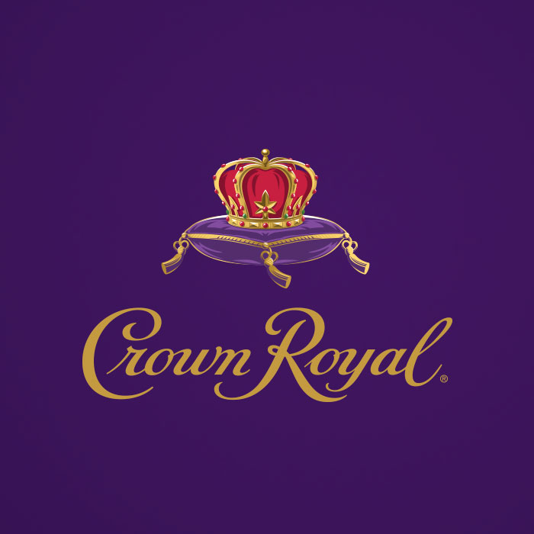

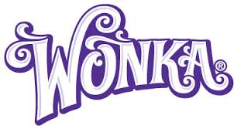
Company Logos

Slide 7


Websites
https://www.meet-build.be/
https://www.landinglion.com/

