Slide 1
Self-Supervised Learning for 12-Lead ECG Classification on PTB-XL

Slide 2
PTB-XL ECG Dataset
Source: PhysioNet (2020)
Size: ~21,837 12-lead ECGs from ~18,885 patients
ECG Details:
Duration: 10 seconds
Sampling: 100 Hz (also 500 Hz)
Patient info: age, sex, heart rate
Imbalanced Dataset : Large proportion of the dataset is Normal Class

Slide 3
BYOL
Cons
Pros
Works without negative samples, so medium-sized datasets like ours are sufficient.
Learns robust latent features from augmented ECG signals (time-warp, jitter, scaling)
Can handle imbalanced datasets
Good starting point if we want embeddings for downstream classification or clustering
Doesn’t explicitly model temporal predictive pattern
Requires careful augmentation to avoid distorting ECG morphology

Slide 4
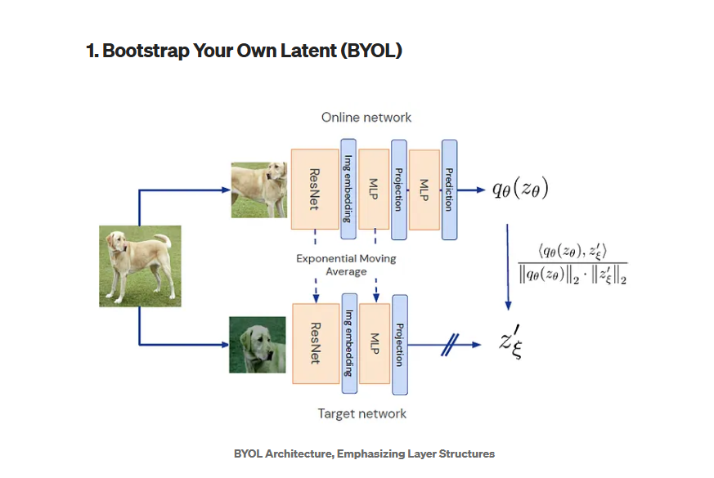
Byol

Slide 5
MAE
Cons
Pros
Reconstructs masked segments → captures fine-grained temporal features of ECG waveforms.
Works with medium dataset size; no negatives or clusters needed
Very robust to class imbalance because pretraining is label-free
Simple augmentation: masking itself acts as the core learning signal
Reconstructs masked ECG segments, learns fine-grained features, robust to imbalance
Focuses on reconstruction → still requires downstream fine-tuning for classification.

Slide 6
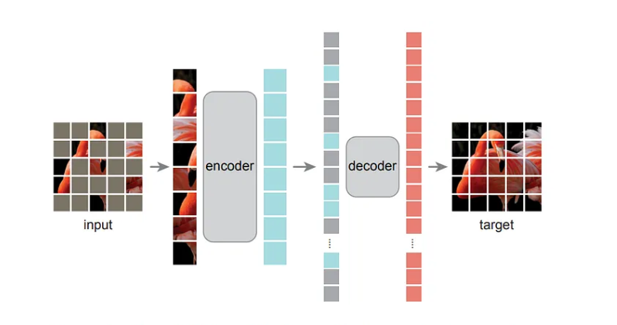
MAE

Slide 7
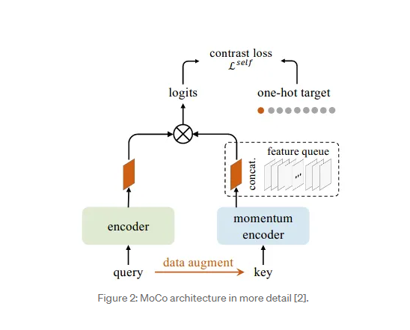
Moco

Slide 8
JEPA
Cons
Pros
Designed for predictive latent modeling, ideal for ECG temporal sequences
Can learn patterns of waveform progression, which is helpful for MI or STTC detection
Works with medium datasets; does not require massive pretraining.
ideal for time-series ECG
Slightly complex to implement, less off-the-shelf code for ECG.
Needs careful choice of prediction window

Slide 9
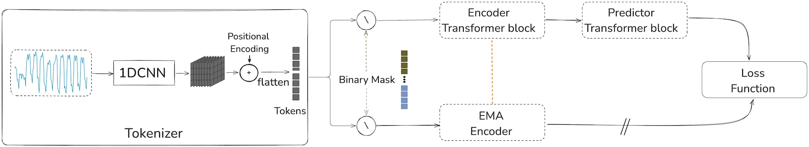
Jepa

Slide 10
Summary
Criterion | Why It Matters for PTB-XL | Selected Models
Works with medium dataset size | PTB-XL has ~20k samples | BYOL, MAE, JEPA,Moco
Learns temporal or sequential patterns | ECG signals have time dependencies | JEPA, MAE
No need for negative pairs (simpler training) | Avoids large batch issues | BYOL, MAE,moco
Can handle class imbalance | PTB-XL is imbalanced | MAE, BYOL
Suited for 1D time-series adaptation | ECG is not image data | JEPA, MAE

