Slide 1
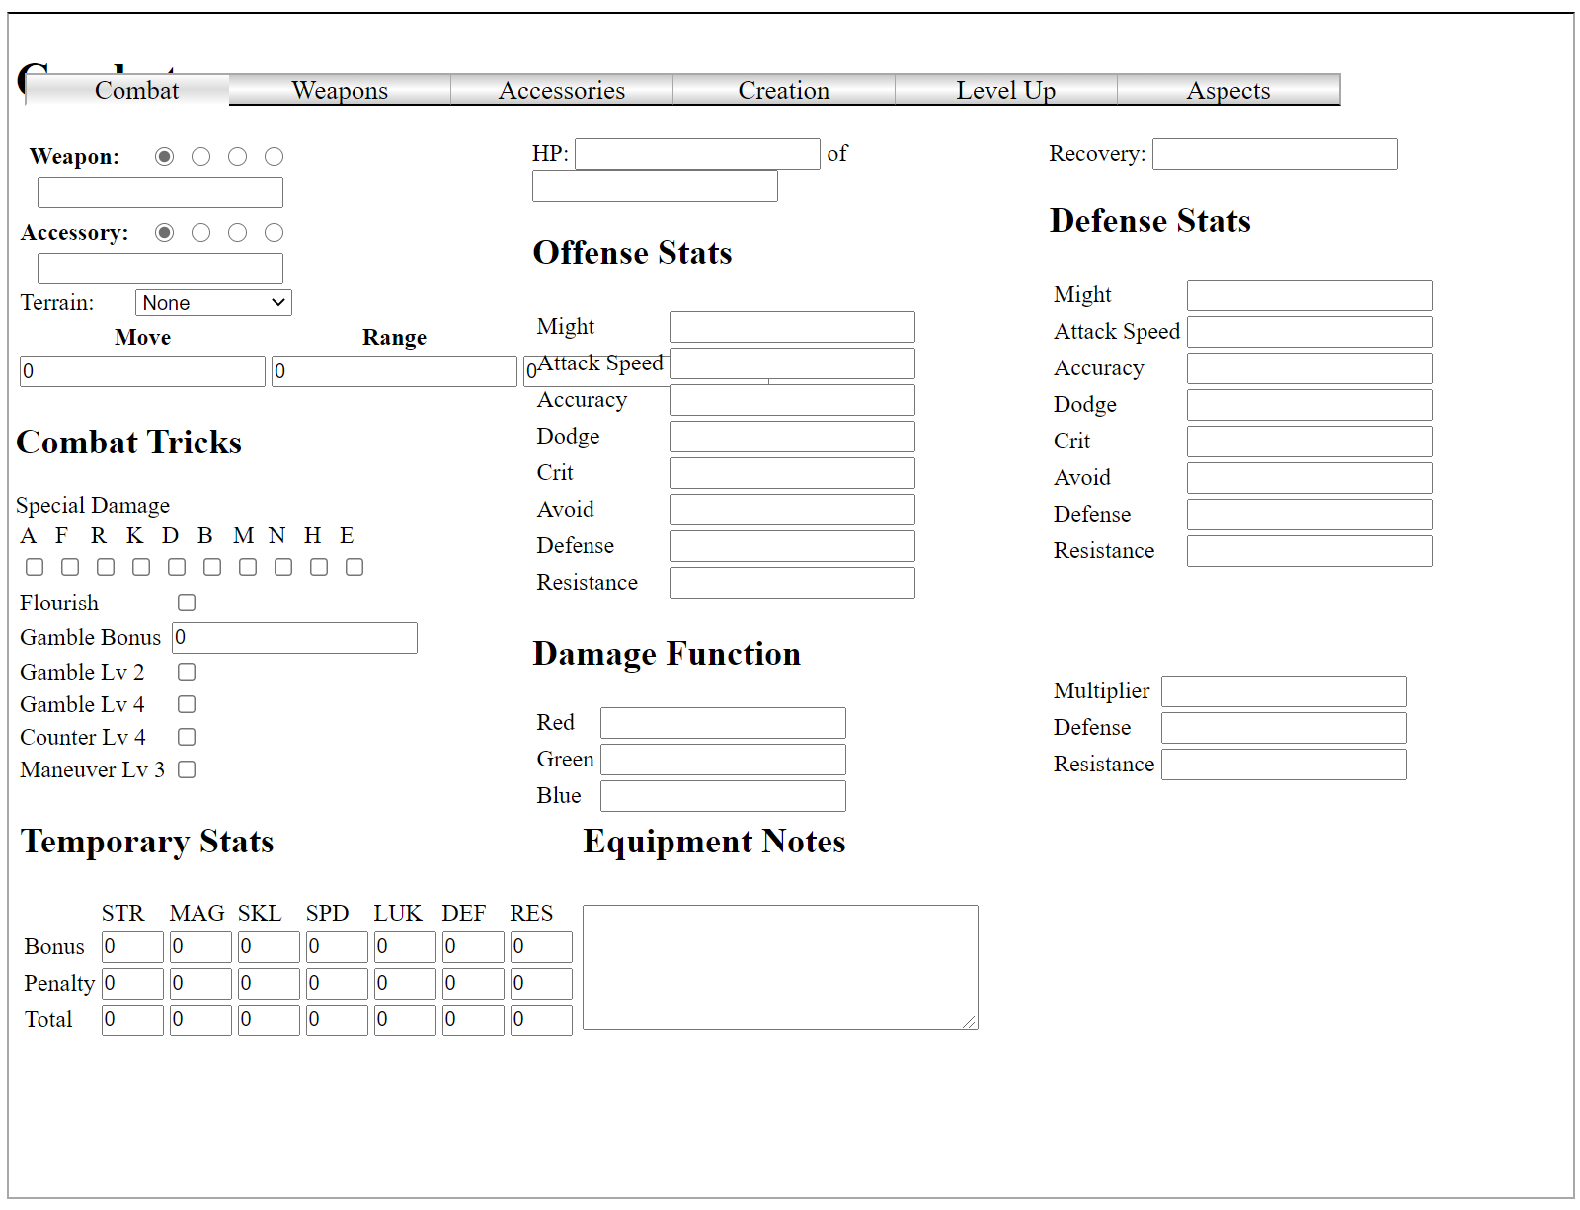
This needs to be drop-downs
I can simplify this list tremendously
This can be straight text, and not boxes
This Entire Section can be text, not boxes
This entire section can be invisible

