Slide 1
Publication Platforms

Slide 2
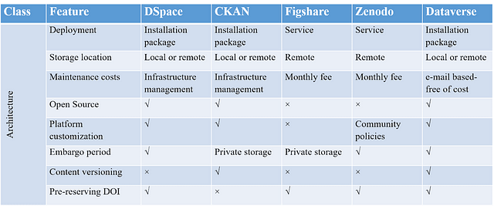
CKAN Architecture

Slide 3
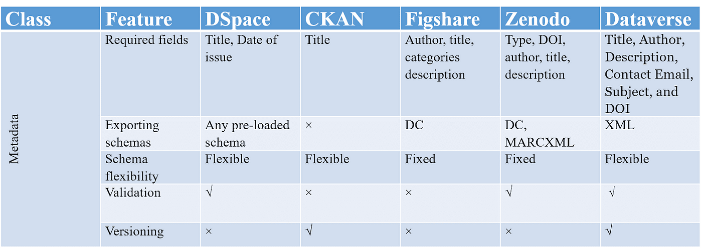

Slide 4
Dataverse Project

Slide 5
Dataverse Project
https://dataverse.org/ - Example: https://dataverse.ucla.edu/, https://dataverse.harvard.edu
Is open-source and widely supported by the developer community
Data Citation automatically generated
Multiple Publishing Workflows
Faceted Search as well as tags can be used for searches
Already defines roles and also custom roles can be designed and assigned to the users
Branding, metadata-based facets, sub-dataverses, featured dataverses,
Re-format, Summary Statistics, and Analysis for Tabular Files integration with TwoRavens
Mapping of Geospatial files and integration with WorldMap
Restricted Files as well as ability to request access to restricted files
Three level of Metadata i.e. description/citation, domain-specific or custom fields, file metadata Search API, data deposit API etc.
Notifications will be generated to the user and also will be communicated by mail for access request, roles, and when data is published
CC0 waiver default, terms of use can be customised by user, and download statistics
Can export reference to EndNote XML, RIS Format, or BibTeX Format

Slide 6
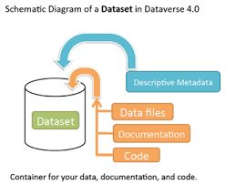
Dataverse

Slide 7
DSpace

Slide 8
DSpace
https://dspace.lyrasis.org/ - Examples:
Can comply with domain-level metadata schemas
Is open-source and has a wide supporting community
Has an extensive, community-maintained documentation
Can be fully under institutions control
Structured metadata representation
Complaint with OAI-PMH
Supports Dublin Core, and MARCXML for metadata exporting
https://demo7.dspace.org/home

Slide 9
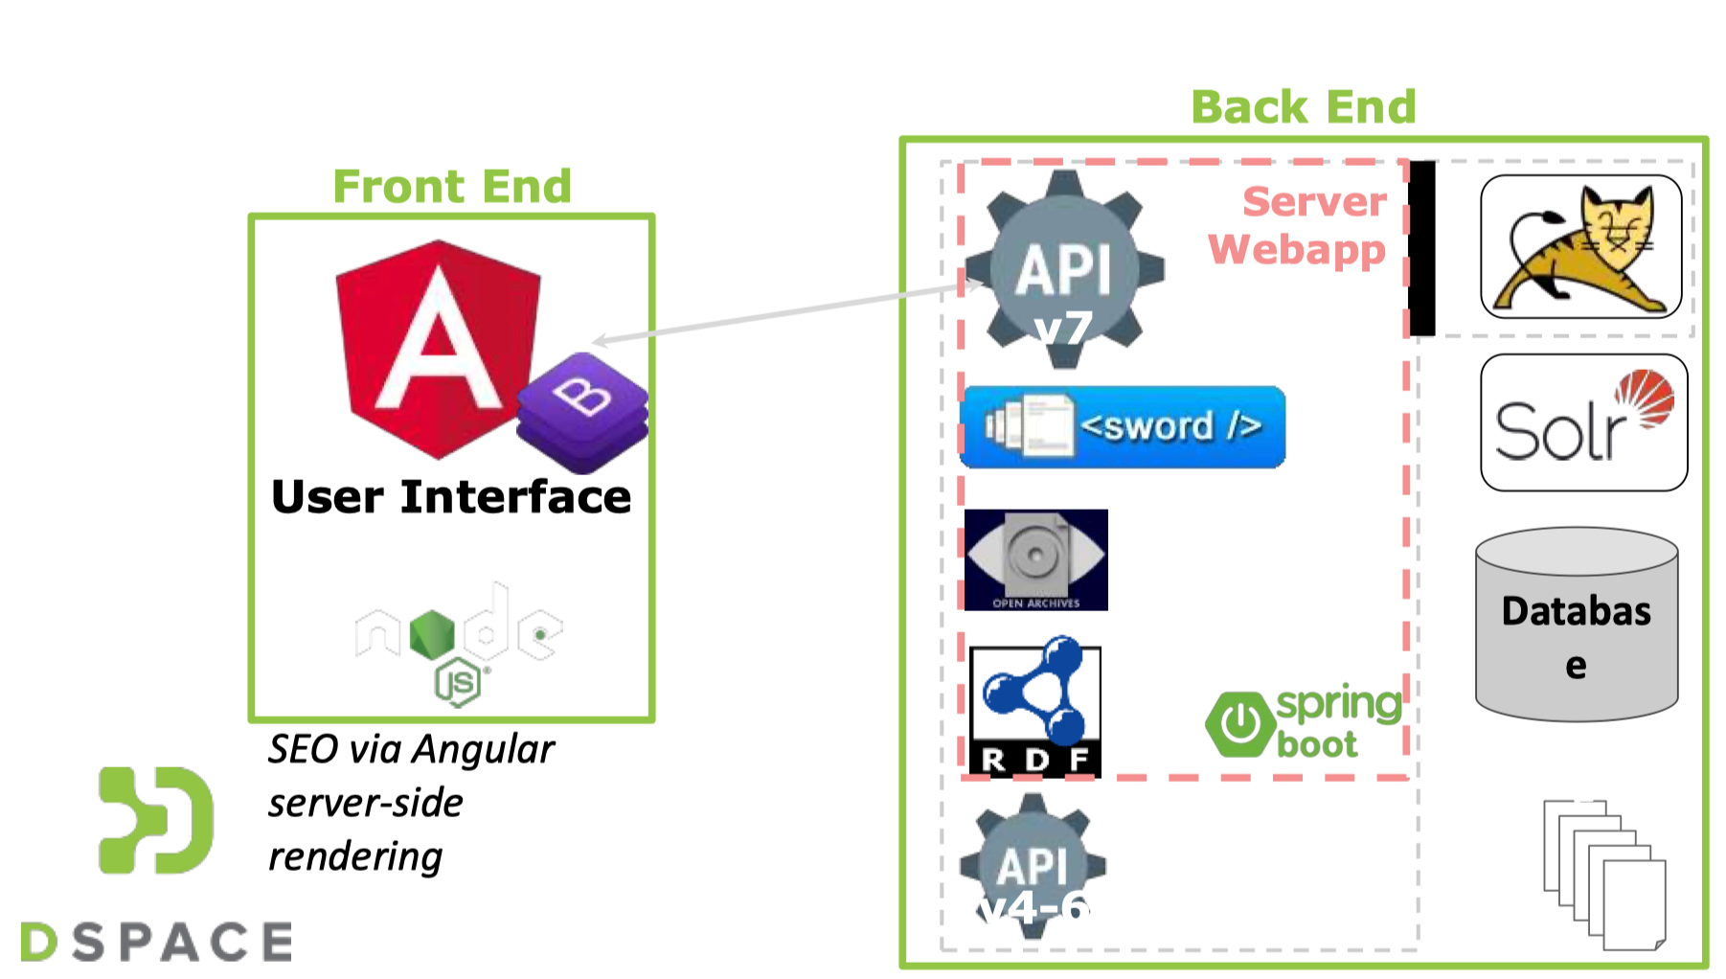
DSpace Architecture

Slide 10
CKAN

Slide 11
CKAN
Is open-source and widely supported by the developer community
Features extensive and comprehensive documentation
Allows deep customization of its features
Can be fully under institutions control
Supports unrestricted (non standards-compliant) metadata
Has faceted search with fuzzy matching
Records datasets change logs and versioning information

Slide 12
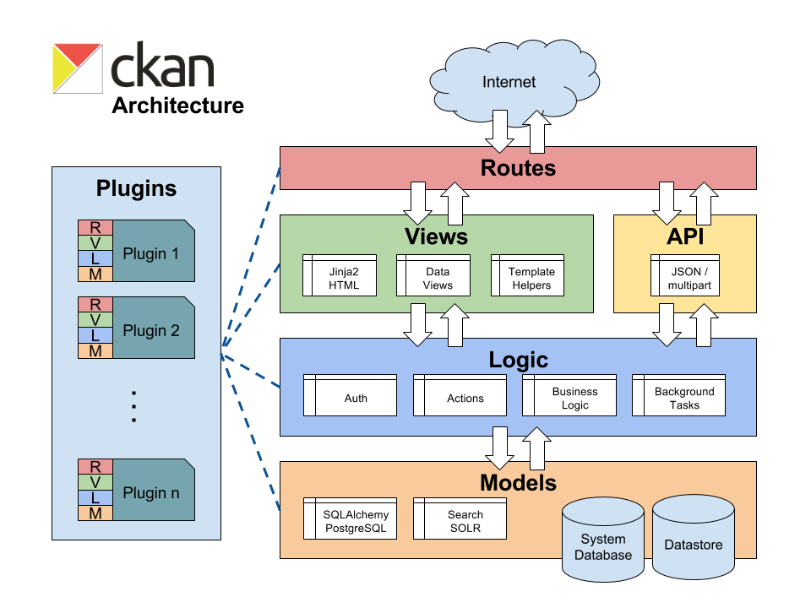
CKAN Architecture

Slide 13
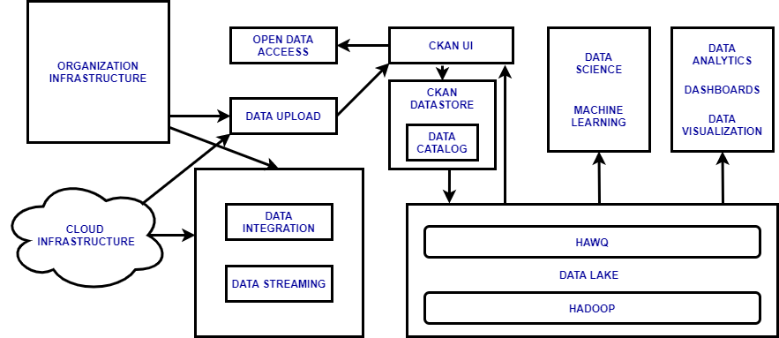

Slide 14
Thank You

