Slide 1
GOLD PRICE PREDICTION
Presented By:
Trivedi Aastha
Batch:
MIP-ML-07

Slide 2
Project Defination
The Gold Price Prediction project aims to develop a machine learning model leveraging historical gold price data and relevant economic indicators to forecast future gold prices accurately.

Slide 3
Problem Overview
Gold price prediction poses a complex challenge due to the multitude of factors influencing its value, including economic indicators, geopolitical events, market sentiments, and currency fluctuations.
The inherent volatility of gold prices further complicates accurate forecasting.
The goal is to provide stakeholders with valuable insights for making informed decisions in gold investments and trading activities amidst dynamic market conditions.

Slide 4
Introduction to Gold Prediction
In this project we explain about the procedure of the project and how the algorithms are used to predict the prices of gold.

Slide 5
Uses
We in this project would forecast gold rates using the most comprehensive set of features and would apply various machine learning algorithms for forecasting and compare their results.
Forecasting rise and fall in the daily gold rates, can help investors to decide when to buy (or sell) the commodity.

Slide 6
PYTHON LIBRARIES & PACKAGES
The python libraries and packages we will use in this project:
Numpy
Pandas
Matplotlib
Scikit-learn
Seaborn

Slide 7
About The Dataset
The dataset has 2511 rows in total and 7 columns in total.
The data of Gold has 7 columns:Date, Open, High, Low, Close, Unnamed: 0, and Volume.
The challenge of this project is to accurately predict the future adjusted closing price of Gold .

Slide 8
Flowchart
Data
Integration
Load Data
Data Preprocessing
Data
Cleaning
Training Data
Testing
Data
Prediction
Performance
Machine Learning
Algorithms

Slide 9
EXPLORATORY DATA ANALYSIS
(EDA)

Slide 10
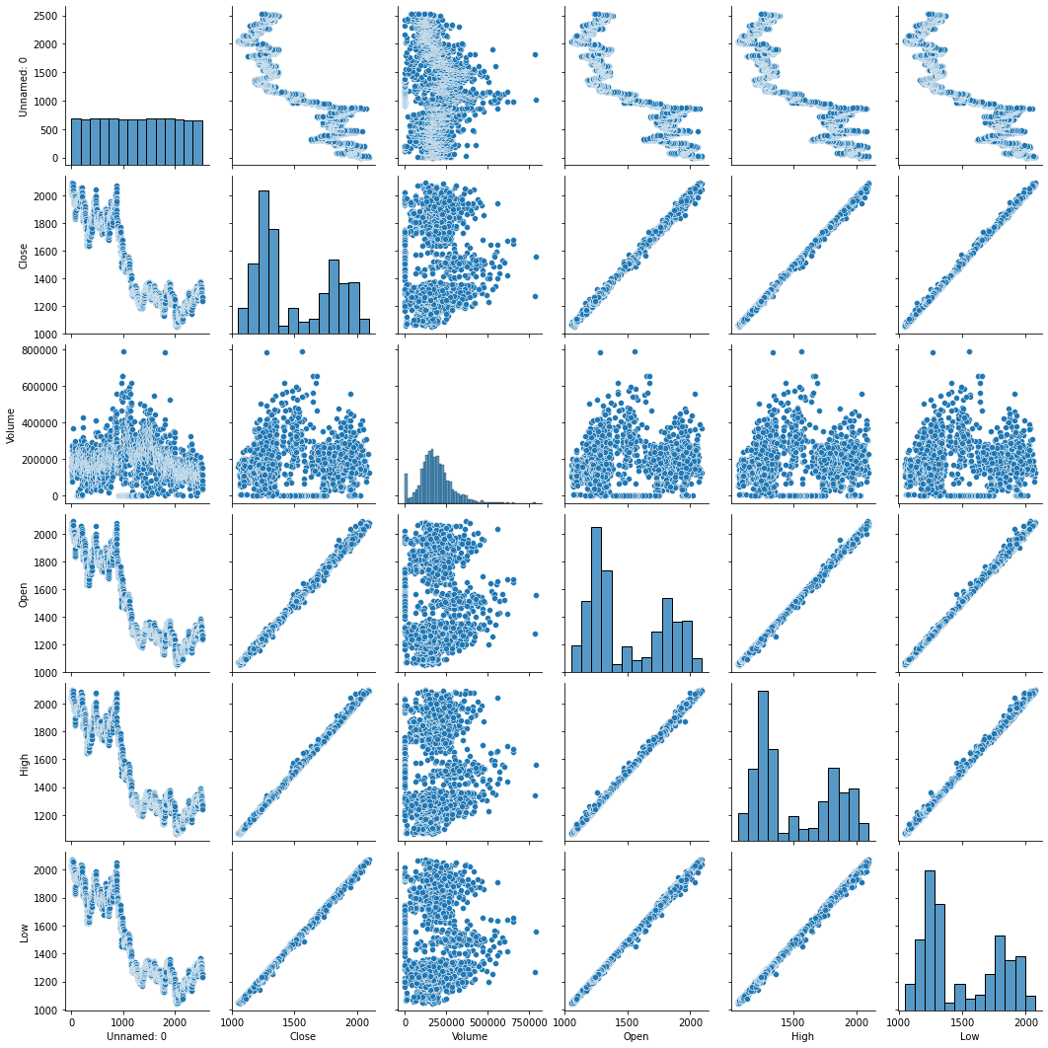
PAIRPLOT OF DATA

Slide 11
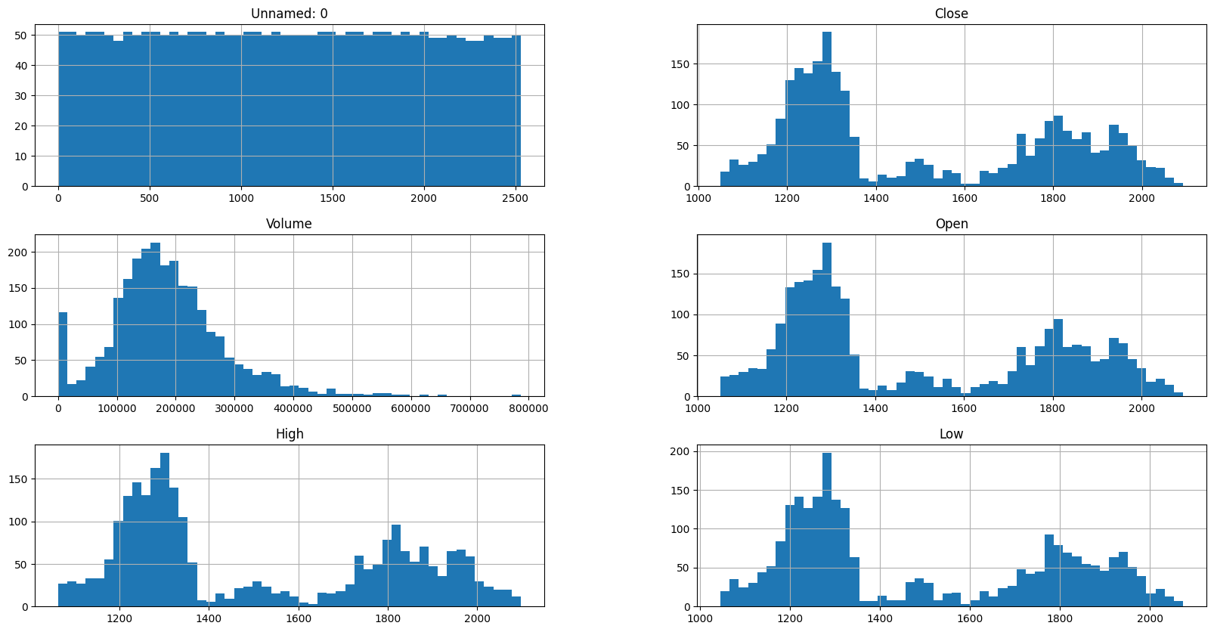
HISTOGRAM OF DATA

Slide 12
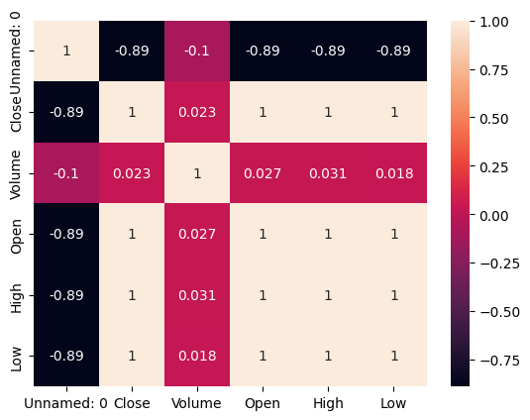
CORRELATION OF DATA

Slide 13
TERMS WE SHOULD KNOW
Accuracy:
Accuracy is the degree of closeness between a measurement and its true value. Precision is the degree to which repeated measurements under the same conditions show the same results.
Confusion Matrix:
A confusion matrix is a table that is used to define the performance of a classification algorithm. A confusion matrix visualizes and summarizes the performance of a classification algorithm.
Classification Report:
A classification report is a performance evaluation metric in machine learning. It is used to show the precision, recall, F1 Score, and support of your trained classification model.
PRECISION : The quality of a positive prediction made by the model.
RECALL : recall refers to the percentage of total relevant results correctly classified by your algorithm.
F1 SCORE : The F1-score combines the precision and recall of a classifier into a single metric by taking their harmonic mean. It is primarily used to compare the performance of two classifiers

Slide 14
TYPES OF CLASSIFICATION ALGORITHMS WE USED
Logistic Regression:
Logistic regression is a statistic model that in its basic form uses a logistic function to model a binary dependent variable, although many more complex extension exists.
Random Forest:
Random forest makes tree more random by additionally using random thresholds for each feature rather than searching for the best possible.
Decision Tree:
Decision tree is a decision support tool that uses a tree like model of decisions and their possible consequences. It is one way to display an algorithm that only contains conditional control statement.
SVM:
It uses a technique called a kernel trick to transform your data and then based on this transformations it finds an optimal boundary between the possible outputs.
Linear Regression:
Linear regression shows the linear relationship between the independent(predictor) variable i.e. X-axis and the dependent(output) variable i.e. Y-axis, called linear regression.

Slide 15
Machine Learning Models
Models
Logistic regression
Random Forest Classifier
Decision Tree
Support Vector Machine
Linear Regression

Slide 16
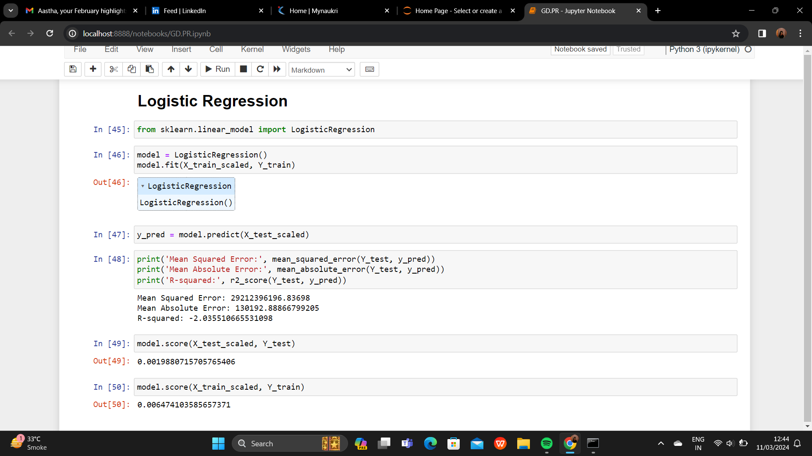
Logistic Regression

Slide 17
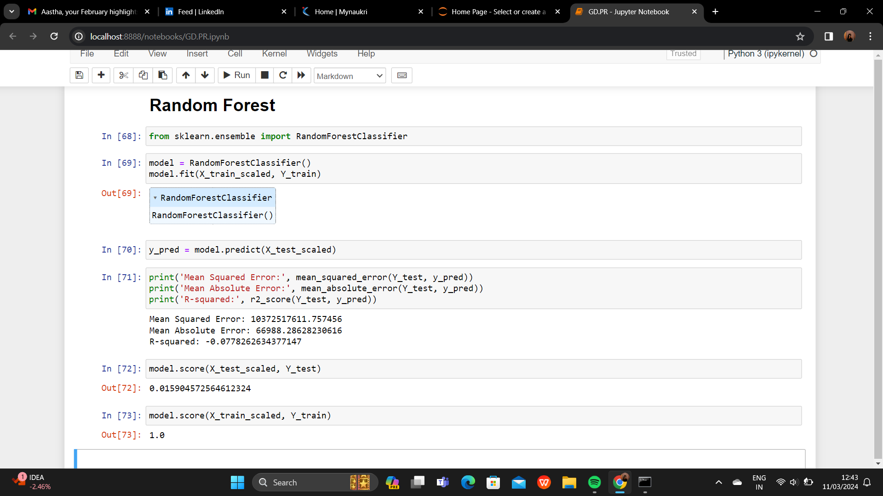
Random Forest

Slide 18
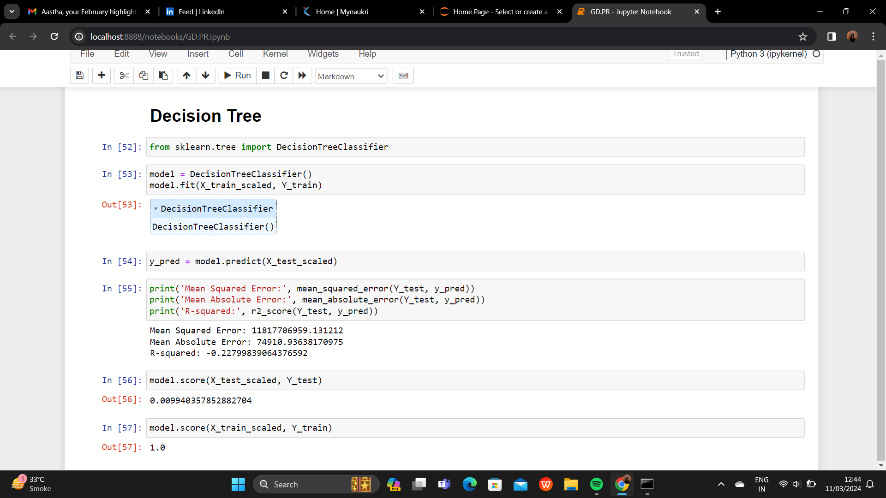
Decision Tree

Slide 19
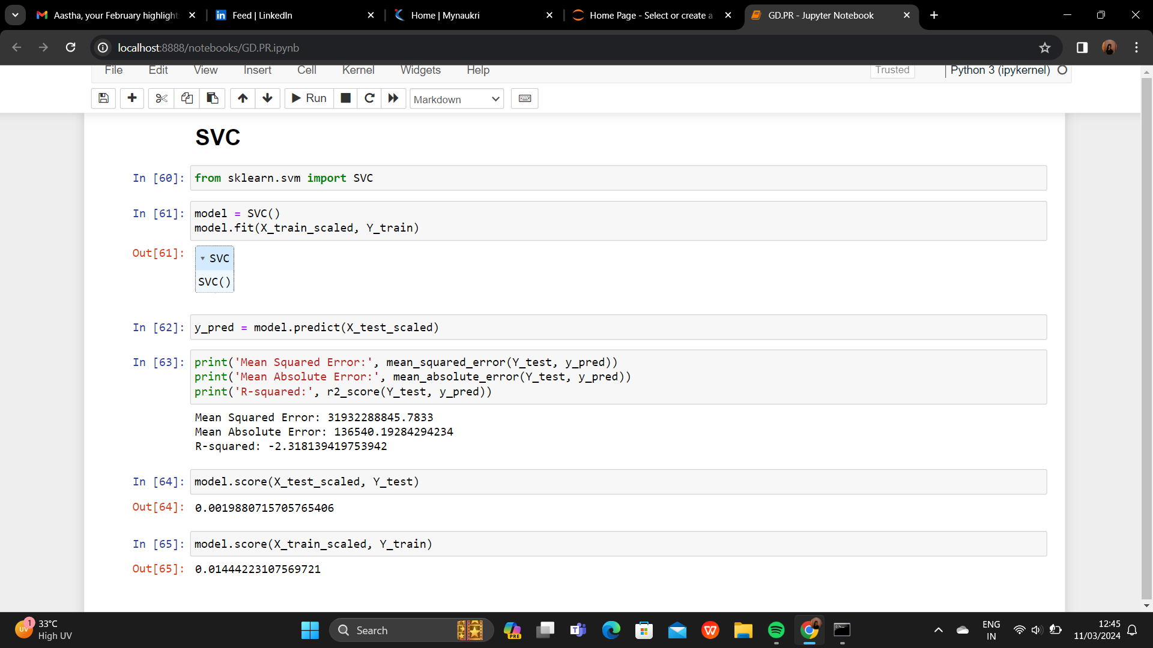
SVC

Slide 20
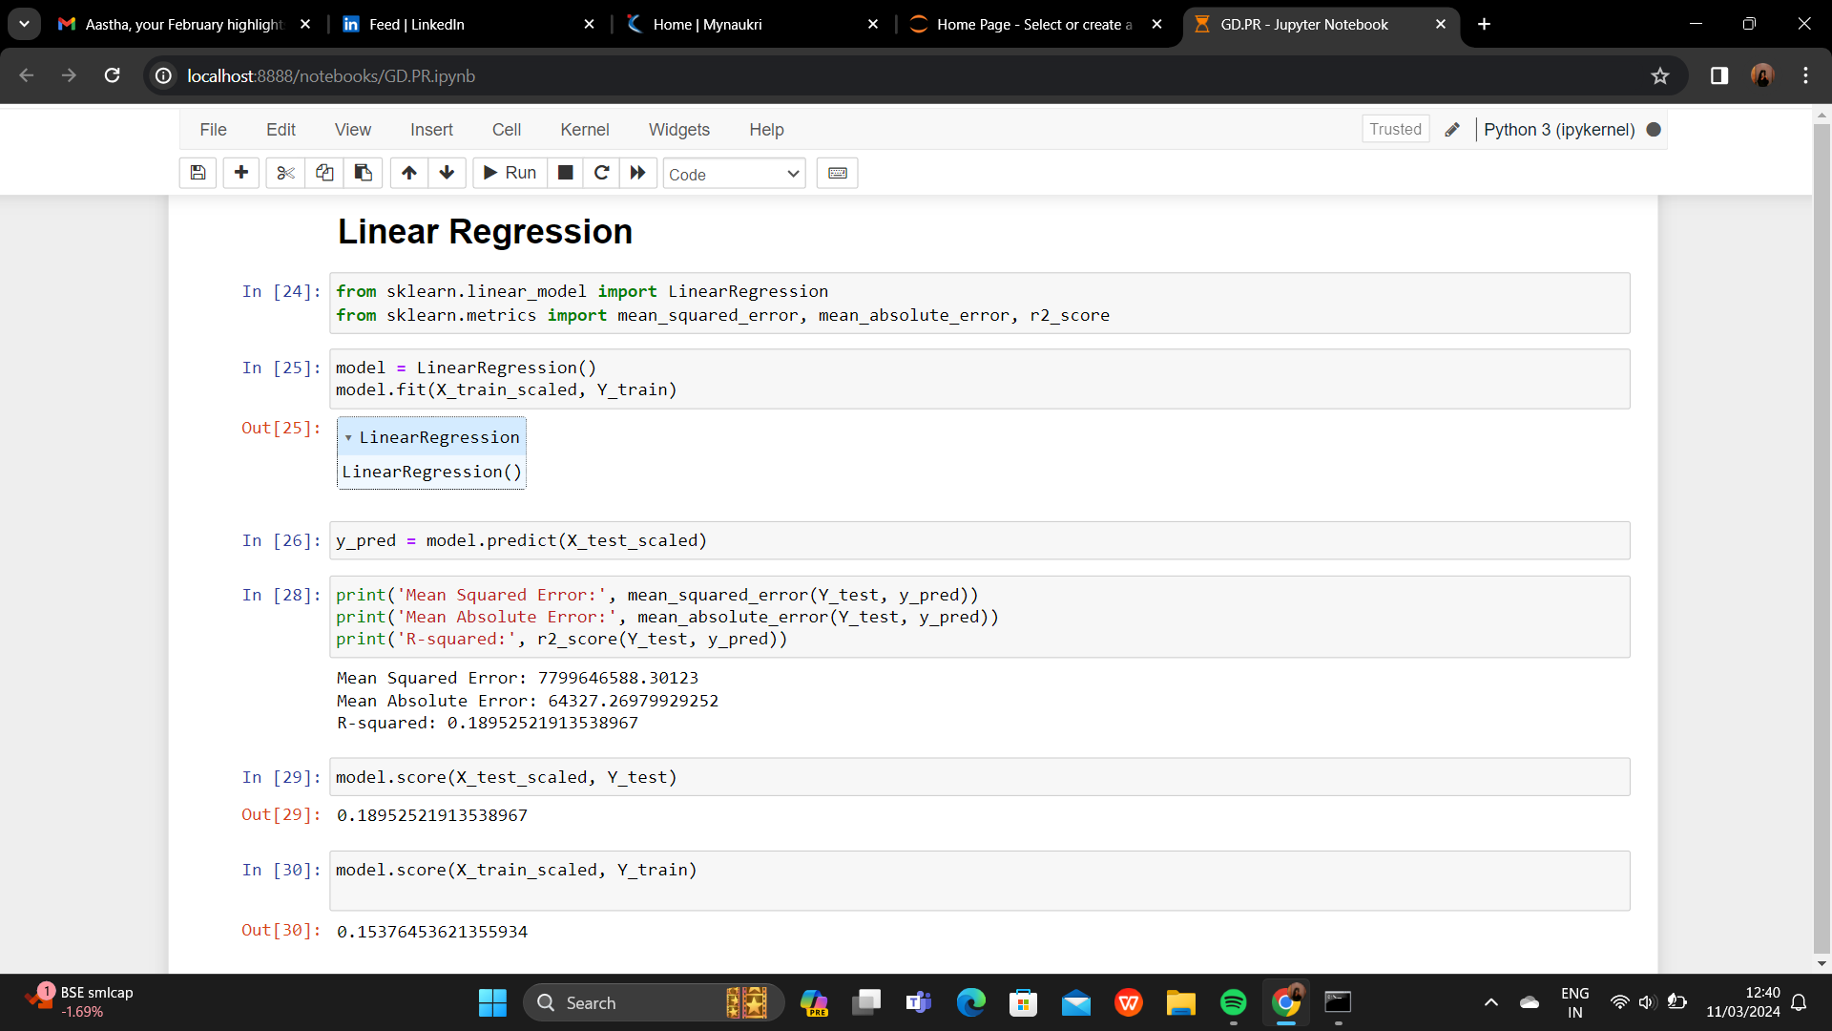
Linear Regression

Slide 21
Result
Algorithm | Training Accuracy | Testing Accuracy
Logistic Regression | 64.78% | 19.88%
Random Forest | 100% | 15.90%
Decision Tree | 100% | 99.40%
SVM | 14.44% | 19.88%
Linear Regression | 15.37% | 18.95%

Slide 22
Prediction Results

Slide 23
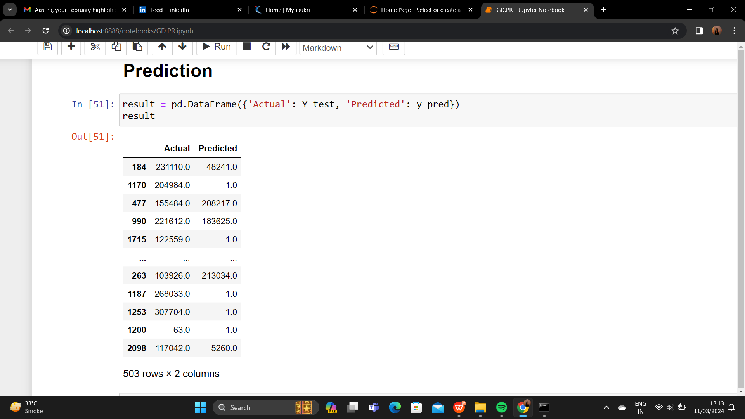
Logistic Regression

Slide 24
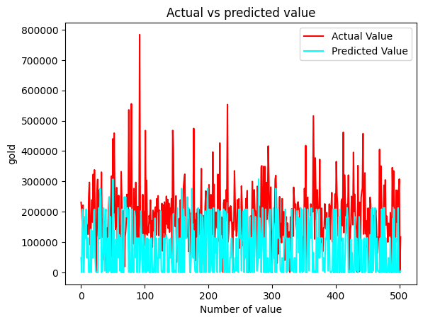
Plotting Actual Vs Predicted Value

Slide 25
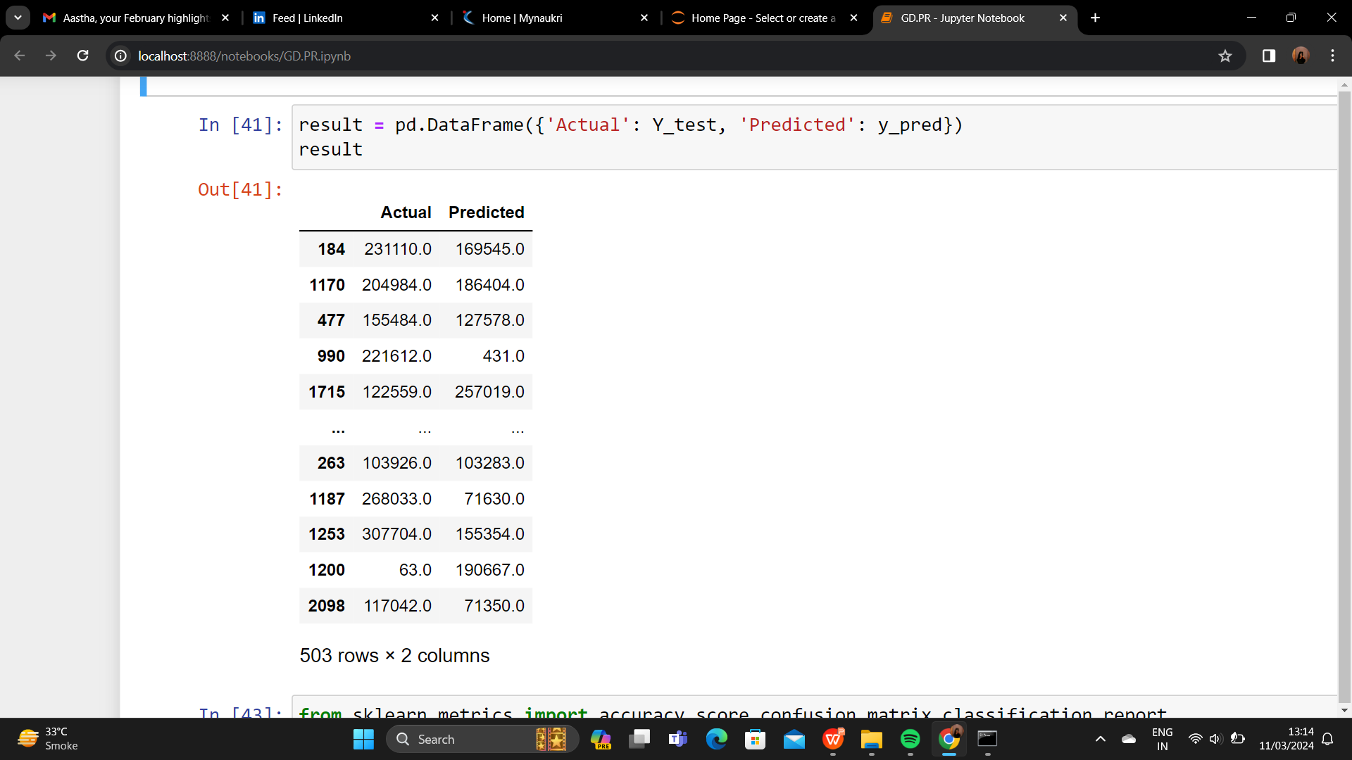
Random Forest

Slide 26
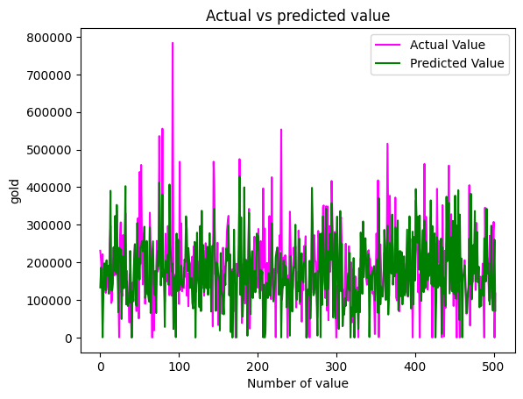
Plotting Actual Vs Predicted Value

Slide 27
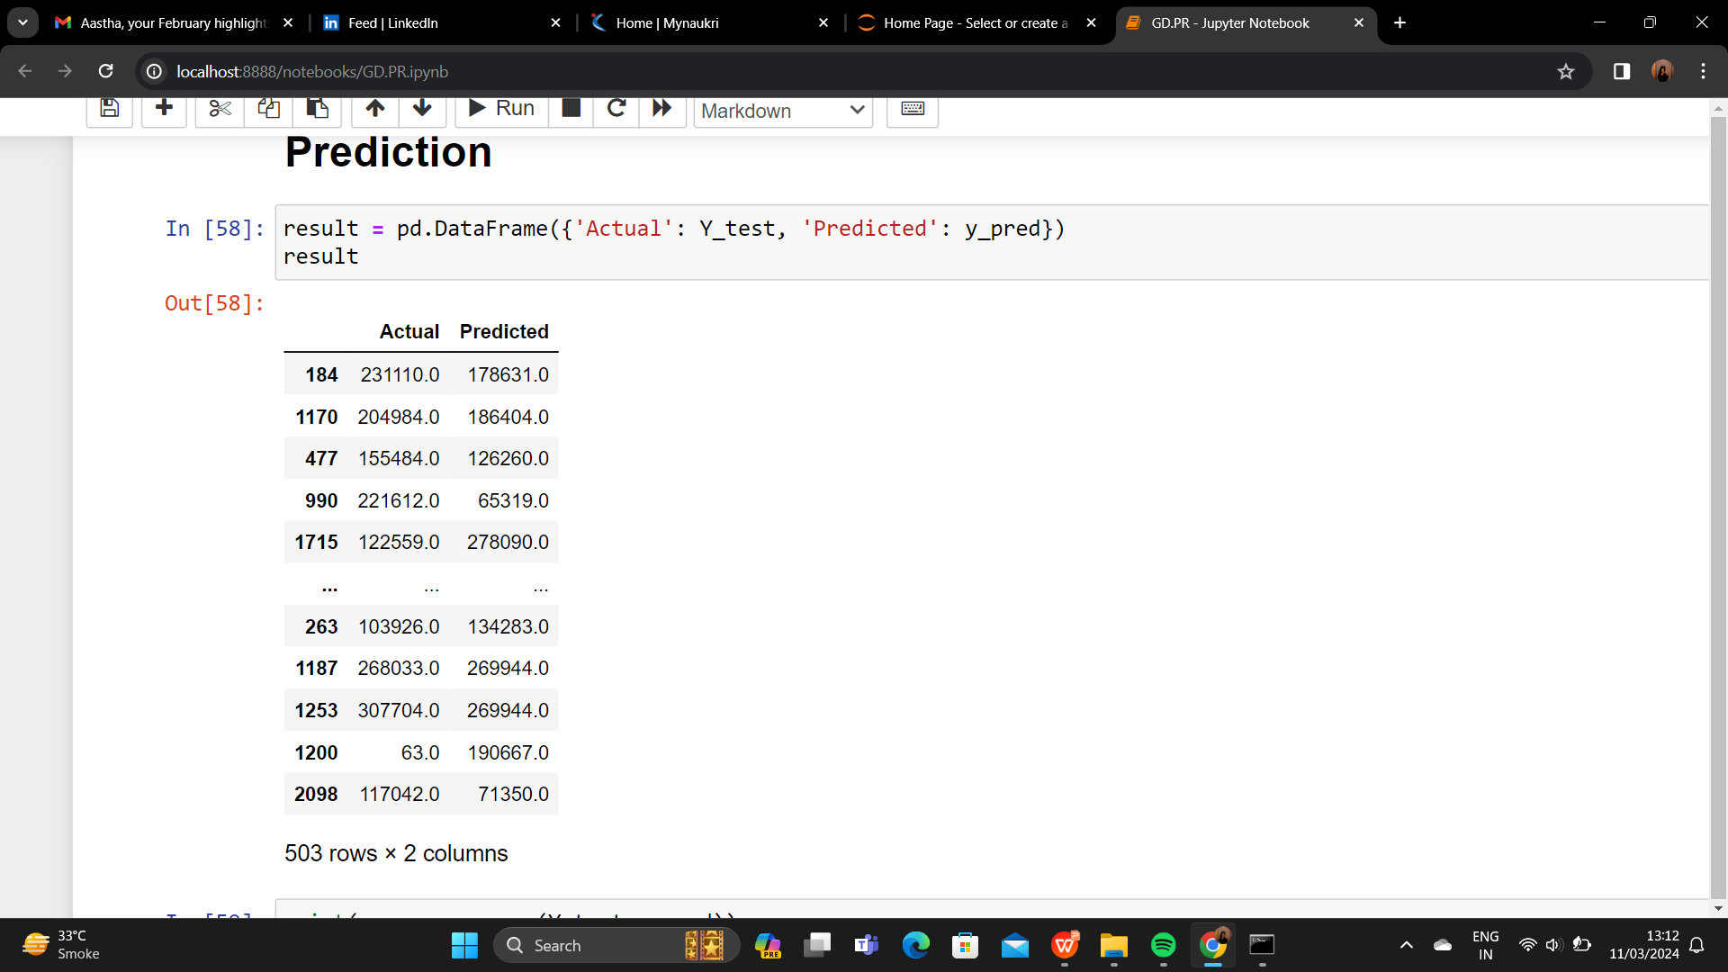
Decision Tree

Slide 28
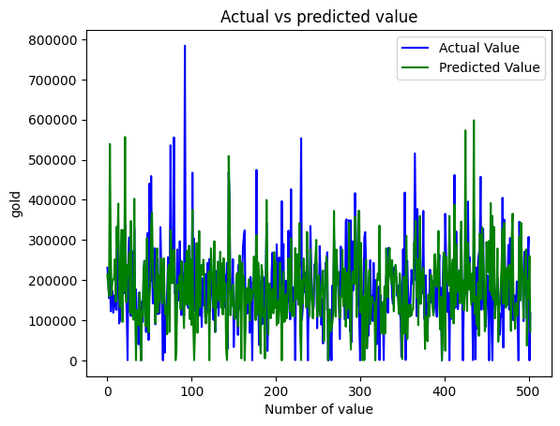
Plotting Actual Vs Predicted Value

Slide 29
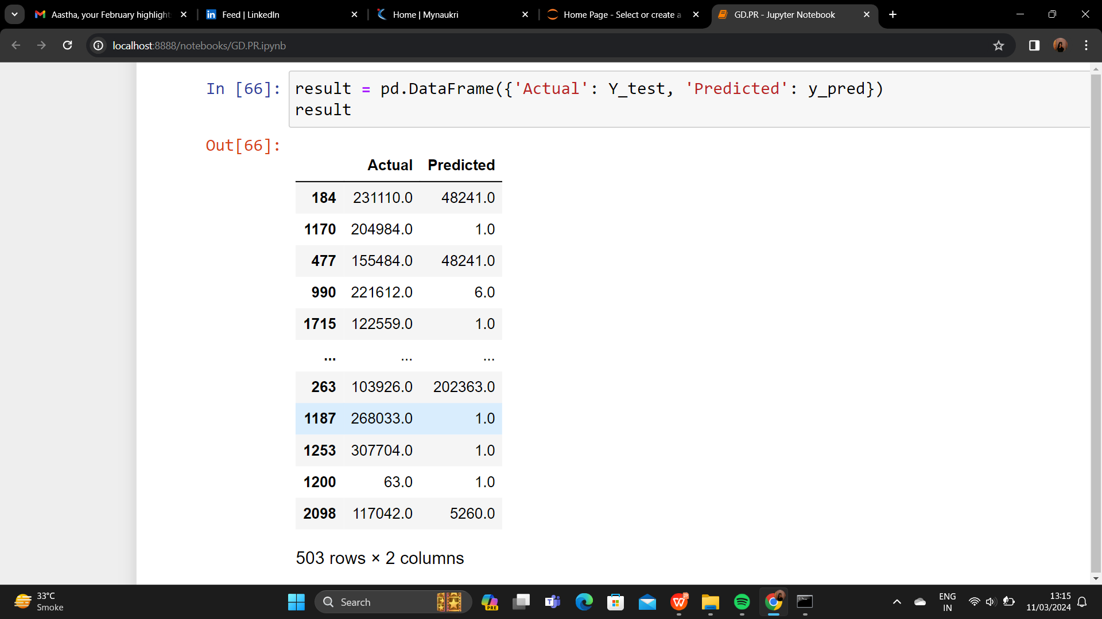
SVC

Slide 30
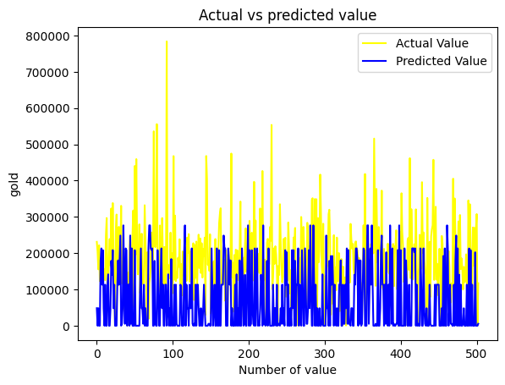
Plotting Actual Vs Predicted Value

Slide 31
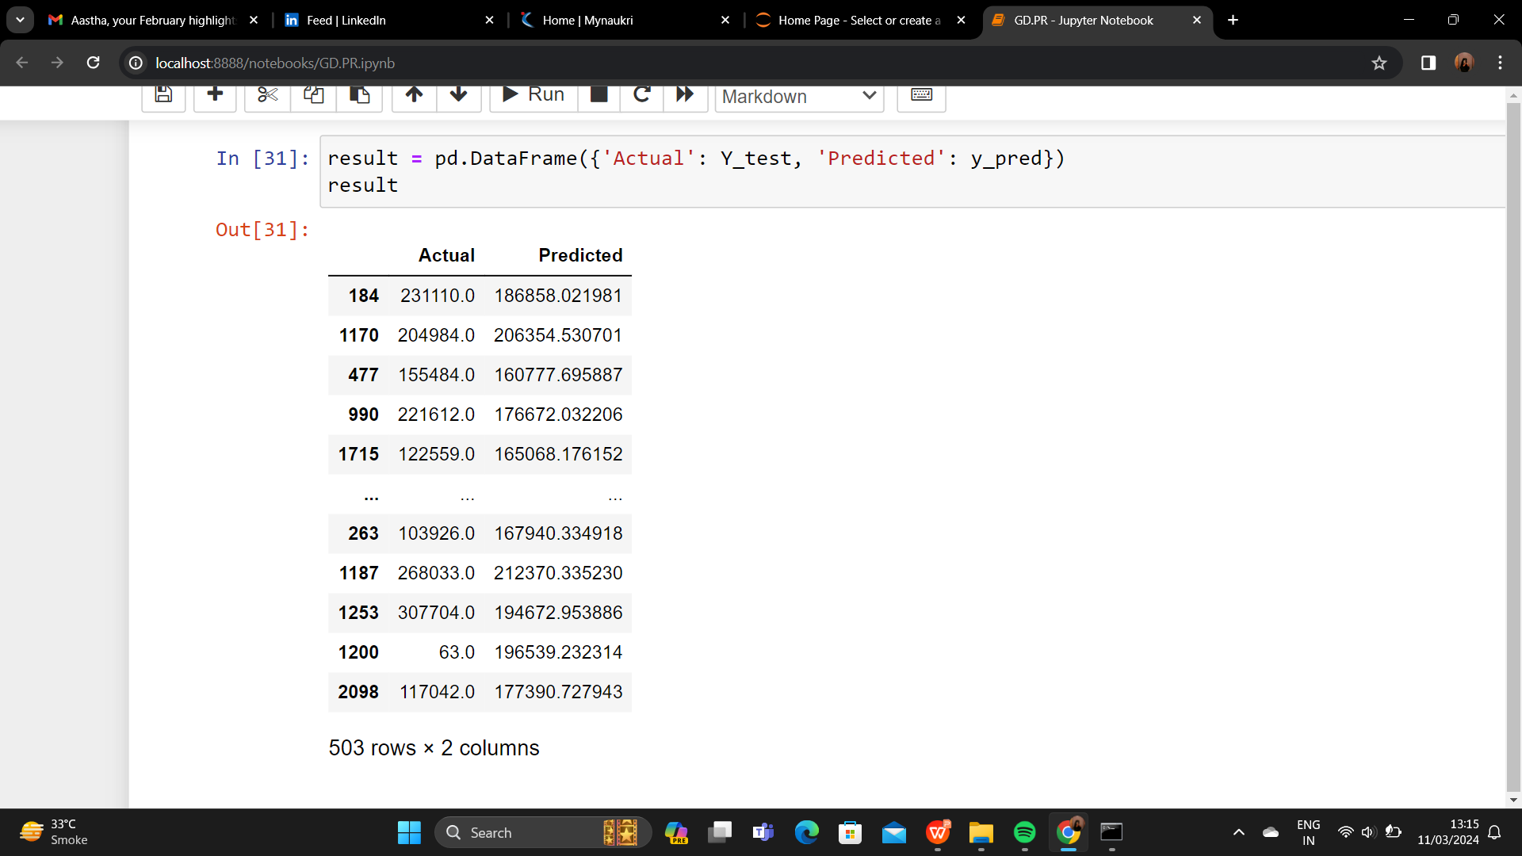
Linear Regression

Slide 32
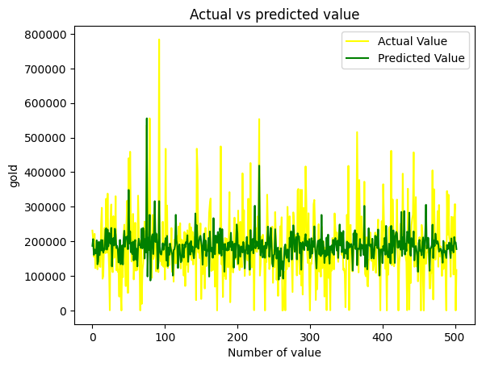
Plotting Actual Vs Predicted Value

Slide 33
Future Scope
In future, this model can be used to compare various machine learning algorithm generated prediction models.
The model which will give higher accuracy will be chosen as the prediction model.

Slide 34
Conclusion
The Linear Regression algorithm is the most accurate for gold price prediction.

Slide 35


