Slide 1
FAST TAG FRAUD DETECTION
Presented By:
Trivedi Aastha
Batch:
MIP_ML_07

Slide 2
Project Defination
Fast tag fraud detection is a technique by which we can detect the vehicles type by using object detection and the Fastag applied on it by using Machine Learning Algorithms.

Slide 3
Problem Overview
Many frauds were occurring without the knowledge of authorities. There are no previous methods used to detect fraud.
Detection cannot detect the correct vehicle type according to the applied Fast tag on it.
Payment due to wrong vehicle detection the toll prices to be paid are not correct.

Slide 4
Introduction to Fastag Fraud Detection
Fast tag fraud detection is a technique by which we can detect the vehicles type by using object detection and the Fast tag applied on it by using Machine Learning Algorithms.
This technique helps the government to get proper toll without any loss and makes effective Fast tag system.

Slide 5
Uses
Fast tag fraud detection is used to solve this problem. The system will be able to identify the type of vehicle and the Fastag amount paid.
Using this system, Fast tag fraud detects if any anomaly has occurred and alerts the system accordingly.

Slide 6
PYTHON LIBRARIES & PACKAGES
The python libraries and packages we will use in this project:
Numpy
Pandas
Matplotlib
Scikit-learn
Seaborn
Scikitplot

Slide 7
About The Dataset
The dataset has 5000 rows in total and 13 columns in total.
The data of Fastag has 13 columns.
The challenge is that a small percentage of activity can quickly turn into big dollar losses without the right tools and systems in place.

Slide 8
Flowchart
Data
Integration
Load Data
Data Preprocessing
Data
Cleaning
Training Data
Testing
Data
Prediction
Performance
Machine Learning
Algorithms

Slide 9
Exploratory Data Analysis (EDA)

Slide 10
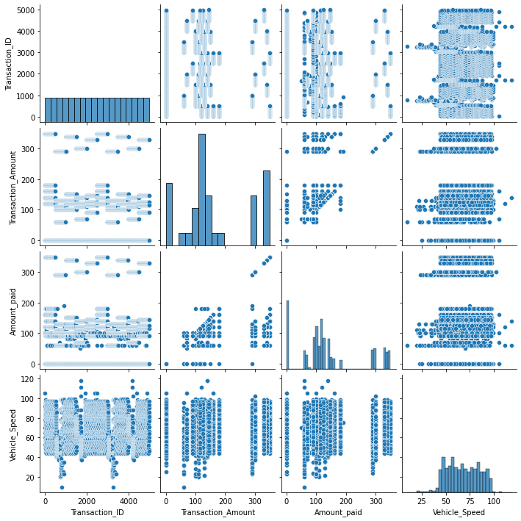
Pairplot Of Data

Slide 11
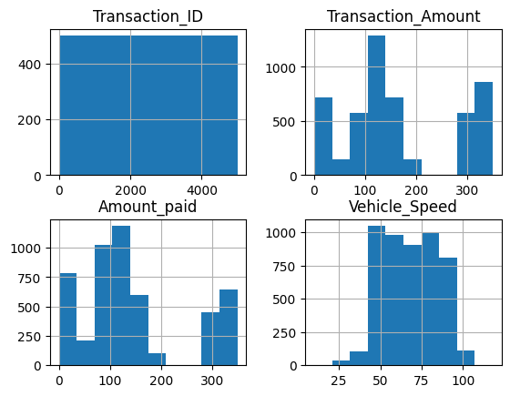
Histogram of Data

Slide 12
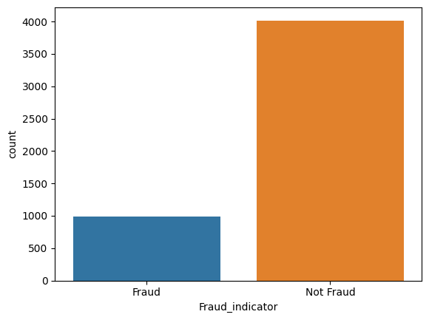
Countplot of Frauds

Slide 13
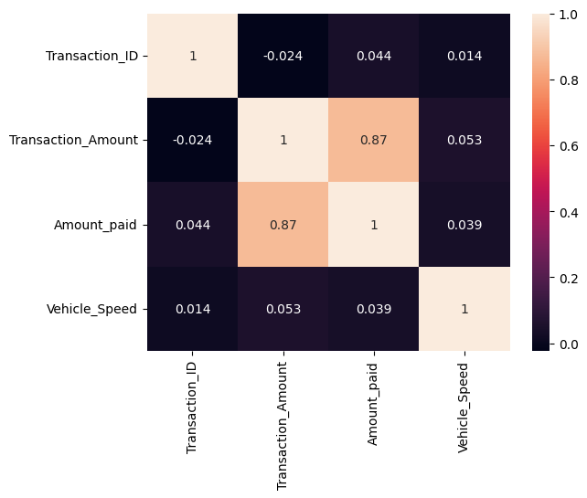
Correlation of Data

Slide 14
Machine Learning Algorithms
Models
Random Forest
Decision Tree
Logistic Regression
KNeighbors
SVC

Slide 15
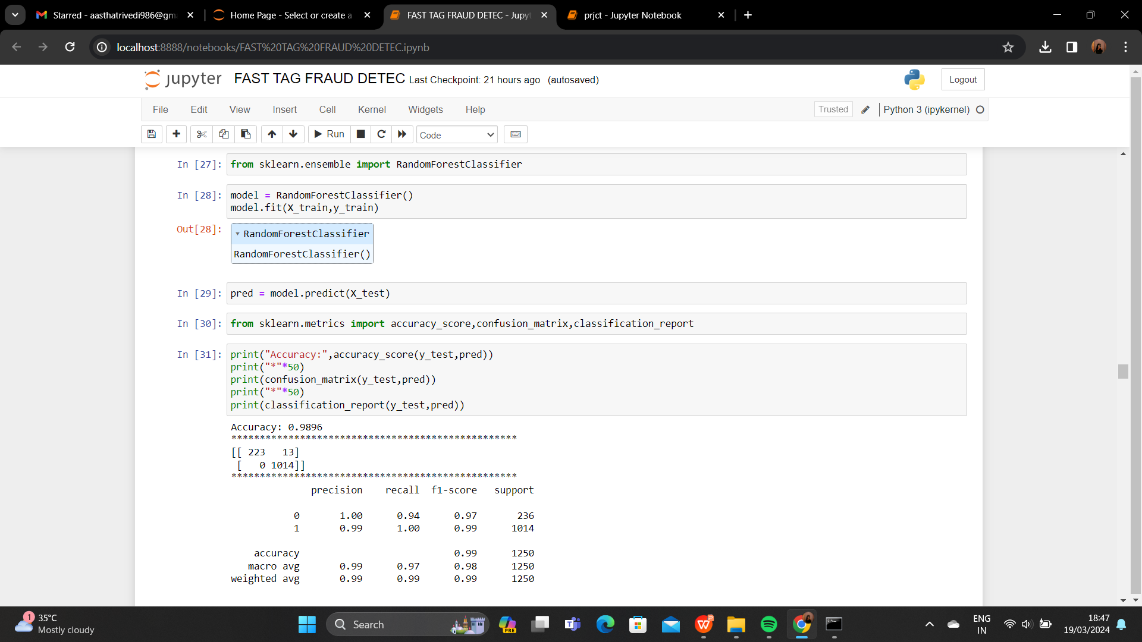
Random Forest

Slide 16
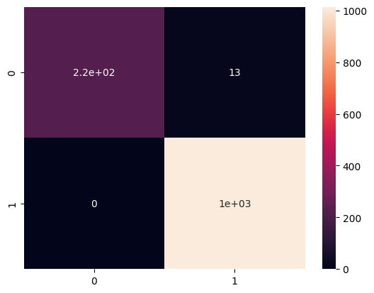
Confusion Matrix

Slide 17
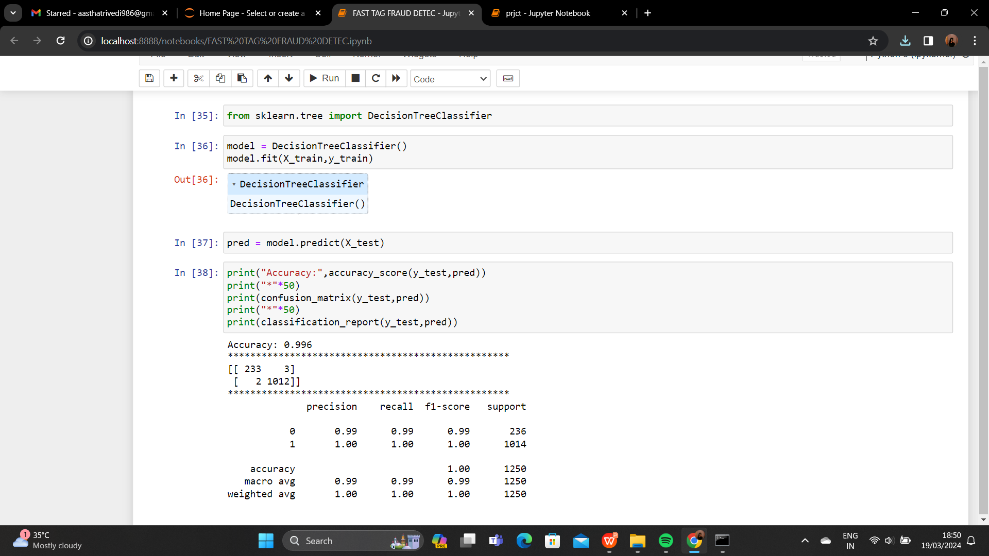
Decision Tree

Slide 18
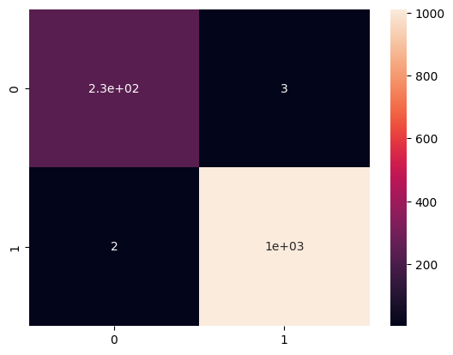
Confusion Matrix

Slide 19
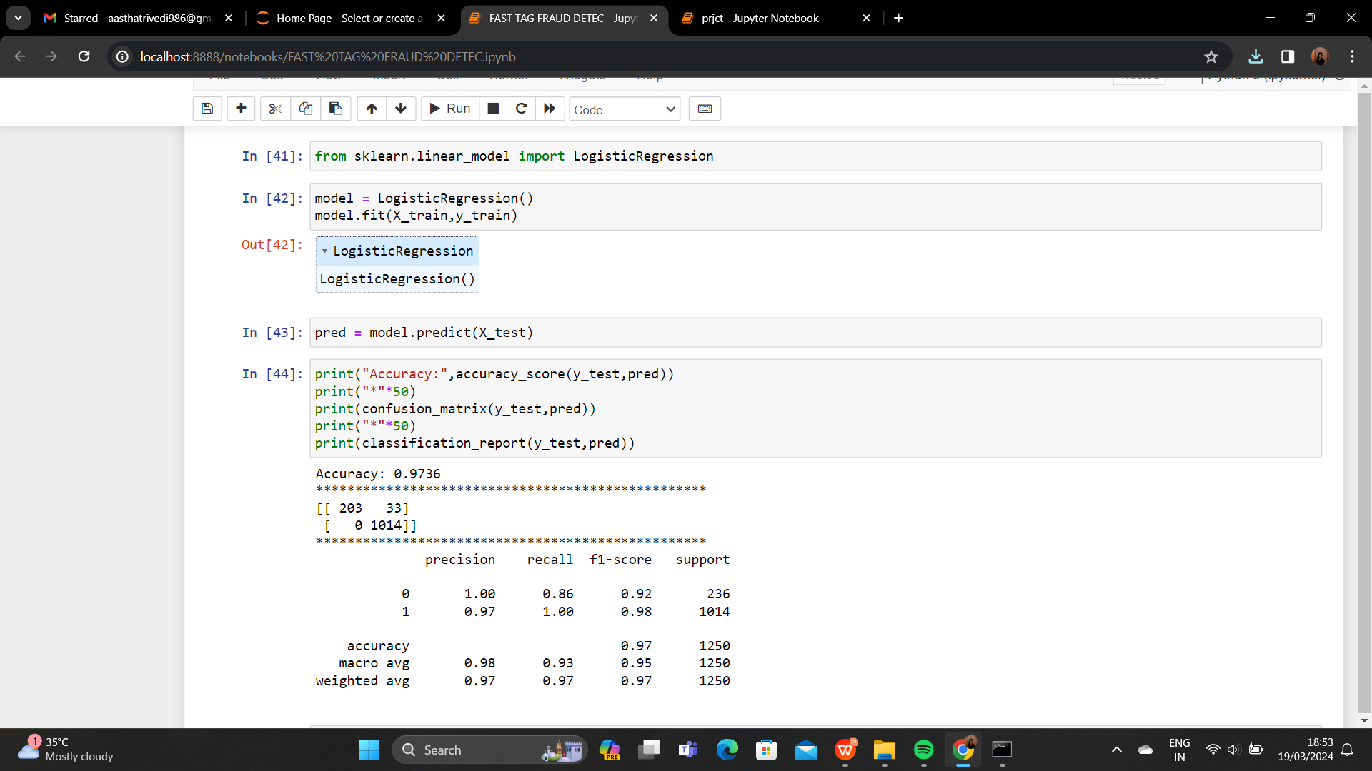
Logistic Regression

Slide 20

Confusion Matrix

Slide 21
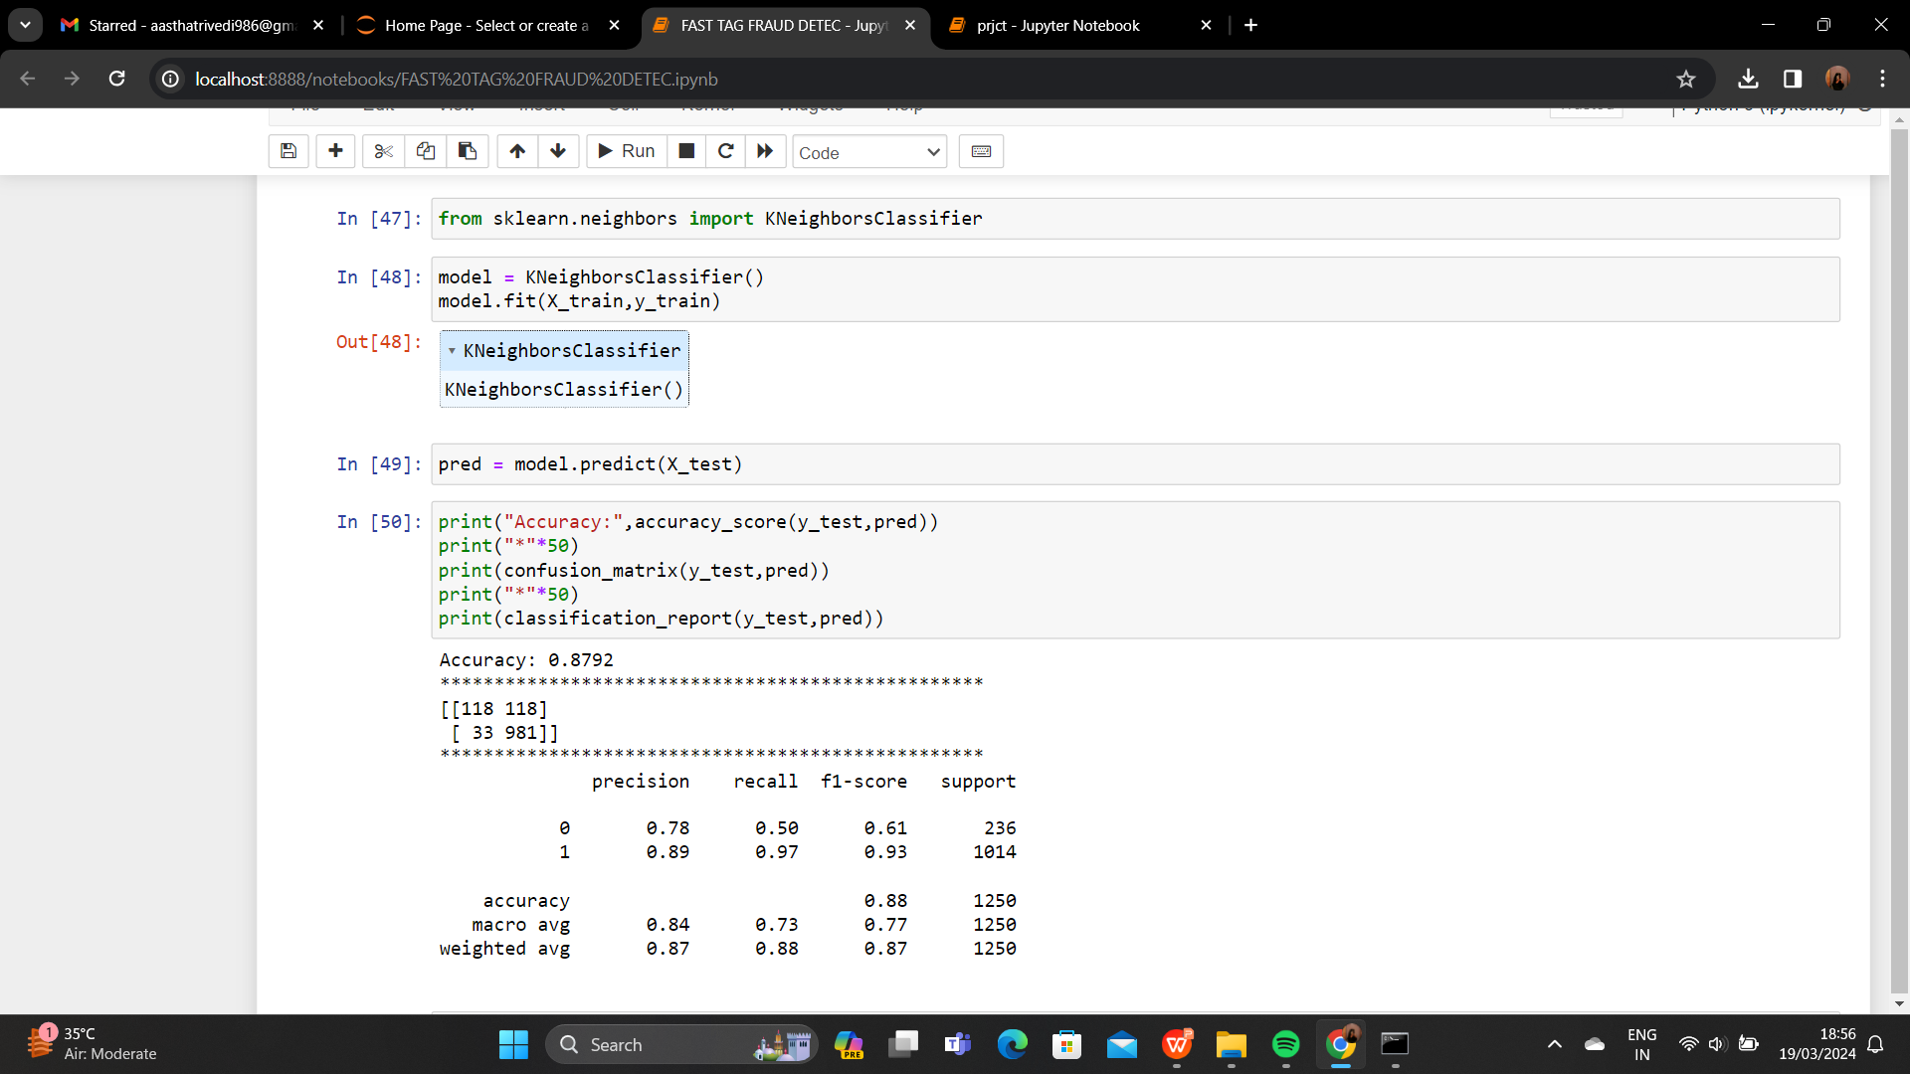
KNeighbors

Slide 22
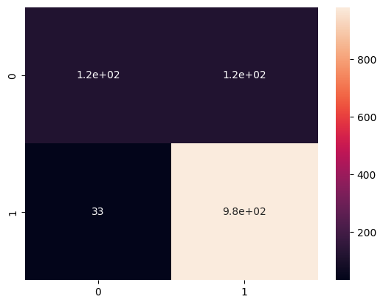
Confusion Matrix

Slide 23
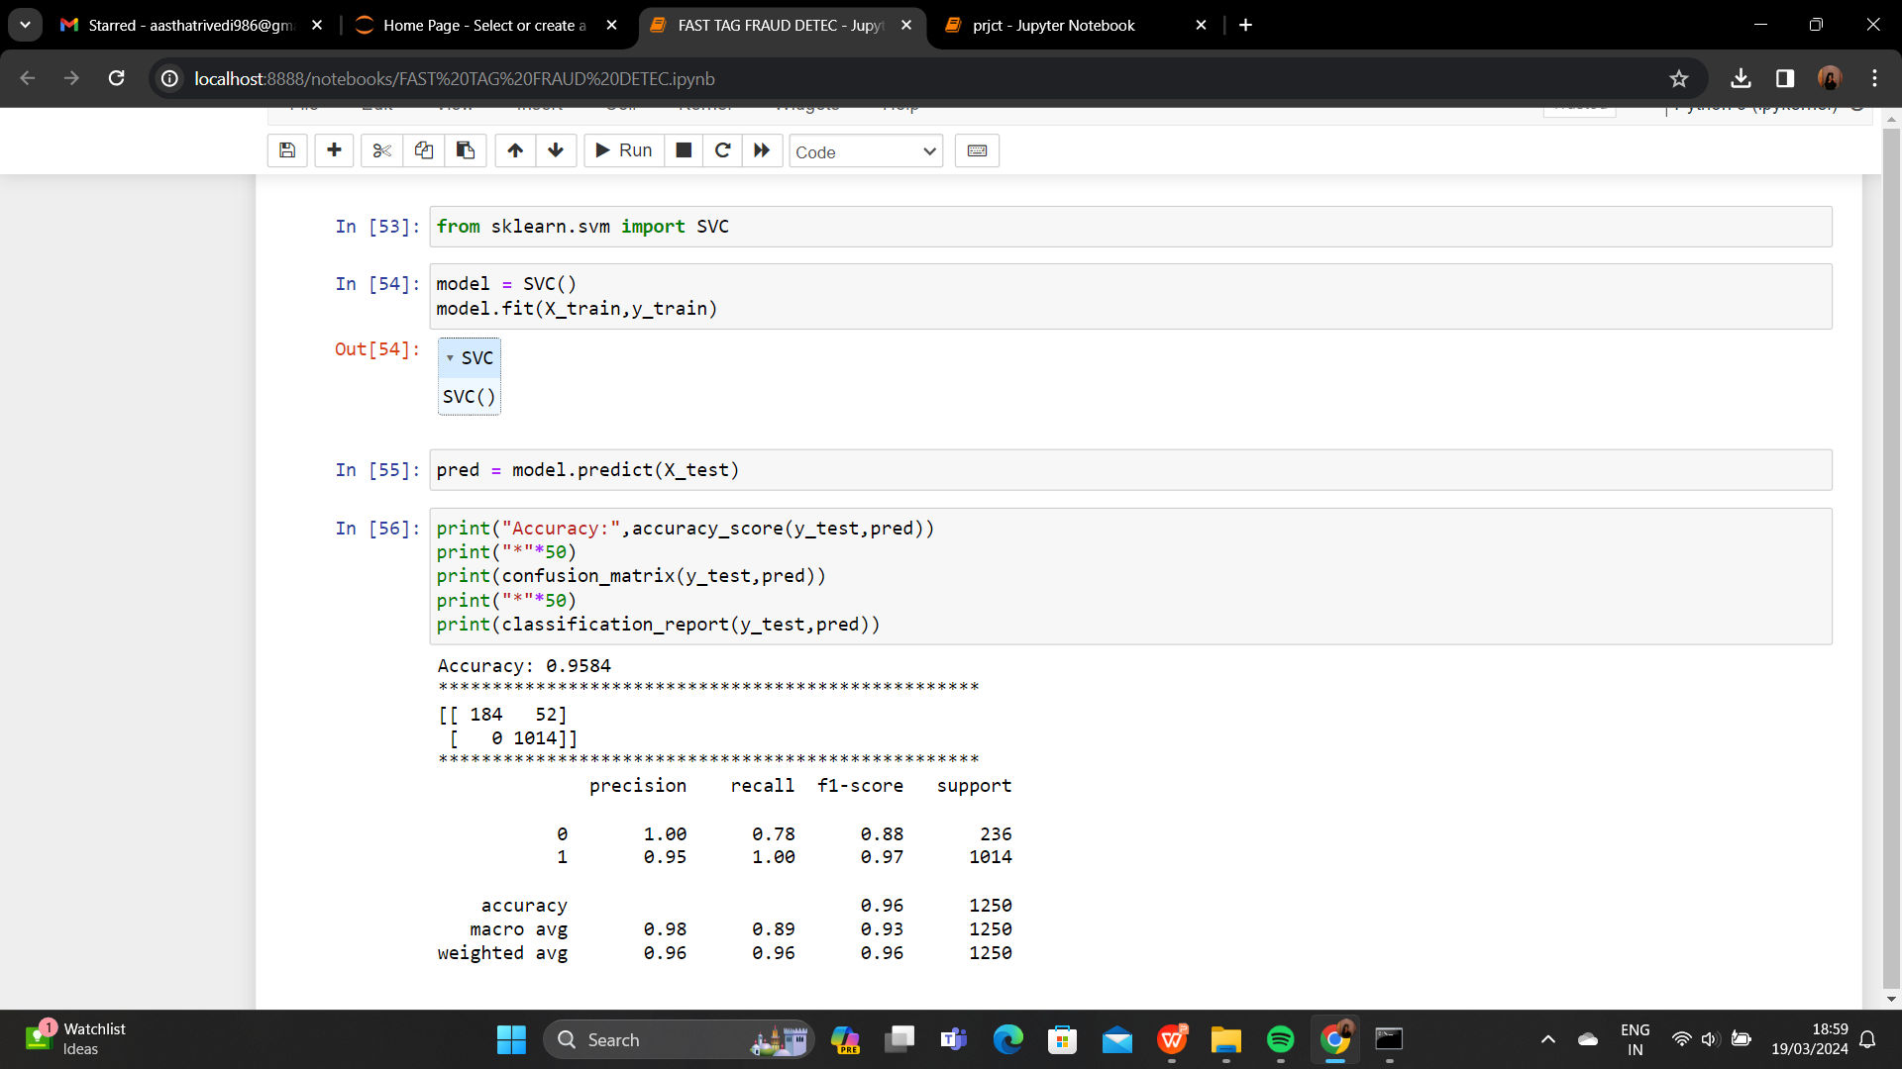
SVC

Slide 24
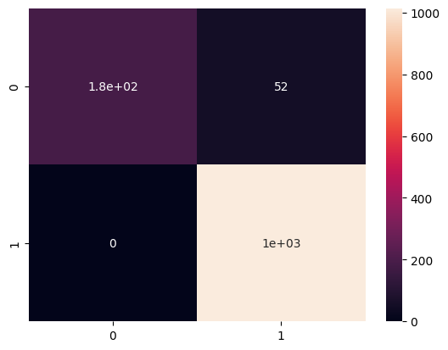
Confusion Matrix

Slide 25
Overall Accuracy Table
Model | Accuracy
Random Forest | 98.88%
Decision Tree | 99.68%
Logistic Regression | 97.36%
KNeighbors | 87.92%
SVC | 95.84%

Slide 26
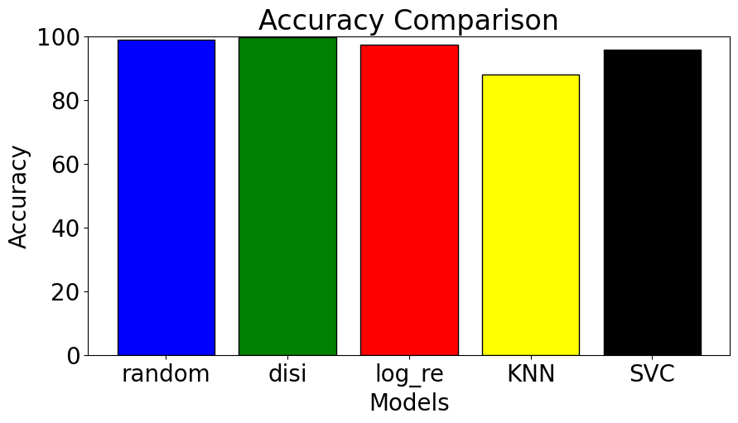
Accuracy Comparison

Slide 27
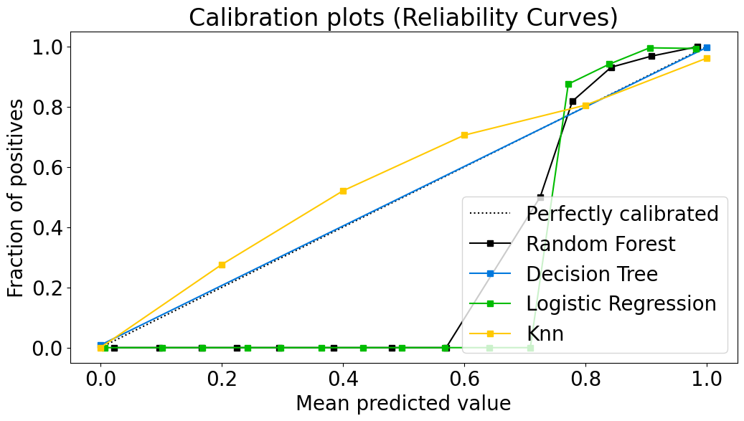
Calibration Plot

Slide 28
Future Scope
In future, this model can be used to compare various machine learning algorithm generated prediction models.
The model which will give higher accuracy will be chosen as the prediction model.

Slide 29
Conclusion
The Decision Tree algorithm is the most accurate for Fast tag Fraud Detection with Accuracy of 99.68%

Slide 30


