Slide 1
BLITHCHRON '27 · IIT GANDHINAGAR · HC26-CULT01 · CHRONOKEEPERS
HeritageGraph AI
From Forgotten Archives to Living Cultural Knowledge
Turn historical images and archives into searchable, evidence-backed knowledge.
67
heritage sites
75
stories
7
connected tools
Live: heritagegraph-ai.onrender.com
Notes:
Introduce the team and the problem statement HC26-CULT01: digital revitalisation of unstructured cultural and architectural heritage archives. One line: HeritageGraph AI turns scattered heritage files into searchable knowledge where every claim shows its source.

Slide 2
THE PROBLEM
Heritage knowledge is stuck in folders
Cannot be searched
Nothing is linked
No visible source
Scanned reports and photos are just pixels. You cannot search inside them or jump to a page.
People, monuments and places are not connected, and dates never become a timeline.
A claim in a PDF has no provenance. Every new researcher starts from zero.
We link it, date it, cite it and make it searchable, and we never invent anything.
HeritageGraph AI · Blithchron '27 · IIT Gandhinagar
2
Notes:
Heritage documentation is produced all the time: site photos, scanned reports, PDFs, slide decks. It ends up in folders. You cannot search inside a scan, nothing links a person to a monument, dates never become a timeline, and nobody can see where a claim came from. Every new researcher starts from zero.

Slide 3
OUR SOLUTION
From scattered files to sourced answers
1 Upload
2 Digitise
3 Structure
4 Ground
Images, PDF, DOCX, PPTX, TXT or a whole ZIP.
Gemini vision reads the image. OCR reads the text, page by page.
Finds people, places and dates. Spots duplicates. Builds a timeline.
Matches Wikipedia and Wikidata. Each graph edge shows its evidence status.
Core rule: nothing is invented. Empty OCR stays empty. Unsupported claims are labelled.
HeritageGraph AI · Blithchron '27 · IIT Gandhinagar
3
Notes:
Walk left to right. 1: the user uploads images, PDFs, Word, PowerPoint, text, or a whole ZIP. 2: a vision AI (Gemini) reads photos and OCR reads text, page by page; each file is processed independently so one bad file never blocks the rest. 3: we pull out people, places, dates and duplicate images and build a timeline. 4: we match entities to Wikipedia and Wikidata, and every relationship in the graph carries an evidence status. The core rule: nothing is invented.

Slide 4
WHAT IT DOES
Six connected tools in one app
Historical search
Image analysis + 3D
Archive Studio
Type a person, place or year. Get a cited summary, photo, key facts and a graph.
Upload a photo. Vision AI and OCR read it, history is fetched and graphed, and it opens as a 3D depth view.
Upload many files or a ZIP. Page-level search, timeline, duplicates, PDF report.
India Heritage Map
Stories & Legends
Research workspace
67 curated sites across all 28 states and 8 UTs, with filters and a route builder.
A story for all 67 sites. Where traditions disagree, both versions are shown.
Accounts, collections, notes and a private history of every search.
HeritageGraph AI · Blithchron '27 · IIT Gandhinagar
4
Notes:
Six features, one app. Search: type a person, place or year and get a cited summary with a photo and graph. Image analysis: upload a photo. Archive Studio: upload many files or a ZIP. India map: 67 curated sites across all states and union territories. Stories and Legends: a story for every one of the 67 sites; the first 18 are hand-checked and the other 57 are short summaries marked unverified. Where traditions conflict they are shown side by side. Research workspace: accounts, collections, notes and a private history.

Slide 5
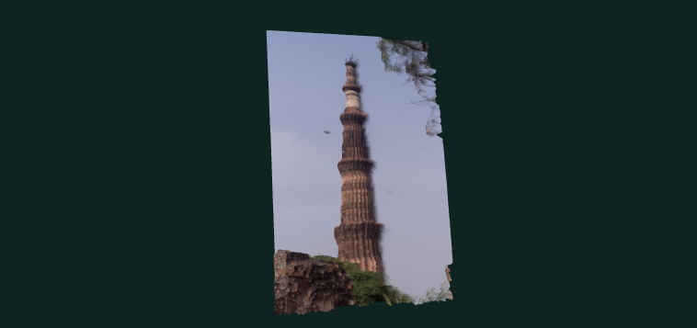
3D DEPTH VIEW
Any photo becomes a 3D depth view
1
Pick a photo
Any heritage photo in the upload box.
2
AI estimates depth
A small model (Depth Anything V2) runs in your browser.
3
Tilt, zoom, explore
Drag to tilt, scroll to zoom, double-click to reset.
Example: a Qutub Minar photo as a tilted depth relief (shown with approximate depth).
An effect, not a scan: depth is estimated from one photo, and the app labels it that way.
HeritageGraph AI · Blithchron '27 · IIT Gandhinagar
5
Notes:
New feature. After choosing a photo in the upload box, click View in 3D. A small AI model, Depth Anything V2, runs inside the browser and estimates how far each part of the photo is. Three.js turns that into a relief you can drag to tilt, scroll to zoom, and double-click to reset. Be clear and honest: this is an effect built from one photo, not a scan or a full 3D model. If the depth model cannot load, the app shows an approximate relief and labels it as approximate.

Slide 6
ARCHITECTURE
How it is built
FastAPI backend
Wikipedia + Wikidata
history and photos
API routes
search · analysis · archive · map · auth
Browser
React 19 + Vite
three.js + depth model
Gemini vision
understands images
Services
the logic: pipelines and grounding
OCR.space
reads text from scans
Repositories
the only layer that touches the DB
SQLite (PostgreSQL ready)
One origin: one server serves the website and /api in one Docker image on Render. The 3D step runs in the browser.
HeritageGraph AI · Blithchron '27 · IIT Gandhinagar
6
Notes:
Three layers. The browser runs a React and Vite app. It talks to a FastAPI backend, split into routes (the web endpoints), services (the logic) and repositories (the only code that touches the database). The backend calls outside services: Wikipedia and Wikidata for history and photos, Gemini for image understanding, OCR.space for text. Data lives in SQLite, and PostgreSQL is supported. One server serves both the website and the API, so there is no CORS problem. Everything ships as one Docker image on Render.

Slide 7
DEMO
Live demo: what we will show
1
Search "Rani ki Vav"
Cited summary, sourced photo, knowledge graph
Try it live
2
Upload a photo
Vision + OCR, evidence on every edge, then View in 3D
heritagegraph-ai.onrender.com
Open the India map
67 sites, filters, a story with two versions
Code on GitHub
TrivediOm1601/heritagegraph-ai
3
Free hosting: the first load after idle can take about a minute.
4
Archive Studio
Drop a ZIP: page search, timeline, PDF report
HeritageGraph AI · Blithchron '27 · IIT Gandhinagar
7
Notes:
Run these four steps on the live link. Open the site a few minutes before, because the free host sleeps after 15 idle minutes and the first load can take about a minute. Step 1: search Rani ki Vav and point to the citation numbers. Step 2: upload a photo, show the evidence status on the graph edges, then click View in 3D (an AI-estimated depth effect, not a scan). Step 3: open the map and a story with two versions. Step 4: drop a ZIP in Archive Studio.

Slide 8
LIMITS AND ROADMAP
Honest limits and what comes next
Known limits
Next steps
OCR is weak on handwriting and old scripts
AI identification is a candidate, not a fact
Sources are mostly secondary (Wikipedia, UNESCO)
57 of 75 stories are short summaries, not yet source-checked
Free hosting sleeps and resets data on restart
3D view is an AI-estimated effect, not a scan
Handwriting-capable OCR
Archival sources: ASI reports, museum catalogues
PostgreSQL and persistent file storage
More stories, in Indian languages
Email verification and MFA for accounts
True 3D models for statues and artefacts
HeritageGraph AI · Blithchron '27 · IIT Gandhinagar
8
Notes:
Be upfront about the limits. OCR is weak on handwriting and old scripts. The AI gives a candidate identification, not a fact, and the UI shows alternatives. Sources are mostly Wikipedia and UNESCO. 57 of the 75 stories are short summaries not yet source-checked. The free host sleeps and resets data on restart. The 3D view is an estimated effect, not a scan. Then the roadmap: better OCR, archival sources, PostgreSQL with persistent storage, more stories in Indian languages, and email verification.

