Slide 1
Types of vulnerability scanner
1.Port scanner
2.Network vulnerability scanner
3.Web applications security scanner
4.Database security scanner
5.Single vulnerability tests

Slide 2
Port scanner
Port scanner is often used by administrators and the test by port scanner will tell the sever running on your network and detect the vulnerabilities

Slide 3
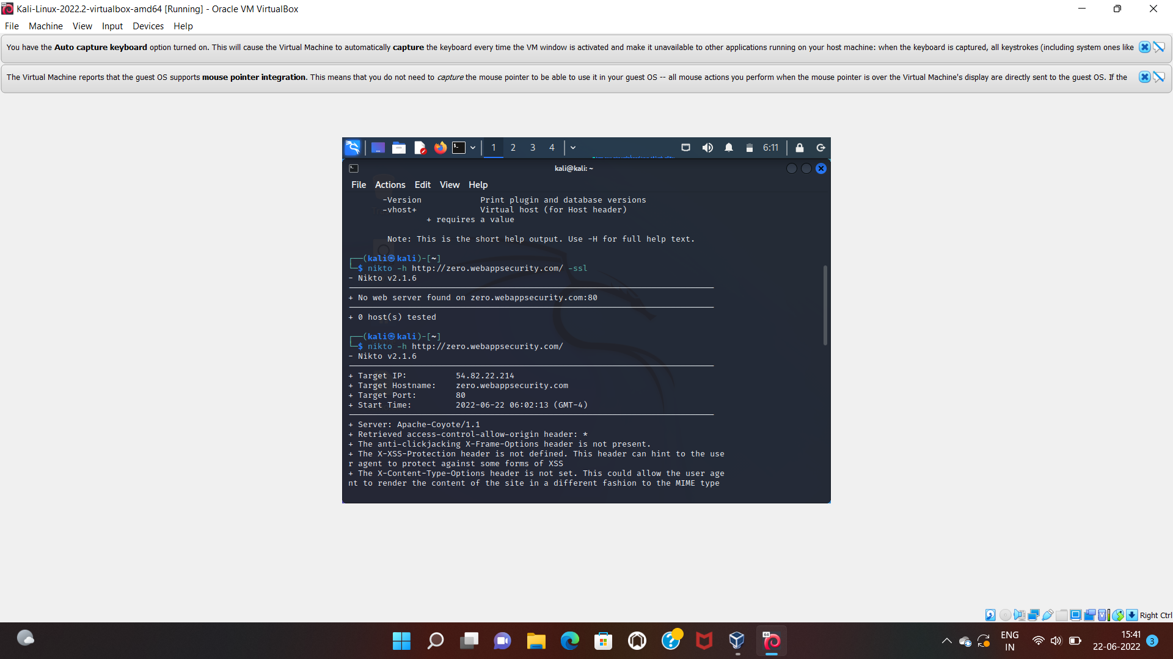

Slide 4
Port numbers are used for consistency and programming. The port number combined with an IP address form the vital information kept by every Internet Service Provider in order to fulfill requests. Ports range from 0 to 65,536 and basically rank by popularity.Ports 0 to 1023 are well known port numbers that are designed for Internet use although they can have specialized purposes as well. They are administered by the Internet Assigned Numbers Authority (IANA). These ports are held by top-tier companies like Apple QuickTime, MSN, SQL services, and other prominent organizations. You may recognize some of the more prominent ports and their assigned services:Port 20 (UDP) holds File Transfer Protocol (FTP) used for data transferPort 22 (TCP) holds Secure Shell (SSH) protocol for secure logins, ftp, and port forwardingPort 53 (UDP) is the Domain Name System (DNS) which translates names to IP addressesPort 80 (TCP) is the World Wide Web HTTP

Slide 5
