Slide 1

Safe and Secure Smart Home Using Cisco Packet Tracer
This presentation explores the design and implementation of a safe and secure smart home environment using Cisco Packet Tracer. We will discuss the key aspects of IoT communication, security measures, and best practices for configuring devices.

Slide 2
Trivikram (2023005439)
Bharat (2023000887)
Prateek (2023000757)

Slide 3
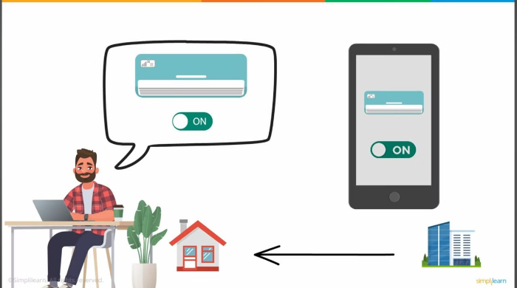
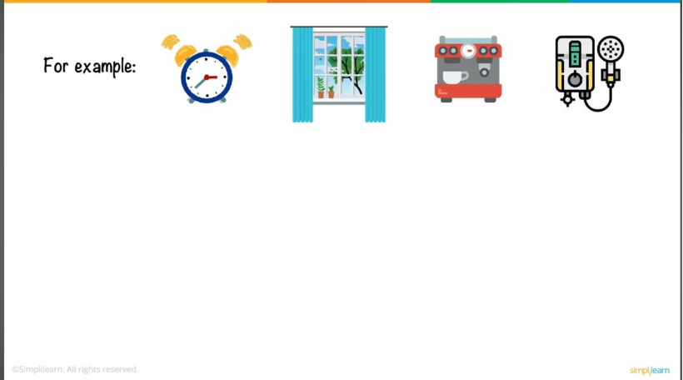

Slide 4




Information Flow: Gateway to Cloud to Phone
Sensors to Gateway
Gateway to Cloud
Cloud to Phone
Sensors send real-time data to the gateway, which consolidates and preprocesses it.
Data is securely transmitted to the cloud via protocols like MQTT and HTTPS.
Processed information is sent to the user's phone through APIs, providing insights and control options.

Slide 5
IoT Sensor-to-Gateway Communication Overview
Sensing Layer
Network Layer
Sensors collect environmental data (e.g., temperature, motion, humidity).
Sensors transmit data to the gateway wirelessly using protocols like Wi-Fi, Bluetooth, Zigbee, LoRaWAN, and NB-IoT.
I2C, SPI, and 1-Wire protocols enable communication with the gateway.
Protocols are chosen based on range, bandwidth, and power efficiency.

Slide 6
Sensing layer
I2C: A common protocol for communicating with sensors and other devices on a microcontroller or embedded system.
SPI: Another serial communication protocol often used for connecting sensors and peripherals.
1-Wire: A simple single-wire protocol for connecting multiple devices to a microcontroller.

Slide 7
Network layer
Wi-Fi: A widely used wireless networking standard, suitable for high-bandwidth applications.
Bluetooth: A short-range wireless technology, commonly used for connecting low-power devices.
Zigbee: A low-power wireless mesh networking protocol, ideal for IoT applications with many devices.
LoRaWAN: A long-range, low-power wireless protocol, suitable for wide-area IoT deployments.
NB-IoT: A narrowband IoT technology, designed for low-power, wide-area applications.

Slide 8

Gateway and Cloud Communication
Gateway Layer
Cloud Layer
The gateway acts as a bridge between sensors and the cloud, using protocols like MQTT, CoAP, and HTTP for data transfer.
Securely stores and processes data, providing analytics and insights to users. Data is transmitted via HTTPS for encryption and REST APIs for seamless integration.

Slide 9
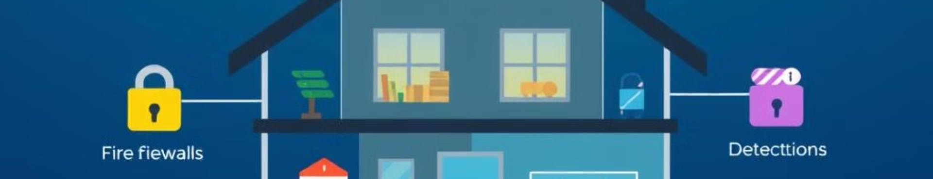
Configuring IoT Devices with Security Measures
1
Strong Authentication
2
Encryption Protocols
3
Additional Measures
Implement multi-factor authentication (MFA) and secure onboarding procedures for devices.
Use TLS/SSL for data in transit and AES for data at rest to ensure confidentiality.
Regular firmware updates, network segmentation, and intrusion detection systems (IDS) enhance security.

Slide 10
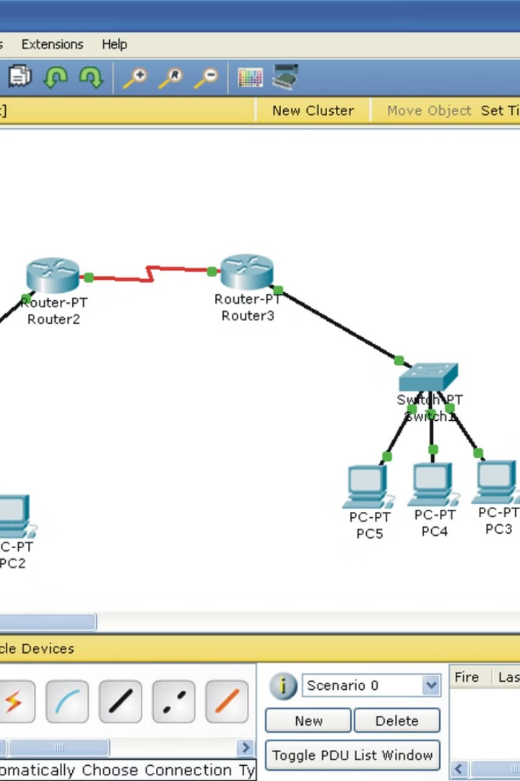



Cisco Packet Tracer Implementation
Smart Door Locks
Thermostats
Secure access control for entryways.
Automated temperature control.
Cameras
Remote monitoring and security surveillance.

Slide 11



Benefits and Challenges of a Secure Smart Home
Convenience
1
Enhanced automation and control.
Efficiency
2
Improved energy management and cost savings.
Safety
3
Real-time monitoring, alerts, and security enhancements.

Slide 12

Conclusion
Smart homes offer numerous benefits, but security is paramount. Cisco Packet Tracer is a valuable tool for designing and testing secure smart home networks. By implementing robust protocols and practices, we can create safe and secure environments for our connected homes.

