Slide 1
C H A P T E R S E V E N
More Object-Oriented
Programming

Slide 2
Modules
First introduced scope rules for data hiding.
Public part consists of variables and functions that are visible outside of the module.
Private part consists of variables and functions visible only within the module.
Modules may span multiple compilation units (files).
Modules generally lack any inheritance mechanism.

Slide 3
Why OO-Programming?
Reduces conceptual load by reducing amount of detail
Provides fault containment
  Can’t use components (e.g., a class) in inappropriate ways
Provides independence between components
  Design/development can be done by more than one person

Slide 4
The Evolution of OOPS
Global Variables -lifetime spans program execution.
Local Variables - lifetime limited to execution of a single routine.
Nested Scopes - allow functions to be local.
Static Variables - visible in single scope.
Modules - allow several subroutines to share a set of static variables.
Module Types - multiple instances of an abstraction.
Classes - families of related abstractions.

Slide 5
Keys to OO Programming
An instance of a class is know as an Object.
Languages that are based on classes are know as Object-Oriented.
  Eiffel
  C++
  Modula-3
  Ada 95
  Java

Slide 6
Keys to OO Programming
Encapsulation (data hiding)
  Enable programmer to group data & subroutines (methods) together, hiding irrelevant details from users
Inheritance
  Enable a new abstraction (i.e., derived class) to be defined as an extension of an existing abstraction, retaining key characteristics
Dynamic method binding
  Enable use of new abstraction (i.e., derived class) to exhibit new behavior in context of old abstraction

Slide 7
Initialization & Finalization of Objects
Choosing a constructor
  How are constructors supported in the language?
References and values
  Value model ➔ object creation results from elaboration
Execution order of initialization
  E.g., with derived classes
Garbage Collection?
  Don’t need destructors!

Slide 8
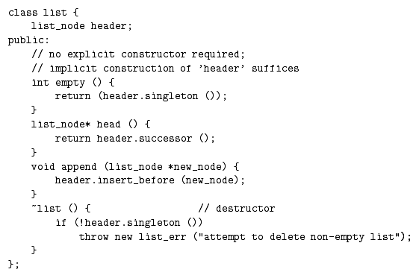
An Example in C++

Slide 9
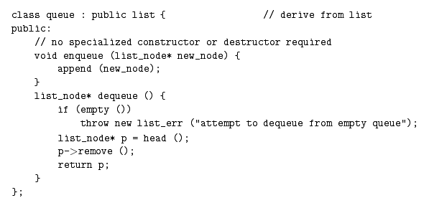
An Example in C++

Slide 10
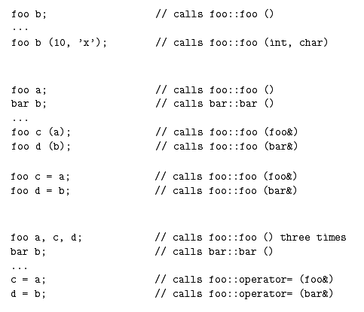
References
& Values
Initialization in C++
This is NOT
assignment!!!
This IS
assignment!!!

Slide 11
Initialization & Finalization of Objects
C++ automatically calls constructors for base classes before current constructor
  Base class members can be explicitly initialized using foo::foo (foo args) : bar (bar args), member1 (m1 args), member2 (m2 args) { … }
  Use of this syntax results in call to copy constructor rather than 0-arg constructor followed by operator=
Java, like C++, by default calls 0-argument versions of base class constructors
  Call to super (args) overrides 0-arg version
Notes:
Smalltalk, Eiffel, and CLOS only initialize base class data members to null.

Slide 12
Classes
Extends the scope rules of modules to include inheritance.
Should private members of a base class be visible in derived classes?
Should public members of a base class always be public members of a derived class.
How much control should a base class have over its members in derived classes?

Slide 13
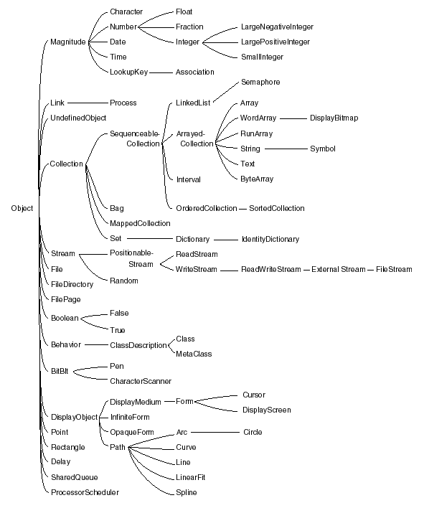
Yikes!
Huge families of classes are used to implement language features.
This is from Smalltalk-80.

Slide 14
C++ Classes
Any class can limit the visibility of its members:
  Public members are visible anywhere the class is in scope.
  Private members are visible only within the class’s methods.
  Protected members are visible inside members of the class and derived classes.
  Friend classes are granted exceptions to (some) of the rules.

Slide 15
C++ Classes
Derived classes can further restrict visibility of base class members, but not increase it:
  Private members of a base class are never visible in a derived class.
  Protected and public members of a public base class are protected or public, respectively, in a derived class.
  Protected and public members of a protected base class are protected members of a derived class.
  Protected and public members of a private base class are private members of a derived class.

Slide 16
C++ Classes
Derived classes that limit visibility of base class members can restore visibility by inserting a using declaration in its protected or public sections.
Rules in other languages can be significantly different.

Slide 17
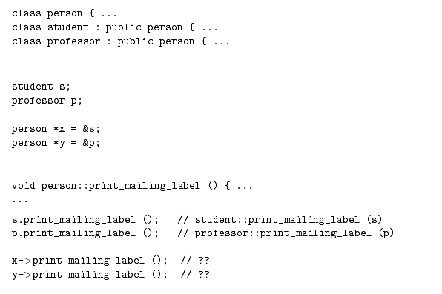
Dynamic Method Binding

Slide 18
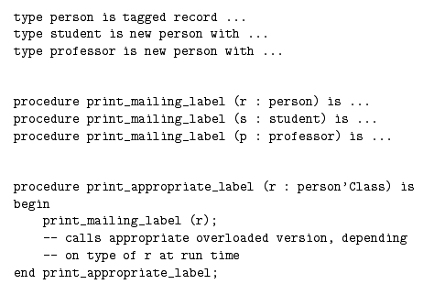
Dynamic Method Binding

Slide 19
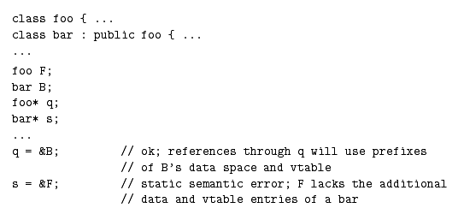
Member Lookup

Slide 20
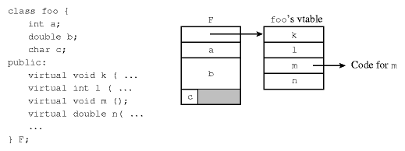
Virtual Methods

Slide 21
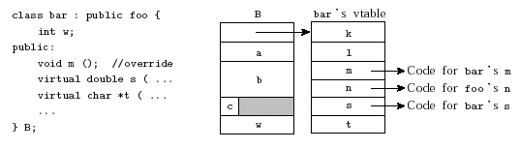
Inheritance

Slide 22
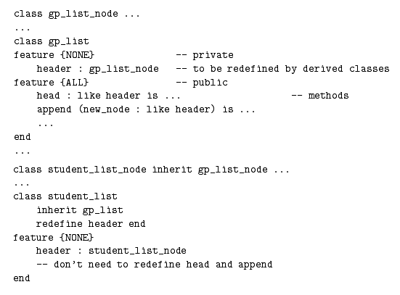
Multiple Inheritance

Slide 23
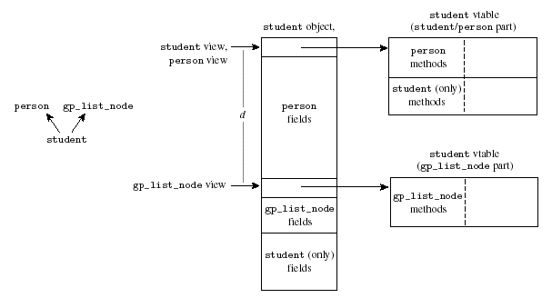
Multiple Inheritance

Slide 24
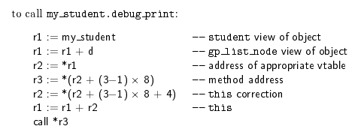
Multiple Inheritance
The vtable entry contains the “this” correction for each method

Slide 25
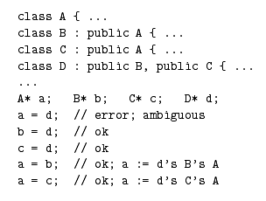
Replicated Inheritance

Slide 26
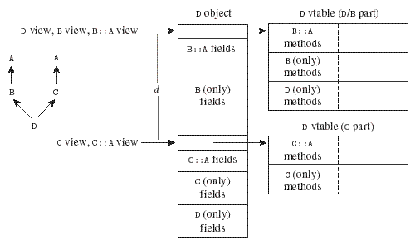
Replicated Inheritance

Slide 27
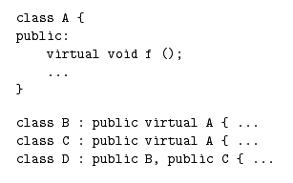
Shared Multiple Inheritance
“A new opportunity for ambiguity and additional implementation complexity”

Slide 28
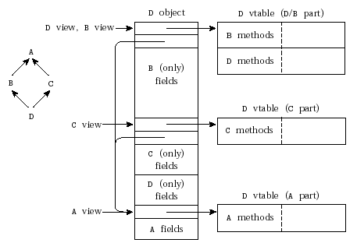
Shared Multiple Inheritance

Slide 29
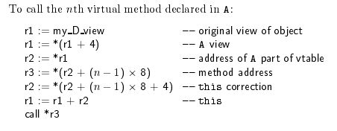
Shared Multiple Inheritance

Slide 30
Mixed Inheritance
A base class composed entirely of abstract methods is called an interface (at least in Java). It has no data nor implements any methods.
Inheritance from one real base class and any number of interfaces is called mixed inheritance.
Virtual methods of the interface(s) are “mixed into” the methods of the derived class.

Slide 31
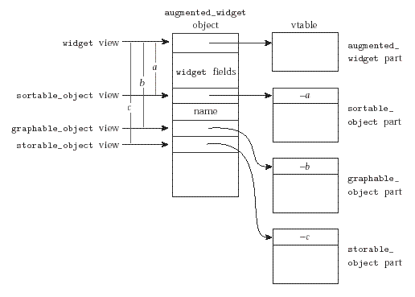
Mixed Inheritance

Slide 32
Summary
Object Oriented Programming has become an important mainstay of software development.
OOP language implementation trades off functionality and “purity” on one hand and simplicity and speed on the other.
Treating variables as references rather than static values requires simpler semantics but imposes runtime performance costs due to extra indirection.

Slide 33
Summary
Garbage collection makes programming easier but has high run-time costs.
Dynamic method binding requires the use of vtables or other lookup mechanism.
Multiple inheritance adds extra complexity to the vtable mechanism (even if unused).
Shared multiple inheritance adds even more indirection and run-time cost.
In-line subroutines can greatly improve performance at the cost of program size.

Slide 34
Summary
Smalltalk is considered the “purest” OO language even though it lacks multiple inheritance. Because it is slow it is rarely used in a commercial setting.
C++ is most widely used because it has default static binding, minimal dynamic checks, and some very good compilers.
Java is more of a niche player, scoring strongly in the internet and portable interface realms. It also tends to be slow.

Slide 35
Next time…
Functional Programming

