Slide 1
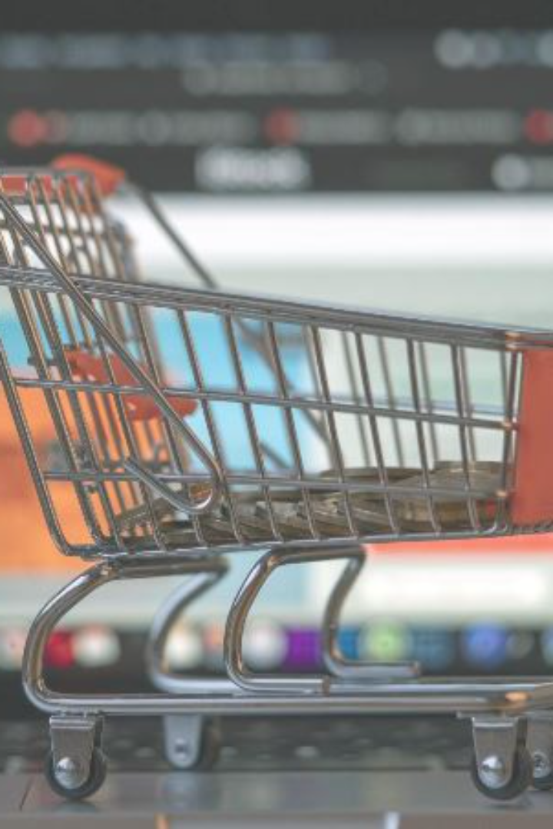
TMK Online Store Project Report
Welcome to the TMK Online Store Project Report! In this presentation, we will explore the background, goals, challenges, and lessons learned from this exciting project
By: Manuel Chub, Carlos Matus, Tyler Rodgriguez
School: St. John's College University
Course: Database Management Security

Slide 2
Background of the TMK Online Store Project
The project anticipates the development of a user-friendly and secure online store that not only meets the immediate needs of the business but also sets the foundation for future scalability and innovation. The integration of a robust database system ensures that the store can handle increasing user loads, maintain data accuracy, and adapt to evolving business requirements. While fostering business growth and ensuring a seamless and secure shopping experience for customers

Slide 3
Research Design
The global e-commerce market is expected to grow at a CAGR of XX% over the next five years. Key trends include mobile shopping, personalized recommendations, and the integration of augmented reality for virtual try-on experiences. Major competitors include Amazon, eBay, and Walmart. Strengths include diverse product selection, user-friendly interface, and efficient delivery. Weaknesses include intense competition and dependence on third-party sellers. Future growth strategies include strategic entry into untapped international market system.

Slide 4
Requirement Analysis
Requirements analysis outlines the necessary features for a successful platform. It includes user authentication and account management, product management, payment gateway, order processing, search and filters, responsive design, security, analytics and reporting, and performance. Users should be able to register with a valid email address, create passwords, and update personal information. Administrators should have access to additional functionalities like product management and order processing. Payment gateways should support multiple payment methods and SSL encryption. Order processing should include confirmation emails and order history. Analytics and reporting should integrate with analytics tools, and performance should be optimized for a smooth user experience.

Slide 5

System Architecture
The system architecture for an e-commerce platform is inspired by large-scale platforms like Amazon, but it would be more complex due to factors like scalability, fault tolerance, and continuous integration. The platform consists of client-side components such as a web browser, mobile app, user interface, backend, database, authentication and authorization, payment gateway, external services like Content Delivery Network, email service, analytics service, and infrastructure like cloud infrastructure, load balancer, monitoring and logging, and security. The frontend includes a web browser, mobile app, user interface, and backend, while the backend handles incoming HTTP requests, manages user sessions, and interacts with the database. The system also includes APIs for communication between the frontend and backend, a product database, authentication and authorization services, and payment gateway.

Slide 6

Implementation
The technology stack for a website includes frontend, backend, server-side language, web framework, APIs, database, authentication and authorization, payment gateway integration, infrastructure, monitoring and analytics, security, and firewalls. The frontend uses HTML/CSS/JavaScript to create a responsive user interface, while the backend uses server-side languages like Node.js, Python, and Java to handle business logic and manage user sessions. The database uses a Relational Database Management System (RDBMS) to store structured data, and authentication and authorization services ensure secure user authentication and access to resources. Payment gateway integration facilitates secure online transactions. Infrastructure includes cloud services for scalable hosting, a Content Delivery Network (CDN) for global static asset delivery, logging and monitoring tools for tracking system events, and SSL/TLS encryption for data confidentiality and integrity.

Slide 7
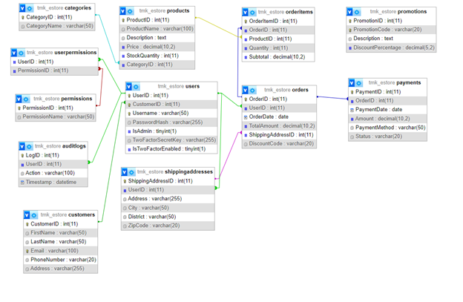
Database Design
⦁ Each User can place multiple Orders, but an Order belongs to only one User. ⦁ Each Order can have multiple OrderItems.
⦁ Each OrderItem belongs to one Order and one Product.
⦁ Each Product can be in multiple OrderItems, but an OrderItem belongs to only one Product.
⦁ Each Product belongs to one or more Categories.

Slide 8
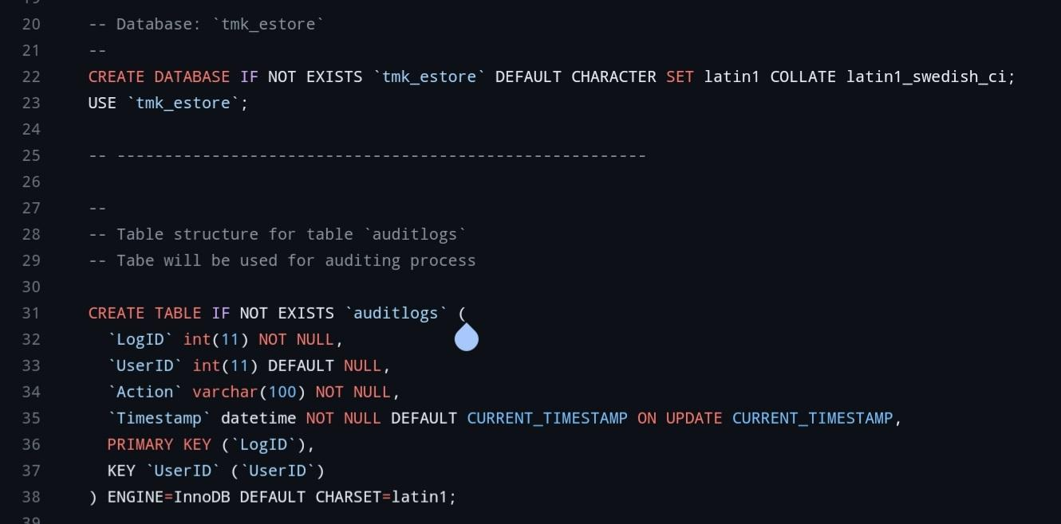
Database Implementation

Slide 9
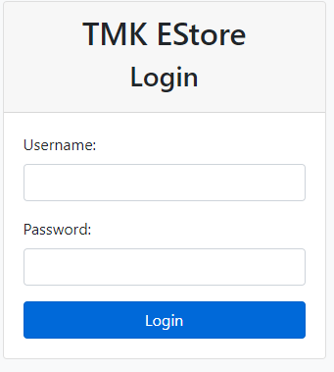
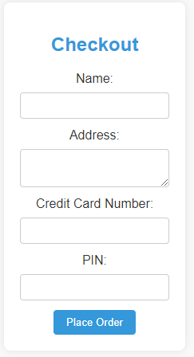
Website Development
an overview of the website development process, including front-end and back-end development.

Slide 10
Security Measures
The security of an online shopping website is crucial for protecting user information, maintaining trust, and complying with regulations. Key security measures include SSL/TLS encryption, user authentication, authorization and access control, PCI DSS compliance, Cross-Site Scripting and Cross-Site Request Forgery protection, HTTP headers, regular security audits and vulnerability scanning, Web Application Firewall (WAF), monitoring and logging, data backups, an incident response plan, and user education. SSL/TLS encryption ensures data transmission between the user's browser and server, while user authentication manages user access securely. Authorization and access control control user access based on roles and permissions, while PCI DSS compliance ensures payment card information is protected. Cross-Site Scripting and CSRF protection prevent common web application vulnerabilities, while HTTP headers enhance web security. Regular security audits, vulnerability scanning, and a robust incident response plan are essential for maintaining a secure online environment.

Slide 11
Testing
Testing is a critical stage in the development of a website to ensure its functionality, security, and performance. It includes functional testing, which ensures all features work as intended, such as user registration, product search, shopping cart, checkout, order management, and order history. Usability testing evaluates the user experience and interface design, while performance testing assesses the website's speed, responsiveness, and scalability. Security testing identifies and addresses vulnerabilities to protect user data and maintain the website's integrity. Compatibility testing ensures the website functions correctly across different browsers, devices, and operating systems. Regression testing ensures that new changes do not negatively impact existing functionalities. Load balancing testing ensures the website can distribute incoming traffic effectively across multiple servers. Error handling testing evaluates how the website handles and communicates errors to users, ensuring clarity and user-friendliness.

Slide 12
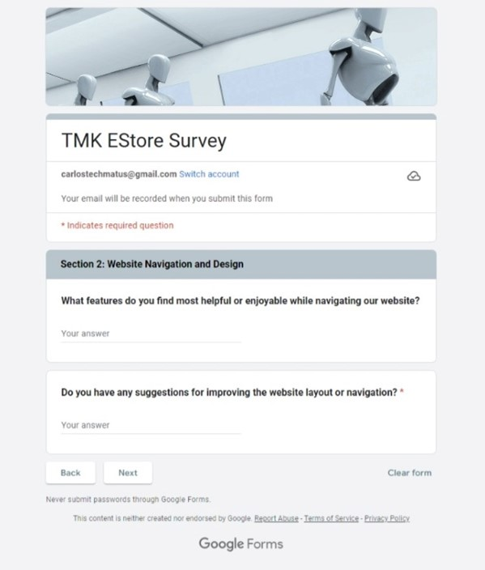
Evaulation
Performance Evaluation Present the performance metrics of the online store website and database, such as response time, scalability, and system uptime.
User Feedback Include feedback from users who participated in testing. Discuss any modifications made based on user suggestions.

Slide 13
Challenges and Lessons Learned
• UX Design: Designing an intuitive, user-friendly interface. • Security Concerns: Ensuring user data security and compliance with industry standards.
• Mobile Responsiveness: Optimizing the website for various devices and screen sizes. • Performance Optimization: Ensuring fast page load times and optimal website performance.
• Testing and Quality Assurance: Conducting rigorous testing across different browsers, devices, and user scenarios.
• Scalability Planning: Planning for increased traffic, product offerings, and customer base.

Slide 14
Future Recommendations
The company is implementing several strategies to enhance its online presence. These include implementing Augmented Reality (AR) for product visualization, enhancing personalization and recommendation engines, adopting 3D Secure Authentication for enhanced security, fostering social commerce and influencer marketing, utilizing AI-powered chatbots for customer service, enhancing mobile app features, exploring social proof and user-generated content, continuously monitoring and adapting to industry trends, and prioritizing data security and privacy compliance.
AR allows customers to virtually experience products before making a purchase, enhancing their confidence and reducing returns. Machine learning algorithms are used to personalize content based on user behavior, preferences, and purchase history. 3D Secure 2.0 is adopted for online transactions, providing a seamless and secure payment experience.
Fostering social commerce and influencer marketing is also a key strategy, enabling social media shopping features and collaborating with influencers for product endorsements and reviews. Chatbots are used for customer service, and the company is also investing in mobile app features to make it a central hub for shopping activities.

Slide 15
Conclusion
Database management security is a critical aspect of protecting the TMK Estore database and web application. It is essential to ensure that sensitive information, such as customer data and financial transactions, are securely stored and protected from unauthorized access. A robust database management security system will not only prevent data breaches but also ensure the integrity and availability of the data.

