Slide 1

Istanbul Water Crisis Detection Project
Melih Kuru

Slide 2
Istanbul and the Water Problem
Istanbul formerly Byzantium and Constantinople, is the largest city in Turkey and the country's economic, cultural and historic center. The city straddles the Bosporus strait, and lies in both Europe and Asia, with a population of over 15 million residents. Istanbul is the largest city in Europe, and the world's fifteenth-largest city.
However, the water problem has always been a problem for Istanbul since the middle ages. Since the Byzantine period, the city's rapid growth has consumed its water resources, and the city's rulers built water channels to carry the surrounding waters to the city.
In 2020, decreasing rainfall and global warming brought the city's water stocks back to 21.66%. In this study, I will first create the fresh water resources of the city according to the information on the official website and check their coordinates with the Foursquare Api.

Slide 3
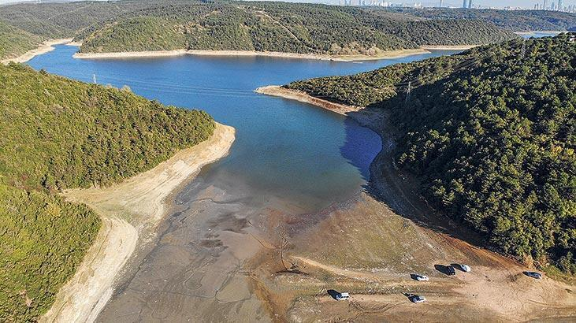
Istanbul and the Water Problem
Own work, CC BY-SA 4.0, https://commons.wikimedia.org/w/index.php?curid=68597384

Slide 4
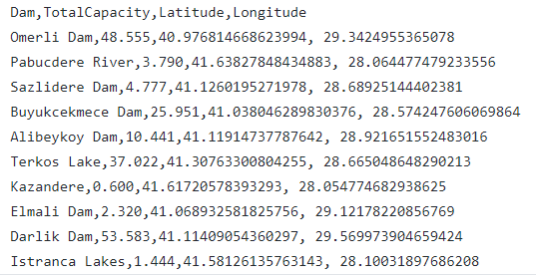
Methodology
First of all, let's visualize the fresh water resources of the city. In this way, we can create public-society awareness.

Slide 5
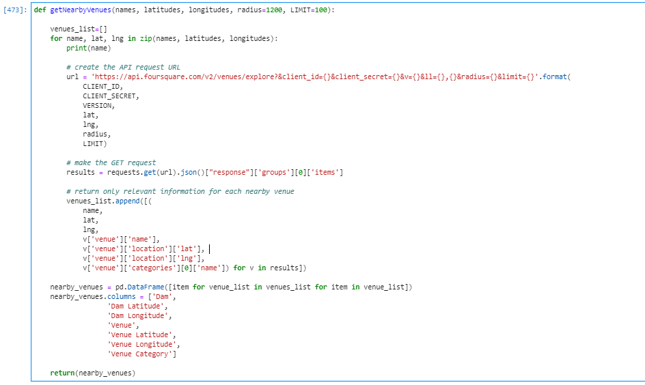
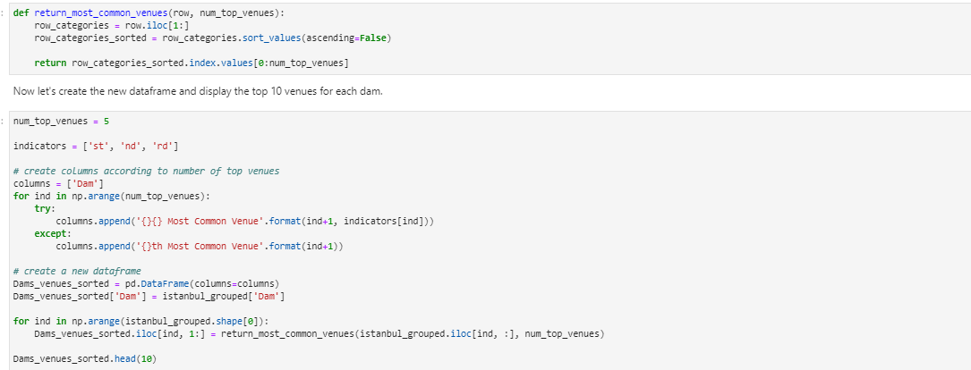
visualization
I will query the dam coordinates I found on the internet with the Foursquare Api.

Slide 6
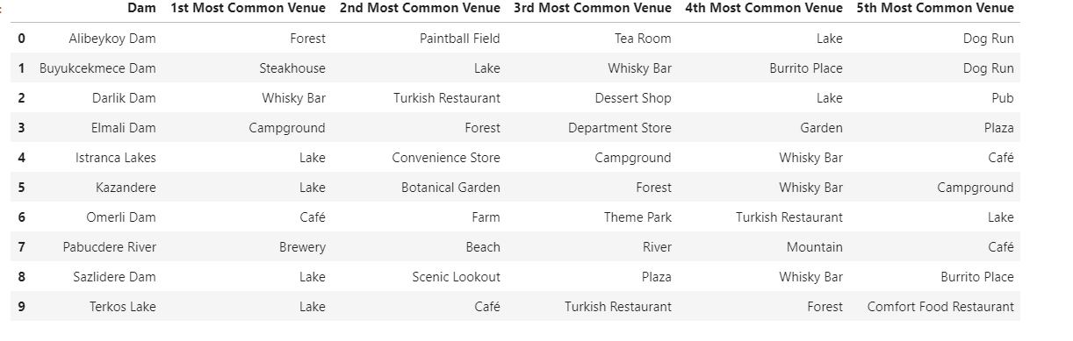
visualization
You can find the detailed codes in my github repo. As a result, Mission Successfully Completed! We Detected Lake or River Record within 1.2 Km of the Coordinates We Received from the Database. Now is the time to integrate our fresh water resources on a map according to their size.

Slide 7
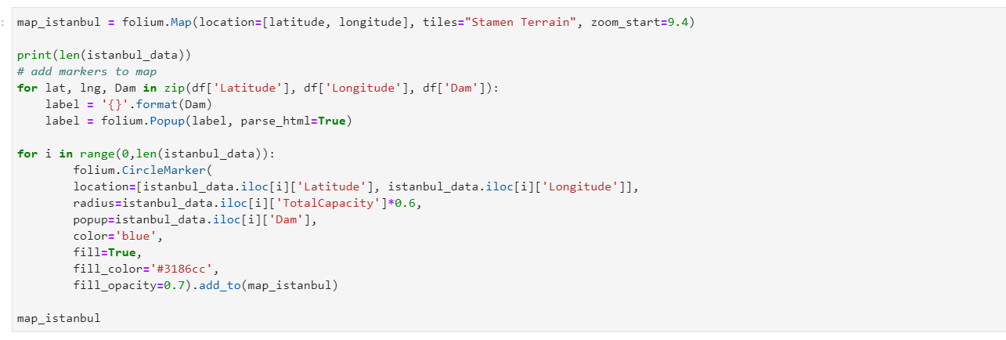
visualization

Slide 8
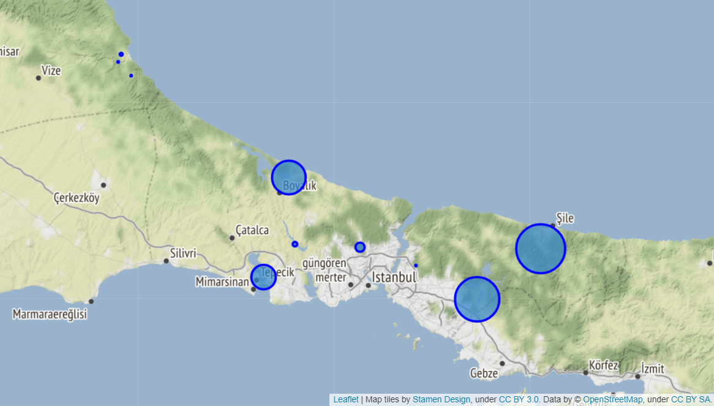
Fresh water resources map of Istanbul

Slide 9
Istanbul's Water Crısıs Predıctıon
After determining the location of our dams, it was time to estimate the thirst.
For this, I will use the data provided by the Istanbul municipality.
These are basically "Dam Occupancy Rates Of The Last 6 Years For December.21.202X", "Total Annual Rain", "Annual Amount of Water Pumped from Surrounding Provinces" and Finally, "Annual Consumption". I will calculate the balance of the water coming out.
Then I will try to establish a proportion between the "Net Water Balance" in the City and the 1-year change percentages of the dams.

Slide 10
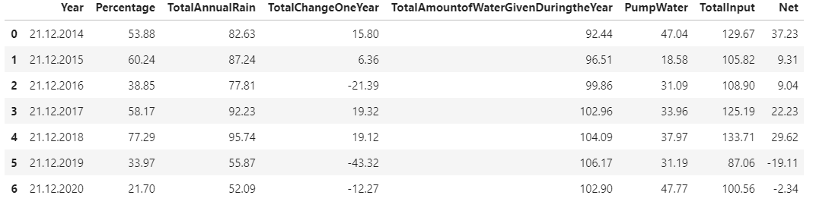
Small Reminders
TotalChangeOneYear = [Percent Of This Year] - [Percent Of Last Year] Istanbul Municipality gives occupancy rates for the same day.
PumpWater = The total water provided to the city by the 2 pump systems established by the Municipality to meet the water requirement
TotalAmountofWaterGivenDuringtheYear = Total amount of water provided for all services(individual, corporate) throughout the year according to official figures
TotalInput = [PumpWater] + [TotalAnnualRain] Total amount of fresh water coming to the city by pumps and precipitation, official records.
Net = [TotalInput] - [TotalAmountofWaterGivenDuringtheYear]
All water values have been found by dividing 10 million cubic meters. Data standardization has thus been achieved.

Slide 11
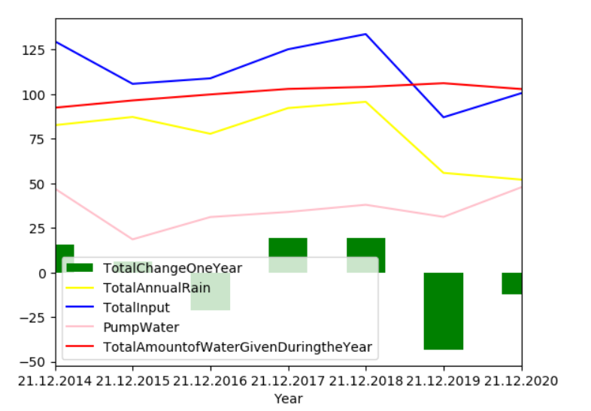
Istanbul's Water Crısıs Predıctıon
While the annual rainfall should be proportional to the dam percentage, some irregularities strike us. Of course, the reasons for this may be the water pumped from the surrounding provinces, low consumption or the factors that we cannot control.
It would be best to build this algorithm on the city's net water balance for 1 year and the percentage change in the 1-year dams.

Slide 12
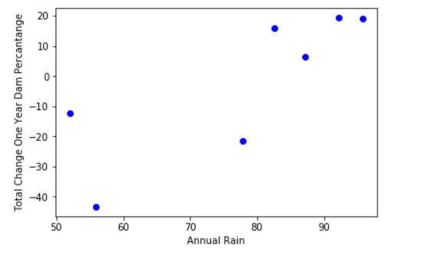
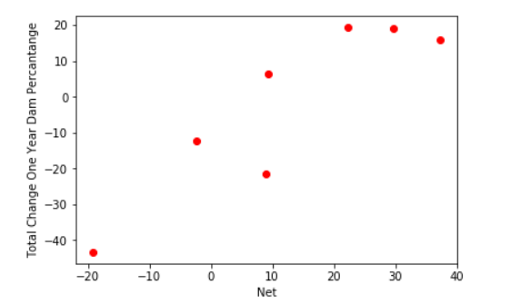
Istanbul's Water Crısıs Predıctıon

Slide 13
Istanbul's Water Crısıs Predıctıon
There are two main problems with the chart.
The first is an outlier in 2016(Net+10): A mistake in the official figures may be due to malfunctions, losses or factors that we cannot calculate. So I'm going to take out 2016 while I'm designing artificial intelligence.
The second important problem is the slowdown in dam occupancy rates when the net water inflow to the city exceeds 30. This again can be related to various problems. Maybe it's an annual thing.
But the most logical theory that comes to mind may be that more water ingress than the dams of the city can store makes no sense. Yes, water is coming, but it cannot be stored. Of course, there may be unfamiliar factors and errors in my measurement. However, this is not a big outlier. The net water inflow has rarely exceeded 30 in the last 20 years. It does not prevent our algorithm working.

Slide 14
Use Of Supervised Neural Network Models - Multi-layer Perceptron For Predictions
I will be honest. I had a hard time finding the algorithm that could most accurately cover and predict the relevant data.
It was obvious that Linear-Regression was not going to work. Because when there are more than 30 net water inflows, our dam percentage does not increase proportionally. There are also deviations in the data.
I tried logorithmic and sigmoid functions in non-linear regression. However, when the net water intake was negative, none of them could provide the arithmetic decrease.
Then I used Multi-layer Perceptron, a simple neural network application. I have tried various test - train ratios. This algorithm provided the most accurate results.
Don't worry, I'll prove it with a graph.

Slide 15
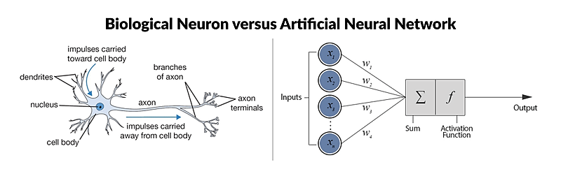
Use Of Supervised Neural Network Models - Multi-layer Perceptron For Predictions

Slide 16
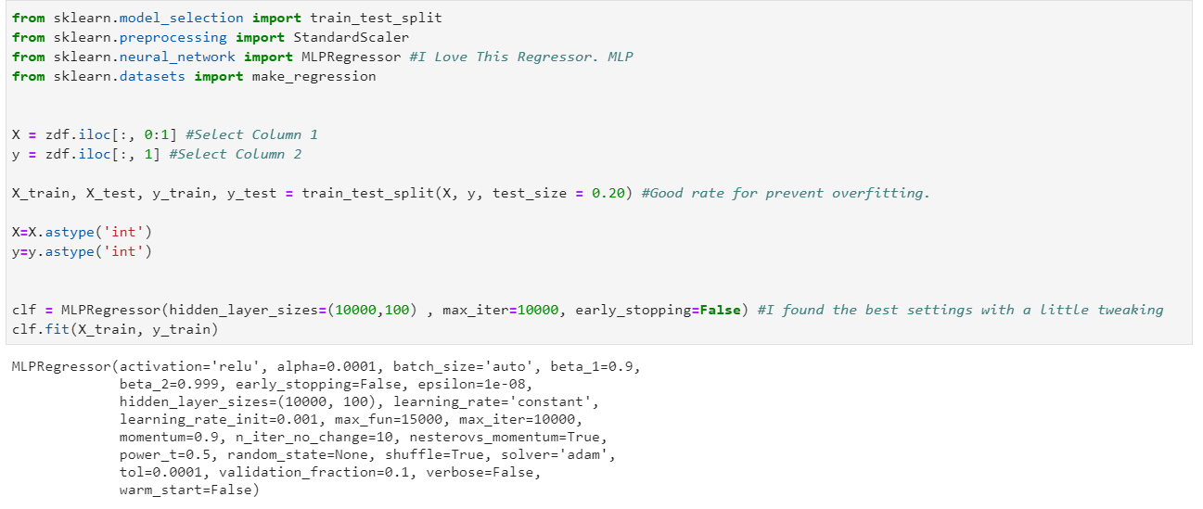
Use Of Supervised Neural Network Models - Multi-layer Perceptron For Predictions

Slide 17
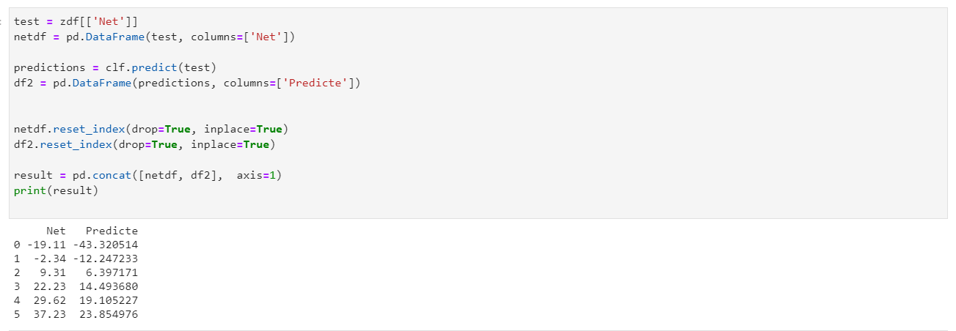
Use Of Supervised Neural Network Models - Multi-layer Perceptron For Predictions

Slide 18
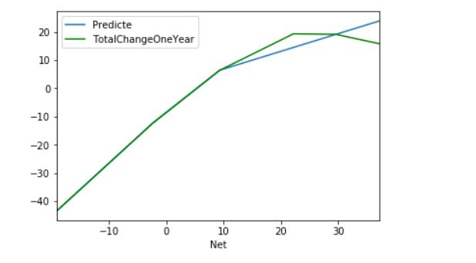
Results:
In this graph, We can see that 2 data were taken for the test of the algorithm. However, we can still see that he made very small estimates with ~ 5 errors for those values. If he had taken the last data for education, it would decrease the percentage change as the amount of water increased. This is like an impossible thing in real life. Yes, the dams can reach the saturation point, but they do not fall to negative just because there is too much rain. So this version of the Algorithm is pretty good. Anyway, a total net water inflow of 30 - 40 above is not possible under these conditions.
When the Net Water balance drops to negative, the algorithm gives excellent results even with 3 training sets. We can say that he is an expert estimator about the rate of water decrease. So let's use this model to predict the water problem of Istanbul.

Slide 19
Predictions:
Occupancy rate of Istanbul dams as of 21.12.2020: 21.66
If our net water balance is 0 next year, our Dam occupancy rate on 21.12.2021: [14.27300521]
If the next year will pass exactly like this year , our Dam occupancy rate on 21.12.2021: [9.41276697]
If we can achieve water balance as in 2014, the rainiest time of the last 6 years, our Dam occupancy rate on 21.12.2021: [45.99567619]
If we can achieve water balance as in 2010, the rainiest time of the last 10 years, our Dam occupancy rate as of 21.12.2021: [52.240123]
If so much water consumption and low rainfall like in 2019 `the worst water balance of the last 10 years`, our Dam occupancy rates as of 21.20.2021: [-21.45358778]
If the next year will pass exactly like this year , but if everyone saves 10% water, our Dam occupancy rate on 21.12.2021: [27.10021104]

Slide 20
DIscussion
At the beginning of my study, I checked with the foursquare api the dam coordinates. The results were pretty accurate. Only one dam was marked as "Campground" instead of "Lake". Then I visualized the related water resources on the map.
In the second part of my study, I established a link between the annual amount of net water entering the city and the annual dam occupancy rate change. Classical regression was somewhat inadequate in this regard. Because dams have a saturation point. However, I found very close results in test data with MLP.
However, this is a project prepared in a short time. For example, water leaks in a municipality can deviate 20% of the total water use. Let's even think a little deeper. How many days are sunny in a year can affect the amount of evaporation. Undoubtedly, this will affect the annual percentage change.
In addition, the majority of water use is made by agricultural lands. (Approximately 50 percent of water consumption in Istanbul). In this case, other factors such as the water need of the planted plants, soil yield, number of snowy days may affect the net water balance.
However, I still managed to forecast on an annual basis with the city's net water balance.
Maybe we cannot affect the annual rainfall directly. However, water consumption may affect the net water balance shifting to a large positive.

Slide 21
DIscussion
In the last part of the study, I made a presentation to raise public awareness. Let's say there is as much rain in 2021 as in 2020 and water intake from the surrounding provinces. However, everybody use their water 10% sparingly throughout 2021. In this case, the total water consumption will decrease by 1/10. This leads to an increase of 10.20 in the net water balance. In 2020, the net water balance was -2.34. With 10% reduced water consumption our net water balance for 2021 would be +7.88. In this case, we will see that our dams are 27% in 21.12.2021 . Who wouldn't want their dams to be full!

Slide 22
Conclusion
As a result, data science helps us at many points in everyday life. For example, even visualizing the dam data we collect from the internet can make people aware that "my water comes from here, they are not too big, I should have been careful".
In addition, according to the estimates we have calculated with MLP, the occupancy rate of our dams can increase by 13% if each person consumes 10% less water, while remaining the same. For exactly this reason, we must use our water very carefully. It is wrong to say that nothing will happen with my consumption. Algorithms have proven this.
Global warming and climate change forces us to use our water resources more rationally. Detailed usage details can be obtained with data science projects. Even, the leak water in the city can be detected and where dam investments can be evaluated.

Slide 23
references
[1] Istanbul - Britannica
[2] Istanbul Water Department Official Site
[3] Forsquare API
[4] Istanbul Dam Occupancy Rates
[5] Google Map
[6] Falling Water Level In Istanbul Dams Increases Risk Of Disease

