Slide 1
Graduation Research

Slide 2
Table of Contents.
Usecase Diagram
Architecture Design & Data Modeling
System Design
3
5
16

Slide 3
1.
Usecase Diagram

Slide 4
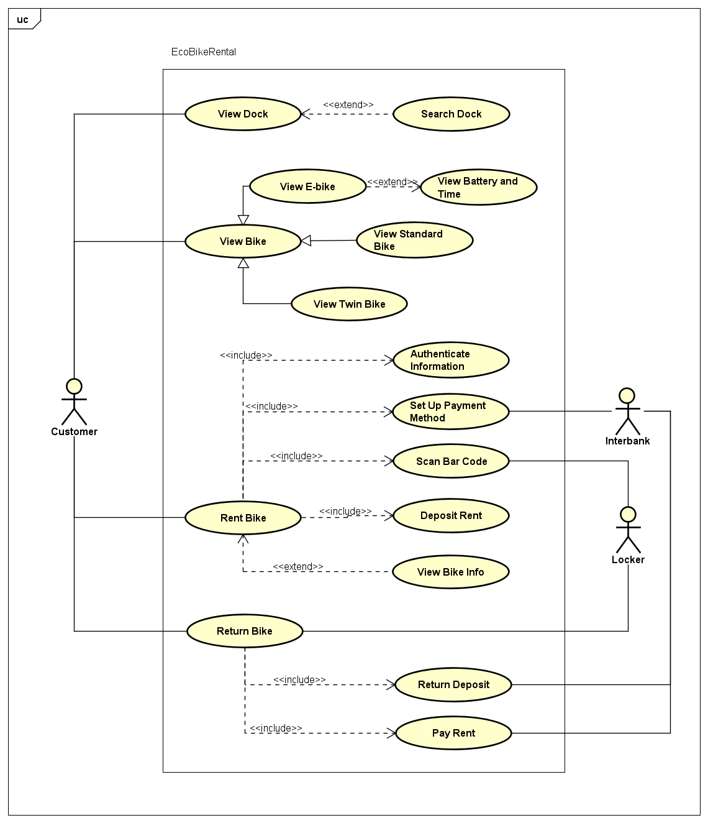

Slide 5
2.
Architecture Design & Data Modeling

Slide 6
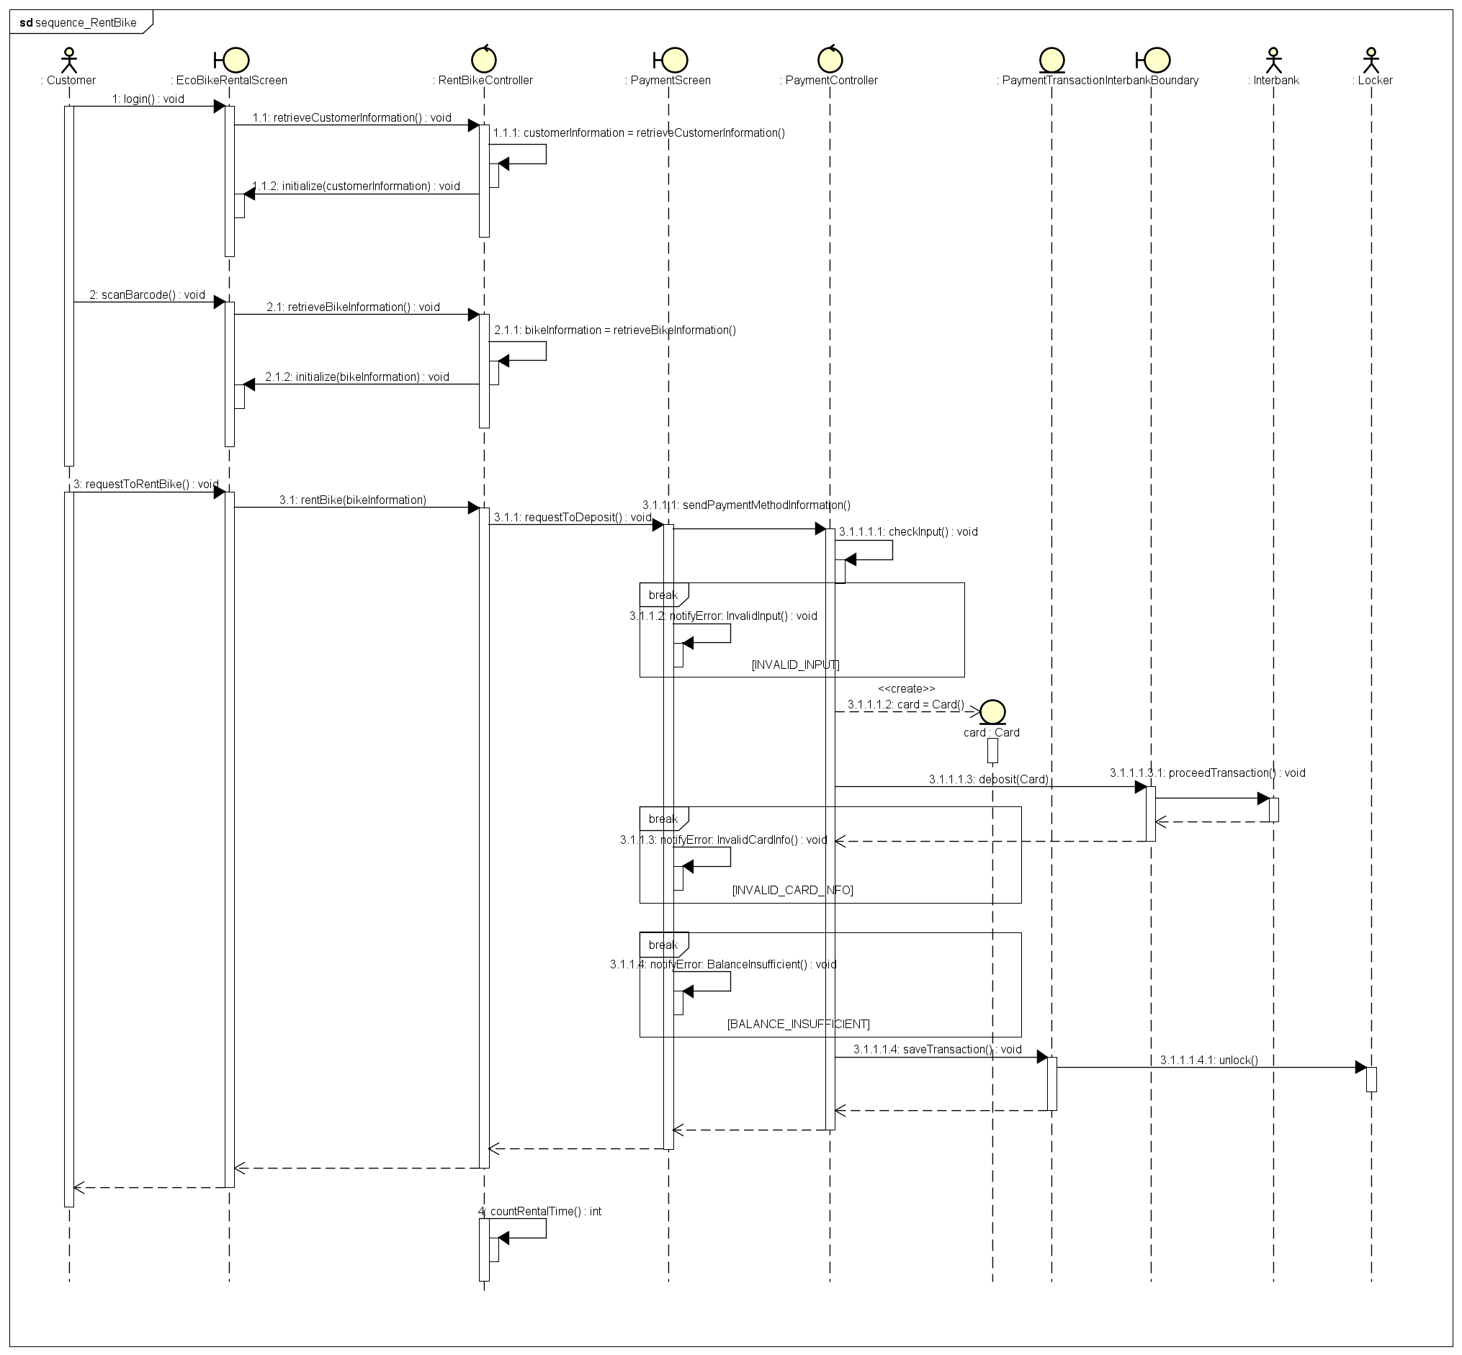
Sequence Diagram for Rent bike UC

Slide 7
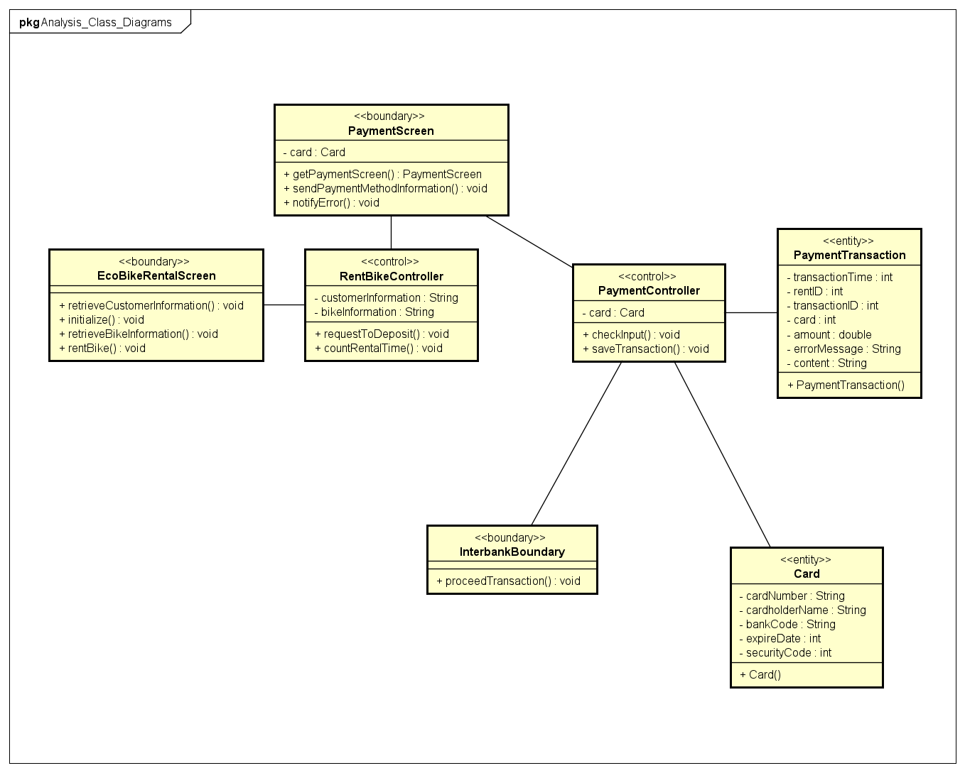
Class Diagram for Rent bike UC

Slide 8
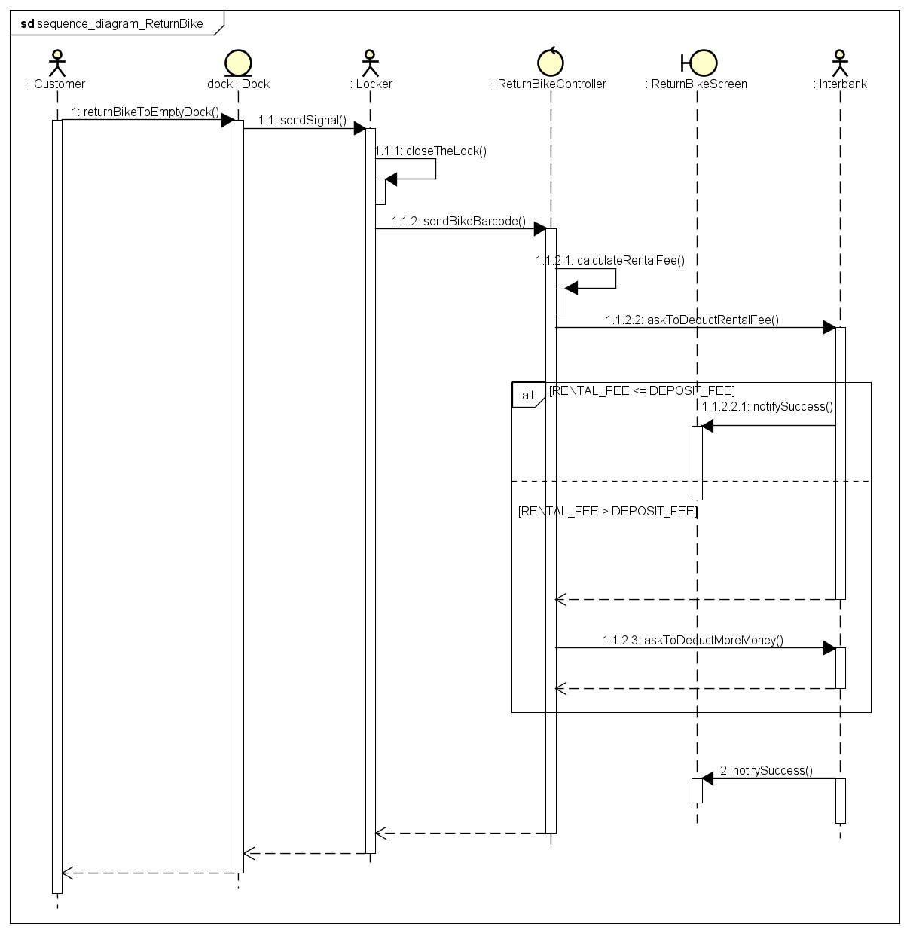
Sequence Diagram for Return bike UC

Slide 9
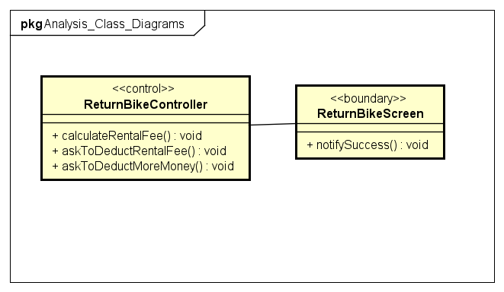
Class Diagram for Return bike UC

Slide 10
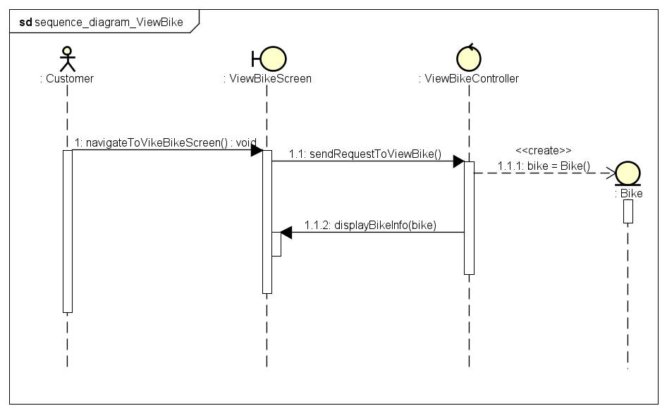
Sequence Diagram for View bike UC

Slide 11
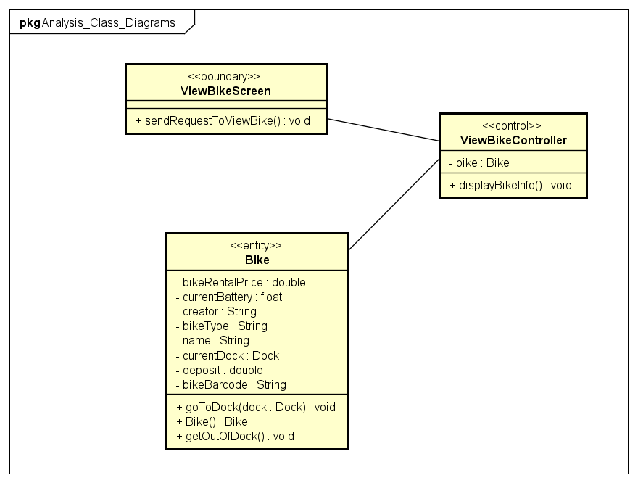
Class Diagram for View bike UC

Slide 12
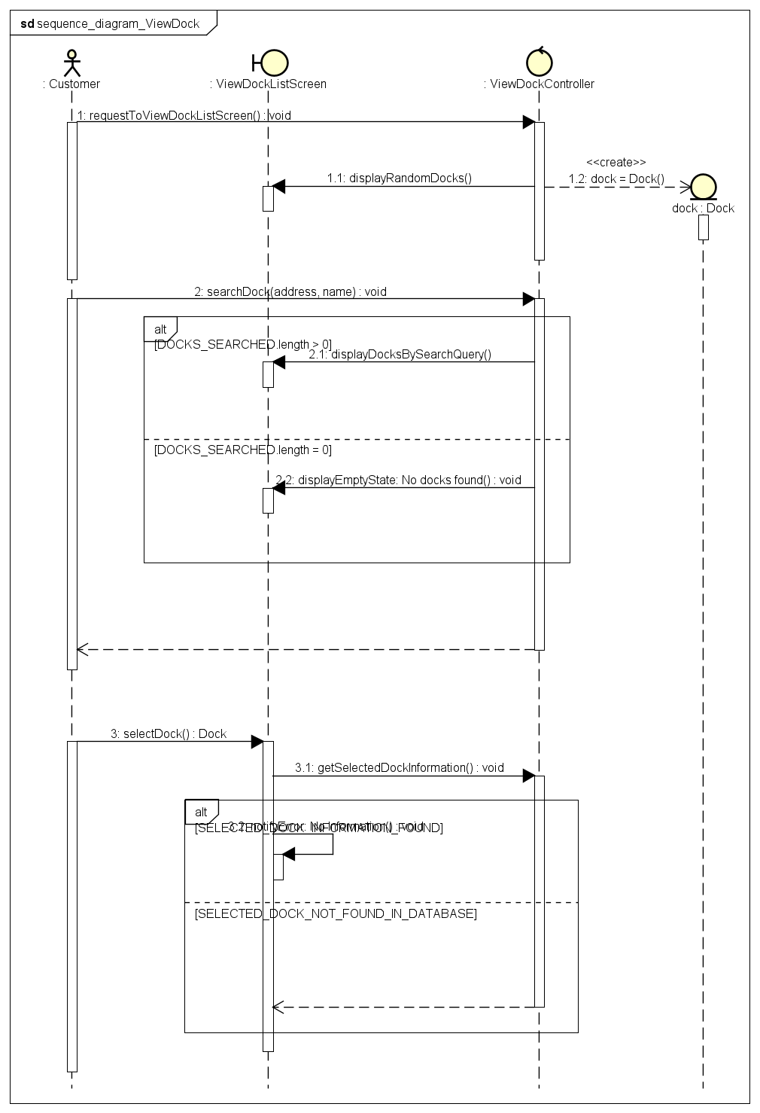
Sequence Diagram for View dock UC

Slide 13
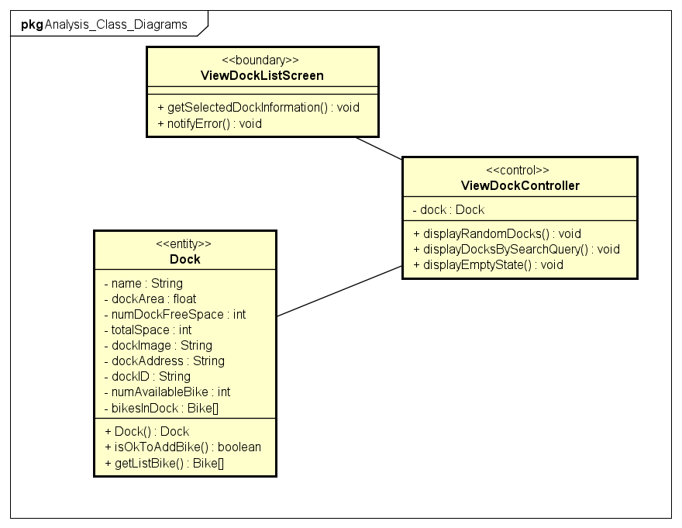
Class Diagram for View dock UC

Slide 14
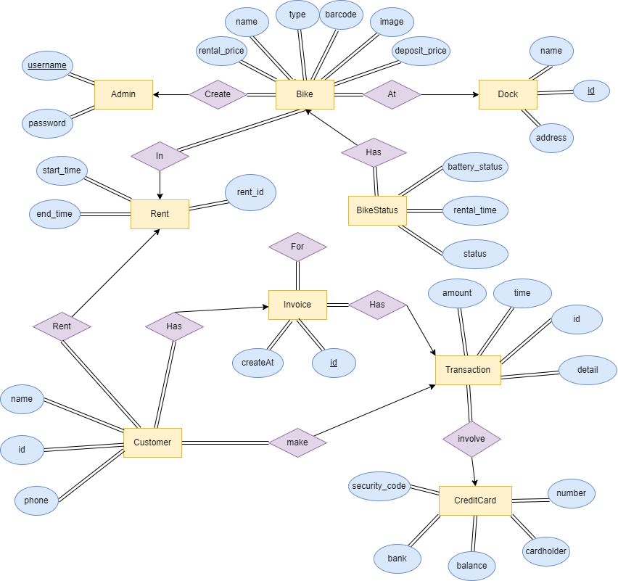
ER Diagram for EcoBike App

Slide 15
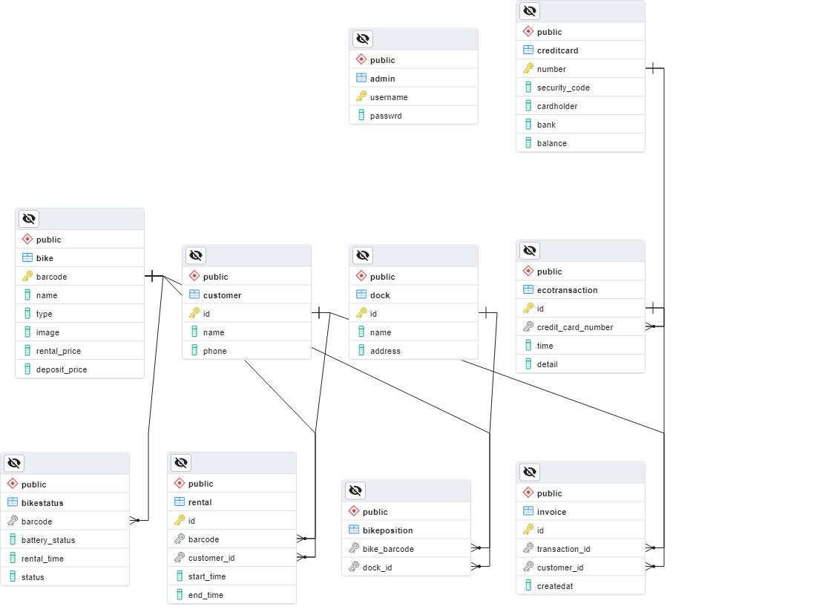
Database Design for EcoBike App

Slide 16
System Design
3.

Slide 17
Thank you for your listening !

Slide 18
Editable Icons

