Slide 1
Path-based knowledge graph completion
Canlin Zhazng

Slide 2
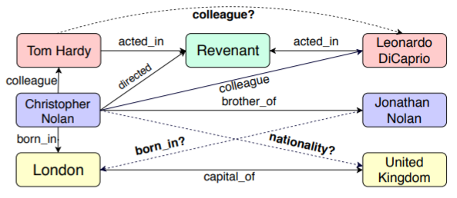
What is knowledge graph completion?
Knowledge graph (KG) completion (or link prediction) means giving the known entities (nodes) and relations (links), we want to predict new links among the entities that could be potentially correct.
Then, transductive link prediction means that the new links are among known entities, while inductive link prediction means that the new links are among unknown ones.

Slide 3
Type of inherent regularity in a knowledge graph
Many different link prediction models: rule-based model, embedding-based model, GNN (graph neural network) based model.
No matter which model, the fundamental is to make use of the information or regularity in the KG to predict new links.
We can classify the regularity inherent in the KG into two types:
1. Extrinsic: involving entities. Say: A is_parent_of B, A is_a female --> A is_mother_of B.
2. Intrinsic: not involving entities. Say: X born_in Y, Y locate_in Z --> X citizen_of Z.
In other words, you cannot obtain extrinsic regularity from the graph property of a KG.

Slide 4
Link prediction model combining Intrinsic & Extrinsic
r
X
Y
predict
r2
...
a
r1
c
X
Y
d
b
Extrinsic
Intrinsic
Extrinsic

