Slide 1
Idea: one-hot charachter embedding sequence for unssen entities in inductive link prediction for knowledge graph
Canlin

Slide 2
Description
First, we collect all the frequenctly occurred characters in the entity name string: Alphanumeric (A-Z, a-z and 0-9) and common symbols (_ , ‘’ .etc).
We build one-hot embedding for each symbol.
Suppose we have the entity “Tom_Hardy”. Then, we will obtain a one-hot charachter embedding sequence:
T
H
a
d
m
r
o
_
y

Slide 3
Description
After that, we will train a reliable embedding-based tranductive link prediction model, such as rotatE, on the training set.
We will further train another deep network to map the one-hot charachter embedding sequence to the corresponding entity embedding in the transductive model, using negative sampling:
inner
product
T
encoder Net
high
H
Tom_Hardy
a
d
m
r
BiLSTM/
attention
o
low
y
Florida_State
_

Slide 4
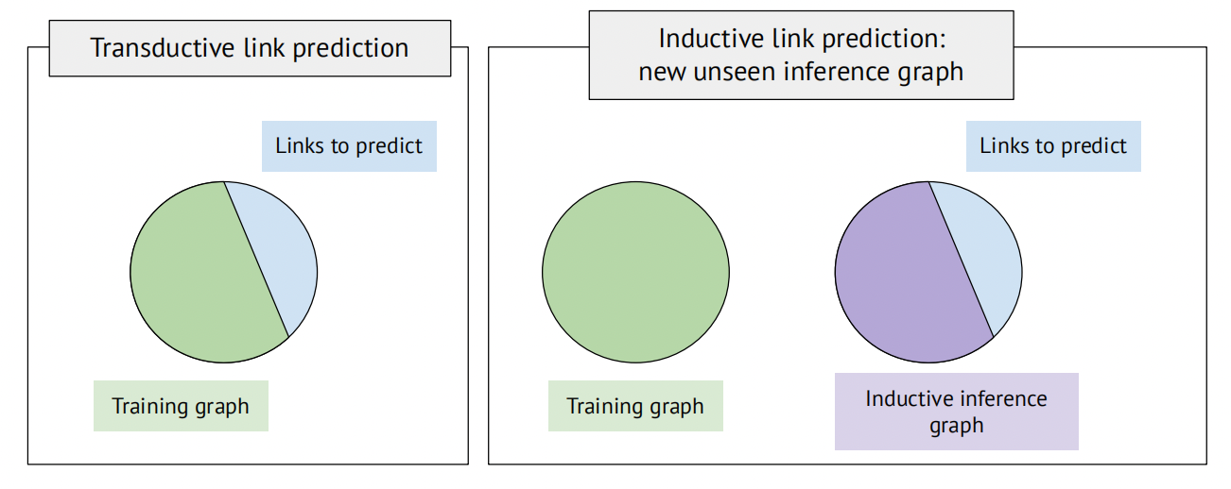
Description
In inference stage, for an unseen entity, we will first obtain the one-hot character embedding sequence. Then by the mapping deep network, we will obtain a vector embedding, which will be used in validation and test.
We need to think about how to use the inductive graph well: The tasks is to “complete” the inductive graph. That is, we cannot change the vector embedding according to the inductive graph. But we can read the triples in the inductive graph and make inference (reasoning) on it.

