Slide 1

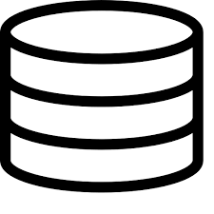
Client
UI
Interfaces
Clients
Server
REST Controllers
Interfaces
Domain logic
Interfaces
Data Access

Slide 2
Application component
Logic interfaces
Logic implementations
DAO interfaces

Slide 3
REST Controllers
Knows DTOs
Domain logic
Data Access
Knows domain objects

Slide 4
UI
View models
Interfaces
Clients

Slide 5
https://localhost:5001/ViewStudents
List of all students:

Slide 6
Component A
Component B
Updates number
StateContainer
Notifies about change

Slide 7

ok
…

